Slide 1
Relationships among urban characteristics, real estate market and spatial patterns of warehouses in different geographic contexts
Renata Oliveira | Metting | 10/05/2021

Slide 2

Authors
Renata Oliveira under supervision of Laetitia Dablanc and Matthieu Schorung

Slide 3
Research hypotheses
Logistics sprawl is higher in cities with a high differential between central and suburban land/rent values.
–
The location of warehouses is closely related to land/rent values of logistics facilities.

Slide 4
Objectives
Compare worldwide metropolitan regions considering the relationships among urban attributes, logistics real estate, and logistics facilities’ spatial structure focusing on logistics sprawl.

Slide 5
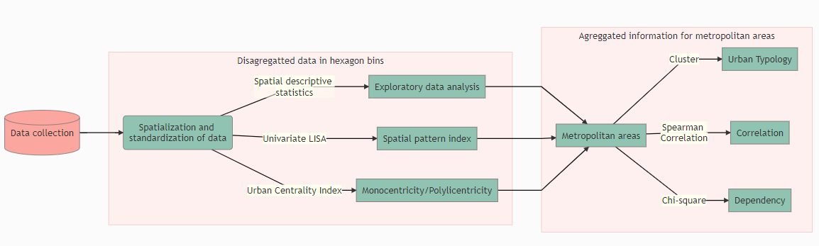
Methodological approach

Slide 6
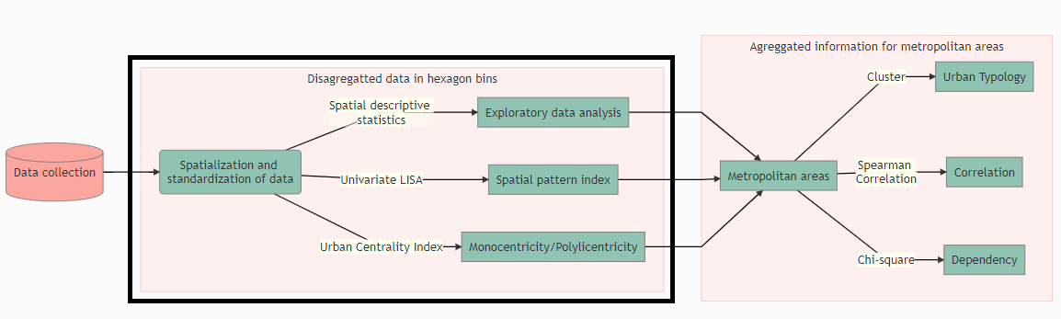
Methodological approach

Slide 7
Methodological approach
Spatial descriptive statistics
Urban Classification
Classification | Category
Lower outlier | Suburban
< 95 % | Suburban
>= 5 % | Central
Upper outlier | Central

Slide 8
Methodological approach
Warehouse location and rent prices
Classification | Category
Lower extreme | Extremely low
Lower outlier | Very low
< 25 % | Low
25 % - 50 % | Medium
50 % - 75% | Medium
> 75 % | High
Upper outlier | Very high
Upper extreme | Extremely high

Slide 9
Methodological approach
Spatial pattern index
Univariate Global and Local Moran’s I - spatial autocorrelation.
LISA map generated considering a 0.05 level of significance and a Monte Carlo simulation (2000 permutations).

Slide 10
Methodological approach
Urban Centrality Index (UCI)*
Computed considering:
- location coefficient - measure the unequal distribution factor of the urban intensity index within each urban área
- spatial separation index, namely Venables index, which aims at evaluating the spatial distribution of spatial patterns of activities; and
- proximity index, which is the normalization of the Venables index considering the respective maximum attainable value. The UCI values range from 0 to 1, where 0 the most polycentric area and 1, maximal monocentricity.

Slide 11
Methodological approach
Dataset containing all hex bins for all the metropolitan regions investigated
Number of warehouses in each hex bin
Average warehouse price in each hex bin
Urban intensity index
Spatial cluster identification for urban intensity index and warehouse count and rent prices
Classification and outlier’s identification for warehouse count and rent prices

Slide 12
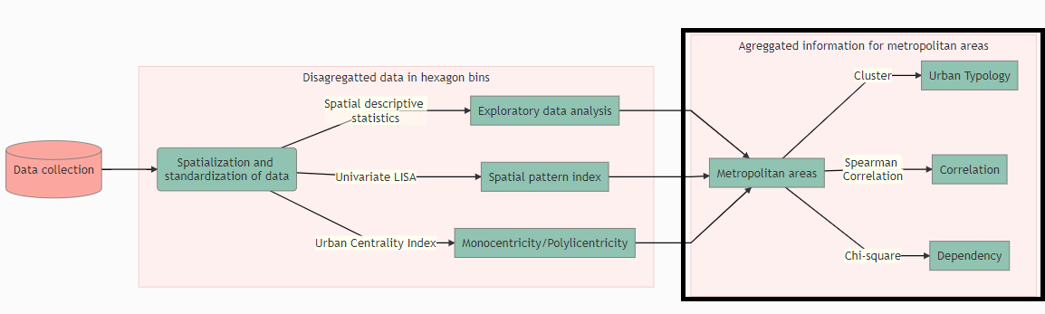
Methodological approach

Slide 13
Methodological approach
Dataset containing the summary indicators for each metropolitan region
Global Moran’s I index for urban activity index
Global Moran’s I index for warehouse spatial distribution
Global Moran’s I index for warehouse rent prices distribution
UCI for urban activity index
UCI for warehouse location
Price differential for central and suburban warehouses
Population (t0 and t1)
Metropolitan territorial area
Number of municipalities
Number of warehouses (t0 and t1)
Average distance to barycenter (t0 and t1)
Yearly logistics sprawl
The proportion of HH, HL, LH and LL clusters for the urban activity index, warehouse location and warehouse price.

Slide 14
Methodological approach
Typology - K-means cluster analysis
Can we gather all metropolitan regions into one comparative analysis?
Dependency of warehouse location and prices on urban activity - Chi-square independent
Do warehouse location and prices depend on urban activity?
Correlation among continuous variables - Spearman correlation
Is logistics sprawl related to warehouse rental prices?

Slide 15
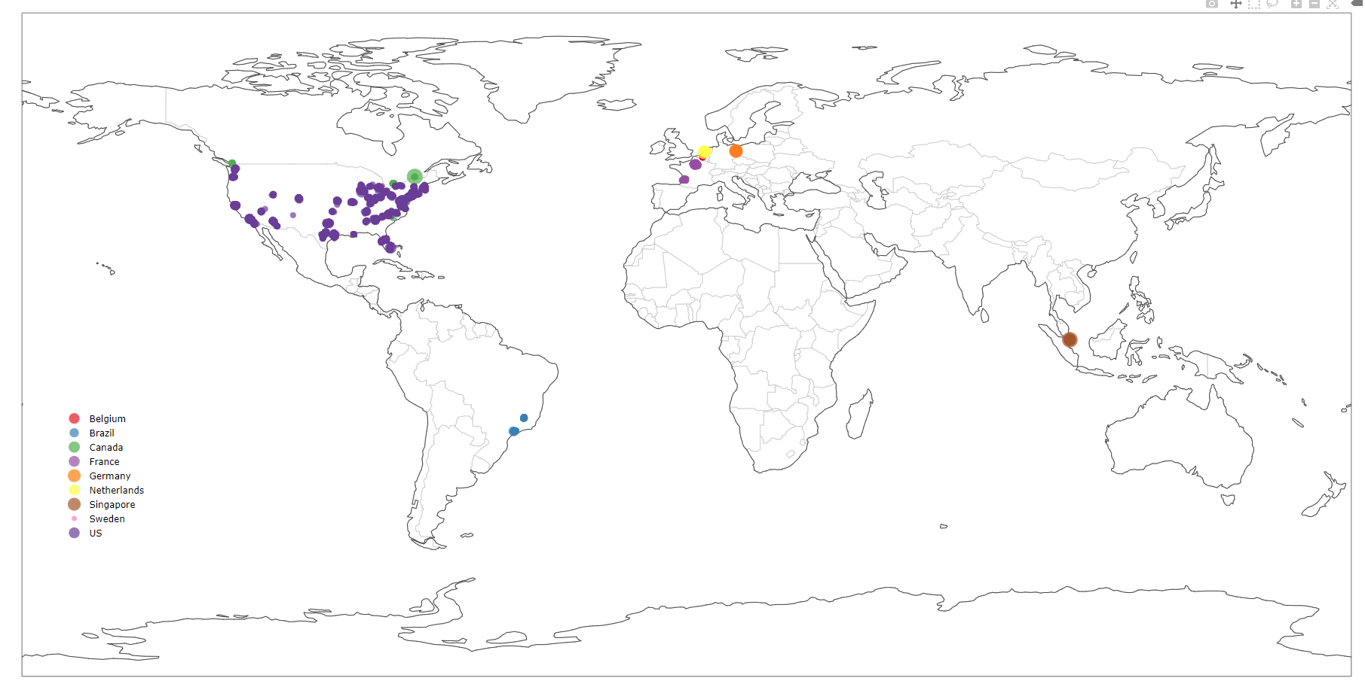

Slide 16
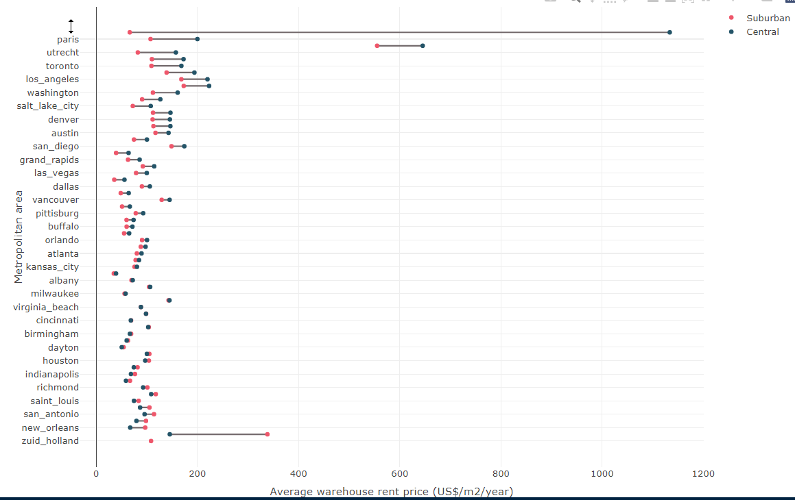

Slide 17
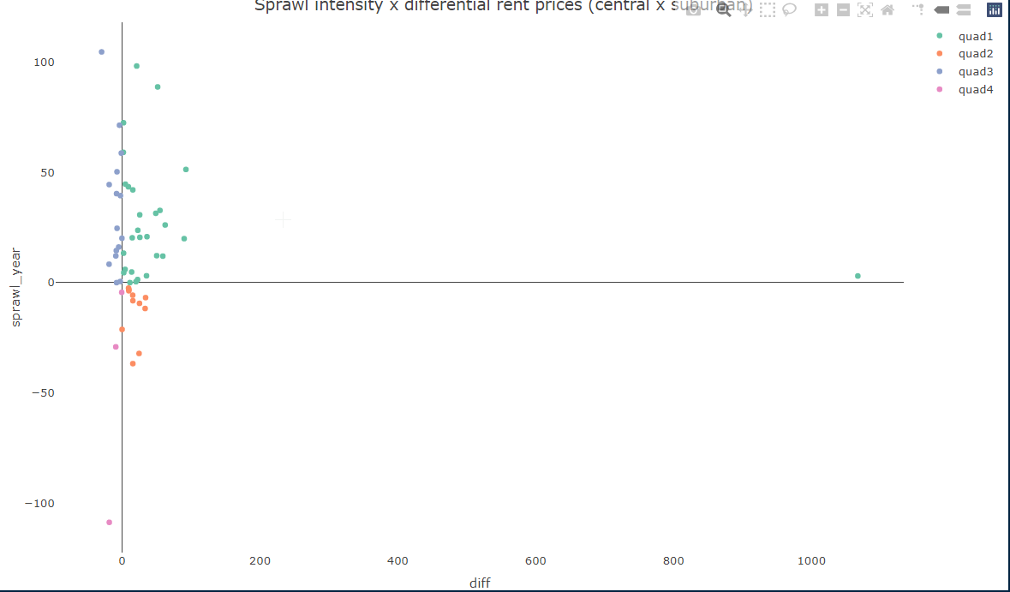

Slide 18
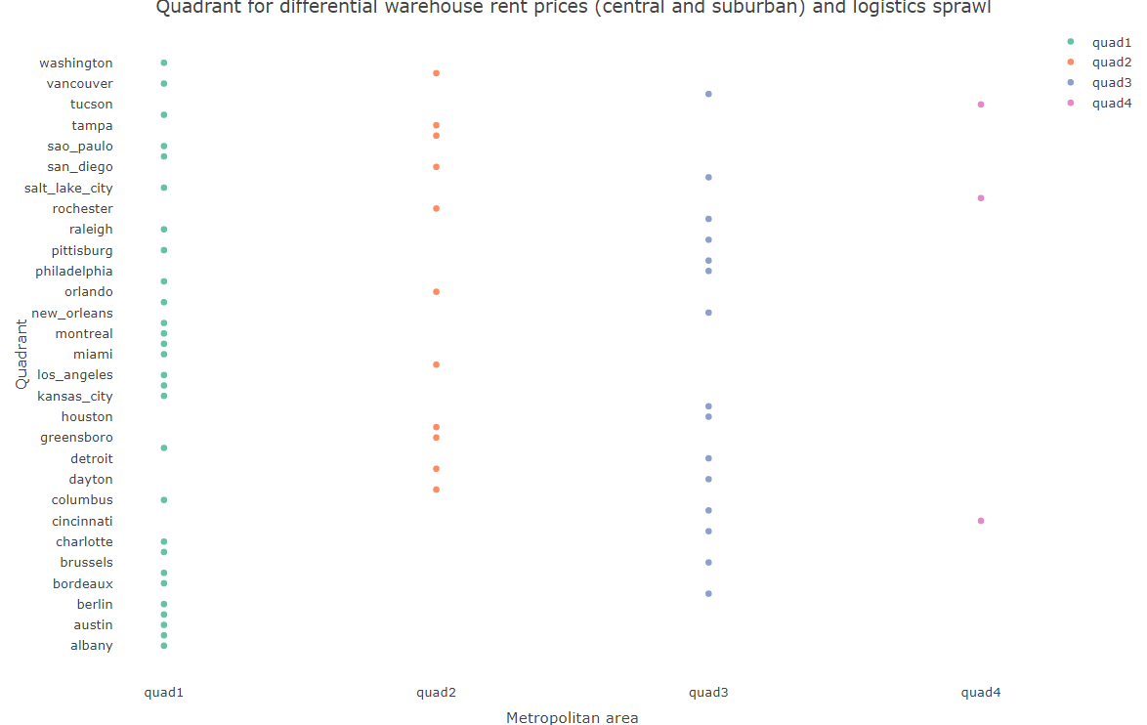

Slide 19
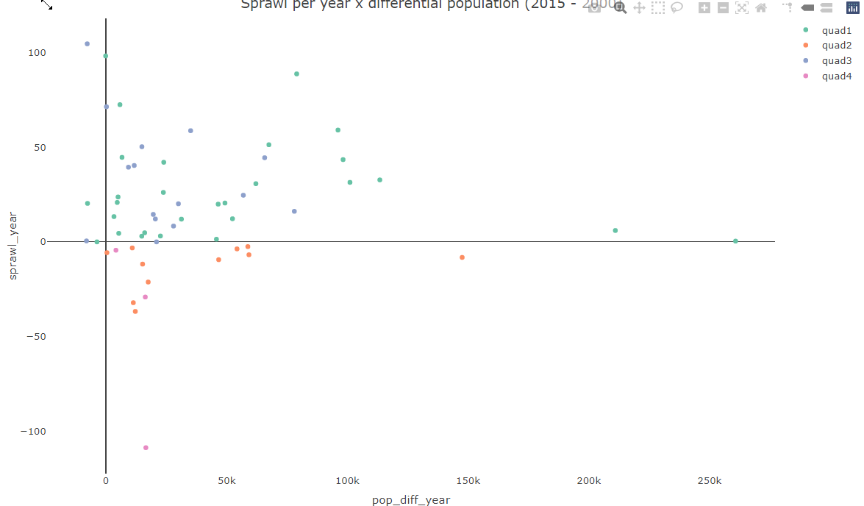

Slide 20
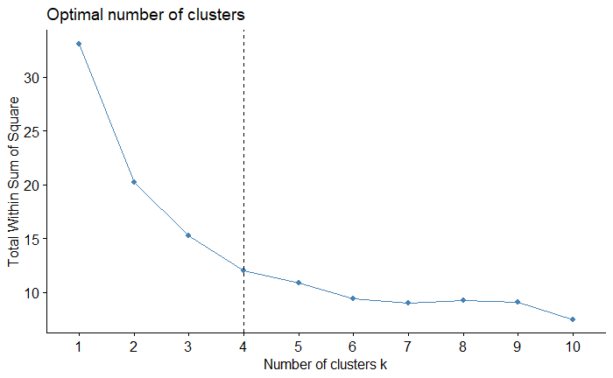
Results - to be reviewed

Slide 21
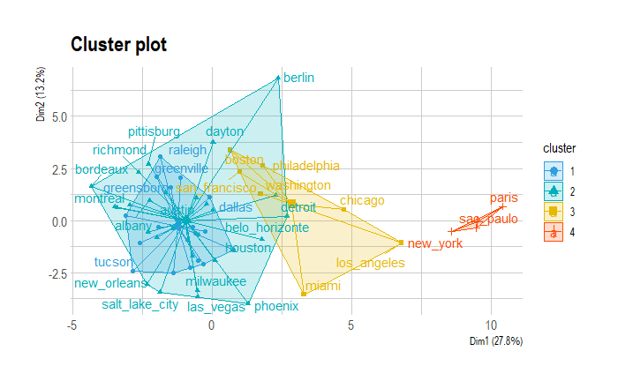

Slide 22
Results
Metropolitan areas for comparison - To be reviewed from cluster analysis
albany
atlanta
austin
belo_horizonte
berlin
bordeaux
boston
buffalo
charlotte
columbus
grand_rapids
kansas_city
las_vegas
los_angeles
miami
milwaukee
montreal
nashville
new_york
paris
pittisburg
raleigh
salt_lake_city
san_francisco
sao_paulo
toronto
vancouver
washington

Slide 23
Futher steps
Conclude classification of metropolitan areas
Compare different classes of metropolitan areas - sprawl x urban attributes
Dashboard
Paper

Slide 24
Research contributions
Methodological: innovative framework for comparing metropolitan regions considering the spatial pattern of logistics facilities and urban characteristics.
Reproducibility
Public Policy: Can induce local and regional public authorities to develop more effective public policy addressed to logistics land use and transportation planning. Coordinating these dimensions is essential to support urban logistics stakeholders’ needs, cities’ livability, and the real estate market.

