Slide 1
Title
Subtitle
Date

Slide 6
$XX
$XX
Xxxxxx xxxx
Xxxxxx xxxx
$XX
$XX
Xxxxxx xxxx
Xxxxxx xxxx
$XX
$XX
Xxxxxx xxxx
Xxxxxx xxxx

Slide 7
RETAIL
FINSERV
INDUSTRIAL
ENTERPRISE IT
MEDIA
$XxM
$XxM
$XxM
$XxM
$XxM
Xxxx
Xxxx
Xxxx
Xxxx
Xxxx
$Xxx
$Xxx
$Xxx
$Xxx
$Xxx
Xxxx
Xxxx
Xxxx
Xxxx
Xxxx
$Xxx
$Xxx
$Xxx
$Xxx
$Xxx
Xxxx
Xxxx
Xxxx
Xxxx
Xxxx
Xx%
Xx%
Xx%
Xx%
Xx%
Xxxx
Xxxx
Xxxx
Xxxx
Xxxx
Xxxxxx
Xxxxxx
Xxxxxx
Xxxxxx
Xxxxxx

Slide 8
Highlights
Xxx
Xxx
Xxx
Xxx
$XxM
$XxM
$XxM
$XxM
Xxx
Xxx
Xxx
Xxx
$XxM
$XxM
$XxM
$XxM

Slide 9
Information about what is presented in the table below, can span more than one line if need be
Item | 2nd column | Number
Xxx | Xxxx | XX
Xxx | Xxxx | XX
Xxx | Xxxx | XX
Xxx | Xxxx | XX
Xxx | Xxxx | XX
Xxx | Xxxx | XX
Xxx | Xxxx | XX
Xxx | Xxxx | XX

Slide 12
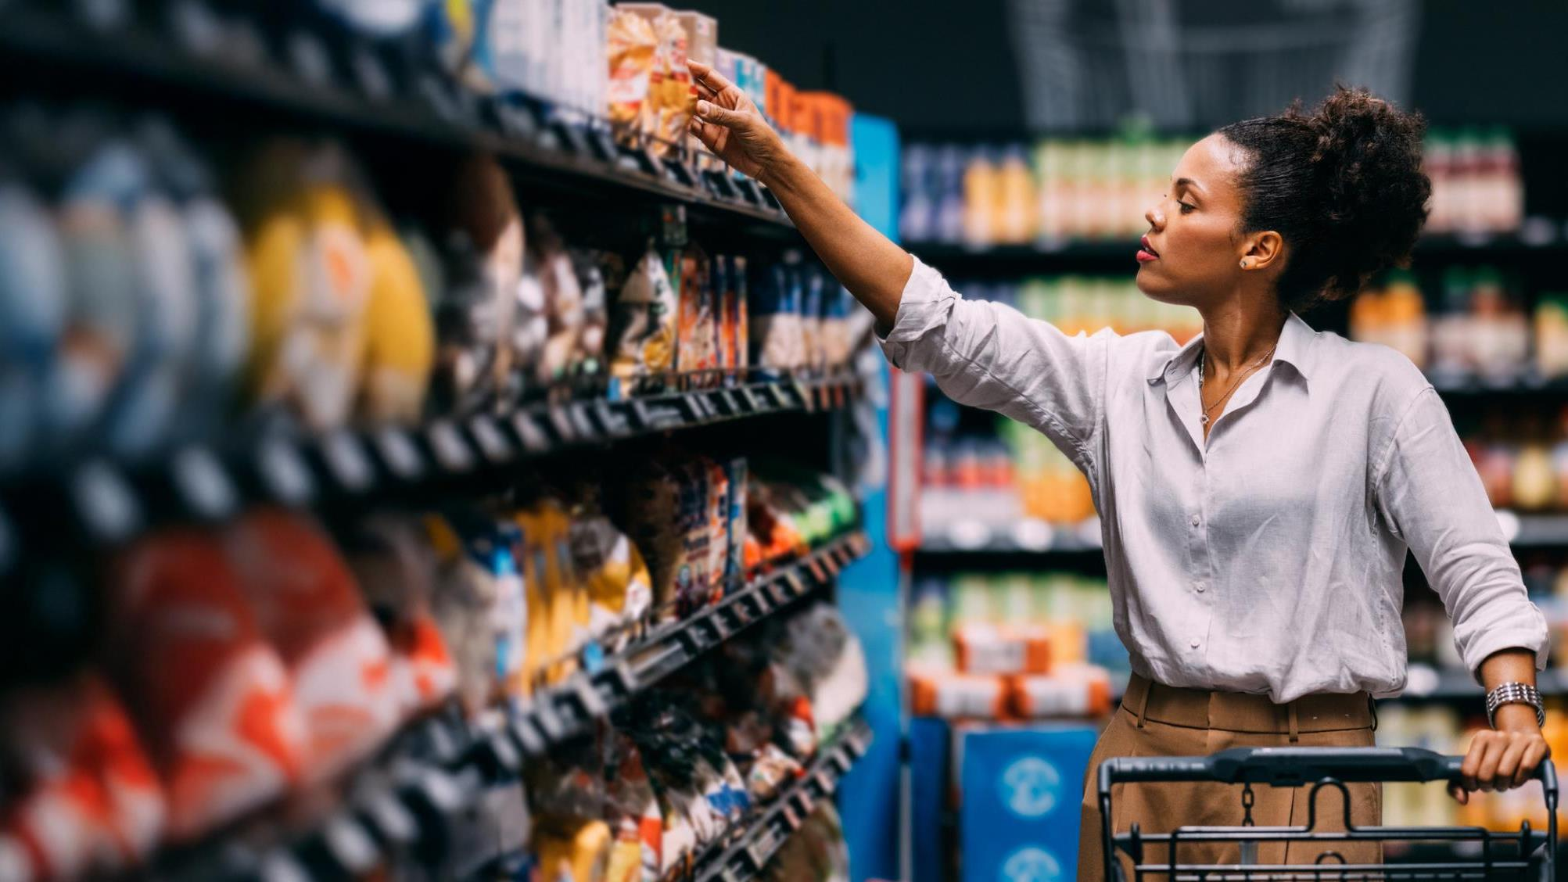


Ready for an 8% sales boost?:
PepsiCo’s guide to AI-driven category growth
Unleashing AI-driven shopper insights to accelerate category growth
Baseline and barriers
Their journey
An F50 global food and beverage leader, $80B+ in annual revenue
Static planograms at 96% market penetration left no room for growth
  Data Integration: Unified 100+ sources into one dataset (1,000+ attributes per store)
  AI-Powered Clustering: Segmented stores into three shopper behavior profiles
  Tailored Planograms: Generated and deployed custom shelf layouts per cluster
  Agile Co-Innovation: Ran weekly sprints with retail partners to refine and scale
Example Results
“At 96% penetration, traditional tactics stalled. By clustering shoppers and tailoring assortments, we reignited category growth.”
  Jan Haluza
  Category Manager, PepsiCo NE
  +8%
  incremental sales
  lift in pilot stores
  3
  shopper-led store clusters covering 1,000+ locations
  35%
  faster shelf
  reset execution
Powered by SymphonyAI: Real-time insights | AI-driven clustering | Automated planogram deployment

