Slide 1
What is IDDOV?
IDENTIFY | DEFINE | DEVELOP | OPTIMIZE | VERIFY
IDDOV
a methodical approach to product development that ensures customer satisfaction and a robust design
IDD… to understand customers and develop solutions to best meet consumer and company needs
…OV to ensure products are robust and will perform consistently for our customers and consumers
Proactive application of statistical tools for product development quality and performance

Slide 2
Components of IDDOV
I
IDENTIFY
Identify the opportunity and product plan
D
Define the requirements needed to achieve Critical to Quality performance
DEFINE
D
Develop concepts and models to testing and production trials
DEVELOP
O
OPTIMIZE
Optimize the design most desireable
V
Verify the performance and capability to customer needs and targets
VERIFY

Slide 3

IDENTIFY: Select and scope the project for success
I
Develop an approved business case for the product
Develop a customer case (be the consumer)
Detail the strategic objective
Scope the project
Define the team and time needed
Determine what skill sets and resources are needed to complete the project
D
D
O
V

Slide 4

DEFINE: Develop a strategy based on customer needs
I
Identify the market and customers
Experience customer usage
Understand what the customer wants and needs
Develop a strategy for customer success
Define critical measure targets
Outline critical to quality requirements
D
D
O
V

Slide 5
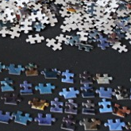
DEVELOP: Based on company and customer needs
I
Be creative and use innovation techniques to generate many concept ideas
Address concept strengths and weaknesses
Refine and select strong concept(s)
D
D
O
V

Slide 6
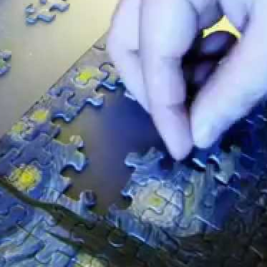
OPTIMIZE: A robust design delivers consistent performance
I
Optimize the design to perform consistently despite aging, use, and manufacturing variation
Understand product and/or process function
Understand causes of variability
Optimize nominal design parameters to maximize robustness
D
D
O
V

Slide 7
VERIFY: All requirements are satisfied prior to launch
I
Verify that the optimized design satisfies the customer requirements
Verify improvement of the optimized design
Release with facts and data
D
D
O
V

Slide 8
Summarizing IDDOV
WHEN TO USE
New innovation
Core products
Voice of the customer
Innovation "in cycle"
Historical performance issue
Design efficiency issues
WHEN NOT TO USE
A problem with an existing product or process
TYPICAL TOOLS TO USE
Voice of the Customer
Thought Process Mapping
Brainstorming / Brainwriting
House of Quality / QFD
Tolerance Design
Axiomatic Design
Iterative Pugh Analysis
P-Diagram
Taguchi Robust Design
Various creative techniques
IDDOV

