Slide 1
Qualitative
Minimal system
Allow to investigate the response of SiPM to 175nm light qualitatively
Reproducibility will be a serious issue (no independent light monitor)
In air, the flash lamp has to be very close to viewport. EMI concern.
Could tune UV light output by moving flash lamp but very sensitive to water content
Cold temperature operation should be ok
Obsolete
Vacuum
line
Amplifier and bias
Sipm
signal
PID controller
Temperature
sensor
viewport
Regulator
Rail
Xenon flash lamp
Rail
LN2
SiPM and PCB
Cold plate
Bandpass
filter wheel
Vacuum enclosure
Use as Faraday cage
as well
Light tight enclosure

Slide 2
Critical qualitative cross-check
Critical cross-check
Verify sensitivity to Xenon scintillation light (alpha source in xenon gas)
Source light yield should be stable (provided Xenon density does not change)
No trigger and no control over light yield (only qualitative)
Obsolete
Vacuum
line
Amplifier and bias
Sipm
signal
Xenon gas
PID controller
2 viewports
Temperature
sensor
Teflon tube
Regulator
Rail
LN2
SiPM and PCB
Alpha source
Cold plate
Gas enclosure
Vacuum enclosure
Use as Faraday cage
as well
Light tight enclosure

Slide 3
Quantitative
Complete system
Use calibrated PMT to simultaneously measure light yield
Use integrating sphere to uniformize the light hitting the photo-detectors
Accommodate alpha source and laser light sources for cross-checks (375, 405nm)
Allow to purge the light tight enclosure with Nitrogen or Argon (low VUV absorption)
Vacuum line
System accommodates
Xenon flash lamp
Visible light from optical fibers
Xenon scintillation chamber
Obsolete
Vacuum enclosure
& Faraday cage
High speed oscilloscope
Nitrogen purge
Calibrated PMT
Amplifier and bias
Neutral density
filter wheel
viewport
PID controller
Xenon flash lamp
Rail
TEFLON based
Integrating
sphere
Regulator
Bandpass
filter wheel
LN2
Light tight enclosure

Slide 4
Final
Xenon gas in/out
BNC
Filter slider
Source 1: Xenon scintillation
Calibrated PMT
BNC
MPPC
Viewport
SHV
Nitrogen/O2
gas in/out
Teflon tube
Iris
Filter
slider
Alpha source
Source 2: Xenon flash lamp
SHV
Xenon flash lamp
Manual
stage
TEFLON based
Integrating
sphere
BNC
Iris
Source 3: UV/visible fast light sources
375, 405, 467, 637 nm
Laser (direct or through fiber)
Filter
slider
Optical
fiber
Iris
BNC
Faraday
cage wall
PPD
Cold
N2 gas
Cold plate

Slide 5
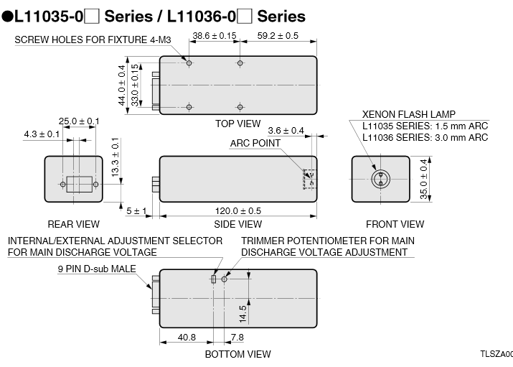
Flash lamp dimension (metric)

Slide 6
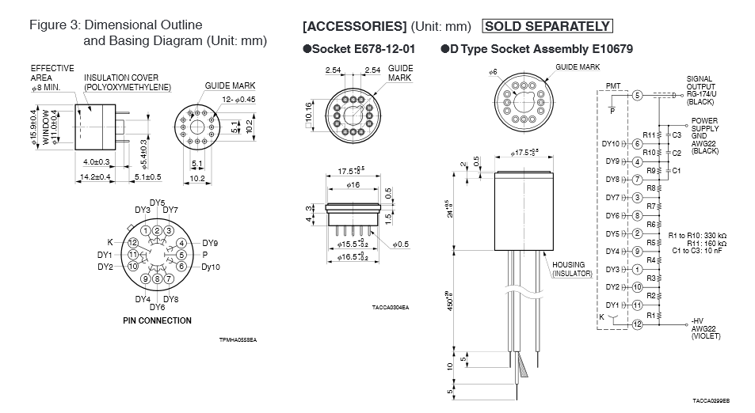
PMT (R9875P) with base (E10679) dimension

