Slide 1
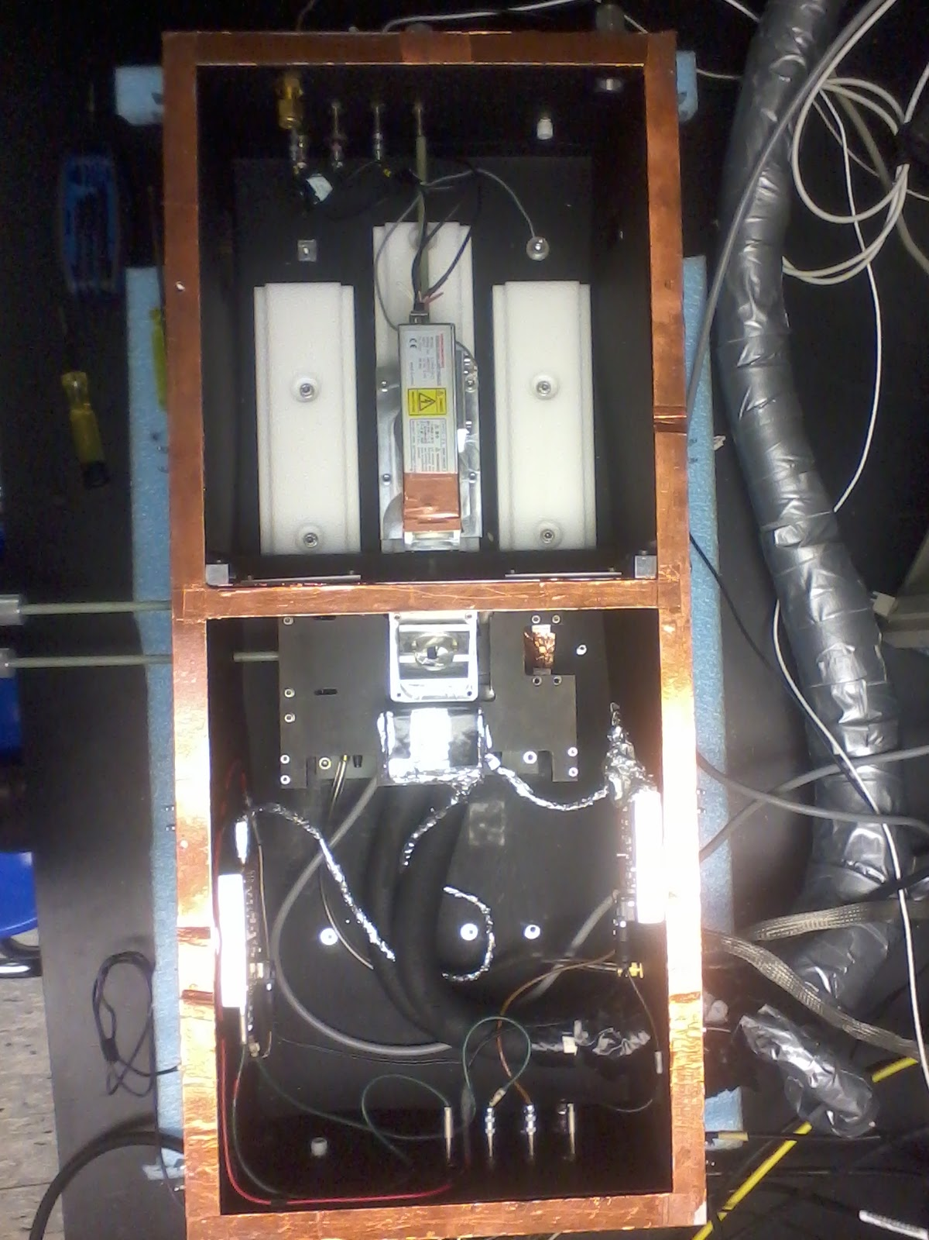

Reminder
N2 input
N2 output
Xenon Flash lamp
Noticed that our results were not reproducible.
Check parameters which could influence our results :
  - Quantity of N2 inside the box
  - Corrected data for over voltage fluctuations
  - The beam splitter
  - The light from the lamp seems not to be constant

Slide 2
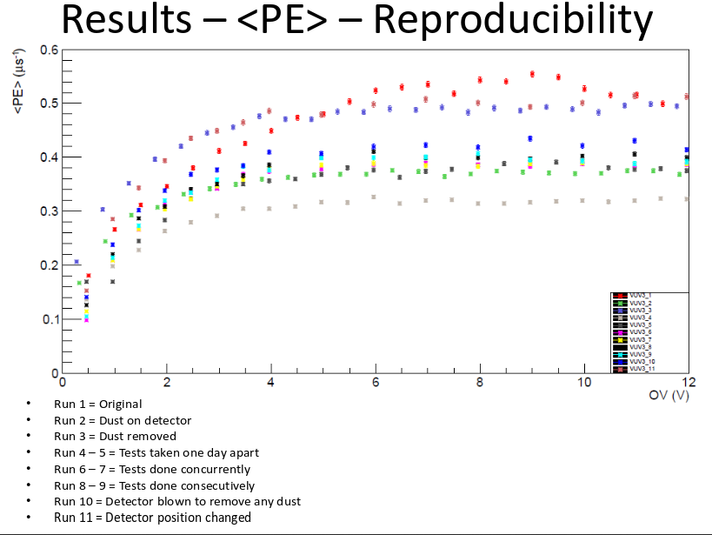
Sources of non reproducibility
The flash lamp died

Slide 3
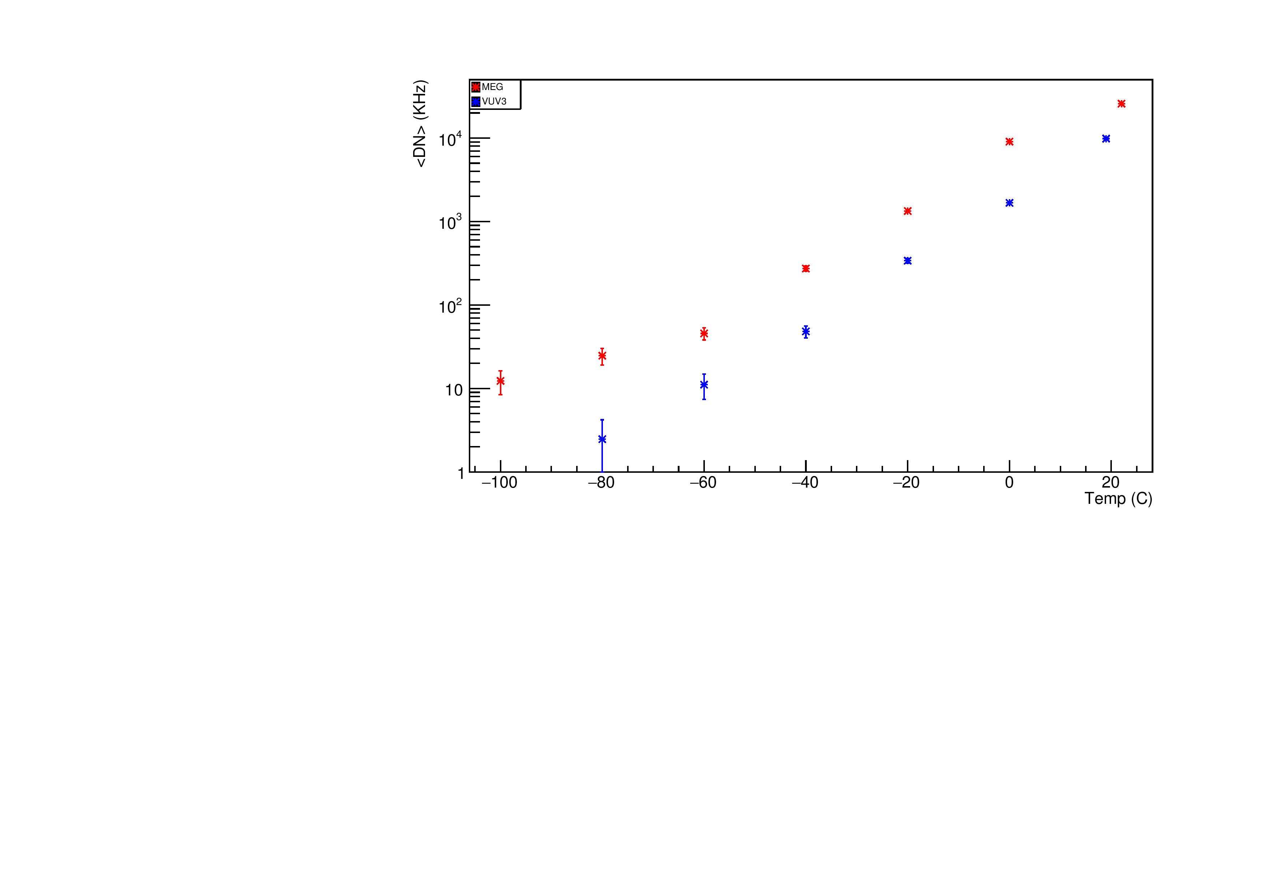
DN vs Temperature for MEG and VUV3
@ -100 °C , VUV3 , not enough satistic
DN for VUV3 is better than the one for MEG

Slide 4
Further
Have taken data for after pulse for VUV3 and MEG
Try Lloyd's and Carl's after pulse algorithms to find after pulses
Get a new flash lamp

