Slide 1
Adaptive PID and Sliding-Mode Control of a DC-DC Boost Converter Using Reinforcement Learning
Control Systems project · Reththika Murugadasan · October 2026
Five controllers, one simulator, identical tests
Fixed PID
Fixed SMC
Direct TD3
TD3 adaptive PID
TD3 adaptive SMC
Notes:
OPENING (about 1 minute). Say what the project is in one sentence: we regulate the output voltage of a boost converter, and we ask whether reinforcement learning can improve two classic controllers (PID and sliding-mode) without being allowed to make the circuit unsafe. Name the five controllers on the chips: two fixed baselines, and three that use reinforcement learning.
No demo on this slide.

Slide 2
Why regulating a boost converter is hard
1
Inputs keep changing
Research question
Input voltage 10–14 V and load 10–30 Ω jump; a fixed duty gives the wrong output.
Can reinforcement learning tune classic controllers (PID, SMC) to do better than fixed settings — without ever being allowed to make the circuit unsafe?
2
The circuit rings
Lightly damped LC pair: damping ratio ≈ 0.07, resonance ≈ 232 Hz.
3
It first moves the wrong way
Approach: build a validated simulator, two tuned baselines, three RL controllers, and compare all five on identical tests.
Right-half-plane zero: raising the duty first lowers Vout (non-minimum phase).
Notes:
PROBLEM (about 2 minutes). A boost converter raises 12 V to 24 V by switching 20,000 times a second; the controller's only knob is the duty cycle.
Three reasons it is a good control problem: (1) the input voltage and the load change, so a fixed duty gives the wrong output; (2) the inductor-capacitor pair is very lightly damped (damping ratio about 0.07), so it rings for tens of milliseconds; (3) it is non-minimum phase: raising the duty first LOWERS the output for a moment (right-half-plane zero). That limits any controller's speed and it is also why the textbook sliding-mode design fails later.
Then state the research question on the right.
SHOW: nothing in code yet. If asked for the numbers: damping ratio and zero come from the linearised model in experiments/tune_pid.py (plant_tf).

Slide 3
The plant: an averaged boost-converter model
Vin | 12 V (10–14)
Vref | 24 V (20–28)
L | 1 mH
C | 470 µF
R | 20 Ω (10–30)
f_sw | 20 kHz
D limits | 0.05 – 0.95
dIL/dt = [ Vin − (1 − D)·Vout ] / L
dVout/dt = [ (1 − D)·IL − Vout / R ] / C
Ideal gain: Vout = Vin / (1 − D), so 12 V → 24 V needs D = 0.5
Exact CCM step (matrix exponential)
DCM model: diode blocks reverse current
Step = 50 µs = one switching period
Notes:
MODEL (about 2 minutes). Two state variables: inductor current IL and output voltage Vout. We use the standard averaged model, where the fast switching is replaced by its average over one cycle, which depends only on the duty cycle D.
Ideal steady state: Vout = Vin / (1 - D), so 12 V to 24 V needs D = 0.5 and an average inductor current of 2.4 A.
Three modelling points to mention: the CCM equations are linear for a held duty, so each 50 microsecond step is solved EXACTLY with a matrix exponential; the diode blocks reverse current, so a separate DCM model is used when the inductor current would reach zero; the step equals one switching period.
SHOW (code): converter/boost_converter.py lines 117-150 (_ccm_step matrix exponential, _dcm_step, _substep mode logic) and config.py for the parameter table.

Slide 4
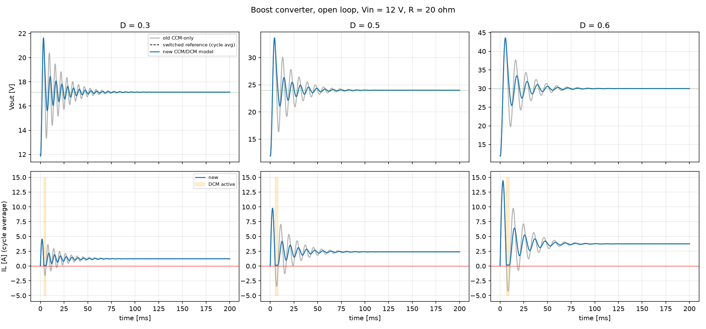
The simulator was validated first
0.013 V
RMS error against a switch-level reference
0 A
minimum inductor current (first version: −4.26 A)
28.045 V
Open loop, D = 0.3 / 0.5 / 0.6. Grey: first (CCM-only) model; dashed: switch-level reference; blue: final model.
DCM operating point equals the closed-form result
Notes:
VALIDATION (about 2 minutes). Before any controller existed the simulator was checked against theory and against an independent switch-level simulation (ideal switch and ideal diode, event accurate).
Key story: the first version used only the CCM equations and let the inductor current go NEGATIVE (down to -4.26 A) in the startup transient; a real diode blocks that. Adding the DCM model fixed it: the minimum current is now 0 A. Cycle-averaged results then match the switching reference to 0.013 V RMS.
The grey curves in the figure are the old model, the dashed black the switching reference, blue the final model; orange shading marks when DCM is active.
The large open-loop overshoot is NOT a bug: it is the lightly damped resonance of a lossless circuit.
RUN (live, about 15 s): python run_converter_validation.py -> expect 'RESULT: PASS'.
SHOW: validation/switched_reference.py (the ground-truth simulator) and results/figures/stage1b_open_loop_validation.png.

Slide 5
Feedback loop and how performance is scored
Disturbances: Vin, R
Reference
24 V
+
Controller
PID / SMC / RL
Boost converter
error e
duty D
Vout
−
sensor: measured Vout
Settling time (±2 %)
Overshoot / startup dip
RMS error
Max deviation after step
Recovery time
Duty variation
Inductor current
Protection trips
5 scenarios, each: cold start → regulate to 24 V → one disturbance at 150 ms (300 ms total): nominal · Vin 12→10 V · Vin 12→14 V · R 20→10 Ω · R 20→30 Ω
Notes:
CONTROL SETUP (about 2 minutes). Walk the loop left to right: reference 24 V, error = Vref - Vout, controller, converter, measured output fed back. Disturbances (input-voltage and load steps) hit the converter without the controller causing them. The controller runs every 50 microseconds (discrete time).
Every experiment is a cold start (output and current zero), regulation at 24 V, then ONE disturbance at 150 ms, 300 ms total. Five scenarios: nominal, Vin 12 to 10 V, Vin 12 to 14 V, R 20 to 10 ohm, R 20 to 30 ohm.
Explain each metric chip in one phrase. Stress that no single score is computed: the metrics are reported side by side.
SHOW (code): analysis/metrics.py (settling_time line 36, overshoot_pct line 50, recovery_time line 90) and config.py PID_SCENARIOS.

Slide 6
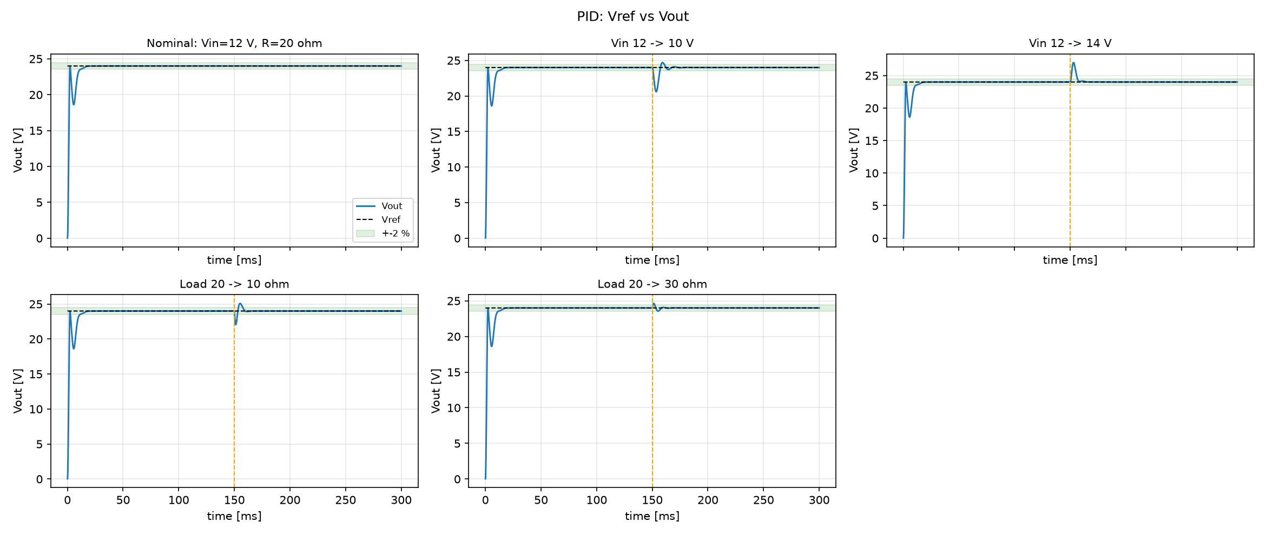
Baseline 1: a tuned PID controller
Anti-windup and a filtered derivative on the measurement
Plant analysis: right-half-plane zero ≈ 5000 rad/s caps the bandwidth
Robust design on 27 operating points (PM ≥ 45°, GM ≥ 6 dB)
Time-domain refinement on the five scenarios
Worst-case margins 56.5° / 6.0 dB. Settling 11.5 ms, overshoot ≈ 0. The dip near 18.6 V is the diode pre-charge surge.
Kp
Ki
Kd
0.0049154
6.6994
2.74e-5
Notes:
PID (about 2 minutes). D = Kp e + Ki integral(e) + Kd de/dt. Explain the three terms in one line each. Implementation points: anti-windup (back-calculation plus a clamp), derivative on the measurement with a 100 microsecond filter, integral stored in duty units so changing Ki never makes the output jump, and NO constant bias: an early version with a 0.5 duty bias gave 43.5 percent overshoot.
Tuning was not guessed: linearise the plant (RHP zero near 5000 rad/s caps bandwidth), robust search on 27 operating points for at least 45 degrees phase margin and 6 dB gain margin, then a time-domain refinement on the five scenarios.
Result: Kp 0.0049154, Ki 6.6994, Kd 2.7364e-5; worst-case margins 56.5 degrees and 6.0 dB; settling 11.5 ms, ~0 percent overshoot. Point out the dip to about 18.6 V in the plot: it is the diode pre-charge surge, not poor tuning.
SHOW (code): controllers/pid.py update() lines 55-81 (anti-windup at lines 77-79); experiments/tune_pid.py (plant_tf line 36, design_cost line 100).
RUN (live, a few seconds): python experiments/run_pid.py -> prints the metric table and writes results/figures/pid_*.png.

Slide 7
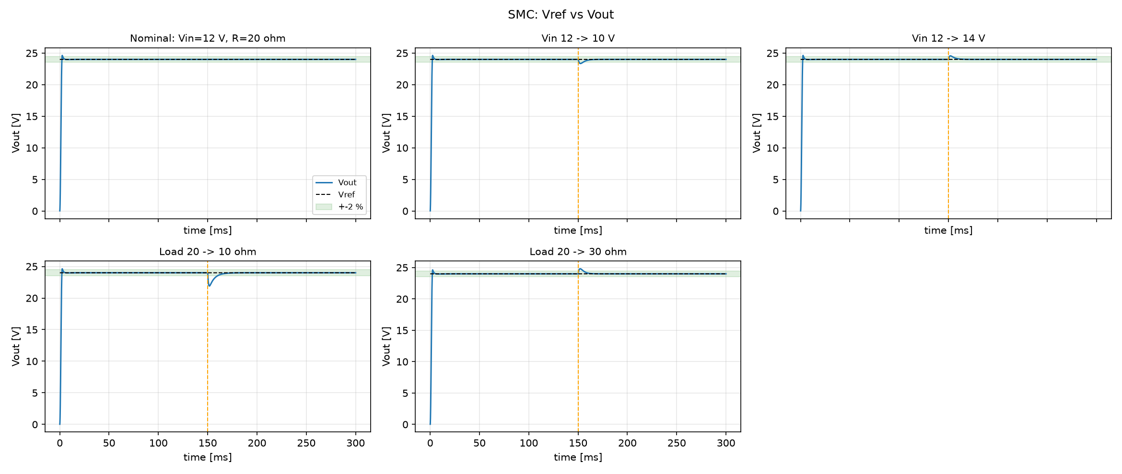
Baseline 2: sliding-mode control
The textbook voltage surface fails
s = de/dt + λe on Vout: the output collapses to 12.6 V when 26 V is requested (right-half-plane zero).
Surface on the inductor current
s = IL − Iref
Iref = clip( Kv·e + Ki∫e, 0, Imax )
D = (1 − Vin,nom / Vout) − K·sat( s / φ )
Kv
Ki
K
φ
Vin,nom = 12 V is assumed, not measured.
0.656
164.7
0.3
0.8 A
Result: settling 2.9 ms, overshoot 2.6 %, no negative current.
Notes:
SMC (about 3 minutes, the most interesting derivation). Idea: define a surface s that is zero when the system is where we want it, then push s to zero with a strong, sign-correct correction; a boundary layer (saturation instead of sign) removes chattering.
Key result: the textbook surface s = de/dt + lambda*e built from voltage only does NOT work on this circuit. Because of the right-half-plane zero, forcing it to zero hides unstable inductor-current dynamics: in simulation Vout collapses to 12.6 V when 26 V is requested (experiments/smc_naive_check.py).
So the surface is placed on the inductor current: s = IL - Iref with Iref = clip(Kv e + Ki integral(e), 0, Imax). Control law: D = (1 - Vin_nominal / Vout) - K sat(s/phi). The 12 V input is the NOMINAL value, not measured, so input steps are real disturbances.
Parameters: Kv 0.656, Ki 164.7, K 0.3, phi 0.8 A, Imax 10 A. Fairness note: the SMC senses current and the PID does not.
RUN (live, a few seconds): python experiments/smc_naive_check.py -> prints the failure. Then python experiments/run_smc.py.
SHOW (code): controllers/smc.py header docstring (the derivation), update() lines 90-110; experiments/smc_naive_check.py.

Slide 8
PID versus SMC: the measured trade-offs
11.5 → 2.9 ms
settling time, PID → SMC
5.40 → 2.07 V
startup dip, PID → SMC
Not like for like: the SMC senses inductor current; the PID uses only Vout.
Notes:
BASELINE COMPARISON (about 2 minutes). Left: peak voltage deviation after each disturbance. The SMC is far better on input-voltage steps (0.65 V and 0.56 V against 3.40 V and 3.00 V), while on load steps the two are similar and the PID is slightly smaller (1.94 against 2.09 V and 0.64 against 0.80 V).
Right: SMC settles in 2.9 ms against 11.5 ms and its startup dip is 2.07 V against 5.40 V. Be honest about fairness: the SMC measures inductor current and its law encodes the boost structure, the PID uses only Vout, so part of the SMC advantage is extra information.
SHOW: results/figures/pid_vs_smc.png (side-by-side waveforms) and results/pid_metrics.csv / results/smc_metrics.csv.
RUN (live): python experiments/run_smc.py prints the full PID-versus-SMC comparison tables.

Slide 9
The reinforcement-learning environment
Observation
Action
Reward
Voltage error (÷ 10 V)
Change of error
Integral of error
Vout (÷ 24 V)
Inductor current (÷ 10 A)
a in [−1, 1]
D = 0.05 + (a+1)/2 × 0.90
one decision every 200 µs
agent never sees Vin or R
tracking, steep near zero
overshoot penalty
duty smoothness
precision bonus
trip: −50
Training: random Vin 10–14 V, R 10–30 Ω, Vref 20–28 V, random disturbances — never the 5 test scenarios
Safety stops end an episode: Vout > 60 V or IL > 30 A (or a negative / non-finite state)
Notes:
RL SETUP (about 2.5 minutes). The environment is a standard Gymnasium environment wrapped around the validated simulator. One agent step holds the duty for 4 converter steps (200 microseconds).
Observation: five numbers, each normalised so they are order 1 (error/10 V, change of error, integral of error clamped, Vout/24, IL/10). The agent does NOT see Vin or R.
Action: a number in -1..1 mapped to duty 0.05..0.95 (a = 0 gives D = 0.5).
Reward: sum of tracking error (with a square-root part so small offsets still cost), an extra overshoot penalty, a duty-smoothness penalty, a precision bonus near zero error, an alive bonus, and a one-off -50 on a protection trip.
Training uses RANDOM conditions (Vin 10-14, R 10-30, Vref 20-28, random disturbances), never the five test scenarios. Safety stops end an episode if Vout > 60 V or IL > 30 A.
SHOW (code): environment/boost_env.py reward_terms() line 62, action_to_duty() line 53, step() line 261 (safety stops lines 286-295), _random_disturbance() line 182.
RUN (live, about 5 s): python environment/check_boost_env.py -> 'ENVIRONMENT CHECK: PASSED'.

Slide 10
TD3: the learning algorithm
1
Twin critics
Network | 2 × 64 units
Learning rate | 1e-3
Discount γ | 0.99
Target rate τ | 0.005
Batch / buffer | 256 / 200k
Exploration σ | 0.1
Training | 200,000 steps
Seeds | 0, 1, 2
Use the smaller of two Q estimates to avoid over-optimism.
2
Delayed actor updates
Update the actor once for every two critic updates.
3
Target-policy smoothing
Add noise to the target action so the critic can’t exploit spikes.
Same settings for all three RL controllers.
Notes:
TD3 (about 2 minutes). TD3 is an actor-critic method for continuous actions: an actor network maps observation to action, critic networks score the action; it learns off-policy from a replay buffer so it needs fewer simulator steps. Three tricks make it stable: twin critics (use the smaller estimate to avoid over-optimism), delayed actor updates (update the actor once per two critic updates), and target-policy smoothing (noise in the learning target).
The network is small on purpose (two hidden layers of 64) because the plant is second order. Hyper-parameters are in config.py and are the same for all three RL controllers. Training length: 200,000 steps, seeds 0, 1 and 2, nine runs, 19 minutes total with three in parallel.
Be clear about the limit: a trained network has no stability guarantee and different seeds give different networks; that is why the adaptive variants add safety layers.
SHOW (code): training/train_td3.py lines 104-118 (the TD3(...) call with every hyper-parameter) and config.py TD3_* block.
RUN (optional, about 8 s): python experiments/run_td3.py --mode both --timesteps 5000 --name td3_demo

Slide 11
Three ways to use the network
Direct TD3
TD3 network
duty D (0.05 – 0.95)
Converter
the network sets the duty
Adaptive PID
TD3 network
Kp, Ki, Kd
PID
D
Converter
the network tunes 3 gains
bounded + smoothed
Adaptive SMC
TD3 network
Kv, Ki, K, φ
SMC
D
Converter
the network tunes 4 parameters
bounded + smoothed
Notes:
ARCHITECTURES (about 2 minutes). Row 1, direct TD3: the network outputs the duty cycle itself. It is the least constrained, so it shows the risks of unconstrained learning.
Row 2, adaptive PID: the network only outputs three numbers that are mapped (relative, logarithmic, zero = baseline) to Kp, Ki, Kd inside a certified box and smoothed; the unchanged baseline PID produces the duty. A zero action reproduces the baseline PID exactly (verified bit for bit).
Row 3, adaptive SMC: same idea with four parameters Kv, Ki, K and phi; the SMC law is unchanged.
In rows 2 and 3 a supervisor can take over at any time (next slide).
SHOW (code): controllers/adaptive_pid.py target_gains() line 101 and _move_toward() line 127; controllers/adaptive_smc.py clamp_params() line 117 and target_params() line 135.

Slide 12
Safety by design: certified bounds
Certified box: Kp ×0.7–1.5, Ki ×0.7–1.05, Kd ×0.9–1.2 → 40.3° / 4.2 dB
Clamp, then smooth: ≤ 5 % change per 200 µs
Supervisor returns gains to baseline if error > 2.5 V for 8 ms, IL > 12 A, or Vout > 1.15 Vref
Notes:
SAFETY (about 3 minutes, an important slide). The baseline PID sits in a narrow stable region. The bar chart shows the worst-case phase margin over 27 operating points when gains are scaled: Ki x1.5 leaves only 18 degrees, Ki x2 and Kd x0.5 are unstable, and moving all three gains together is far worse (plus or minus 25 percent gives 3.8 degrees, plus or minus 50 percent gives -41 degrees). So a naive wide range for the network is unsafe.
A first version with a wider box let the agent drive Ki to its floor and settling slowed from 11.5 to 37 ms. The final box (Kp x0.7-1.5, Ki x0.7-1.05, Kd x0.9-1.2) was found by search so that EVERY gain combination keeps at least 40 degrees and 4 dB on every operating point (40.3 degrees, 4.2 dB measured).
Other layers: clamp every proposal, smooth with at most 5 percent change per 200 microseconds, and a recovery supervisor that returns the gains to baseline when the error stays above 2.5 V for 8 ms, IL exceeds 12 A or Vout exceeds 1.15 Vref. The adaptive SMC bounds were checked the same way by simulating 1,296 parameter/operating-point combinations.
This is evidence on a linearised model over a grid, not a proof for every situation.
RUN (about 40 s): python experiments/analyze_gain_bounds.py (prints the margin sweeps).
SHOW (code): experiments/analyze_gain_bounds.py worst_margins() line 20 and search_tight_box() line 97; controllers/adaptive_pid.py _supervise() line 150; experiments/analyze_smc_bounds.py judge() line 62.

Slide 13
A reward is only as good as its test
Old reward
Redesigned reward
+38.0 vs +26.5
+499.7 vs +431.7
a weak 5,000-step policy scored above the PID
PID first, the same policy second, random last (+51.9)
Linear tracking cost made small offsets almost free
Duty smoothness cost was almost zero for visible jitter
A one-off trip cost less than surviving a bad episode
Notes:
REWARD LESSON (about 2 minutes). Before long training the reward function was tested with reference policies on identical episodes. The old reward ranked a weak 5,000-step policy ABOVE the PID (+38.0 against +26.5) even though its final error was 0.48 V against 0.001 V and its duty moved 3.5 times more. Reasons: tracking cost was linear so small offsets were nearly free, duty smoothness was nearly free, and tripping could cost less than surviving a bad episode.
The redesigned reward (square-root tracking, a precision bonus, a stronger smoothness penalty, an alive bonus and a -50 trip penalty) ranks the PID first (+499.7) and random last (+51.9), with the same weak policy in between (+431.7).
Take-away: an RL agent optimises exactly what the reward measures, so a reward should be tested against reference policies first.
RUN (about 30 s): python experiments/reward_diagnostics.py --tag demo --models td3_smoke (needs models/td3_smoke.zip). The saved results are results/reward_diag_v1_old_reward.csv and results/reward_diag_v2_new_reward.csv.
SHOW (code): environment/boost_env.py reward_terms() line 62.

Slide 14
Final study: key metrics (3 seeds)
Metric (nominal) | Fixed PID | Fixed SMC | Direct TD3 | Adaptive PID | Adaptive SMC
Settling time (ms) | 11.5 | 2.9 | 11.2 ± 14 | 12.1 ± 2.1 | 5.1 ± 1.9
Overshoot (%) | ≈ 0 | 2.62 | 3.31 ± 0.07 | ≈ 0 | 3.41 ± 0.38
Startup dip (V) | 5.40 | 2.07 | 2.23 ± 0.21 | 5.13 ± 0.06 | 2.00 ± 0.02
RMSE (V) | 1.375 | 1.256 | 1.264 ± 0.011 | 1.365 ± 0.007 | 1.259 ± 0.001
Duty variation (×10⁻⁴) | 1.0 | 1.5 | 38 | 1.1 | 1.7
Peak IL (A) | 8.89 | 9.12 | 8.95 | 8.88 | 9.25
Protection trips | 0 | 0 | 0 | 0 | 0
RL columns: mean ± sample std over seeds 0, 1, 2 (200,000 steps each). Zero protection trips in all 55 evaluation runs. No ranking is computed.
Notes:
FINAL STUDY, TABLE (about 2 minutes). Each RL controller was trained for 200,000 steps with seeds 0, 1 and 2 (9 runs, 19 minutes) and evaluated deterministically on the five scenarios; RL cells are mean plus or minus sample standard deviation over seeds. Nothing is ranked.
Highlights to point at: direct TD3's cold-start RMSE is within 1 percent of the fixed SMC's (1.264 against 1.256 V), but its duty variation is about 38 times larger (and 25-70 times across scenarios); direct TD3 settling has a huge spread (11.2 +- 14 ms: seeds gave 3.0, 27.9 and 2.7 ms); the adaptive controllers stay close to their baselines; there were zero protection trips in all 55 evaluation runs.
OPEN (not run live): results/final/final_report.md (readable tables) and results/final/final_metrics_by_run.csv (the combined CSV, 55 rows).
If asked how it was produced: python experiments/train_final.py --tag final --jobs 3, then python experiments/final_evaluation.py --tag final. SHOW (code): experiments/final_evaluation.py collect() line 128, summarise() line 159, protection_trip() line 72.

Slide 15
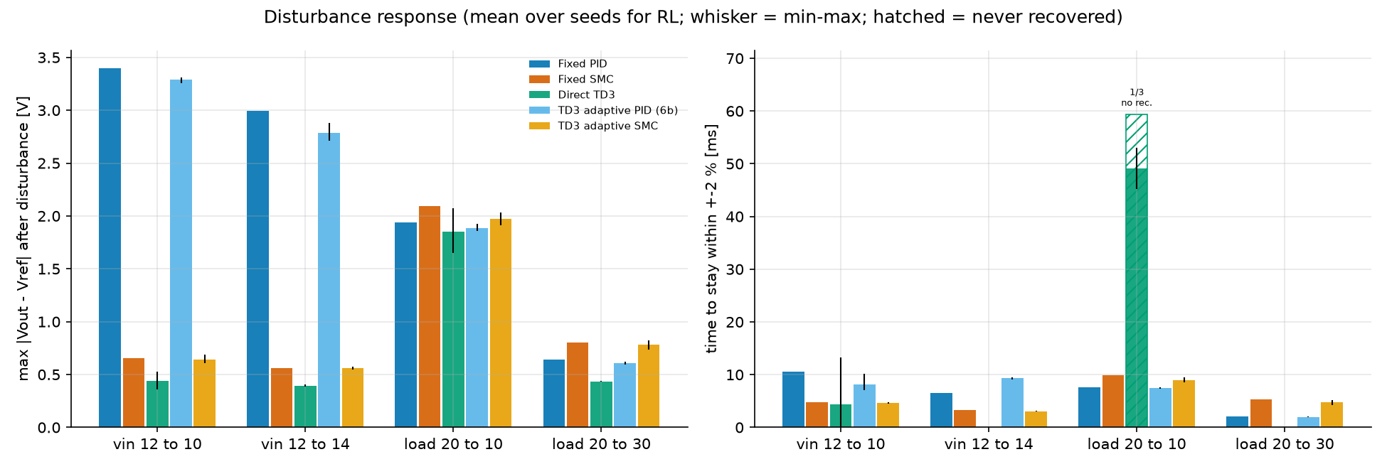
Disturbance response, all five controllers
Bars: mean over seeds for the RL controllers; whiskers: min–max across seeds; hatched: never recovered within the run.
Direct TD3 has the smallest mean peak deviation in all four cases (R 20→10 Ω: within the seed spread), but one seed never recovers after that step. Adaptive controllers track their baselines within a few %.
Notes:
DISTURBANCES (about 2 minutes). Left panel: peak deviation after each of the four disturbances; right panel: time until the output stays within plus or minus 2 percent. Bars are means over seeds for the RL controllers, whiskers show min-max across seeds; a hatched bar means the output never came back to the band.
Objective reading: the fixed SMC and adaptive SMC are best on input-voltage steps among the fixed-structure controllers; direct TD3 has the smallest MEAN peak deviation in all four cases (on R 20 to 10 ohm, 1.85 V against 1.94 V for the PID, the margin is within its seed spread of +-0.21 V) but is slow to recover after that step (45-53 ms in two seeds, never in the third); adaptive PID and adaptive SMC stay within a few percent of their baselines. A recovery of 0 means the output never left the band.
Do not call a winner: three seeds and one configuration.
OPEN: results/final/figures/final_disturbance_recovery.png (and final_vout_tracking.png for the waveforms).

Slide 16
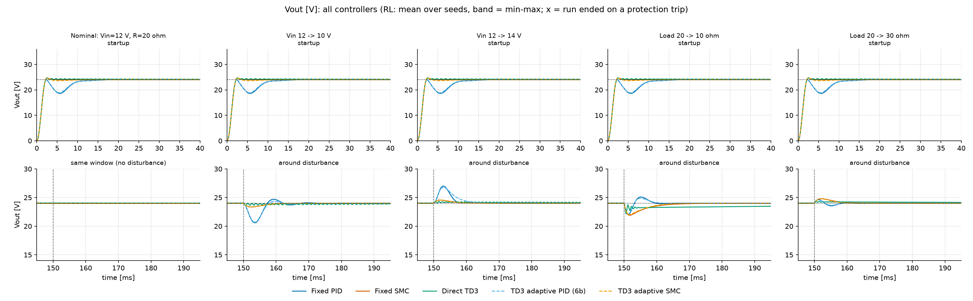
Waveforms: startup and disturbances
Every controller reaches 24 V; the PID variants dip to ≈ 18.6 V first (diode pre-charge surge)
SMC variants and direct TD3 hold the output tighter after the steps
Notes:
WAVEFORMS (about 2 minutes). Top row: the 40 ms after power-up for each scenario; bottom row: the window around the disturbance. Colours: fixed PID blue, fixed SMC vermillion, direct TD3 green, adaptive PID light blue dashed, adaptive SMC orange dashed; the RL curves are the mean over seeds with a min-max band.
Point out: every controller reaches 24 V; the PID variants dip to about 18.6 V after the first pass (diode pre-charge surge) while the SMC variants and direct TD3 hold the output tighter; after the disturbances the PID overshoots/undershoots the most; direct TD3 shows a slow drift after R 20 to 10 ohm.
OPEN: results/final/figures/final_vout_tracking.png. Optional extras: final_duty_cycle.png (shows direct TD3's intermittent duty oscillations) and final_inductor_current.png.

Slide 17
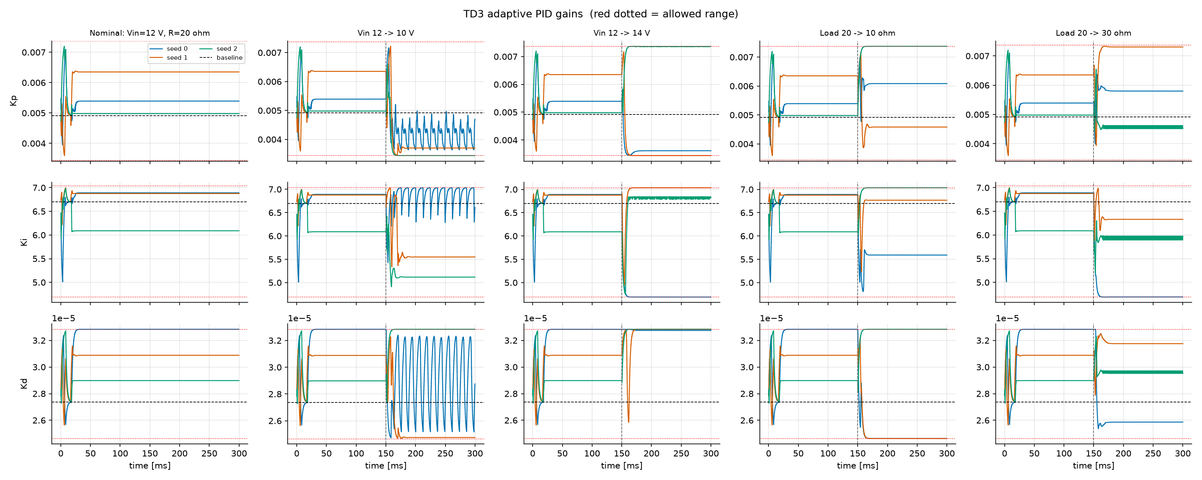
What the adaptive PID learned
Gains react to each disturbance
Each seed learns a different policy
One seed oscillates after Vin 12→10 V, inside its bounds
Supervisor: engaged once per run, at startup only
Red dotted lines: certified gain limits. Dashed black: baseline gain.
0
protection trips; gains and SMC parameters never left their certified bounds
Notes:
ADAPTATION (about 2 minutes). These are the Kp, Ki and Kd trajectories for the three trained seeds in each scenario; the red dotted lines are the certified limits and the dashed black line is the baseline. The gains genuinely react to each disturbance and every seed learns a different policy. In one seed the gains oscillate persistently after the Vin 12 to 10 V step, but they never leave their bounds. The supervisor engaged once per run, during the cold start only. The adaptive SMC behaves similarly (see final_adaptive_smc_params.png); in the earlier 5,000-step smoke run it had output constant values, which did not recur after 200,000 steps.
OPEN: results/final/figures/final_adaptive_pid_gains.png and final_adaptive_smc_params.png.
SHOW (code, optional): controllers/adaptive_pid.py _supervise() line 150.

Slide 18
What the results show — and what they don’t
Shown (3 seeds, 200k steps)
Not shown
No controller is best on every metric
Direct TD3 regulates tightly but moves the duty 25–70× more and varies widely across seeds
Adaptive controllers stay within a few % of their baselines
0 protection trips in all 55 evaluation runs
A winner: three seeds, one configuration
Hardware behaviour: ideal averaged model (no ESR, diode drop, ripple)
Stability proofs beyond the tested grids
SMC vs PID is not like for like (current sensing)
Notes:
INTERPRETATION (about 2.5 minutes). Be balanced and specific. Shown: no controller is best on every metric; direct TD3 regulates tightly but moves its duty 25 to 70 times more than PID/SMC, with intermittent oscillations in some seeds and varies a lot across seeds; the adaptive controllers stay within a few percent of their baselines; zero protection trips in 55 evaluation runs.
Not shown: a winner (three seeds, one configuration, differences of a few percent are within the seed spread); hardware behaviour (the model is ideal and averaged: no ESR, no diode drop, no ripple, so the direct-TD3 duty oscillations could be a real problem for switches); stability proofs beyond the tested grids; and the SMC versus PID comparison is not like for like because the SMC senses current.
SHOW: results/final/final_report.md section 'protection trips and supervisor activity'.

Slide 19
Conclusions and next steps
Conclusions
Next steps
Validated CCM/DCM simulator and two tuned baselines
Textbook SMC surface fails here; a current surface works
RL tuning inside certified bounds is safe (0 trips) but its gains are small and mixed
Unconstrained direct TD3 regulates tightly but oscillates the duty intermittently
More seeds and longer training
Penalise duty oscillation in the reward
Add ESR, diode drop and inductor resistance; re-derive the bounds
Hardware-in-the-loop test
Notes:
CLOSING (about 2 minutes). Conclusions: (1) a validated CCM/DCM simulator and two properly tuned baselines were built; (2) the textbook SMC surface fails on this non-minimum-phase plant, a current surface works; (3) reinforcement learning can tune the controllers inside certified bounds and with a supervisor, with zero protection trips, but the gains over the fixed controllers are small and mixed; (4) unconstrained direct TD3 regulates tightly but oscillates the duty cycle and varies across seeds.
Next steps: more seeds and longer training, a stronger duty-change penalty for direct TD3, add ESR/diode drop/inductor resistance and re-derive bounds, then hardware-in-the-loop.
Invite questions. Keep the appendix slide ready for 'how do I reproduce this?'.

Slide 20
Appendix: reproduce everything
pytest -q tests
228 tests
python run_converter_validation.py
simulator checks
python experiments/run_pid.py
fixed PID
python experiments/run_smc.py
fixed SMC + comparison
python experiments/train_final.py --tag final --jobs 3
9 RL runs, about 19 min
python experiments/final_evaluation.py --tag final
CSV, report and plots
All parameters live in config.py · results in results/final/ · models in models/
Notes:
APPENDIX (backup). Everything runs from the folder adaptive_dc_dc_rl with the virtual environment active; all parameters are in config.py. The first three commands take seconds; the training command takes about 19 minutes (3 jobs in parallel); the evaluation takes about 40 s.
If a live demo fails, open the saved results instead: results/final/final_report.md and the figures in results/final/figures/.

