Slide 1
ODYSSE · TAKE-HOME · RIDE-HAILING OPERATIONS
Right trip, right driver
Can Odysse cut the 61% of offers that go unaccepted by sending each trip to the driver most likely to take it, without giving anyone more work?
Leo · 5,576 ride offers, 17–22 August · 42 drivers
Notes:
Open with the question, then: I'll answer it in four steps and end with what I'd test. About 10 minutes, then questions; the notebook is open in another tab for any number you want to see computed.

Slide 2
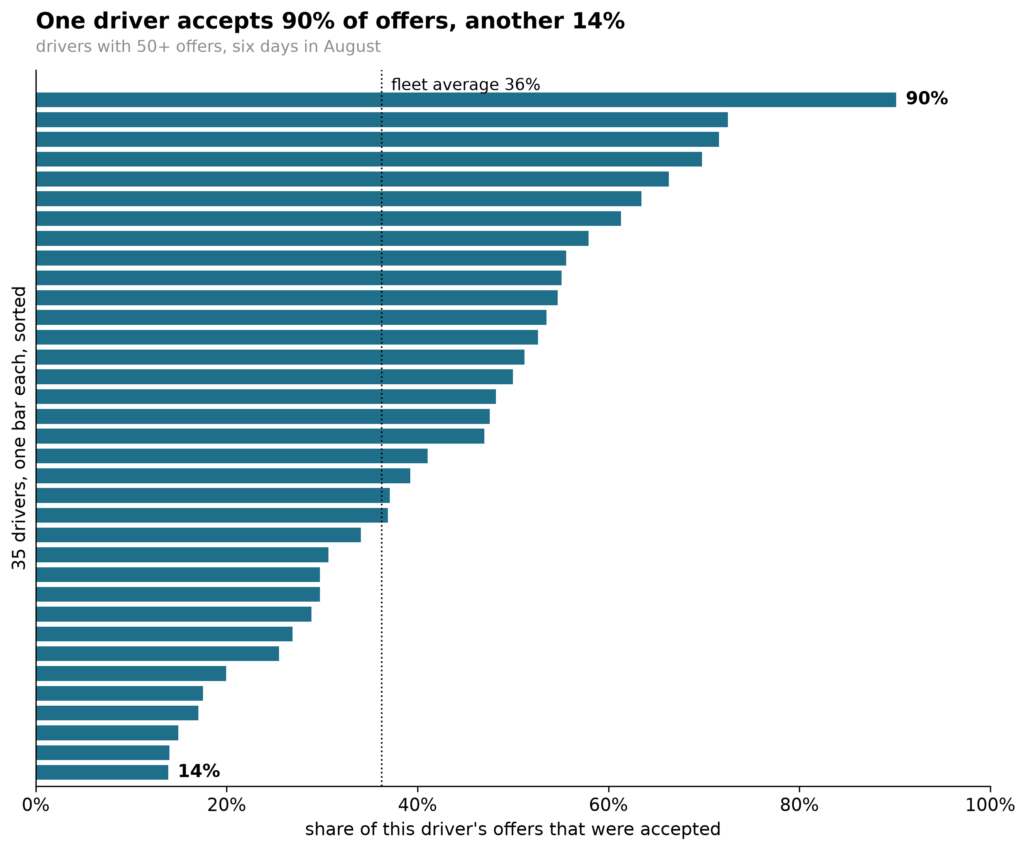
Six offers in ten go unaccepted, and it varies hugely by driver
61%
HOW I GOT THIS
Every offer ends in one of four states. Not accepted = status "Driver rejected" or "Driver did not respond", divided by all 5,576 offers.
Accepted = an acceptance timestamp exists (37%). The remaining ~2% ended another way, e.g. the rider cancelled first — so accepted and not-accepted don't sum to 100.
Noise floor: if every driver behaved the same, sampling alone would spread these 35 drivers by √(mean of p̂(1−p̂)/n) ≈ 4 points. The observed spread is 19.
Notebook: Step 0 — cells 6, 10, 13
of 5,576 offers not accepted: 43% got no response, 18% were turned down. Each bar on the left is one driver.
14% → 90%
share accepted, across the 35 drivers with 50+ offers
Odysse's drivers are salaried and on shift, so every unaccepted offer is paid capacity that didn't carry a passenger, and a rider kept waiting.
Two kinds of miss
No response (43%) looks like availability; turned down (18%) looks like choice. Slide 7 separates them on days the model never saw.
Not accepted = no response + turned down; accepted = 37%; the remaining ~2% ended another way (e.g. rider cancelled first). Drivers with 50+ offers cover 97.5% of all offers. Rider cost is not measurable here (waiting time is blank in the export); response times and re-dispatch counts would size it.
Notes:
Two signals, separated later: no response looks like availability; turned down looks like choice. The spread from 14% to 90% accepted is the puzzle. Chance alone would spread drivers by about 4 points, not 19. If anyone says 'six in ten turned you down': six in ten weren't accepted; about two in ten were actual declines, the rest was silence.

Slide 3
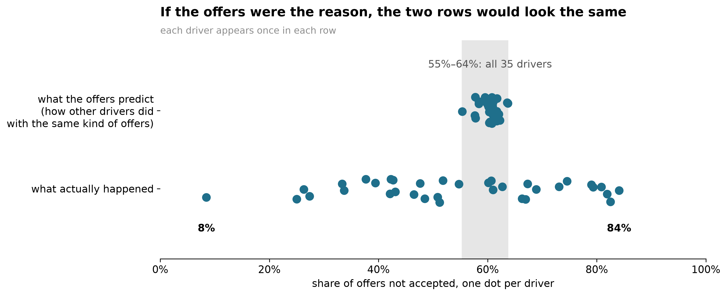
1. Is it the trips? No: the offers look alike, the outcomes do not
HOW I GOT THIS
For each offer, ask how often OTHER drivers failed to accept the same kind of offer: same pickup ring (<3, 3–8, 8–15, 15+ km from Charing Cross) × same 6-hour block; the ring alone if fewer than 20 comparisons exist.
Leave-driver-out: the cell's counts minus the driver's own, then divide. The average over a driver's offers is their expected rate.
Share explained = Var(expected) ÷ [Var(observed) − sampling noise] = 0.8%.
Notebook: Step 1 — cells 15–17
What you're looking at
Top row: for each driver, how other drivers did with the same kind of offers (same area, same time of day). Bottom row: what each driver actually did.
The finding
Whoever receives them, these offers get 55–64% not accepted. Drivers range from 8% to 84%. The gap is not explained by the offers.
How hard I pushed
Under 1% of the differences here; at most a few per cent with finer zones, a 4 km grid or a boosted model on raw coordinates. Driver ranking unchanged (0.99).
Expected rate = leave-driver-out mean over pickup ring × 6-hour block. Drivers with 50+ offers (35 of 42, 97.5% of offers).
Notes:
Say: the obvious explanation is that some drivers get worse offers, so I checked what everyone else did with the same kind of offers. Never 'the driver's fault': the gap is not explained by the offers.

Slide 4
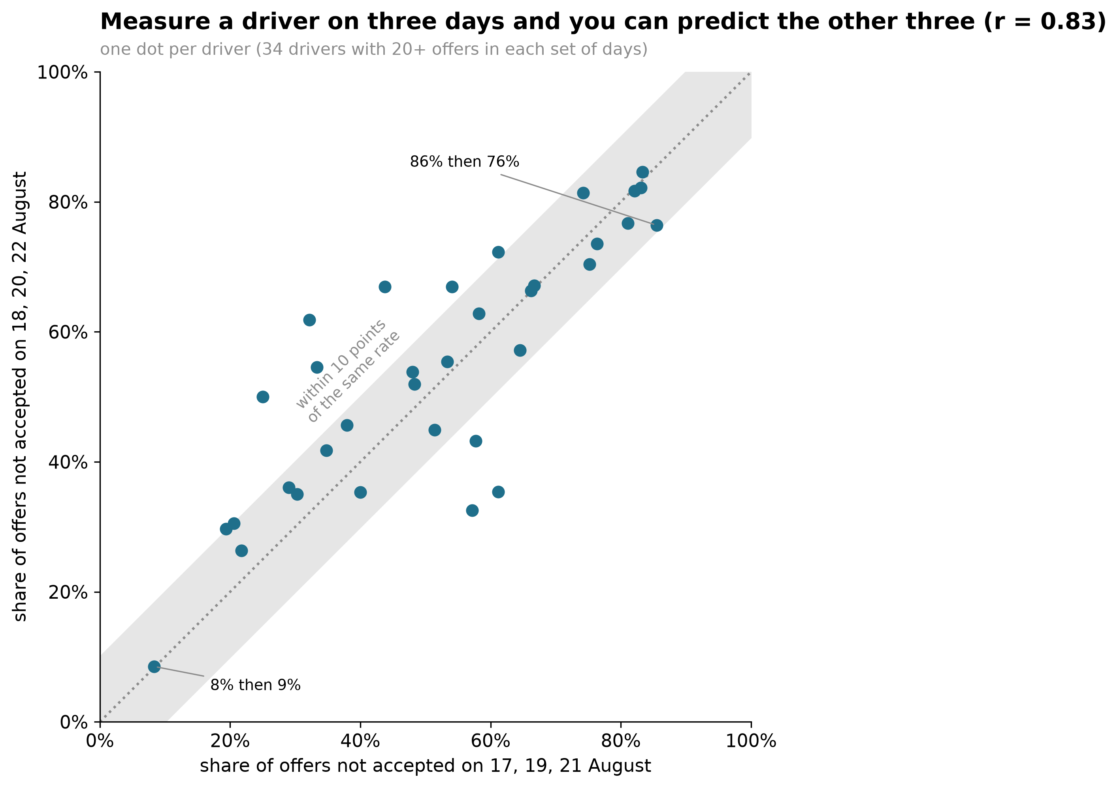
2. Is it a bad day? No: each driver's pattern is predictable from day to day
The test
Measure each driver on 17, 19 and 21 August; then again on 18, 20 and 22. Alternate days, so the thin 19th lands in one set only.
HOW I GOT THIS
Split the six days into two sets that share no day: A = 17, 19, 21 Aug; B = 18, 20, 22. Each driver's share not accepted in each set, keeping the 34 with ≥20 offers in both.
Pearson r between the two across drivers: 0.83. Subtracting each driver's expected rate first: 0.84.
Why it's model-free: noise in set A is independent of noise in set B, so agreement can only come from something that persists.
Notebook: Step 2 — cell 22
The finding
The first predicts the second, r = 0.83 (1 = identical, 0 = no relation); 24 of 34 drivers stay within 10 points. Stable, so dispatch could learn it.
What it isn't
Not a ranking of good and bad drivers. A stable pattern could be availability, app habits or preference.
34 drivers with 20+ offers in both sets. Same result after subtracting each driver's expected rate (r = 0.84).
Notes:
If these were noise, the dots would scatter around the middle rather than line up on the diagonal. Learnable is the word that matters: it sets up the router.

Slide 5
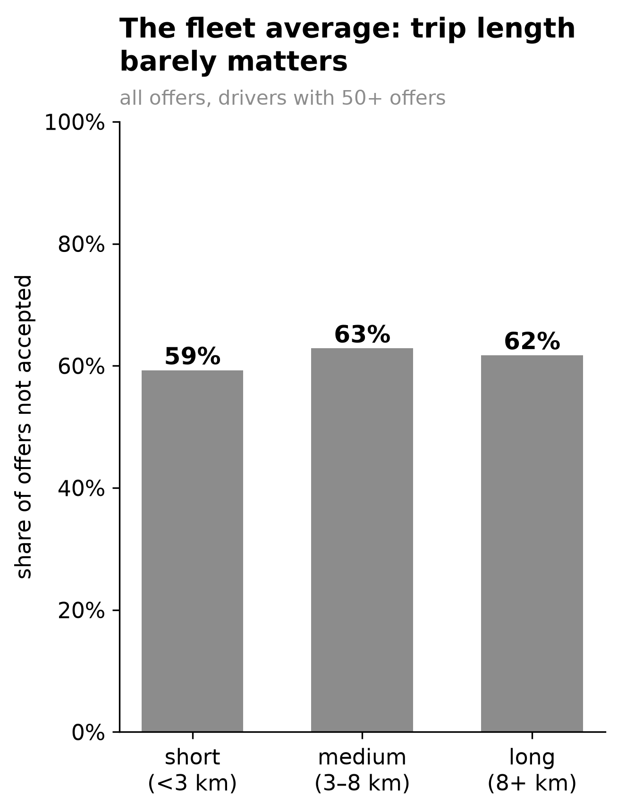
3. Do drivers prefer different trips? The fleet average says no
Short, medium or long, the share not accepted is 59%, 63%, 62%.
This is what a standard analysis shows. On this evidence, trip length is not worth dispatch's attention.
Now the same data, one driver at a time.
HOW I GOT THIS
Trip length = straight-line km between pickup and dropoff (road distance is about 1.4× that, r = 0.955 on finished trips): short <3, medium 3–8, long 8+.
Share not accepted in each band, pooling every offer sent to the 35 drivers with 50+ offers.
59.3% / 62.9% / 61.7% — a three-point range, within noise.
Notebook: Step 3 — cells 33–34
Trip length is straight-line km from pickup and dropoff coordinates; drivers with 50+ offers.
Notes:
Pause here. Let them agree that trip length doesn't matter. Then advance.

Slide 6
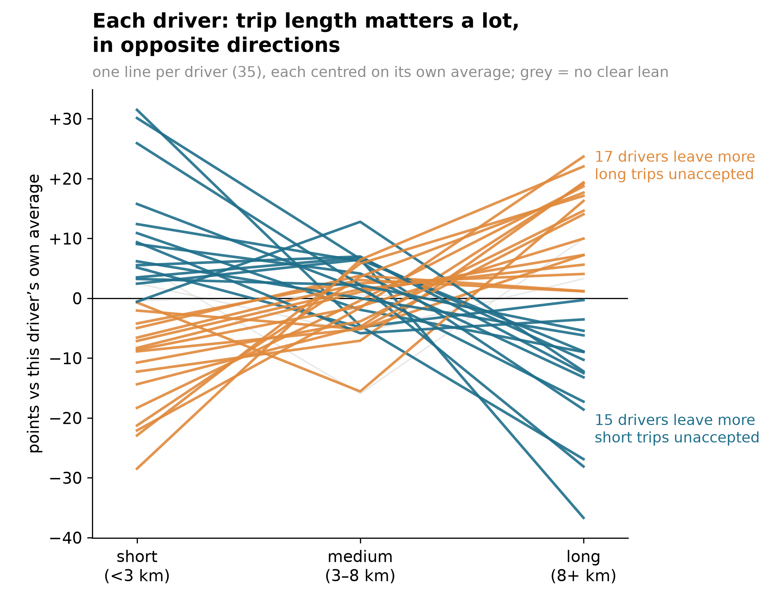
Driver by driver, trip length matters a lot, in opposite directions
What the colours mean
Orange lines rise: 17 drivers leave more long trips unaccepted. Teal lines fall: 15 leave more short trips unaccepted. 3 grey lines: no clear lean. They cancel out, so the average is flat.
HOW I GOT THIS
Per driver and band: mean of (observed − expected), then centred on that driver's own average so only the shape is left. Lean = long minus short; ±5 points counts.
Repeat test: the same long-minus-short gap on set A vs set B, r = 0.77 across 30 drivers.
Null by permutation: shuffle the long/short labels within each driver × day-set — which keeps every driver's rate and number of long trips — 1,000 times. Largest r by chance 0.60, so p = (0 + 1)/1,001 ≈ 0.001.
Size: split-half covariances → the swing is 23% of what repeats (90% CI 14–34%).
Notebook: Step 3 — cells 29–35
Is it real?
The split repeats on alternate days, r ≈ 0.77. Shuffling which offers were long or short 1,000 times never gets past 0.60, so p ≈ 0.001.
Why it matters
Two drivers with the same overall rate can be opposites on trip length. A ranking cannot use that. Matching can.
Each line centred on that driver's own average; 35 drivers with 10+ offers in every band. Stability test uses the 8 km split, 30 drivers.
Notes:
The insight to land. Point at one orange line and one teal line. This is what the fleet average hid.

Slide 7
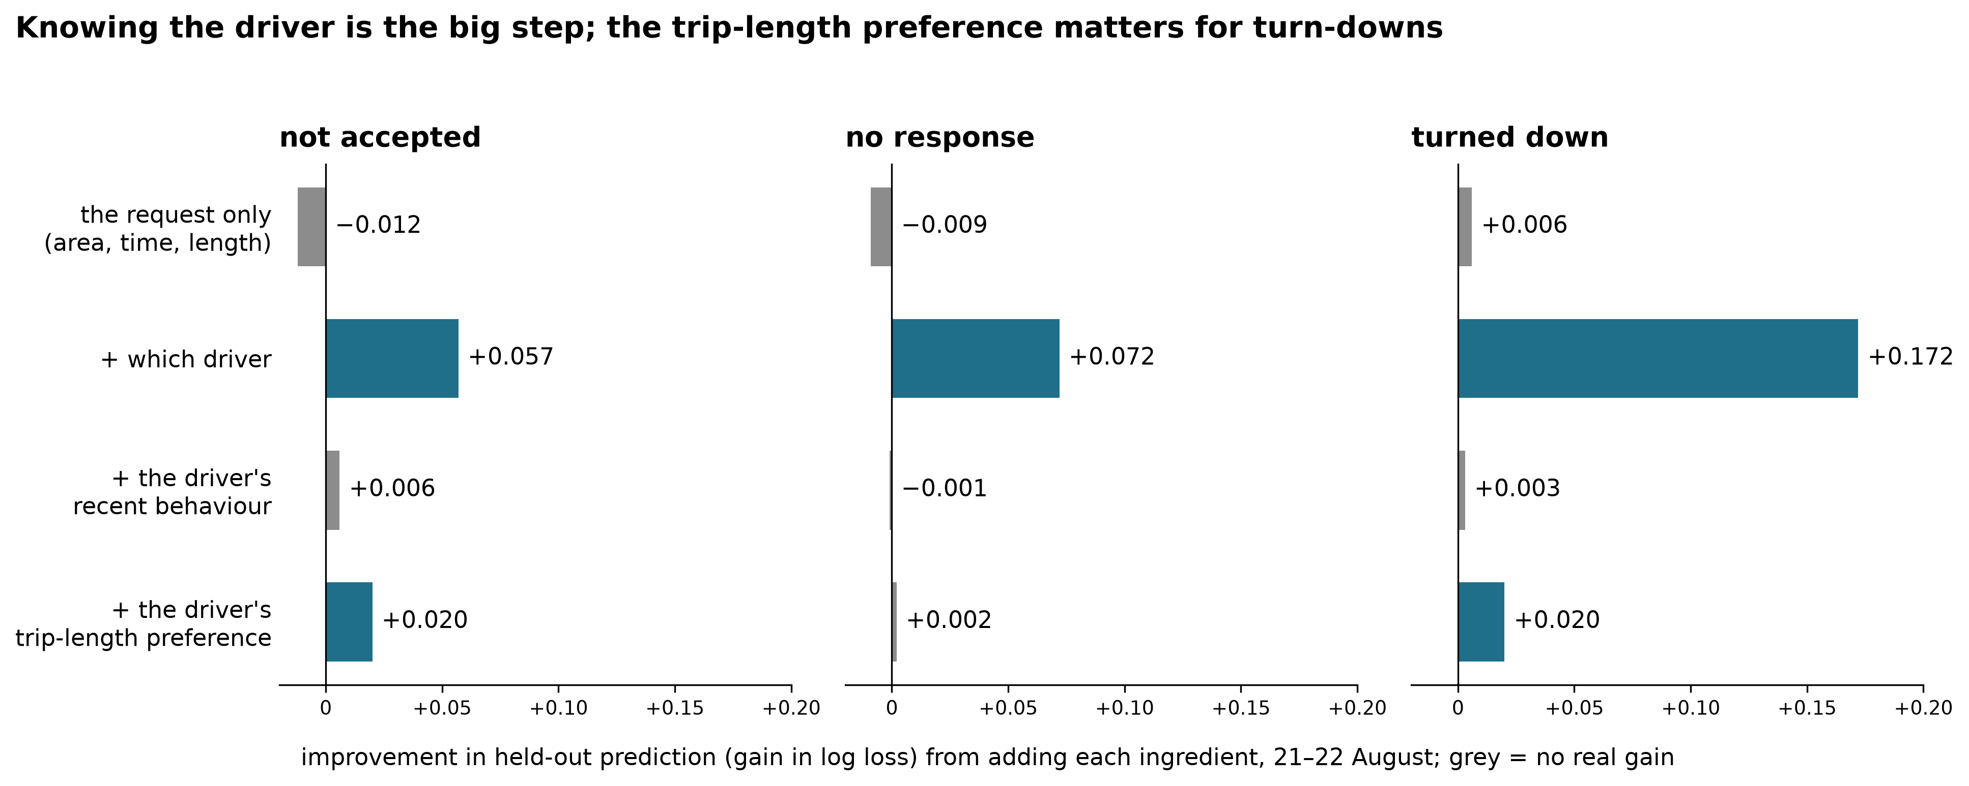
4. Does it hold on days the model never saw? Two signals, both driver-level
HOW I GOT THIS
Train on 17–20 Aug, test on 21–22. L2 logistic regression; the regularisation strength is chosen by fitting 17–19 and scoring 20 Aug, then refitted on all four days.
Score = log loss on the unseen days. Each bar is the gain over the model above it; the first is over a constant at the training base rate.
Four nested models: request → + driver (one 0/1 column each) → + recent state (only what was ≥60 s old) → + driver × log km.
90% intervals from resampling whole driver-days 1,000×, because offers within a driver-day are not independent.
Notebook: Step 4 — cells 39–44
The test
Logistic models trained on 17–20 August, tested on 21–22 August. Each bar is how much better the prediction gets when that ingredient is added.
The finding
The request alone predicts worse than a constant. Knowing the driver is the big step. Recent behaviour adds almost nothing once the driver is known.
Two signals
No responses are predicted by who the driver is, not the trip: availability. Turn-downs are predicted by the driver and their trip-length preference: choice.
Gains in held-out log loss; 90% intervals from resampling driver-days. Recent behaviour uses only information at least 60 seconds old at dispatch time.
Notes:
The request-only model does worse than guessing the average on unseen days: the strongest version of 'it's not the trips'. The trip-length interaction helps turn-downs and not no-responses, as you'd expect if turn-downs are choices.

Slide 8
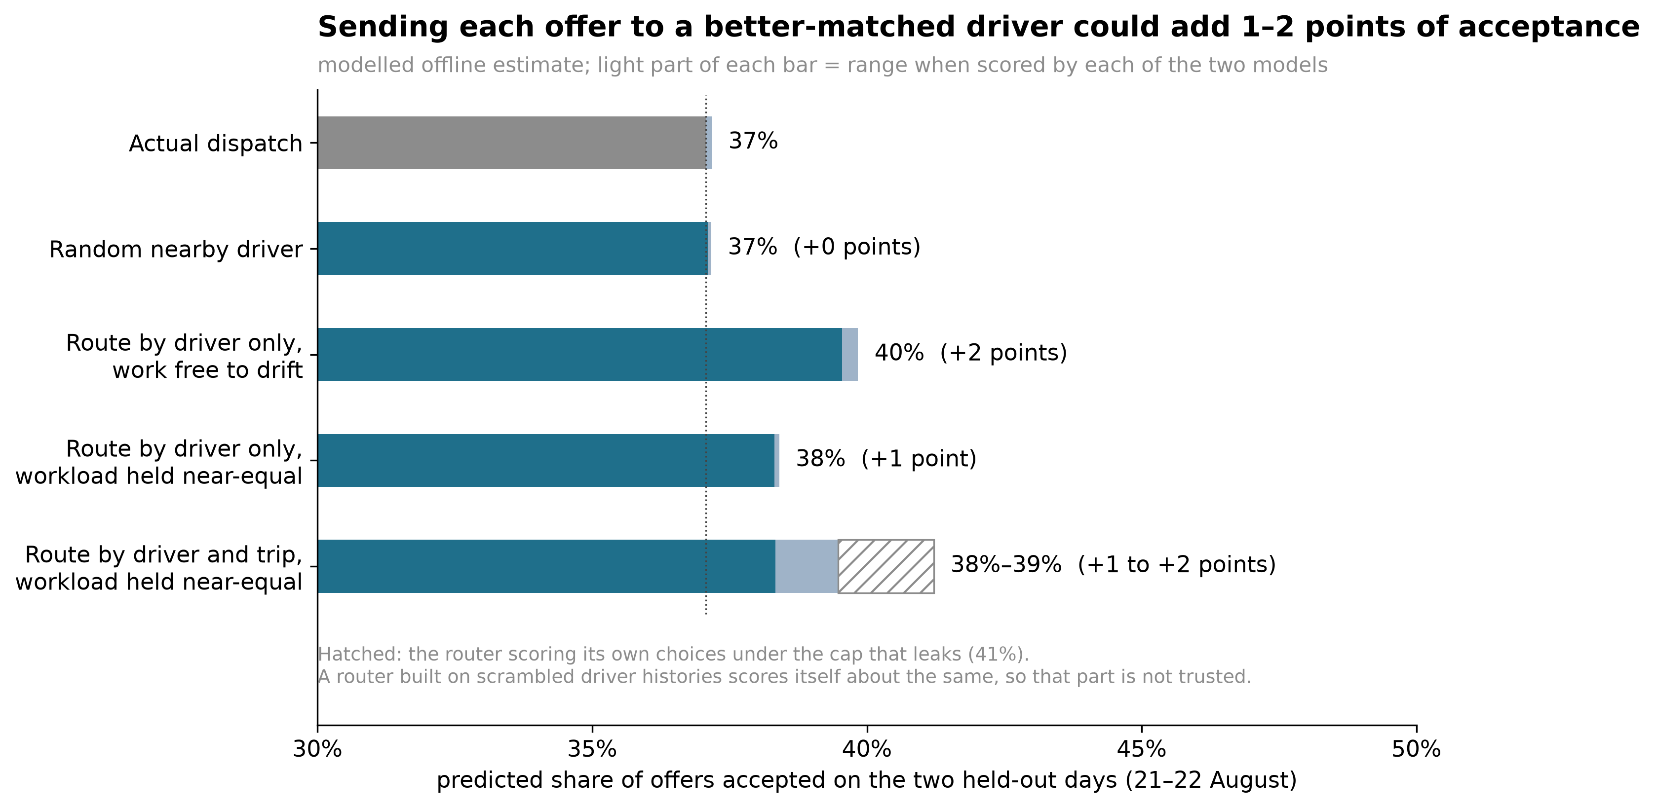
5. Could dispatch use it? A prototype router: about 1–2 points, test it live
HOW I GOT THIS
Two acceptance models trained on 17–20 Aug: driver-only, and driver + driver × km.
Candidates for each test offer: the actual driver, plus anyone offered something in the same ring within ±10 min who wasn't mid-trip (median 2).
Route in time order to the highest-scoring candidate with room; strict cap = never more than 3 offers ahead of the work that had actually come their way.
Every policy is scored by both models, so none is judged only by the model that chose it.
Notebook: Step 5 — cells 55–62
The rules
Trained on four days, run on two it never saw. Each offer goes to the nearby driver most likely to accept, workload held near actual.
My own correction
First estimate +4 points. A router built on scrambled histories scored itself +4 too, so the model was flattering its choices. Honest range at held workload: +1 to 2.
What it can and can't show
Like for like, routing by driver alone also gains about a point; the trip term adds up to a point more, but only by the model that contains it. The router proves the lever is real; the case for matching rests on the held-out test and a driver-visible preference.
2,221 test offers; median 2 candidate drivers; 15% moved under the strict cap, so the 1–2 point average is roughly 8–16 points on the offers that move. Two nested models scored on the same offers: a cautious check. Modelled, not measured.
Notes:
Say the correction unprompted, and the like-for-like result. Then point to where the matching evidence sits: the held-out turn-down result and the driver-visible profile. The A/B test settles ranking vs matching. If asked about 32% vs 44%: that sanity check is on the uncapped router, which moves 38% of offers.

Slide 9
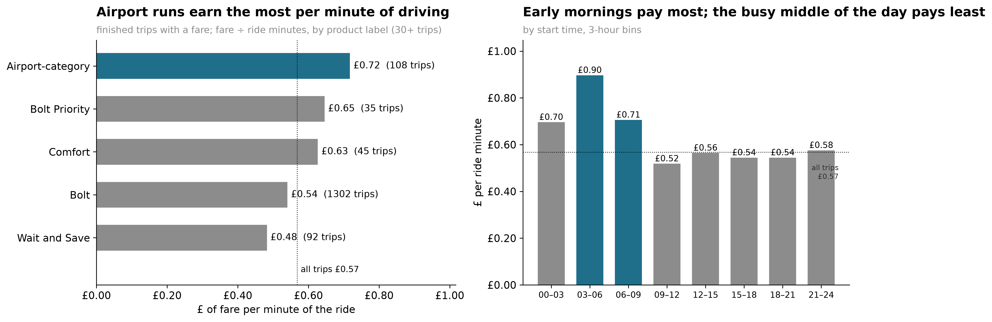
6. Where is a salaried minute worth most? Airport runs and early mornings
HOW I GOT THIS
Fare ÷ ride minutes as totals per group over 1,604 finished trips with a fare — totals, not the mean of per-trip ratios, so every minute counts the same.
Airport = a product label on the category, not a zone. Declined less: 50% of the 280 airport-category offers were not accepted, vs 61% of all offers.
Capacity: a driver-block = one driver × 3-hour block × date with ≥1 offer — the closest stand-in for availability in this export.
Fare model: least squares on recorded miles and minutes; 5-fold CV R² 0.88.
Notebook: Step 6 — cells 66–69; airport check in cell 76
Why per minute
Odysse's drivers are paid for their time, so the fare a trip earns per minute of driving is what matters, not the fare per trip.
The finding
Airport-category trips earn £0.72 a minute against £0.54 for a standard trip, and go unaccepted less often (50% vs 61%). Trips starting 3–9am earn £0.70–0.90 a minute; the busy 9am–9pm stretch earns £0.52–0.56.
Where the capacity is
73% of driver activity sits in the 9am–9pm stretch, which earns £0.54 a minute; 13% sits in 3–9am, which earns £0.73. Most of the fleet's paid time is in its worst-paying hours. No cost data in the export, so this is fare, not profit.
Fare ÷ ride minutes over 1,604 finished trips with a fare. Gross fare revenue, not profit; the empty return leg from airports is not in the data. Airport is a product label, not a zone.
Notes:
Keep it to a minute. Per minute, not per trip, because time is the cost for a salaried fleet. Airport runs and early mornings are worth positioning for; say 'gross fares, not profit' out loud.

Slide 10
Route each request to a driver who is available, well-matched and operationally sensible, keeping workload fair
AVAILABILITY
Is this driver meaningfully available now?
After a run of no-responses, re-route sooner so the rider isn't kept waiting, and check in with the driver. This is about rider time, not prediction.
Evidence: slide 7 — no-responses are predicted by who the driver is, not the trip (cell 44). Recent no-responses don't predict the next one once the driver is known.
PREFERENCE
Is this a suitable request for this driver?
A trip-length preference profile that drivers can see and adjust. Feed it into the existing orchestration as a feature, and A/B test it at equal workload.
Evidence: slides 6–7 — opposite leans that repeat (r = 0.77, cell 31); the trip-length term improves held-out turn-down prediction (cell 44).
VALUE
Of the good matches, which is best for the fleet?
Fares are mostly distance and time (R² 0.88); airport-category trips pay about £6.60 more. Weigh predicted trip value alongside the chance of acceptance.
Evidence: slide 9 — fare model and value per minute (cells 67–69). A dispatch-time version needs predicted distance and duration.
These are inputs to Odysse's existing orchestration system, not a replacement for it.
Notes:
Three layers, one sentence each. The preference profile is driver-friendly: drivers see and adjust it. Tie value back to the fare model. Say explicitly this slots into what they already run.

Slide 11
So: can the 61% come down?
It isn't explained by the trips, each driver's pattern is stable, and drivers differ in which trips suit them. That is a lever dispatch isn't pulling. Routing on it is worth about 1–2 points of acceptance across all offers in the offline test — roughly 56–112 more accepted offers over a six-day window like this one, about £700–1,400 in gross fares. It looks small because it can only act where a second driver is free: on the offers it does move, acceptance rises about 8 to 16 points. Whether matching on the trip beats a plain ranking is the open question the A/B test answers.
HOW I GOT THIS
Lever arithmetic: 1 point of acceptance on 5,576 offers = 56 more accepted; about ¾ of accepted offers finish (1,604 finished trips of ~2,060 accepted); at ~£17 a trip that is ≈ £700 per point. Gross fares, not profit — no cost data.
8–16 points on moved offers = the 1.2–2.4 point average ÷ the 15% of offers that move.
EV lead: logistic regression of turn-downs on driver, 3-hour bin, long trip, miles so far today ÷ 50 and hours since first offer ÷ 4, over the 3,206 responded offers. Miles coefficient 0.41 [0.24, 0.77], which is about +9 points at the 32% base rate; hours ≈ 0.
Notebook: cells 52, 61–62, 67–69; Step 6 note
A question for an EV fleet
Drivers turn down more trips as their completed miles for the day build up, about +9 points per 50 miles; time since their first offer makes no difference. That hints at something that depletes with driving: charge, or fatigue. A lead, not a finding; battery and shift logs would settle it.
Next steps
A/B test preference-aware dispatch, workload held equal
Log candidate drivers per request, response times, pickup ETA, fare shown
Add battery, charging and shift start/end logs
Re-run on a longer window: six days is thin
Limits: six days, one nearly empty; another driver's answer to the same offer is never observed; rings, straight-line km and mileage are proxies.
Notes:
Close on the 61%: not the trips, stable per driver, opposite preferences, a lever worth 1–2 points before touching no-responses, test it. Then the EV question, the limits, and stop.

Slide 12
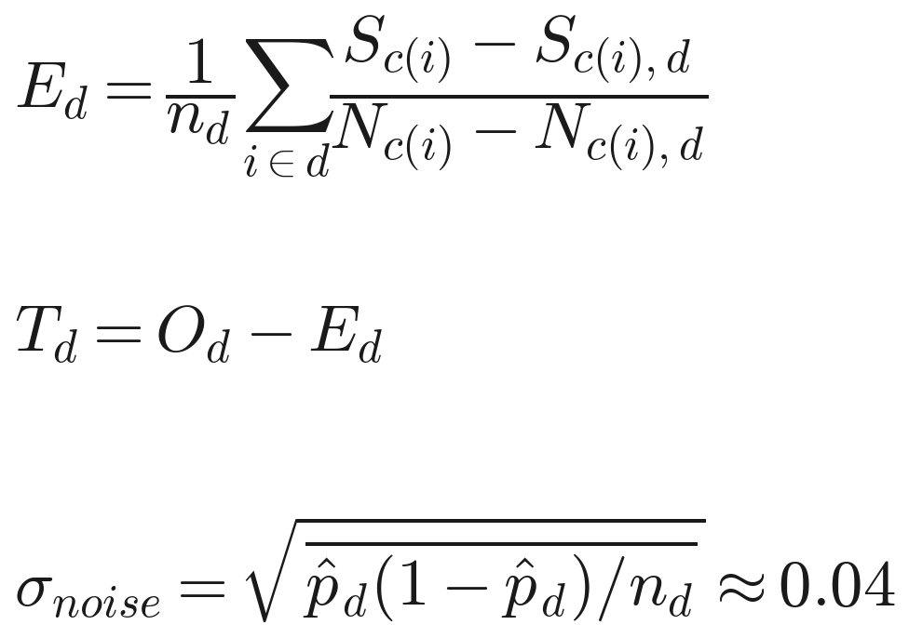
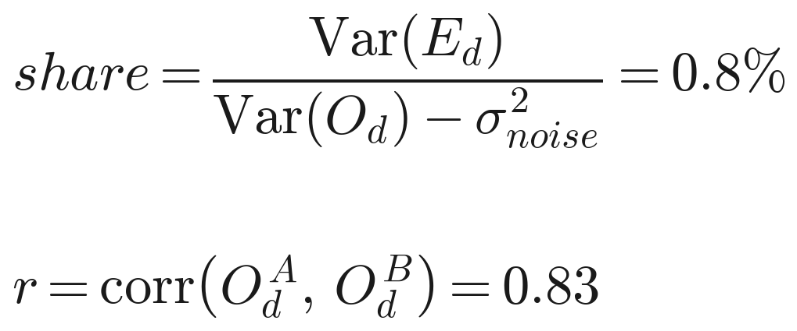
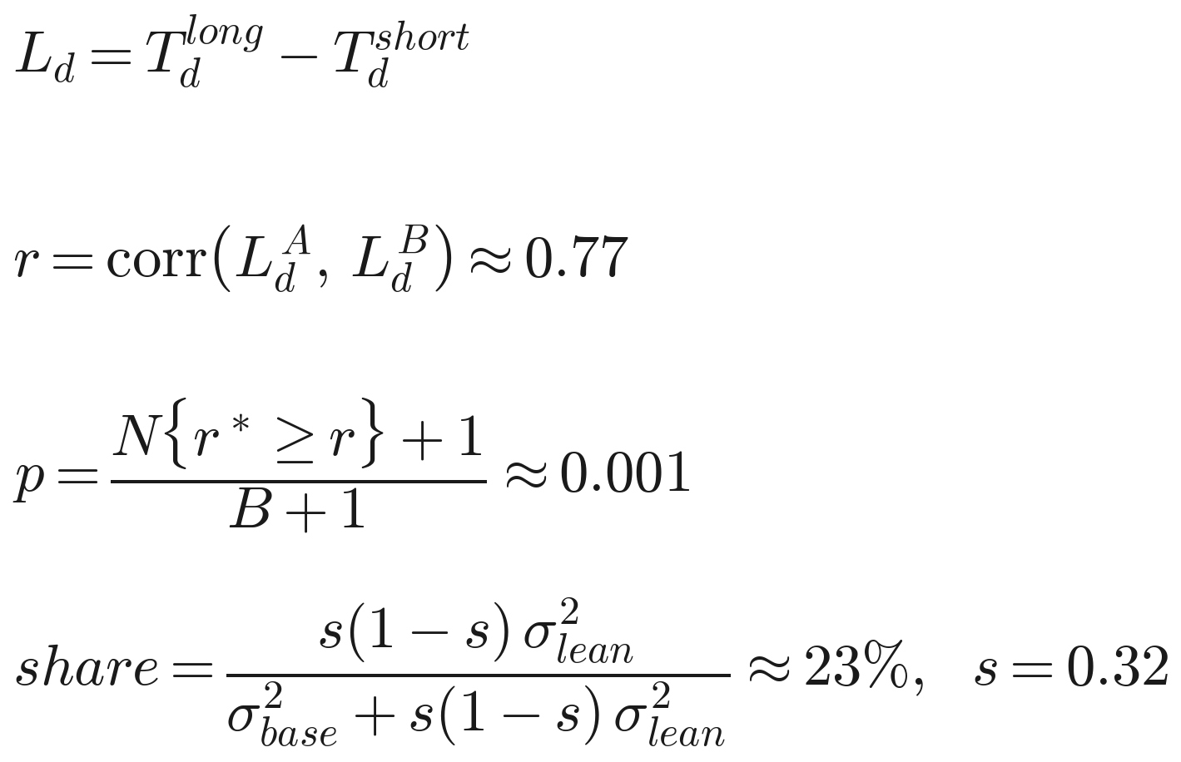
The maths, part 1: how each number is computed
Expected rate, leaving the driver out
What the offers explain, and stability
Trip-length lean, its test, its size
Var(O_d) − σ²_noise is the between-driver variance with sampling noise removed. A variance ratio, not a regression R² — the more generous construction for the request mix. 1% with rings, 2–3% with fine zones, 4% with a boosted model on raw coordinates. A = 17, 19, 21 Aug; B = 18, 20, 22 Aug; drivers with 20+ offers in each.
Notebook cells 17, 22
Cell c = pickup ring × 6-hour block. S = offers not accepted in the cell, N = offers in it; the driver's own are subtracted. O_d is what the driver actually did. σ_noise uses each driver's own rate p̂_d and count n_d, averaged over the 35 drivers (with the fleet rate instead it is ≈ 0.045). Observed spread across drivers: 0.19.
Notebook cells 10, 15–17
r* is the correlation after shuffling the long/short label within each driver and day-set, B = 1,000 times; the largest was 0.60. The variance split uses split-half covariances (set A × set B), so day-to-day noise cancels; s(1−s) turns a between-group gap into its per-offer variance, with s the share of offers that are long trips.
Notebook cells 29–31, 35
Nothing here is a fitted model: counting, correlation and a permutation test.
Notes:
Hold in reserve unless they ask how something was computed. The leave-driver-out formula is the one to derive on a whiteboard. If asked about the 23%: two independent routes to the repeatable driver variance agree — binomial subtraction gives σ 0.186, Spearman–Brown on the split-half gives 0.181.

Slide 13
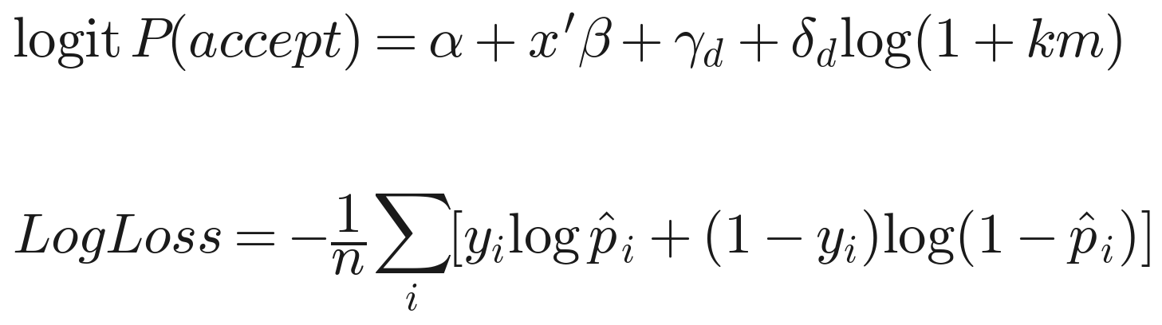
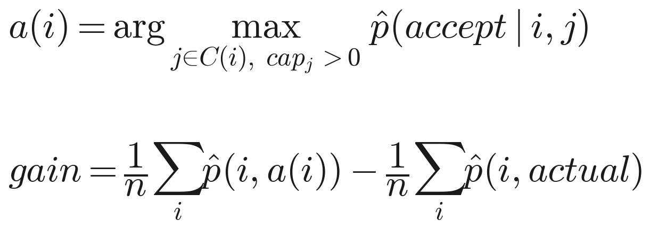
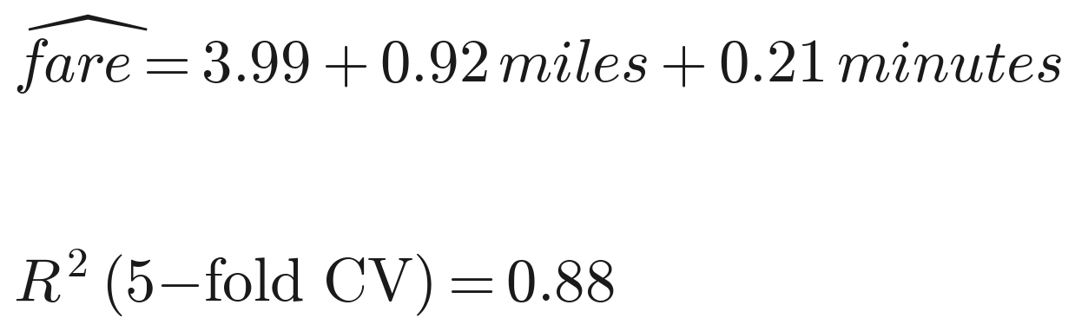
The maths, part 2: the models and how they were validated
Acceptance model, scored out of sample
Router
Guards against fooling myself
x: pickup ring, product, log trip km, 3-hour bins, scheduled. γ_d: the driver. δ_d: that driver's own slope on trip length. L2 regularised, strength chosen on the last training day only. Train 17–20 Aug, test 21–22 Aug; 90% intervals by resampling driver-days 1,000 times (300 for the mileage lead).
Notebook cells 39–44, 51–52
C(i): drivers seen in training with an offer in the same ring within 10 minutes, not on a trip, plus the actual driver. Two caps: nobody exceeds their actual test-day count (loose), or is ever more than 3 offers ahead of the work that had come their way (strict). Scored by each of the two models; the self-scored figure is discounted.
Notebook cells 55–62
Scrambled driver histories: that router scores itself about +4 too
Recent-behaviour features use only information 60+ seconds old; without the rule the gain doubled
Offers the uncapped router would move (38% of them) were accepted 32%, vs 44% for those it kept
Permutation tests rather than assumed distributions
Trip value: the fare regression above, 5-fold cross-validated.
Notebook cells 44, 62, 66–67
These two logistic models and the fare regression are the only fitted models in the analysis.
Notes:
If asked 'where's the ML?': two logistic models tested on days they never saw, plus one linear fare model. Dwell on the guards.

Slide 14
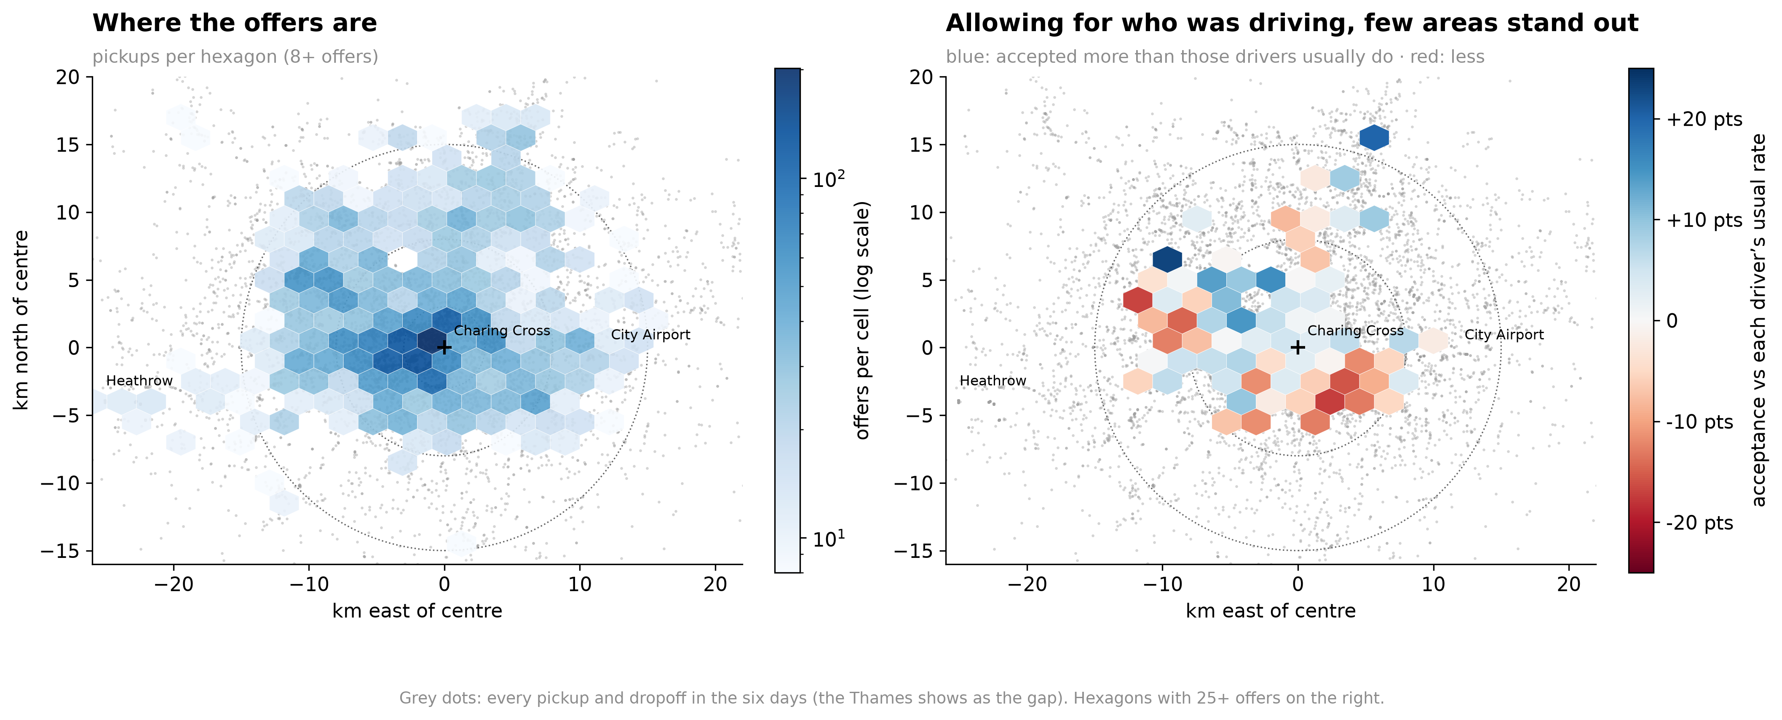
Appendix. Is it where they work? Mostly no: area averages reflect who was driving there
HOW I GOT THIS
2 km squares within 20 km of Charing Cross; keep the 59 with ≥30 offers. Square rates spread 0.11 vs 0.07 from chance — so places do differ.
But a square's rate correlates 0.65 with the usual rate of the drivers who happened to work there.
Remove the driver: each offer minus its own driver's usual rate; square means on set A vs set B repeat at only r = 0.31 (43 squares with ≥15 offers on each).
Notebook: Step 2 — cells 23–24, 27
Left
Where the work is: central and west London. Grey dots are every pickup and dropoff; the Thames shows as the gap.
Right
Acceptance against each driver's usual rate. Few areas stand out, and the pattern only weakly repeats across days (r = 0.31).
Why it matters
Raw area rates correlate 0.65 with the usual rate of the drivers working there, so a plain map would mislead.
Hexagons with 25+ offers; km east and north of Charing Cross.
Notes:
Thirty seconds unless they ask. A naive map would have sent me chasing bad areas that are really driver mix.

Slide 15
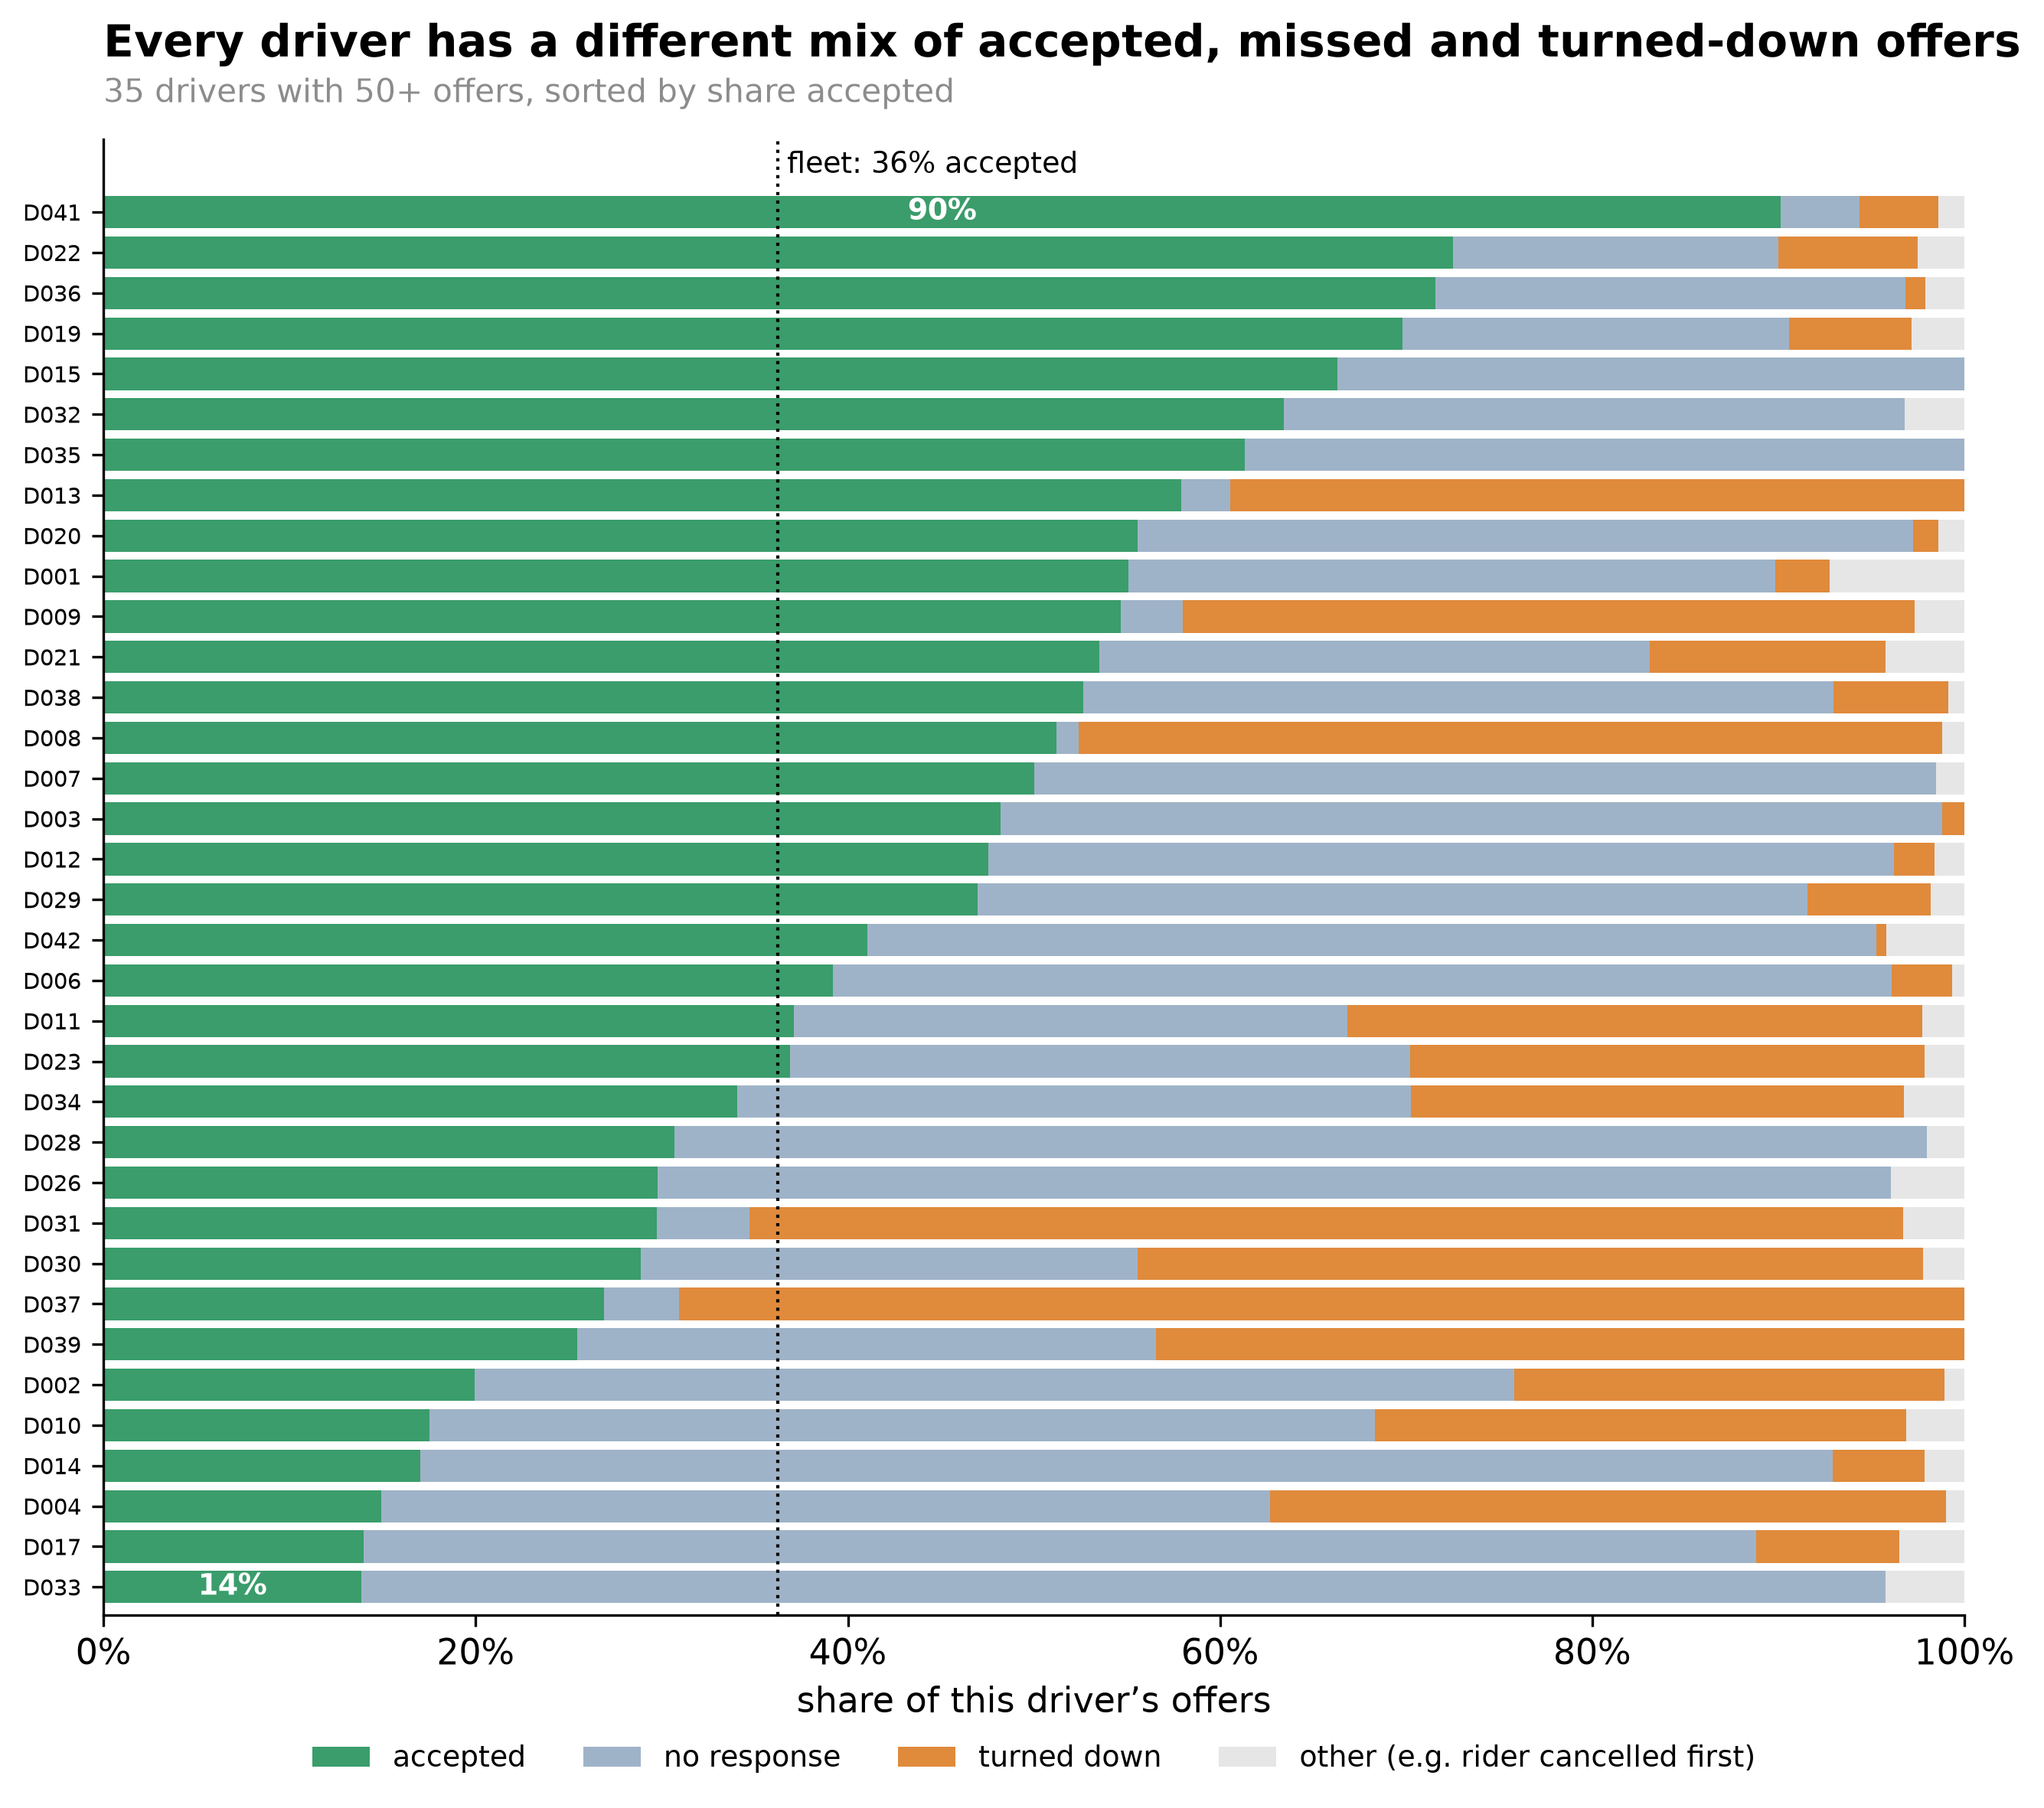
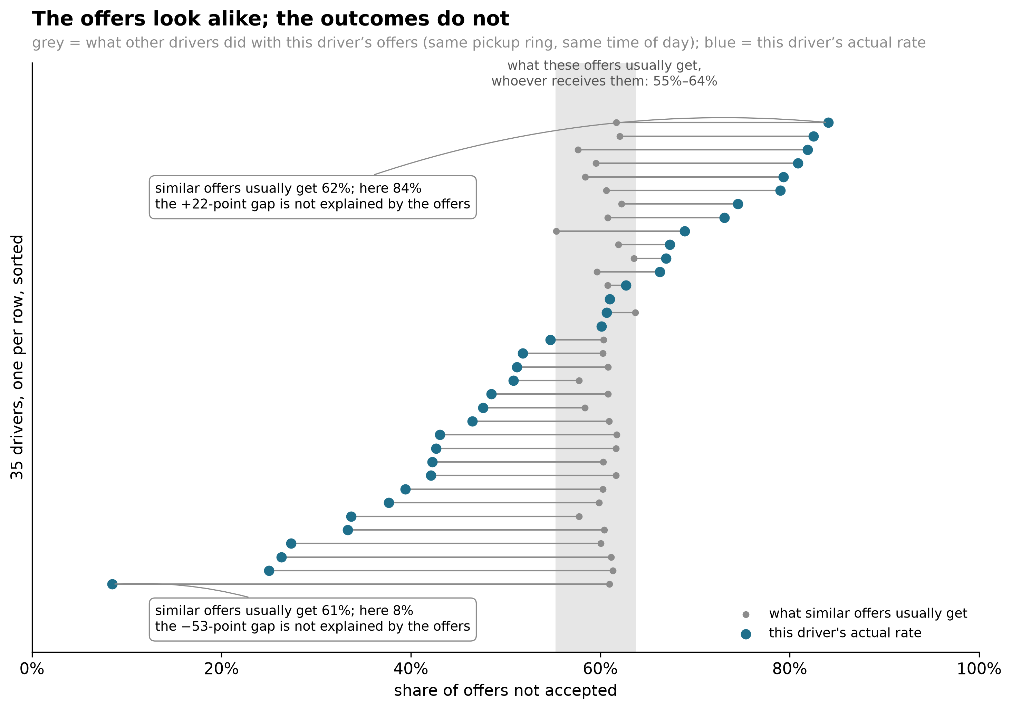
Appendix B. Two more views of the same evidence
Every driver misses in a different way
One bar per driver: accepted, no response, turned down, other. 21 of 35 miss almost entirely one way — 16 mostly silence, 5 mostly refusals. Cells 11–12.
The offers look alike; the outcomes do not
Grey dot: what other drivers did with this driver's offers (same ring, same time of day). Blue dot: this driver's actual rate. Every grey dot sits in 55–64%; the blue ones run 8–84%. Cells 17–19.
Both charts are the notebook's own outputs; slides 2 and 3 show the plainer versions.
Notes:
Only if asked. The stacked bars answer 'is 61% a rejection rate' visually: most of the misses are silence. The dumbbell chart is the per-driver version of slide 3.

