Slide 1
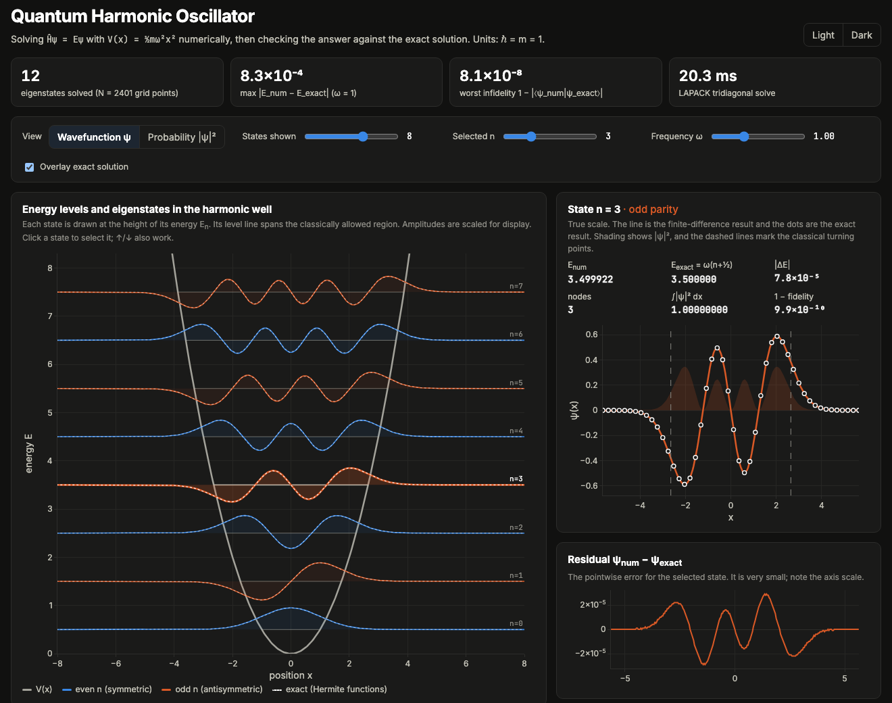
HACKATHON DEMO
Quantum Harmonic Oscillator
solved numerically, checked exactly
Turn the Schrödinger equation into a matrix, diagonalise it, and show that the eigenvalues land on ℏω(n + ½), in a visual you can explore live.
python -m qho.build → demo/index.html
Notes:
We solved the quantum harmonic oscillator numerically and checked every result against the exact textbook solution. The whole pipeline runs in milliseconds.

Slide 2
THE PHYSICS
Schrödinger equation with a harmonic potential
−(ℏ²/2m) ψ″(x) + ½ mω² x² ψ(x) = E ψ(x)
time-independent Schrödinger equation, V(x) = ½ mω² x²
What to look for
● Zero-point energy ½ℏω: the ground state never sits at the bottom of the well
● Equally spaced levels, ΔE = ℏω
● Parity (−1)ⁿ: even states are symmetric, odd states antisymmetric
● State n has exactly n nodes
● Tails leak past the classical turning points
Exact solution
E_n = ℏω (n + ½) n = 0, 1, 2, …
ψ_n(ξ) ∝ H_n(ξ) e^(−ξ²/2), ξ = x √(mω/ℏ)
Natural units: ℏ = m = ω = 1, so E_n = n + ½
Notes:
The harmonic oscillator is one of the few potentials with a closed-form solution, which makes it a good benchmark for a numerical solver.

Slide 3
HOW IT'S SOLVED
Numerical method: finite differences, then diagonalise
1 Grid
H (N × N, symmetric)
x_i ∈ [−L, L], spacing h, hard walls (ψ = 0 at the edges)
2 Stencil
ψ″(x_i) ≈ (ψ_{i−1} − 2ψ_i + ψ_{i+1}) / h² error O(h²)
3 Matrix
H is tridiagonal: diagonal 1/h² + V(x_i), off-diagonal −1/(2h²)
4 Solve
scipy.linalg.eigh_tridiagonal: lowest k eigenpairs only
5 Tidy
normalise so Σ ψ² h = 1, then align each sign with the exact ψ_n
■ 1/h² + V(x_i)
■ −1/(2h²)
Demo: L = 12, N = 2401, h = 0.01, 12 states
Notes:
Replacing the second derivative with a three-point stencil turns the Hamiltonian into a symmetric tridiagonal matrix. LAPACK finds its lowest eigenpairs in milliseconds.

Slide 4
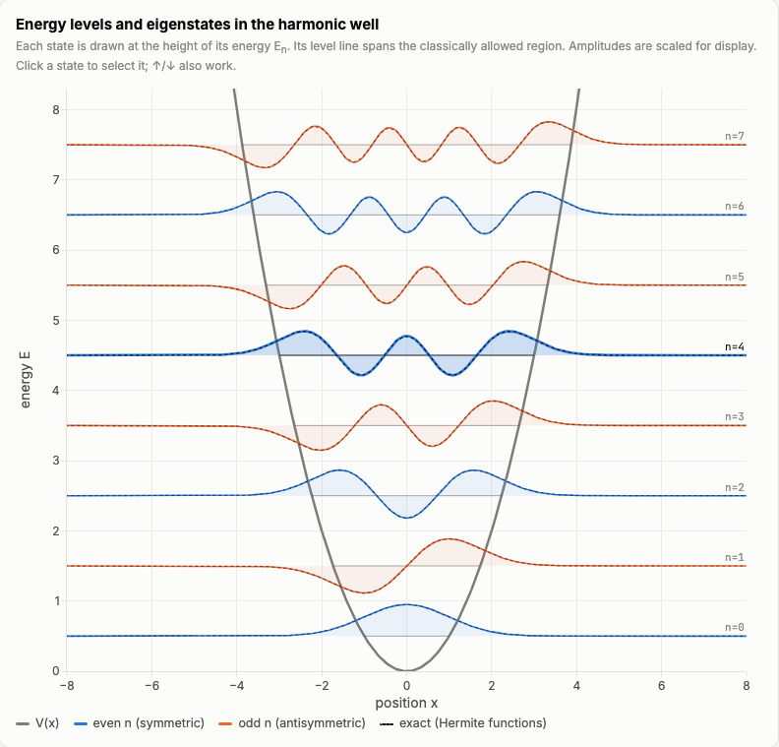
VISUALISATION
The central picture: states sit at their energies
Equal spacing
Levels are ℏω apart and start at ½ℏω, not at zero.
Parity by colour
Blue states are even and orange states are odd. State n has n nodes.
Beyond the turning points
ψ leaks into the classically forbidden region where V(x) > E. Each level line ends at a turning point.
Exact overlay
The dotted Hermite functions are indistinguishable from the finite-difference curves.
Notes:
Each eigenstate is drawn at the height of its energy inside the parabola. The dotted overlay is the exact Hermite function, and it lies on top of the numerical curve.

Slide 5
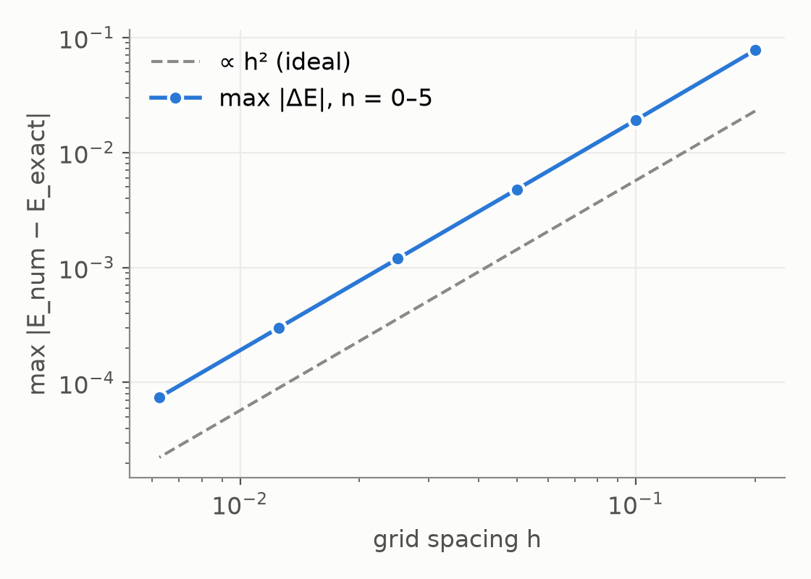
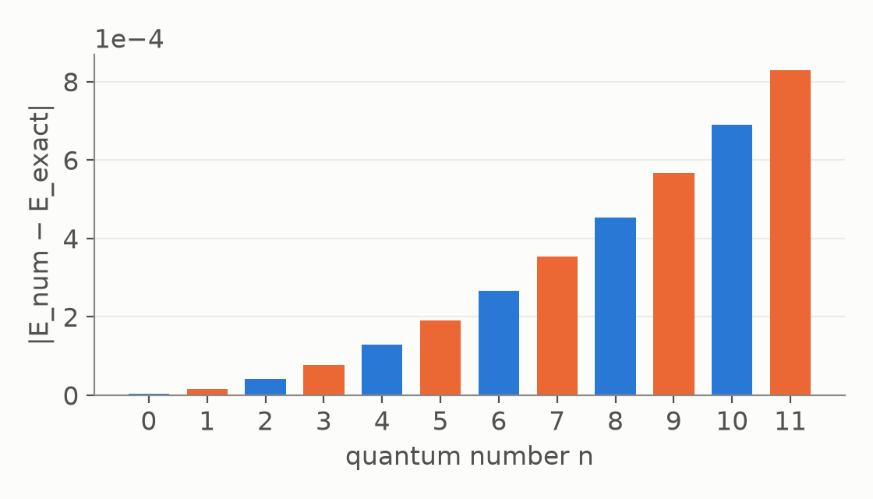
VALIDATION
Numerical vs analytical: it checks out
8.3e-04
8e-08
7e-16
×4.01
max |E_num − E_exact|, 12 states
worst 1 − |⟨ψ_num|ψ_exact⟩|
max |∫|ψ|² dx − 1|
error drop per halving of h (ideal ×4)
18 pytest checks
ascending order
E ≈ n + ½
spacing = ℏω
normalisation
orthogonality
parity (−1)ⁿ
n nodes
exact ψ match
O(h²) convergence
ω rescaling
small-box failure
build output
|ΔE| grows with n: finer detail needs a finer grid
Notes:
All 12 energies match n + ½ to within 8.3e-04. The error falls by about 4× each time the grid spacing halves, which is the signature of a second-order method.

Slide 6
HOW IT FITS TOGETHER
Demo and architecture
qho/solver.py
finite-difference Hamiltonian + eigh
qho/build.py
demo/index.html
solve, compare, embed as JSON
self-contained page, Plotly.js
qho/analytic.py
E_n = n + ½, Hermite functions
Controls
● View: ψ or |ψ|²
● States shown (1–12) and selected n
● ω slider (exact scaling law)
● Exact-solution overlay
● Click, ↑/↓ keys, URL presets
tests/
verifies solver and build
pytest: physics and build checks
$ pip install -r requirements.txt
$ python -m qho.build && open demo/index.html
$ pytest
Notes:
Python is the source of truth. The build step bakes the solution into a single HTML file that opens directly in a browser with no server.

Slide 7
WRAP-UP
Takeaways and limitations
What we showed
Limitations
● Finite differences reproduce E_n = n + ½ to 8e-04 with 2401 points in ~19 ms
● Wavefunctions match the Hermite functions (1 − fidelity < 1e-7)
● Second-order convergence is directly visible: ×4 per halving of h
● One picture shows the potential, the quantised levels, ψ, |ψ|² and the exact overlay
● Finite box with hard walls: high n needs a larger L (tested: a small box pushes the energies up)
● O(h²) error grows with n, so fine structure needs finer grids
● 1D, time-independent, harmonic potential only (the solver accepts any V(x), but only this one is validated)
● The ω slider rescales the ω = 1 result. This is identical to re-solving on a grid scaled by 1/√ω (tested)
Notes:
A 30-line solver reproduces the textbook oscillator to about 1e-3, and the error behaves exactly as the theory of the method predicts. The limitations below are known and tested.

