Slide 1
Building Cloud Weather Station
Viktor Tsykunov

Slide 2





Project Idea
Web Page – PowerBI Embedded
Azure Based Backend
with history
Skype BOT
Cross-platform App
Windows
WP
Android
IOS
Device with sensors
E-mail BOT
Outside temperature
Inside temperature
Humidity
Light

Slide 3
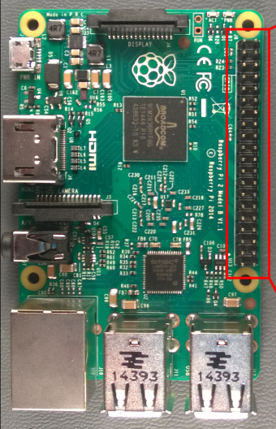
Solution Architecture
WebApp BOTs
LUIS
BOT Framework
PowerBI
Stream Analytics
IOT Hub
WebApp Dashboard
WebApp
Data Abs-traction
Raspberry Pi 2
Linux Raspberrian
DHT11 (Temperature, humidity)
XX external temperature
SQL Azure
Mobile Service

Slide 4
Goals
What I have (know)
Raspberry Pi2
Installed and configured script to get temperature and sent it to IOT Hub
Stream Analytics configured with PowerBI
What I want to learn
Use GIT
Work in the team on the project
Create WEB APIs
Understand how PowerBI Embedded works
Write Xamarin App
Write e-mail and Skype BOT
(hope it is not too much for a good team ☺)

