Slide 1






MAR-JAVA
CHAT
APP
A CHAT APP BASED ON JAVA

Slide 2

INTRODUCTION
01
OUTPUT
04
OVERVIEW
ABSTRACT
02
CONCLUSIONS
05
TECHNOLOGY USED
03
06
OUR TEAM

Slide 3
INTRODUCTION
THIS PROJECT “CHAT APP” AIMS TO DELIVER A VERSATILE AND USER-FRIENDLY CHAT APPLICATION THAT ENABLES REAL-TIME COMMUNICATION BETWEEN USERS. THE PROJECT IS DEVELOPED USING JAVA PROGRAMMING LANGUAGE, INCORPORATING VARIOUS TECHNOLOGIES AND CONCEPTS TO PROVIDE AN INTUITIVE AND SECURE CHAT EXPERIENCE.
THE APPLICATION UTILIZES THE SWING FRAMEWORK FOR CREATING A GRAPHICAL USER INTERFACE, ALLOWING USERS TO EXCHANGE TEXT messages, share multimedia files, and engage in seamless conversations .

Slide 4
ABSTRACT
THE "CHAT APP" PROJECT IS A JAVA-BASED CHAT APPLICATION DESIGNED TO FACILITATE REAL-TIME COMMUNICATION BETWEEN USERS. THE APPLICATION OFFERS A USER-FRIENDLY INTERFACE AND SUPPORTS CROSS-PLATFORM COMPATIBILITY, ALLOWING USERS TO CONNECT AND EXCHANGE MESSAGES SEAMLESSLY ACROSS DIFFERENT DEVICES. EMPHASIS IS PLACED ON SECURITY, WITH PLANS TO IMPLEMENT USER AUTHENTICATION AND END-TO-END ENCRYPTION TO ENSURE PRIVACY AND DATA PROTECTION. THE PROJECT'S FUTURE WORK INCLUDES THE DEVELOPMENT OF MOBILE APPLICATIONS AND ENHANCEMENTS TO AUTHENTICATION MECHANISMS.
OVERALL, THE "CHAT APP" PROJECT AIMS TO PROVIDE USERS WITH A SECURE, INTUITIVE, AND VERSATILE CHAT APPLICATION FOR EFFICIENT AND ENJOYABLE COMMUNICATION EXPERIENCES .

Slide 5


TECHNOLOGY USED
JAVA
SWING
THE MAIN PROGRAMMING LANGUAGE USED FOR DEVELOPING THE CHAT APP IS JAVA. JAVA IS A POPULAR AND VERSATILE LANGUAGE FOR DEVELOPING VARIOUS TYPES OF APPLICATIONS.
THE REPOSITORY UTILIZES THE SWING FRAMEWORK, WHICH IS A GRAPHICAL USER INTERFACE (GUI) TOOLKIT FOR JAVA. SWING PROVIDES A SET OF COMPONENTS AND UTILITIES FOR CREATING THE GRAPHICAL INTERFACE OF THE CHAT APP.
SOCKET
SERVER
THE PROJECT UTILIZES SOCKET PROGRAMMING TO ESTABLISH NETWORK CONNECTIONS AND ENABLE COMMUNICATION BETWEEN CLIENTS AND SERVERS. SOCKET PROGRAMMING ALLOWS FOR REAL-TIME MESSAGING AND DATA TRANSMISSION OVER NETWORKS.
THE CHAT APP IMPLEMENTS A CLIENT-SERVER ARCHITECTURE, WHERE CLIENTS CONNECT TO A SERVER TO EXCHANGE MESSAGES AND DATA. THIS ARCHITECTURE ALLOWS FOR CENTRALIZED COMMUNICATION MANAGEMENT AND FACILITATES REAL-TIME UPDATES ACROSS CLIENTS.

Slide 6
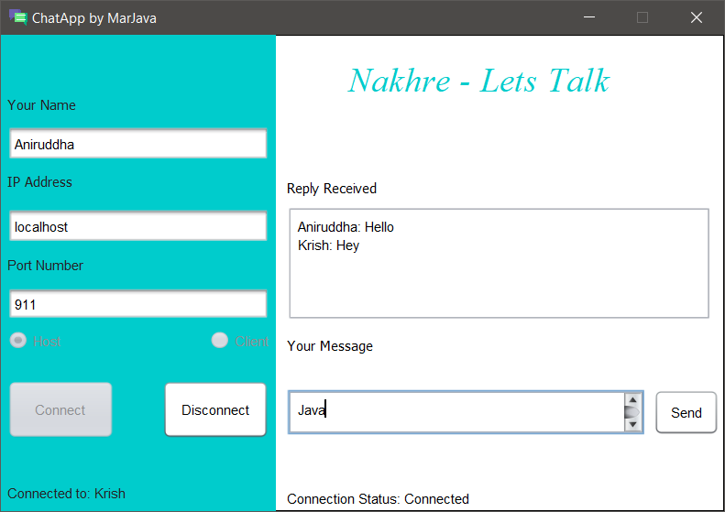
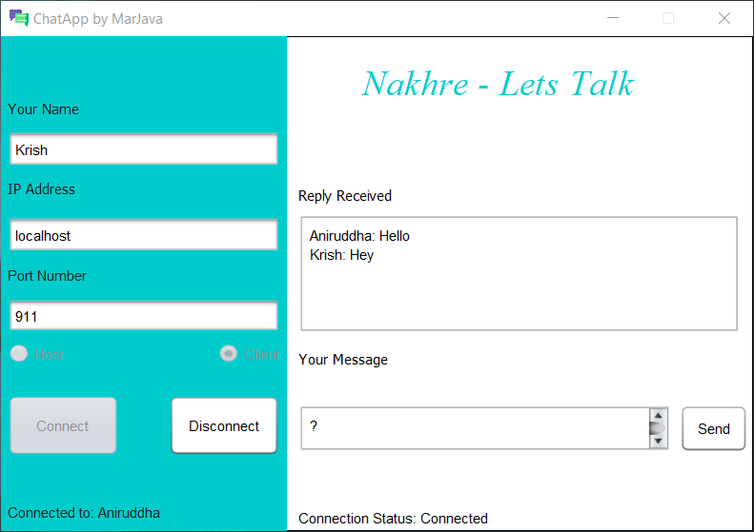



OUTPUT
HOST
CLIENT

Slide 7
CONCLUSTION
IN CONCLUSION, THE "CHAT APP" PROJECT HAS SUCCESSFULLY ACHIEVED ITS OBJECTIVE OF DEVELOPING A USER-FRIENDLY AND SECURE CHAT APPLICATION. BY UTILIZING JAVA AND INCORPORATING VARIOUS TECHNOLOGIES, WE HAVE CREATED A ROBUST PLATFORM THAT ENABLES REAL-TIME COMMUNICATION BETWEEN USERS. THE PROJECT'S EMPHASIS ON FEATURES LIKE CROSS-PLATFORM COMPATIBILITY, AND FUTURE ENHANCEMENTS SUCH AS USER AUTHENTICATION AND END-TO-END ENCRYPTION ENSURES A SEAMLESS AND PROTECTED CHAT EXPERIENCE. WITH THE POTENTIAL FOR FURTHER ADVANCEMENTS LIKE MOBILE APPLICATION DEVELOPMENT, THE "CHAT APP" PROJECT IS POISED TO CONTINUE PROVIDING USERS WITH A MEANS OF COMMUNICATION .

Slide 8


MAR-JAVA
OUR TEAM
@
@
@
KRISH SRIVASTAVA
(AP21110010302)
AYON SARKAR
(AP21110010286)
ANIRUDDHA DEWANGAN
(AP21110011194)
PARAS AGARWAL
(AP21110010324)
NAGESHWAR PRASAD YADAV
(AP21110011194)
SUMAN KUMAR
(AP21110010286)

