Slide 1

DCET-MITWPU
Distributed Server Process Manager with Containerisation
Domain: Cloud Computing, Distributed Systems, DevOps
In-house project, Group P91, Midterm review
Students with ERP nos: Ibrahim Ansari (1032233145), Chayan Raj Bharati (1032233134), Omkar Darekar (1032232336)
BTech Capstone Project Guide: Dr. Pratvina Vinayak Talele
In-house or industry sponsored: In-house
Number of times students met the Project Guide: 2
Slides approved by Project Guide: YES

Slide 2
Literature Survey (1/4)
Sr | Title, authors, venue | Methodology | Pros | Cons
1 | Crash-Only Software. G. Candea, A. Fox, 2003. HotOS IX (conference, USENIX). | Position paper. Argues from failure data and design principles that restart should be the only recovery path, and that components must be crash-safe. | Restart-as-recovery is cheap and predictable. Justifies restart policies and crash counters in a process manager. | No concrete manager for a mixed set of apps across machines. Assumes state already lives outside the process.
2 | An Updated Performance Comparison of Virtual Machines and Linux Containers. W. Felter, A. Ferreira, R. Rajamony, J. Rubio, 2015. IEEE ISPASS (conference). | Benchmarks. CPU, memory bandwidth, network and disk microbenchmarks plus Redis and MySQL workloads on native, Docker and KVM. | Shows Docker overhead is near zero for CPU and memory, with measurable costs only in some I/O paths. Justifies container-by-default. | Single host, one container runtime. Does not cover Podman, systemd units, or start-up latency for short-lived processes.
3 | Large-scale cluster management at Google with Borg. A. Verma, L. Pedrosa, M. Korupolu, D. Oppenheimer, E. Tune, J. Wilkes, 2015. EuroSys (conference, ACM). | System description plus analysis of production traces: job mix, utilisation, failure and eviction rates across cells. | Shows what per-task resource limits, health checks and automatic restart buy at scale. Source of the isolation and limit ideas. | Requires a central master, a dedicated scheduler and thousands of machines. Not a fit for a small self-hosted cluster.

Slide 3
Literature Survey (2/4)
Sr | Title, authors, venue | Methodology | Pros | Cons
4 | Container-based Operating System Virtualization: A Scalable, High-performance Alternative to Hypervisors. S. Soltesz, H. Pötzl, M. E. Fiuczynski, A. Bavier, L. Peterson, 2007. EuroSys (conference, ACM). | System design plus benchmarks. Compares Linux-VServer containers with Xen on CPU, network and disk workloads and on density. | Origin of the isolation-versus-overhead argument. Containers give near-native performance and higher density than VMs. | Pre-dates Docker and cgroup v2. Measures VServer, not the runtimes we use. No process-manager view.
5 | CAP Twelve Years Later: How the 'Rules' Have Changed. E. Brewer, 2012. IEEE Computer (journal). | Retrospective essay. Re-examines the CAP theorem against a decade of systems and proposes partition-recovery design patterns. | If data and work stay together, the part that is still running keeps running during a partition. Argues for self-managing nodes. | Theory. Does not say how to split a control panel from the processes it manages, or how to share sessions between nodes.
6 | Borg, Omega, and Kubernetes. B. Burns, B. Grant, D. Oppenheimer, E. Brewer, J. Wilkes, 2016. ACM Queue (journal). | Experience report. Compares three generations of Google's container managers and records the lessons that carried over. | Container-first scheduling with resource limits. Labels, controllers and the pod model come from production experience. | Built for data-centre scale. Too heavy for two or three nodes. No live console or file manager for an operator.

Slide 4
Literature Survey (3/4)
Sr | Title, authors, venue | Methodology | Pros | Cons
7 | Communicating and Displaying Real-Time Data with WebSocket. V. Pimentel, B. G. Nickerson, 2012. IEEE Internet Computing (journal). | Measurements. Compares WebSocket against HTTP polling and long polling for latency and overhead on live data streams. | Shows why WebSocket is the right channel for a live console: lower latency and less overhead than polling. | Sensor-data use case, not process consoles. No authentication or multi-host discussion.
8 | Containers and Cloud: From LXC to Docker to Kubernetes. D. Bernstein, 2014. IEEE Cloud Computing (journal). | Survey article. Traces LXC, Docker and Kubernetes and explains images, layers, namespaces and cgroups. | Places container runtimes and orchestrators in one picture. Explains what a container adds over a bare process. | No measurements. Written before Podman and rootless containers. Nothing on single-host managers.
9 | Architectural Styles and the Design of Network-based Software Architectures. R. T. Fielding, 2000. PhD dissertation, UC Irvine. | Derives the REST constraints by adding one constraint at a time to a null style and evaluating each against network properties. | Defines REST. Shows why HTTP works for managing remote resources without a shell: stateless requests, uniform interface, cacheable, layered. | No treatment of long-lived two-way streams (a live console) or of process control. Architectural, not operational.

Slide 5
Literature Survey (4/4)
Sr | Title, authors, venue | Methodology | Pros | Cons
10 | The WebSocket Protocol, RFC 6455. I. Fette, A. Melnikov, 2011. IETF Standards Track (standard). | Protocol specification: handshake over HTTP, framing, masking, close semantics, defined through the IETF standards process. | One TCP connection in both directions over the usual HTTP ports and proxies. Fits a browser console with input and output. | Transport only. No login model, no per-connection authorisation, nothing about multiplexing consoles from several hosts.
11 | systemd service management. Z. Jędrzejewski-Szmek, J. B. Guðmundsson, 2016. USENIX ;login: (magazine article). | Practitioner article. Describes unit files, dependency ordering, socket activation and cgroup-based resource control by example. | Restart policies, cgroup limits and supervision on one Linux host. Units survive the restart of whatever started them. | One host only. No HTTP API, web UI or browser console. Needs a shell. Nothing about a cluster view.

Slide 6
Research Gaps (1/2)
1
Single-host managers have no HTTP interface
REST is the established way to manage a remote resource without a shell [9]
systemd [11], Supervisor and runit do not offer an HTTP API, a web UI or a browser console
Routine work on these tools still goes through SSH
2
Restart-based recovery stops at one machine
Crash-only design treats restart as the normal recovery path [1]
systemd [11] and PM2 apply it per host
Nothing gives two or three self-hosted nodes one login and one view
3
The WebSocket standard covers transport only
RFC 6455 defines the channel [10]; measurements show it beats polling on latency [7]
The protocol has no login or per-connection ticket model
Tools that do ship a console bundle it with a panel stack and a database

Slide 7
Research Gaps (2/2)
4
Panel tools make the panel a single point of control
CAP guidance is to keep work on the node so it survives a partition [5]
In Pterodactyl, Pelican and PufferPanel, a panel outage stops all administration
Nodes should keep managing themselves; the panel should only display
5
Isolation is available at cluster scale or not at all
Borg and Kubernetes provide limits and health checks through a central scheduler [6][3]
Simple managers run apps as bare processes with no CPU or memory limit
Container overhead is low enough for default use [2][4]; small clusters still lack a light tool [8]
6
The execution backend is fixed per tool
systemd units [11] and Docker containers [4] are chosen by the tool, not per app
An operator should be able to run one app in-process, one under the OS supervisor, one in a container
Only the last two survive a restart of the manager itself

Slide 8
Problem Statement
What we are building
What is out of scope
Octyne: a server process manager in Go, one binary per node
One HTTP and WebSocket API for start, stop, kill, console and files [9][10]
Login once; token shared across nodes through Redis
Each node keeps running its apps if the dashboard is down [5]
Per-app CPU, memory and uptime on every node
A ProcessRenderer backend with three modes: integrated, systemd, docker
Docker mode gives each app an image, CPU and memory limits, a volume and a restart policy [4][8]
Restart on crash in every mode [1]
No automatic scheduler. The operator picks the node [6][3]
No central database. Redis holds tokens only
No game templates or app catalogue
No orchestration of multi-container apps

Slide 9
Comparative Analysis of Existing Tools
System | Started | Language | License | Console | Files | HTTP API | Web UI | Multi-node | Docker | General apps | Local CLI
Octyne (our system) | 2019 | Go | Apache-2.0 | Yes | Yes | Yes | Yes | Federated | Optional (CLI) | Yes | Yes
systemd [11] | 2010 | C | LGPL-2.1 | No | No | No | No | No | n/a | Yes | Yes
Supervisor | 2004 | Python | BSD-derived | Partial | No | Partial | Partial | No | No | Yes | Yes
daemontools / runit / s6 | 1990s–2000s | C | Public domain / various | No | No | No | No | No | No | Yes | Yes
PM2 | 2013 | JavaScript | AGPL-3.0 (core) | Partial | No | Partial | Partial | Partial | No | Partial | Yes
GNU Screen / tmux | 1987 / 2007 | C | GPL | Yes | No | No | No | No | No | Yes | Yes
SSH / SFTP | 1995 | C (OpenSSH) | BSD-style | Yes | Partial | No | No | No | n/a | Yes | Yes
Pterodactyl | 2015 | PHP + Go | MIT | Yes | Yes | Yes | Yes | Central DB | Always (API) | Partial | Partial
Pelican Panel | 2024 | PHP + Go | AGPL-3.0 | Yes | Yes | Yes | Yes | Central DB | Always (API) | Partial | Partial
PufferPanel | 2013 | Go + Vue | Apache-2.0 | Yes | Yes | Yes | Yes | Partial | Partial | Partial | Partial
MCSManager | 2018 | TypeScript | Apache-2.0 | Yes | Yes | Yes | Yes | Yes | Yes | Partial | Partial
Crafty Controller | 2018 | Python | GPL-3.0 | Yes | Yes | Partial | Yes | No | No | No | No
AMP (CubeCoders) | 2010s | C# / proprietary | Commercial | Yes | Yes | Yes | Yes | Yes | Partial | Partial | Partial
Closest matches: PufferPanel and Pterodactyl. Octyne needs no game template, no required container and no panel stack: one Go binary, a command and a folder.

Slide 10
Requirements Gathering: functional and non-functional
Each requirement follows from a gap. O1 to O5 are the project objectives. [n] points to the survey.
Functional
Non-functional
FR1 ServerConfig per app: directory, command, renderer, image, limits, restart policy (O1)
FR2 ProcessRenderer with integrated, systemd and docker modes [11][4] (O2)
FR3 Start, stop, kill through the renderer; restart on crash [1] (O3)
FR4 Live console over WebSocket with a one-time ticket [7][10] (O3)
FR5 File manager under the app directory: list, upload, download, move, compress (O3)
FR6 Log in once; token valid on every node via Redis [5] (O1)
FR7 Per-app CPU, memory, uptime through GET /server/{id} (O4)
FR8 The Web UI dashboard shows every node's load and reachability; operator picks the node (O4)
FR9 Web UI dashboard: node list, servers, console, files (O5)
FR10 octynectl for the same actions over the Unix socket (O3)
NFR1 Isolation: in docker mode an app cannot pass its CPU or memory limit or touch other apps' files [4]
NFR2 Availability: a node keeps its apps running if the Web UI dashboard or another node is down [5]
NFR3 Recovery: systemd and docker modes keep apps up across an Octyne restart [11]
NFR4 Footprint: one static Go binary per node; Redis is the only shared service
NFR5 Security: token on every API call; console needs a fresh ticket; file paths stay under the app directory
NFR6 Performance: overhead of systemd and docker modes vs integrated is measured [2] (O5)
NFR7 Portability: any Linux host; docker mode works with Docker or Podman
NFR8 Usability: day-to-day work needs no SSH session [9]

Slide 11
Requirements Gathering: hardware and software
Hardware | Justification
Laptop or desktop, multi-core CPU, 8 GB RAM minimum | Go toolchain, Docker Engine and the Next.js dev server run at the same time
Two to three machines, physical or virtual (nodes) | Shared login and the dashboard node list need more than one machine
LAN or Internet connection | Node-to-node API calls, Redis access, image pulls from a registry
Software | Justification
Ubuntu Linux 24.04 | Stable systemd, Docker and cgroup v2. Same OS on every node
Go 1.22+ | Octyne is Go. One static binary per node
systemd (D-Bus API) and Docker Engine or Podman API | The two external ProcessRenderer backends [11][4]
Redis 7 | Shared token store for RedisAuthenticator. TTL handles expiry
Node.js, Next.js / React | Web UI dashboard: console, files, node list
REST + WebSocket, Git, VS Code | One API for the Web UI dashboard and octynectl. Version control and review

Slide 12
Project Timeline Diagram
Aug 2026
Sep 2026
Oct 2026
Nov 2026
Dec 2026
Status
Literature survey and comparative analysis
Done
Synopsis (Level 2) and requirements
Done
Architecture, ServerConfig model, API and session design
Done
M2 Connector: auth, API, console, files (Ibrahim)
In progress
M3 Metrics, node list, tests (Omkar)
In progress
M4 Web UI dashboard and octynectl (Chayan)
In progress
M1 ProcessRenderer: systemd and docker modes (Chayan)
Not started
Integration tests and renderer benchmarks (Omkar)
Not started
Documentation, papers and final review
Not started
Midterm review, 24 Sep 2026
Study and design
Module implementation
Testing and closure
Work completed so far

Slide 13
System Design (Team): architecture
HTTPS
Exists in Octyne today
Operator
Web UI dashboard
Next.js, one instance for all nodes
Added by this project
External service or runtime
REST + WebSocket
REST + WebSocket
Node 1
octynectl (CLI)
Node 2
Octyne (Go binary)
Octyne (Go binary)
Unix socket
Connector: HTTP + WebSocket API
/login /ott /servers /server/{id} /console /files
Connector: HTTP + WebSocket API
/login /ott /servers /server/{id} /console /files
Redis
shared login tokens
Ticket store
one-time console tickets
RedisAuthenticator
token check on every call
RedisAuthenticator
token check on every call
Ticket store
one-time console tickets
Process ×N
StartProcess, StopProcess, KillProcess, MonitorProcess
Process ×N
StartProcess, StopProcess, KillProcess, MonitorProcess
ProcessRenderer (new)
chosen per app from ServerConfig
ProcessRenderer (new)
chosen per app from ServerConfig
integrated
systemd (new)
docker (new)
integrated
systemd (new)
docker (new)
OS process
in Octyne's process tree
systemd unit
survives Octyne restart
Docker / Podman container
image, limits, volume
OS process
in Octyne's process tree
systemd unit
survives Octyne restart
Docker / Podman container
image, limits, volume

Slide 14
System Design (Team): modules and how it works
Modules
How a request flows
1
ProcessRenderer backend
The Web UI dashboard or octynectl calls the Connector on one node
Connector asks the Authenticator to validate the token; RedisAuthenticator looks it up in the shared Redis
A start action reaches Process.StartProcess, which hands the ServerConfig to the ProcessRenderer named in it
integrated runs the command in Octyne's own process; systemd creates a transient unit; docker creates a container with limits and a volume
MonitorProcess polls CPU, memory and uptime and serves them on GET /server/{id}
For a console, the client fetches a one-time ticket (GET /ott), then opens the WebSocket; output is fanned out to every attached client
If the Web UI dashboard goes down, every node keeps running; octynectl still works locally
Interface plus integrated, systemd and docker modes; ServerConfig fields for image, limits, restart policy
Chayan Raj Bharati (after midterm)
2
Connector: auth, API, console, files
Authenticator (Memory / Redis), one-time tickets, WebSocket console, file endpoints
Ibrahim Ansari
3
Monitoring and tests
MonitorProcess stats, dashboard node list, integration tests, benchmarks
Omkar Darekar
4
Web UI dashboard and octynectl
Node list, server pages, console, file manager; CLI over the Unix socket
Chayan Raj Bharati

Slide 15
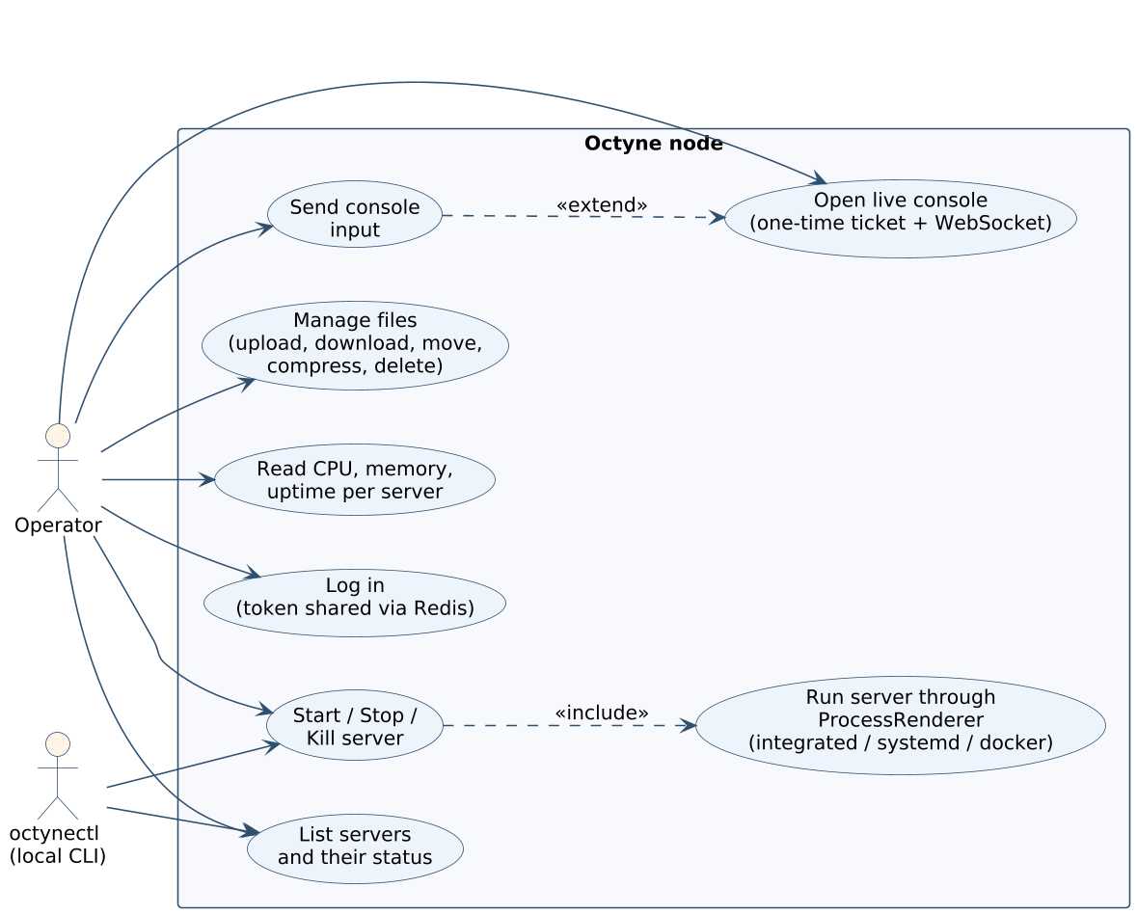
System Design (Team): use case diagram
Notes
Two actors: the operator (through the Web UI dashboard) and octynectl on the same host
Login is one use case; the token it returns is valid on every node [5]
Console access needs a one-time ticket first, then the WebSocket [10]
Start, stop and kill go through the ProcessRenderer, whichever mode is set
CPU, memory and uptime per server come from MonitorProcess

Slide 16
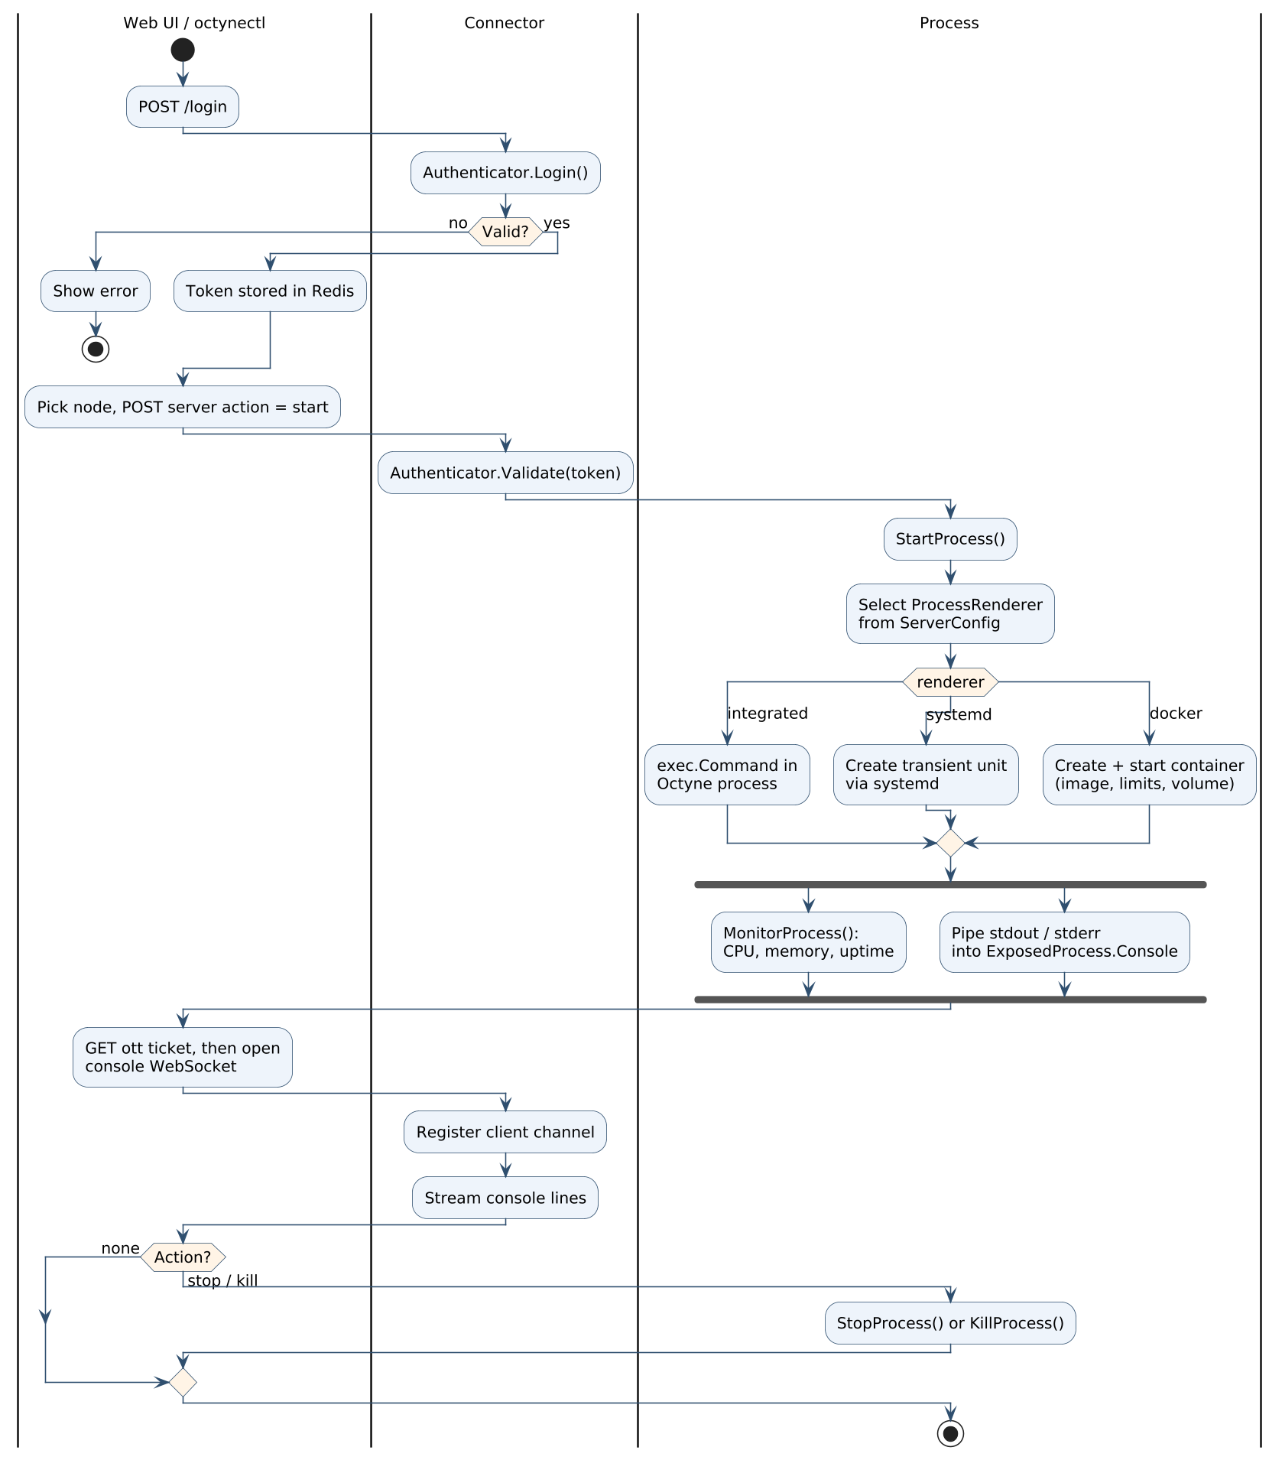
System Design (Team): activity diagram
Notes
Authenticator.Login runs first; the token lands in Redis
A start action is sent to one node; Connector validates the token on that node
StartProcess picks integrated, systemd or docker from ServerConfig
Two things run in parallel after start: MonitorProcess and console piping
Stop and kill go back through the same Process methods

Slide 17
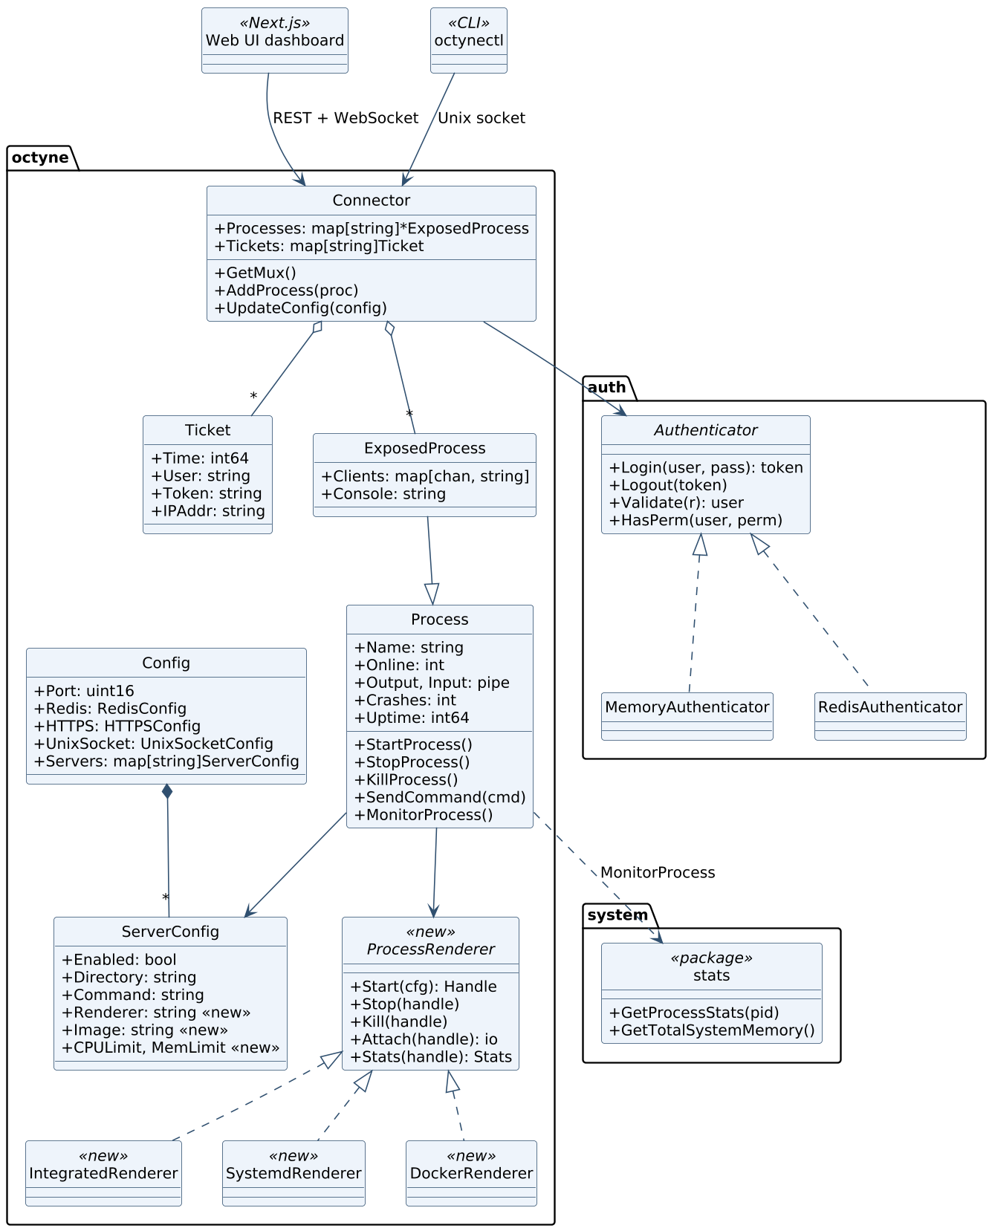
System Design (Team): class diagram
Notes
Connector holds ExposedProcess entries and Tickets, and delegates auth to the Authenticator interface
MemoryAuthenticator and RedisAuthenticator are Octyne's two implementations
ExposedProcess extends Process with the console buffer and client channels
ProcessRenderer and its three implementations are new; ServerConfig gains renderer, image and limit fields
The Web UI dashboard and octynectl are the two clients of the Connector

Slide 18
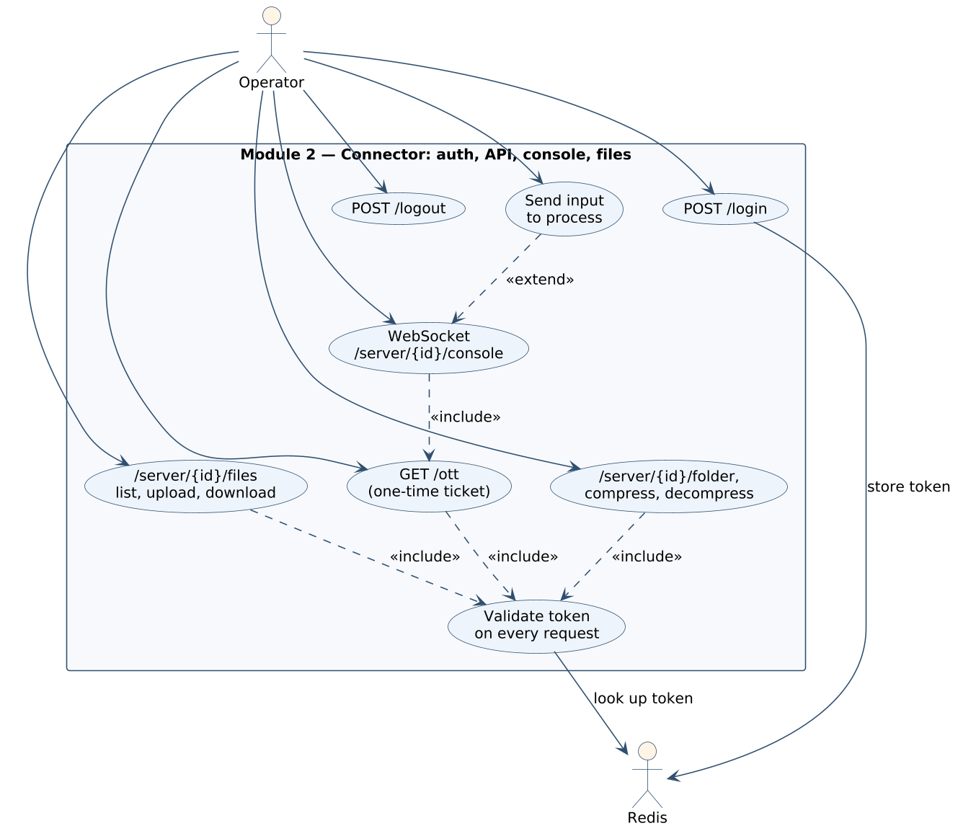
System Design (Individual): Ibrahim Ansari
Module 2: Connector, auth, API, console, files. PRN 1032233145. Objectives 1 and 3.
My part
Use case diagram
Authenticator interface, MemoryAuthenticator and RedisAuthenticator; shared tokens [5]
Endpoints: /login, /logout, /ott, /servers, /server/{id}
One-time Ticket then WebSocket /server/{id}/console; fan-out to ExposedProcess.Clients [10]
File endpoints under ServerConfig.Directory: files, file, folder, compress, decompress
Dependencies
Provides the API and token check used by the Web UI dashboard and octynectl
Calls Process.StartProcess / StopProcess / KillProcess; the renderer behind them is Module 1
Returns MonitorProcess figures from Module 3 in GET /server/{id}

Slide 19
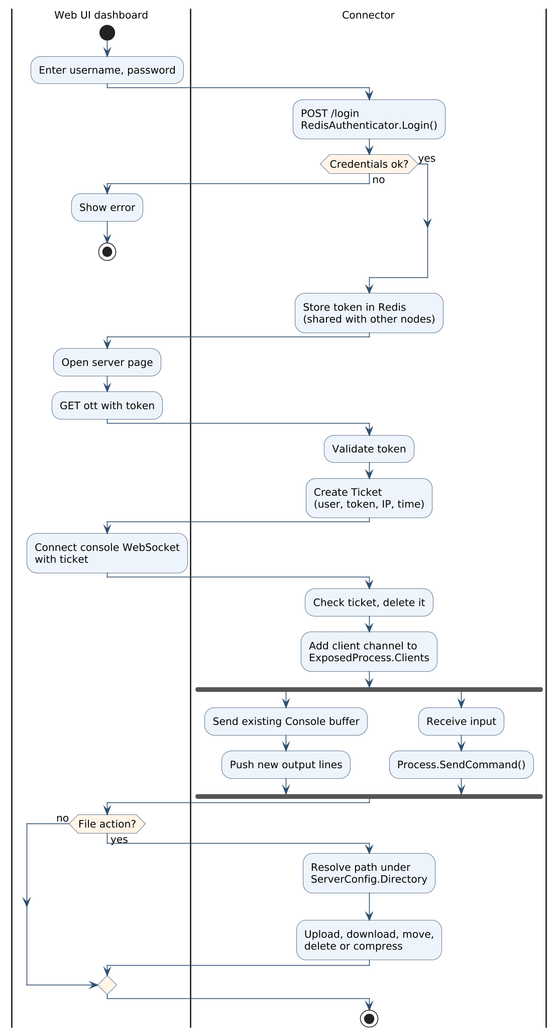
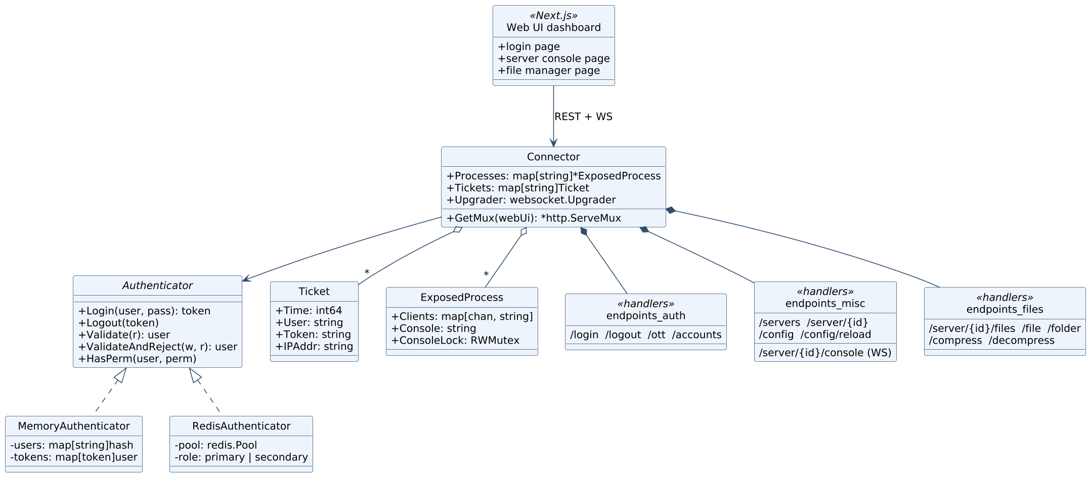
Ibrahim Ansari: activity and class diagrams
Activity diagram
Class diagram

Slide 20
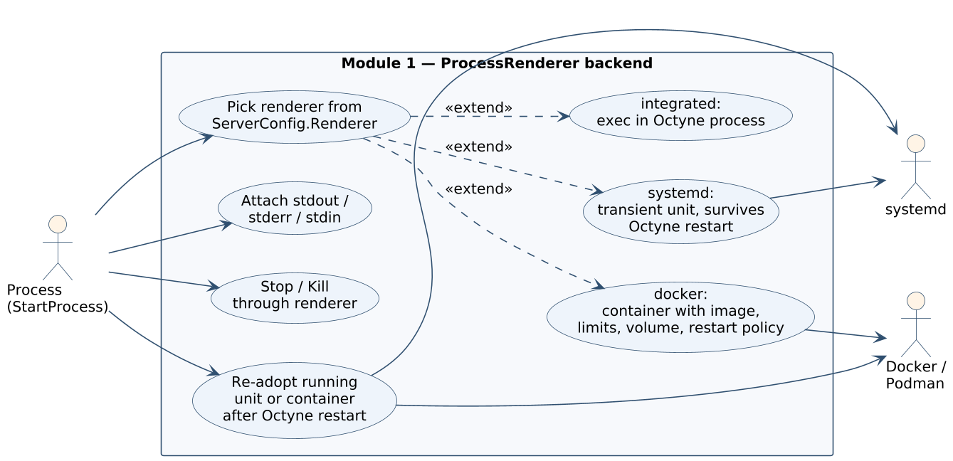
System Design (Individual): Chayan Raj Bharati
Module 4 now, Module 1 after midterm: Web UI dashboard and octynectl, then ProcessRenderer. PRN 1032233134. Objectives 2 and 5.
My part
Use case diagram (Module 1, ProcessRenderer)
Web UI dashboard: node list, server pages, console, file manager (in progress)
octynectl over the Unix socket (in progress)
Later: ProcessRenderer interface with Start, Stop, Kill, Attach, Stats, Adopt
Later: IntegratedRenderer (exec), SystemdRenderer (transient unit, survives Octyne restart) [11], DockerRenderer (Docker or Podman; image, limits, volume, restart policy) [4]
Dependencies
The Web UI dashboard uses Module 2's API and tickets, and Module 3's node list
ProcessRenderer is called by Process.StartProcess (Module 2 side) and reports Stats to MonitorProcess (Module 3)
New ServerConfig fields (renderer, image, limits) are read by Module 1 and shown by Module 4

Slide 21
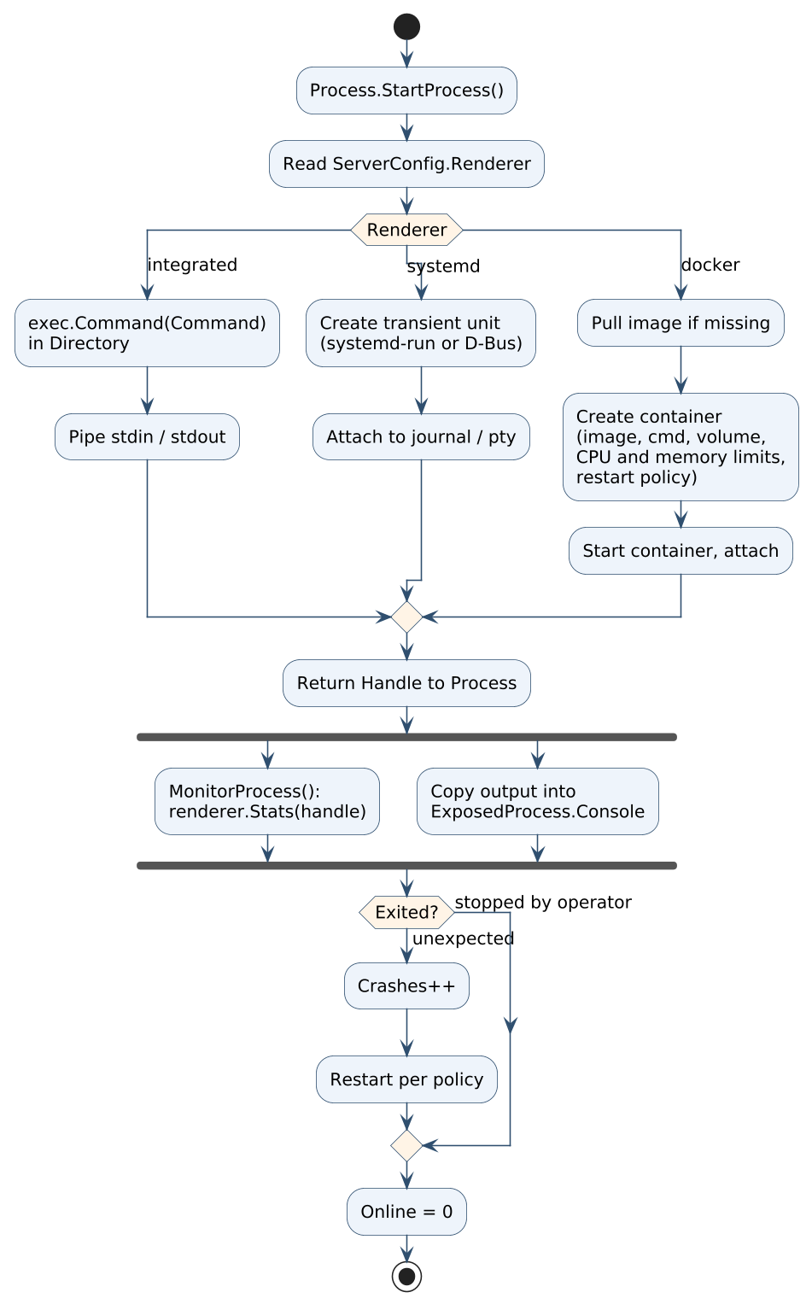
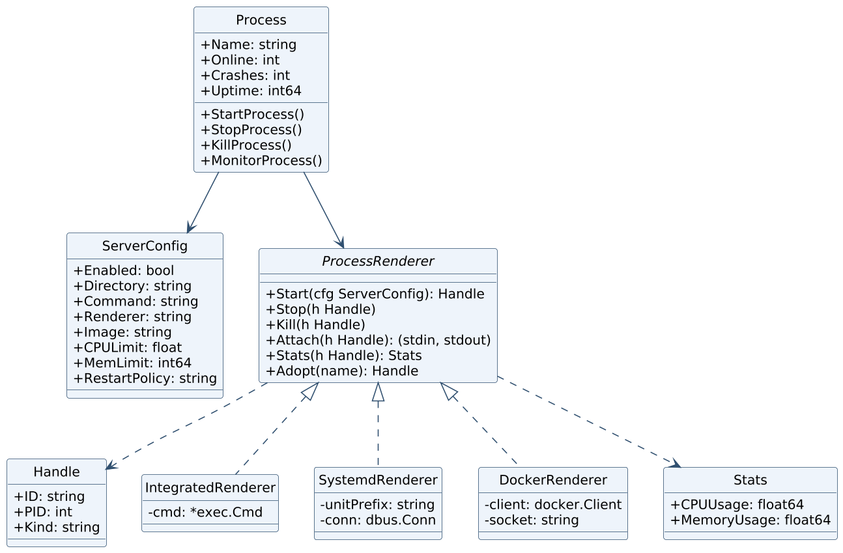
Chayan Raj Bharati: activity and class diagrams
Activity diagram (Module 1, ProcessRenderer)
Class diagram

Slide 22
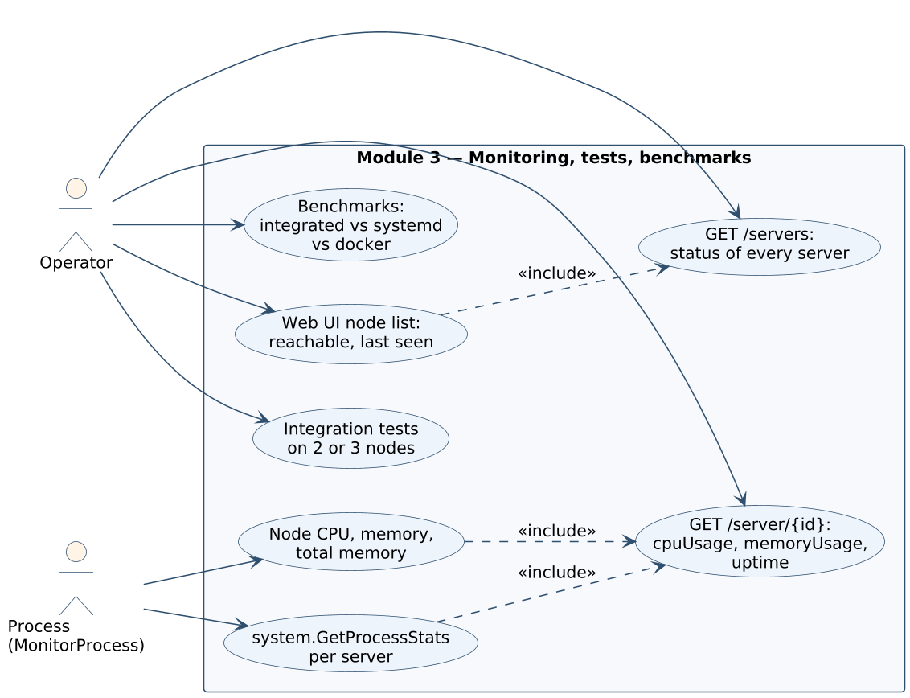
System Design (Individual): Omkar Darekar
Module 3: Monitoring, tests, benchmarks. PRN 1032232336. Objectives 4 and 5.
My part
Use case diagram
MonitorProcess: CPU, memory, uptime per server through the system package or renderer.Stats
Node CPU, total memory and per-server figures in GET /servers and GET /server/{id}
Dashboard node list: reachable (GET /servers answers), last seen, load per node
Integration tests on two or three nodes; benchmarks of integrated vs systemd vs docker [2]
Dependencies
Reads Stats from Module 1's renderer once it lands; until then from the system package
Serves figures through Module 2's GET /servers and GET /server/{id}
Node list is rendered by Module 4

Slide 23
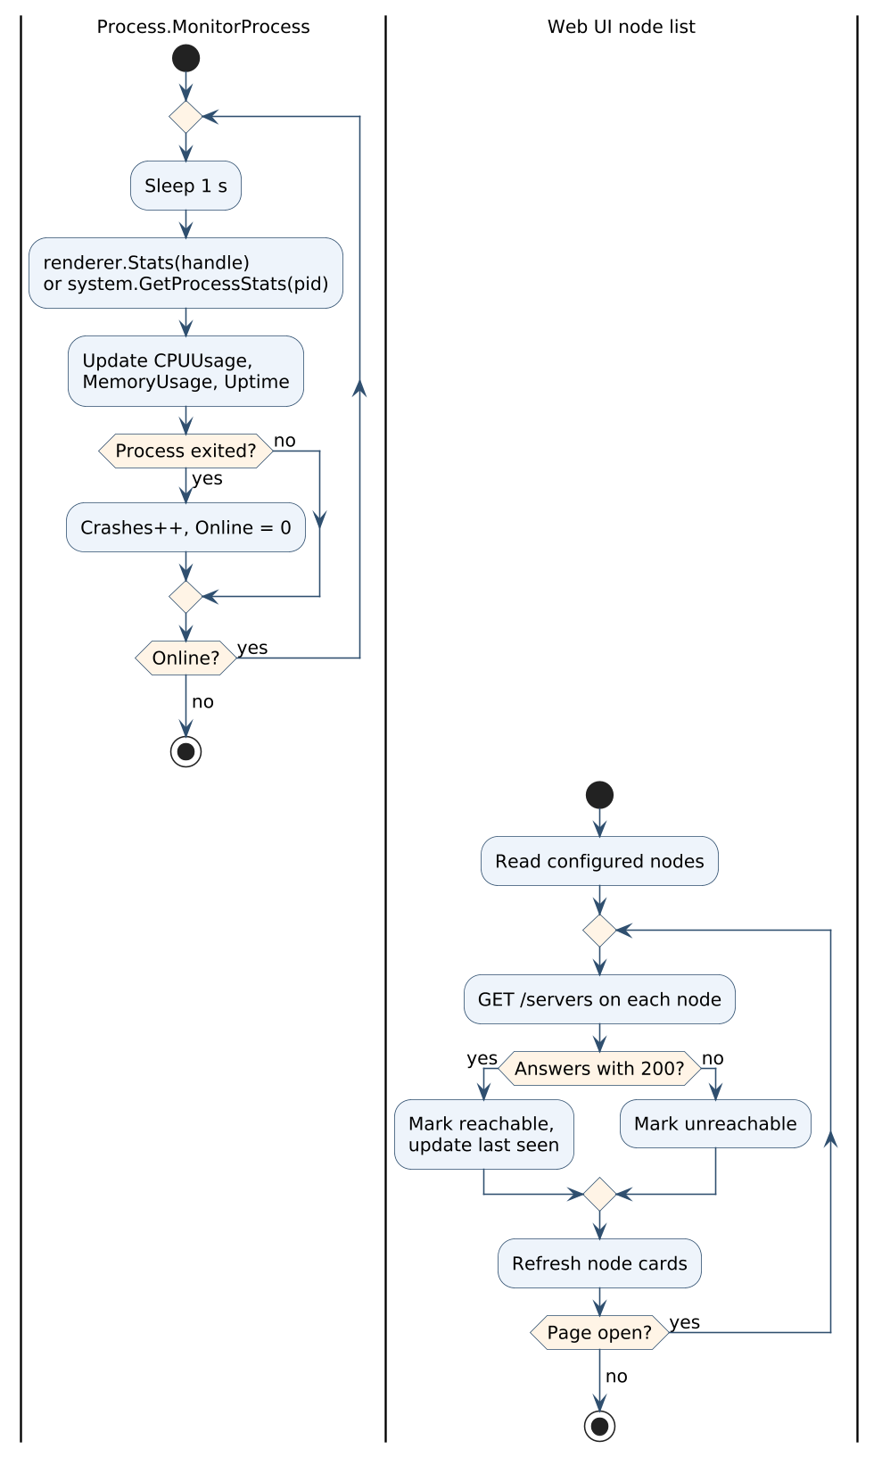
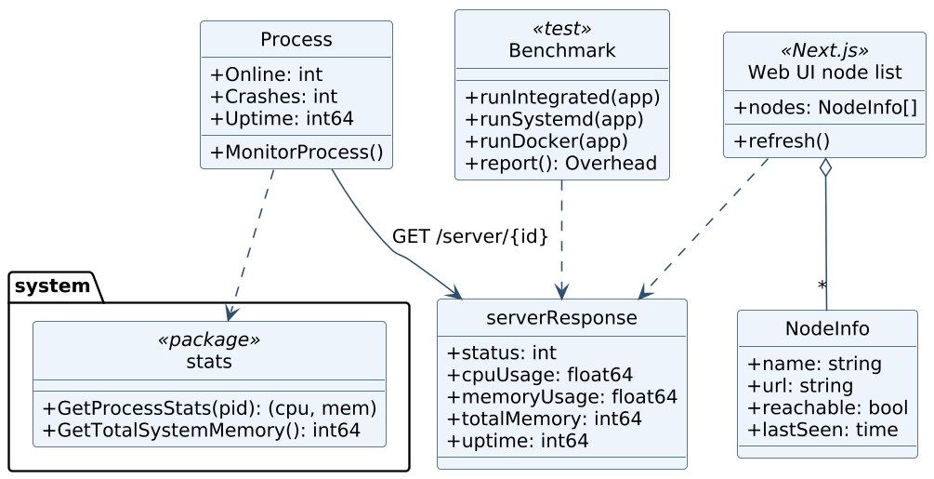
Omkar Darekar: activity and class diagrams
Activity diagram
Class diagram

Slide 24
Future Aspects: plan to completion
1
Implementation
2
Testing
3
Deployment
Now: M2 Connector work, M3 metrics and node list, M4 Web UI dashboard and octynectl
Oct to Nov: M1 ProcessRenderer; IntegratedRenderer first, then systemd, then docker
Weekly integration on a shared Git branch. API contract frozen at midterm
Compose file for Redis and a local image registry
Unit tests per Go package; fake renderer for Process tests
Integration tests on three nodes: shared login, node list, console, files
Fault tests: kill a container, restart Octyne under systemd mode, stop the Web UI dashboard. Apps should stay up [1][5]
Benchmark: integrated vs systemd vs docker on CPU, memory and start-up time [2]
One static Go binary and a systemd unit per node
Redis 7 and the image registry on a separate VM
Web UI dashboard as a static Next.js build
Install script and a short operator guide. Demo on two or three Ubuntu 24.04 nodes

Slide 25
Publication Details
Literature review paper
Implementation paper (planned)
Working title: A comparative study of server process managers, from single-host supervisors to multi-node panels
Content: the eleven-source survey [1] to [11] and the 13-tool comparison
Contribution: a feature matrix and a gap analysis for a small, container-capable manager that does not depend on a panel
Submission: October or November 2026
Authors: Ibrahim Ansari, Chayan Raj Bharati, Omkar Darekar. Guide: Dr. Pratvina Vinayak Talele
Working title: A pluggable process backend for Octyne: integrated, systemd and container execution with shared sessions
What we measure: overhead of each renderer mode [2], recovery after an Octyne restart, recovery after a node or panel failure
Setup: three Ubuntu 24.04 nodes, Redis 7, a mixed workload (Java jar, Node.js service, static site)
Timeline: experiments in Nov and Dec 2026, submission after the final review
Artefact: open-source repository (Apache-2.0) with install and benchmark scripts

Slide 26
Thank you
Distributed Server Process Manager with Containerisation. Group P91
Ibrahim Ansari, Chayan Raj Bharati, Omkar Darekar
Guide: Dr. Pratvina Vinayak Talele. Department of Computer Engineering and Technology, MIT-WPU

