Slide 1
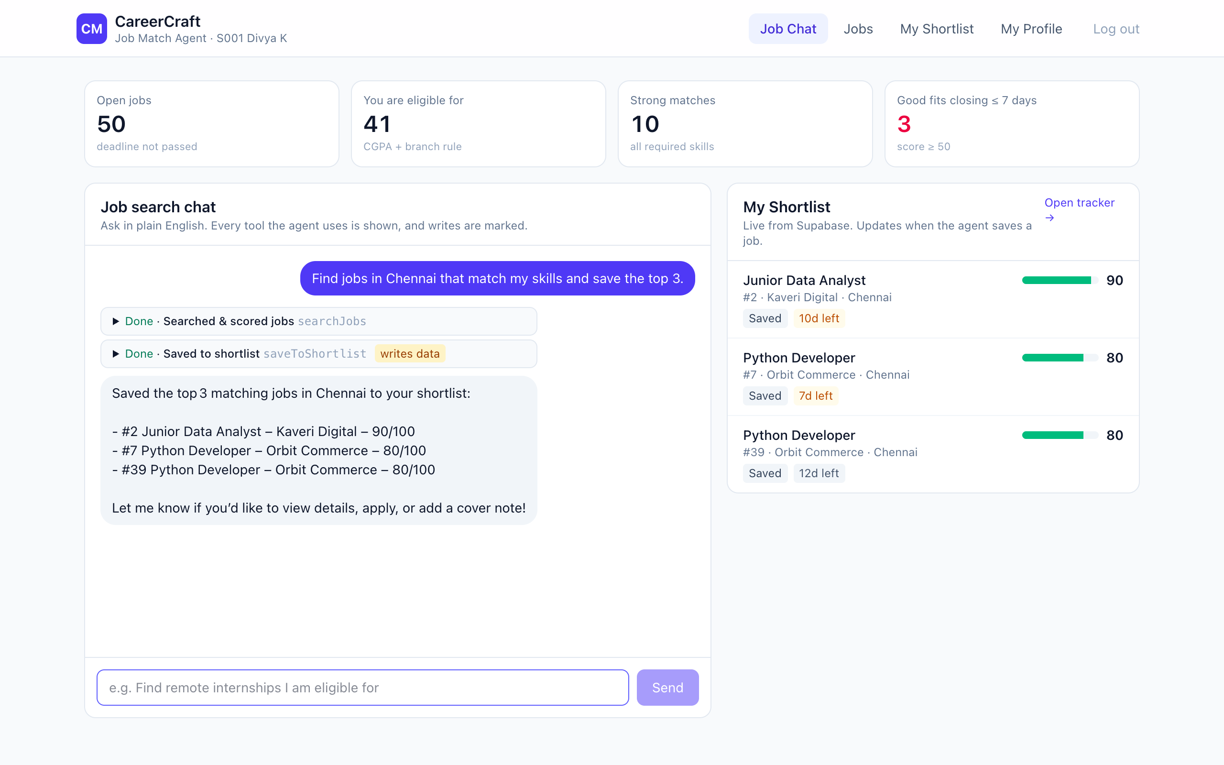
CareerCraft
PS6 · JOB MATCH AGENT
An AI agent that tells students which jobs fit them, and what to learn next.
The live app: chat on the left, shortlist on the right
SRM Agentic AI Hackathon · Team number and member names go here
Notes:
Open with the business user: Divya, a final-year CSE student looking for a job. CareerCraft is her job search assistant.

Slide 2
The problem: students apply blind
1
They apply to jobs they cannot get
One student, one job board
A CGPA cut-off or branch rule quietly blocks them.
50 open jobs
2
They miss the jobs that fit
41 she is eligible for
Good matches are buried in a long list of openings.
They do not know what to learn
10 really match her skills
3
Nobody says which skill would open more doors.
Real numbers from our data for student Divya K (CSE, CGPA 8.1)
Notes:
Only 10 of 50 open jobs are a real fit for Divya. Without help she cannot tell which 10, and she wastes applications on jobs she is not eligible for.

Slide 3
Our solution: just ask the agent
1
Ask in plain English
“Find jobs in Chennai that match my skills and save the top 3.”
2
The agent checks and scores
It skips jobs she is not eligible for and gives every other job a score out of 100.
3
The best jobs are saved
The top matches land in her shortlist, live on screen.
Match score = 70% required skills + 20% bonus skills + 10% preferred city
Notes:
Demo this live: one sentence in, two tools called (search, then save), and the shortlist on the right updates. Every tool call is visible in the chat.

Slide 4
How the agent works
Student asks
in plain English
›
AI picks a tool
by itself, no if/else
›
Zod checks it
bad arguments are rejected
›
Tool runs
reads or writes Supabase
›
Answer shown
with every step visible
Steps 2 to 4 repeat until the agent can answer. The AI never touches the database directly.
6 tools that read
4 tools that write to Supabase
getMyProfile
searchJobs
scoreJobMatch
getSkillGapPlan
whatIfLearnSkill
getMyShortlist
saveToShortlist
updateMySkills
updateApplicationStatus
saveCoverNote
Notes:
This is the agent rule from the guide: at least 2 tools, 1 writes to Supabase, the model chooses the tool itself, Zod checks the arguments, and the result is visible on screen. We have 10 tools, 4 of them write. Stack: Next.js, TypeScript, Tailwind, Supabase, Zod, Vercel, LLM function calling.

Slide 5
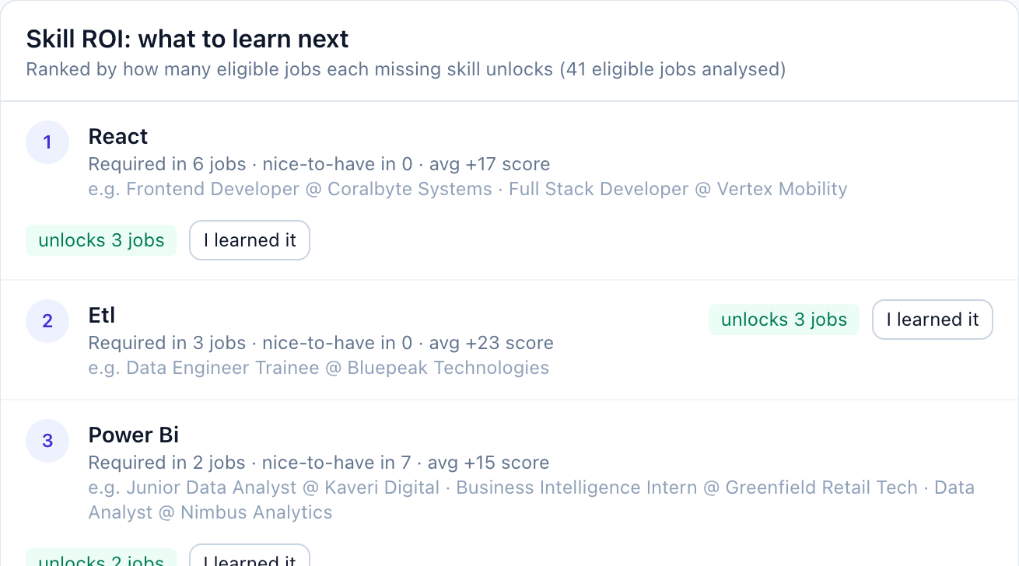
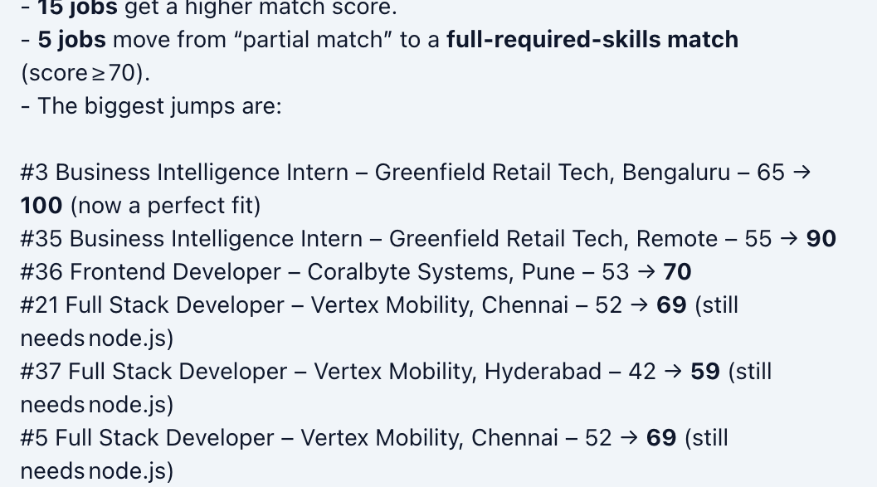
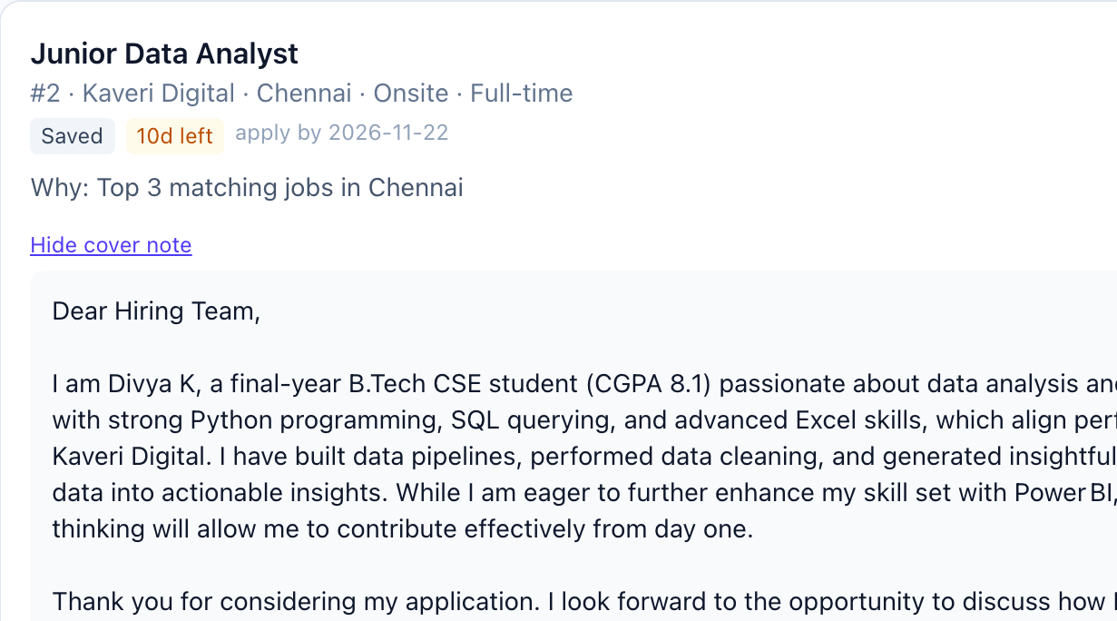
Our own idea: a coach, not just a search
Skill ROI plan
What-if simulator
Tracker and cover notes
Ranks the skills she is missing by how many jobs each one unlocks. React alone unlocks 3 jobs.
Try a skill before learning it. With Power BI, one internship jumps from 65 to 100.
Saved, applied, interview, offer. Deadline countdown and an AI cover note for each job.
The guide asked for a job search. We also answer: “What should I learn next?”
Notes:
These three features are not in the problem statement. Skill ROI and the what-if simulator turn the app from a job filter into a career coach. The tracker follows each job after it is shortlisted.

