Slide 1
Cybersecurity
Jesse Villanueva, Hayden Flagg, Pierce Peterson, and Anthony Quintero

Slide 2
Sad Server
Anthony Quintero
Locally hosted - http://capstone.retrop.net/
Uses PHP, HTML, CSS and SQL
Meant to be vulnerable
Notes:
We have 2 servers, a good 1 and a sad 1. The sad server is Locally hosted on Jesse’s PC. it involves HTML and CSS for the front end. PHP is used for the login and signup features to access our database and sql is what we used for our database. This sad server is meant to be vulnerable to hacking like sql injections.

Slide 3
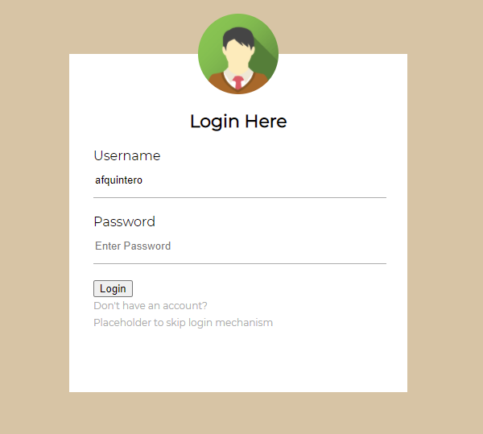
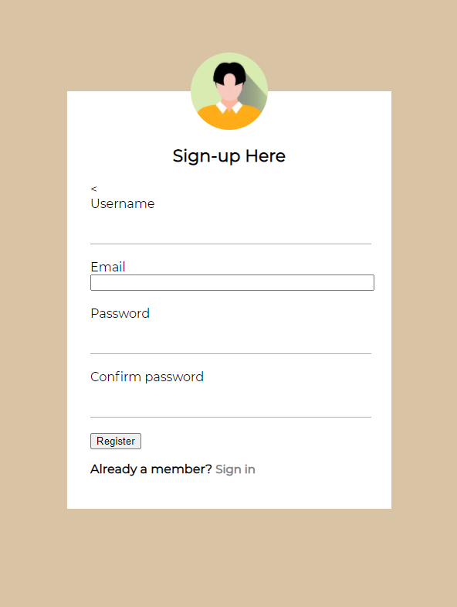
Sad Server - Login/Sign Up Pages
Anthony Quintero
Asks for Username/Password
Link to Sign Up page
Can skip sign up
Asks for Username/Password/Email
Also supplies a link back to the Login page.
Will add details to our database
Notes:
Login page is the first page new visitors will see. It allows previous users to login and new users to access the sign up page. For ease of use we’ve also included a skip login link to go to the account page. The sign up page is similar to our login, it asks for your username password and email. Once you click register it will save your acct details to our database. If you already ahve an account you can click the link at the bottom to go back to our login page.

Slide 4
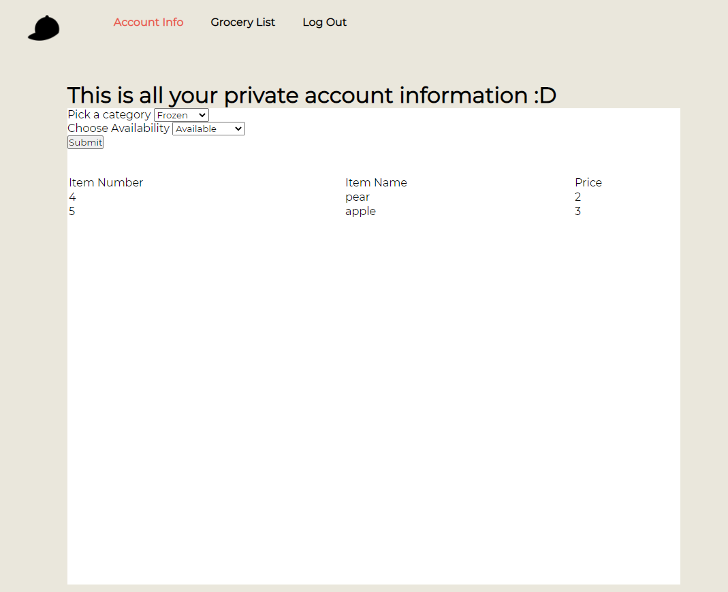
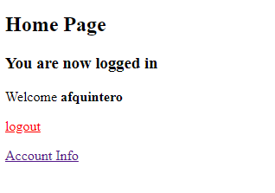
Sad Server - Index/Account Pages
Anthony Quintero
After you login/sign up
Lets you know login was successful
Server will keep you logged in if it was recent
Notes:
Once you login or sign up you will be taken to our Index/Home Page. it will let you know you successfully logged in and you can then logout or access our account info page. If you had logged in recently, you will be taken straight to the index page skipping the login and sign pages. On our account page we have a list of available products organize din the drop down window by produce and frozen

Slide 5
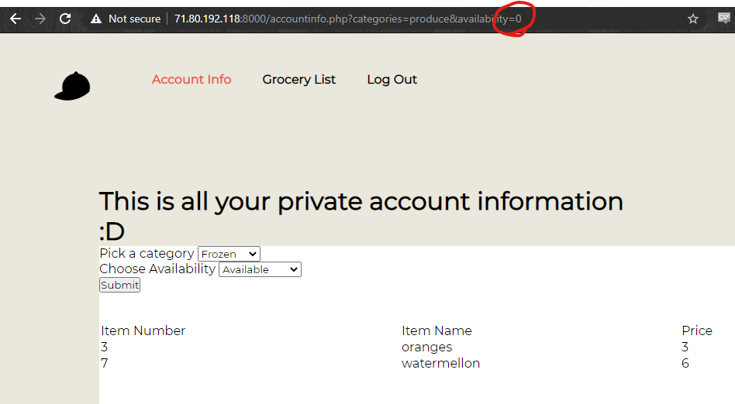
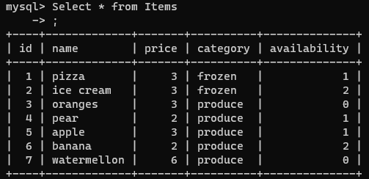
Exploits
Jesse Villanueva
SadServer uses the URI for the form submission.
Other values can be added to the URI which may be different from what is normally allowed.
This SQL server uses an availability column for unreleased, available, out of stock.
Availability setting on the page only allows Available or Out of Stock.
Manually setting the availability to 0 allows user to view items they should not be able to see.

Slide 6
Solutions to exploits
Jesse Villanueva
Avoiding URI for queries
Taking the category from the fields directly can help prevent unwanted inputs.
Using lists can prevent unwanted inputs without use of console.
Filtering the input before its taken into the query can further prevent unwanted inputs.
Using better queries
Firebase queries are more robust allowing less need for filtering.

Slide 7
Good Server - Firebase Hayden Flagg
•Uses a third-party source to emulate our good server.
•Contains our database full of user information and items in our store.
•Firebase is also used to host the good server version of our website and can be visited at https://store-edf16.firebaseapp.com
•An advantage is that it’s protected against cyber attacks that our other server may not be protected against.

Slide 8
Good Server - Languages Hayden Flagg
•HTML & CSS
This makes up the body of the website
•JavaScript
Retrieves data from our server and displays the needed data onto the website
The JS interacts with our database through firebase.

