Slide 1
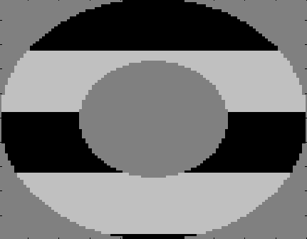
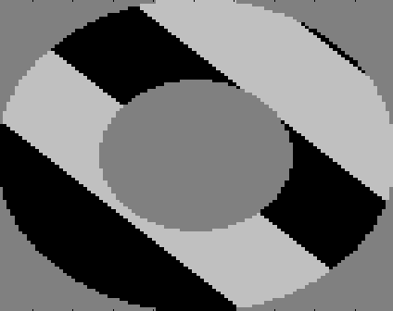
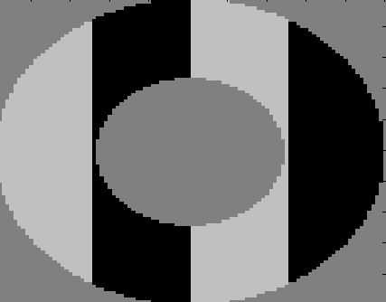
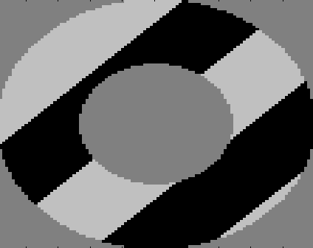
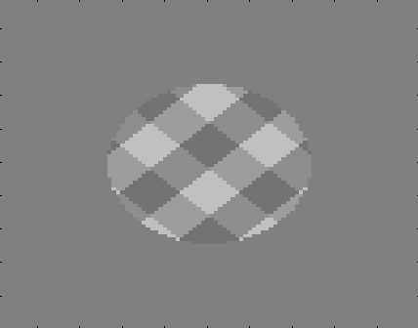
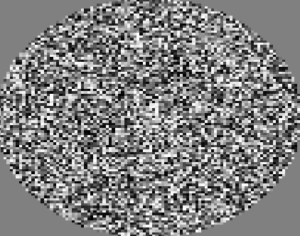
Duration: 400 ms
Placeholder
Foil primed
Neither primed
Target primed
Duration: 17, 34, 67, 134, or 268 ms
Prime
Duration: 84 ms
Target flash
Response: ‘\\\’ versus ‘///’
Mask

