Slide 1
Wireshark & Commands

Slide 2
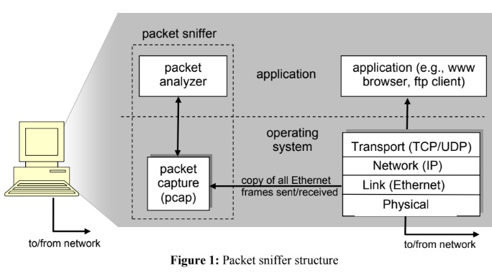
Wireshark - Introduction
Packet Sniffing Tool
Layer-wise Protocol Visualization
Understanding Details of Protocol Operations

Slide 3
Wireshark - Installation
Go to https://www.wireshark.org/
Go to Download
Download the latest stable release version
Run the setup file & follow the steps
Recommended: Don't check any unchecked checkbox & don't uncheck any checked checkbox

Slide 4
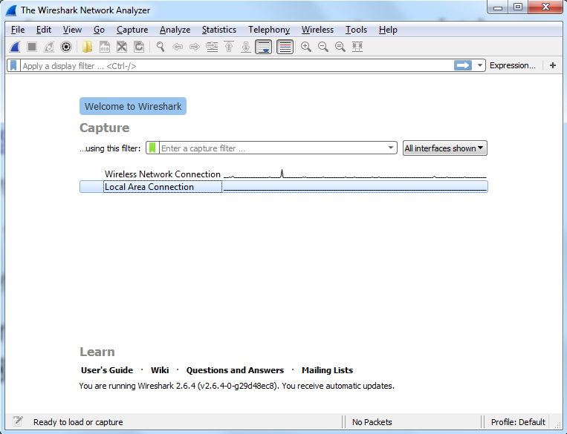
Wireshark – Demonstration (1)
Choose Wireless Network Connection if your pc is connected to internet via wifi, choose Local Area Connection if connected via LAN

Slide 5
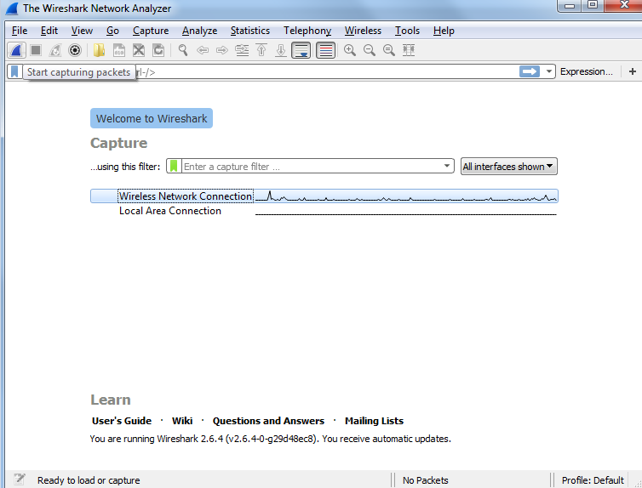
Wireshark – Demonstration (2)
Click on the button like shark fin (Start capturing packets) to begin packet sniffing

Slide 6
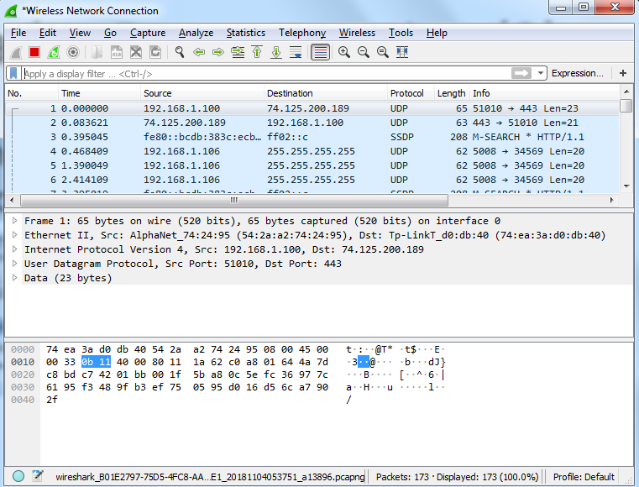
Wireshark – Demonstration (3)
Packets are being captured & all of them are shown
Packets can be sorted by Time (default), Source, Protocol etc. by clicking on them)
Clicking on the Stop (red square) button to stop tracing packets or the green fin like restart button start the process again

Slide 7
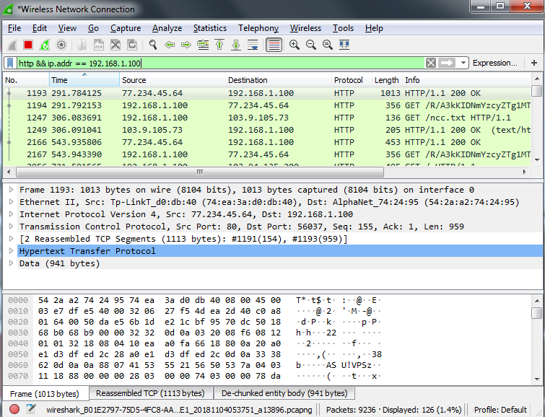
Wireshark – Demonstration (4)
In the text field below the buttons & above the packets shown, you can apply suitable filters and join them by && in case of multiple ones

Slide 8
Wireshark – Demonstration (5)
All packets, a particular packet details, raw data are shown in top, middle & bottom of display area respectively
Protocol (& packet modification) in each layer are shown
Follow stream (blue: sent from your machine, normally request, red: sent from remote machine, normally response) shows messages exchanged sequentially
Expanding any protocol in the packet details section shows information relevant to that protocol

Slide 9
Wireshark – Practice Guideline
Try to check the difference in packets sent/received in different protocols, like http & https (don’t worry if you don’t understand unknown protocols, just get acquainted with the capabilities of wireshark)
Explore protocols in different layers (you will understand this better when these are covered in the theory classes)
Save some captured packets to a file & open it to analyze later.

Slide 10
Network Related Commands
ipconfig <Windows>, ifconfig <Linux> ipconfig /all, ipconfig /displaydns https://docs.microsoft.com/en-us/windows-server/administration/windows-commands/ipconfig
arp -a https://docs.microsoft.com/en-us/windows-server/administration/windows-commands/arp
ping https://docs.microsoft.com/en-us/windows-server/administration/windows-commands/ping
tracert <Windows>, traceroute <Linux> https://docs.microsoft.com/en-us/windows-server/administration/windows-commands/tracert
netstat -a https://docs.microsoft.com/en-us/windows-server/administration/windows-commands/netstat

