Slide 1
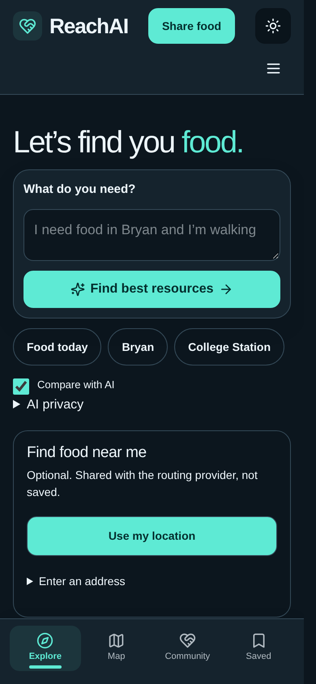
ReachAI
A PRACTICAL NEXT STEP
Find food.
Find a way forward.
Food assistance, made easier to find.
ReachAI / Congressional App Challenge
Raman Jamal · Bryan High · 11th grade
Aran Jamal · Davila · 7th grade
CONGRESSIONAL APP CHALLENGE
01
Notes:
Raman: Hi, I am Raman Jamal, an 11th-grade student at Bryan High. Aran: And I am Aran Jamal, a 7th-grade student at Davila. Together: This is ReachAI, designed to make finding food assistance simpler. This deck shows actual local app screenshots captured October 25, 2026 Central time.

Slide 2
ReachAI
THE PROBLEM
A national problem. A local next step.
≈ 1 in 7
47.9M
U.S. households experienced
food insecurity in 2024.
people lived in
food-insecure households
USDA ERS · 2024 data · 13.7% of households ≈ one in seven
CONGRESSIONAL APP CHALLENGE
02
Notes:
USDA reports that 13.7 percent of U.S. households experienced food insecurity in 2024—about one in seven. 47.9 million people lived in food-insecure households. This is not a pantry-use statistic and does not measure lack of awareness. Source: https://www.ers.usda.gov/topics/food-nutrition-assistance/food-security-in-the-us/key-statistics-graphics

Slide 3
ReachAI
THE DESIGN QUESTION
Make the next decision easier.
01
02
03
Where can I go?
Will it fit my
needs?
How do I get there?
Source-backed pickup
locations.
Pickup times and known
requirements.
Location-aware directions
and contact details.
CONGRESSIONAL APP CHALLENGE
03
Notes:
ReachAI focuses on three practical questions: where can I go, will it fit my needs, and how do I get there? The design prioritizes simple actions and readable information over long forms. We have not measured how many people miss pantry help because of lack of information.

Slide 4
ReachAI
DEMO 01 / SEARCH
Ask in everyday language.
“I need food in Bryan
and I’m walking.”
No account needed to search.
Use a location or enter an address.
Keep browsing if AI is unavailable.
CONGRESSIONAL APP CHALLENGE
04
Notes:
On the home screen, describe what you need. A user can choose a starting location or enter an address. Food search does not require an account. The current screenshots are real local captures. The AI checkbox is a preference, not evidence that a live AI request succeeded.

Slide 5
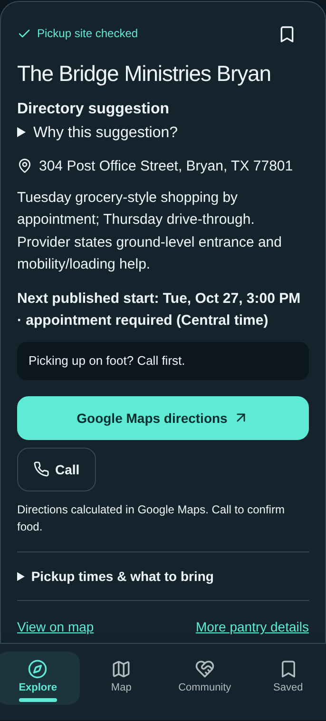
ReachAI
DEMO 02 / RESULTS
Useful details, not just a pin.
66
maintained food-assistance sites
Pickup address and published schedule
Known requirements and contact details
Source information and uncertainty
Includes restricted programs. Coverage is not exhaustive.
CONGRESSIONAL APP CHALLENGE
05
Notes:
The maintained directory has 66 pantry and food-distribution sites after source and district checks. They are not all unrestricted walk-in pantries: some are senior grocery programs. This screenshot is a directory result, not a live AI recommendation. Food stock and pickup entrances have not been verified on-site.

Slide 6
ReachAI
AI + RELIABILITY
Help explain. Never invent.
Compare real
options
Explain the choices
Keep a fallback
Distance, published pickup
windows, and known
requirements inform
comparisons.
When configured, hosted
AI helps interpret requests
and summarize listed
facts.
Directory results remain
available when AI cannot
respond.
No fabricated locations, live stock claims, or guaranteed “perfect” match.
CONGRESSIONAL APP CHALLENGE
06
Notes:
The app combines comparison logic with AI-assisted interpretation and explanation. AI must use the directory facts. This local session had no configured Groq key, so live AI was not exercised for these slides. Do not claim a successful live summary unless you demonstrate one during recording. The app cannot guarantee the perfect pantry.

Slide 7
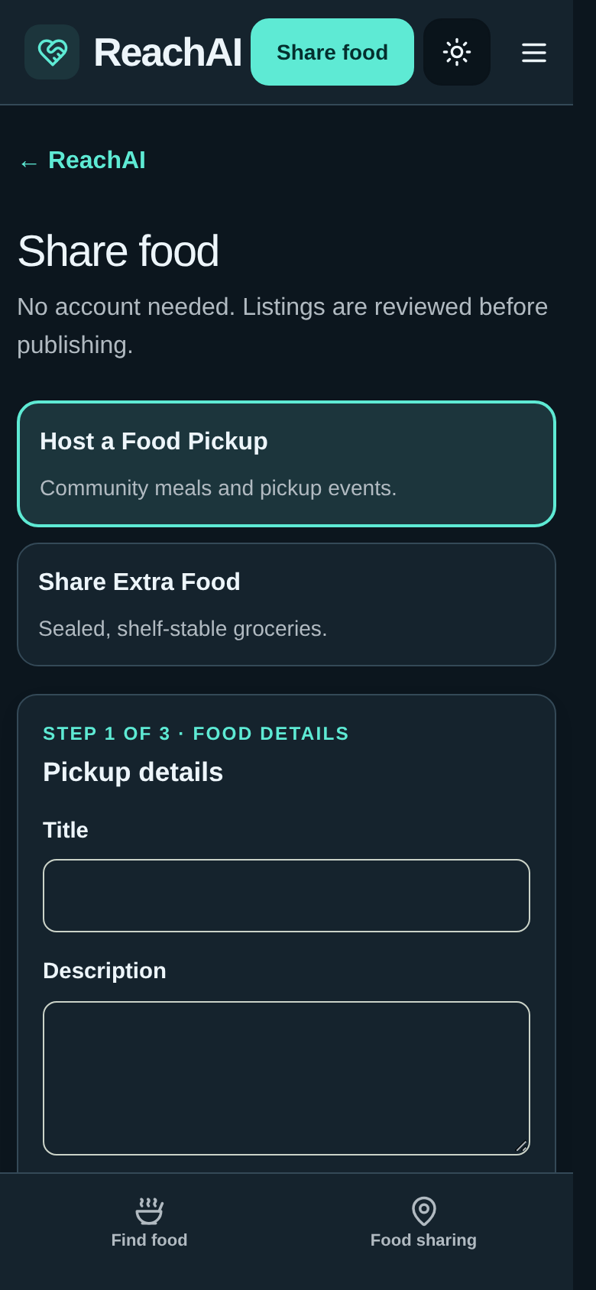
ReachAI
DEMO 03 / COMMUNITY
Share food. Review before publishing.
Host a Food Pickup
Community meals and pickup events.
Share Extra Food
Sealed, shelf-stable groceries.
Submit → Moderator review → Public listing
CONGRESSIONAL APP CHALLENGE
07
Notes:
Community members can submit pickup events or sealed, shelf-stable groceries without creating an account. Listings require moderator approval before they become public. Approved active listings can appear alongside pantry options. No real submission was created while capturing this deck. Review is not a guarantee of food safety or availability.

Slide 8
ReachAI
ENGINEERING
Built for a dependable core.
INTERFACE
APPLICATION
Next.js + React
TypeScript
Mobile-first screens
Search and comparison logic
STORAGE
EXTERNAL SERVICES
SQLite
Maps + hosted AI
Listings and moderation
Honest failure states
CONGRESSIONAL APP CHALLENGE
08
Notes:
ReachAI uses Next.js, React, TypeScript, and SQLite. OpenStreetMap-based mapping and hosted AI are external services. Search and source-backed information remain useful when those services fail. Explain your own contributions honestly and disclose AI development assistance where submission rules require it.

Slide 9
ReachAI
EVIDENCE / LIMITS
Tested software. More fieldwork ahead.
Next priorities
661
Test with real users.
Confirm pickup details with providers.
Verify the deployed demo end to end.
unit tests passed
Latest UI check: 14 mobile / desktop checks
TypeScript + production build passed
Tests do not prove food availability or real-world
impact.
CONGRESSIONAL APP CHALLENGE
09
Notes:
The recorded project checks include 661 unit tests and 14 mobile/desktop browser checks for the latest UI changes; TypeScript and production build passed. This is not a new full audit of every workflow. During this screenshot session AI was unconfigured and the basemap failed to load, so no successful live AI or map demonstration is claimed. Next priorities are real-user testing, provider confirmation and deployed installation verification.

Slide 10
ReachAI
THE GOAL
From “I need food”
to a practical next step.
ReachAI
Raman Jamal + Aran Jamal
Thank you
CONGRESSIONAL APP CHALLENGE
10
Notes:
ReachAI does not solve food insecurity alone. Its goal is to make a practical next step easier. We are Raman Jamal and Aran Jamal, and this is ReachAI. Thank you. Add a real public demo URL or QR code only after deployment is verified; none has been invented here.

Slide 11
ReachAI
APPENDIX / SOURCES
Evidence behind the presentation
USDA Economic Research Service
2024: 13.7% of U.S. households; 47.9 million people in food-insecure households.
https://www.ers.usda.gov/topics/food-nutrition-assistance/food-security-in-the-us/key-statistics-graphics
Directory source review
66 maintained sites; restrictions and unresolved facts retained.
Repository: docs/TX10-COVERAGE-AUDIT.md and docs/TX10-SIXTY-REVIEW.md
Real app screenshots
Captured from the local ReachAI build. No invented AI response or private submission.
Repository: https://github.com/returnedlegend/Reach • branch improve/food-first-experience
CONGRESSIONAL APP CHALLENGE
11
Notes:
Source appendix; keep available for judges, but it need not be narrated. Source statistics were directly checked on the USDA webpage in this conversation. Screenshot capture: October25,2026 America/Chicago. Software checks are historical reported checks from the latest changes, not user impact measurements. Presenters: Raman Jamal, Bryan High, 11th grade; Aran Jamal, Davila, 7th grade.

