Slide 1

styleX
Styling for react-native

Slide 2

What need for every react-native application?

Slide 3
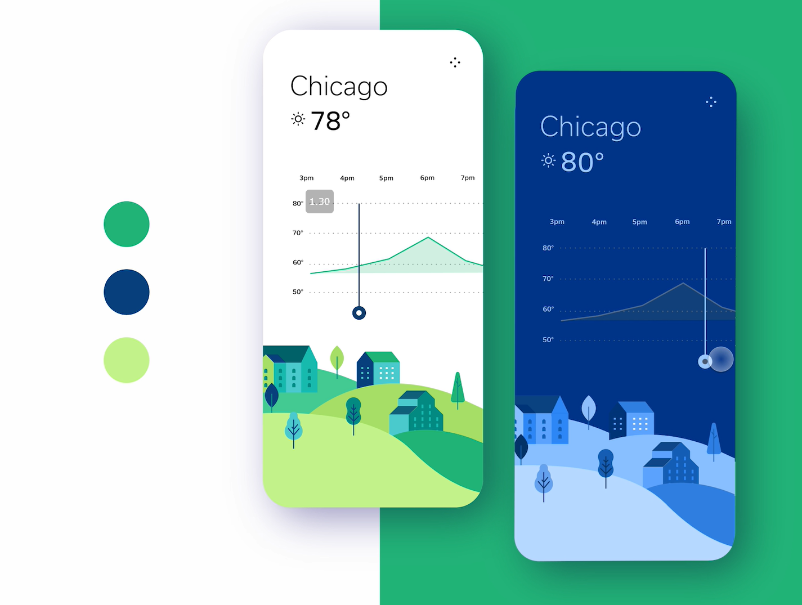
Dark or Light mode?

Slide 4
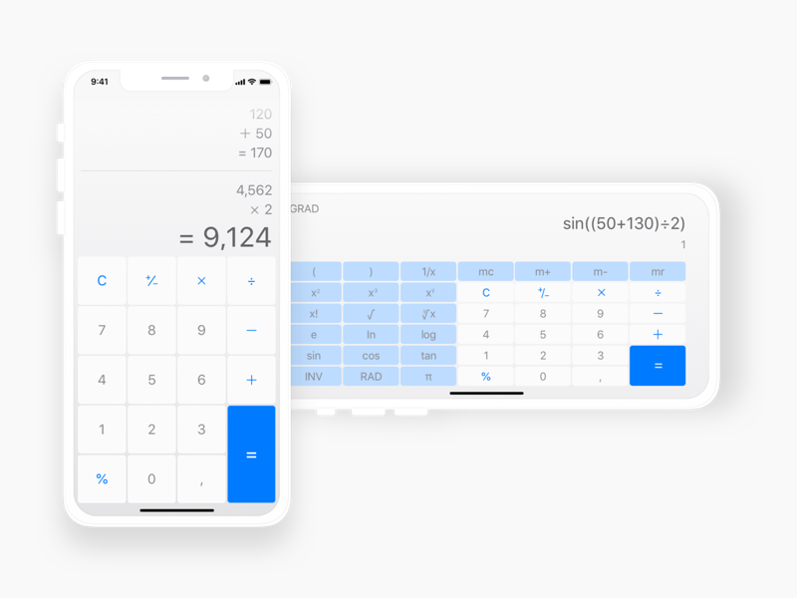
Portrait and landscape orientations?

Slide 5
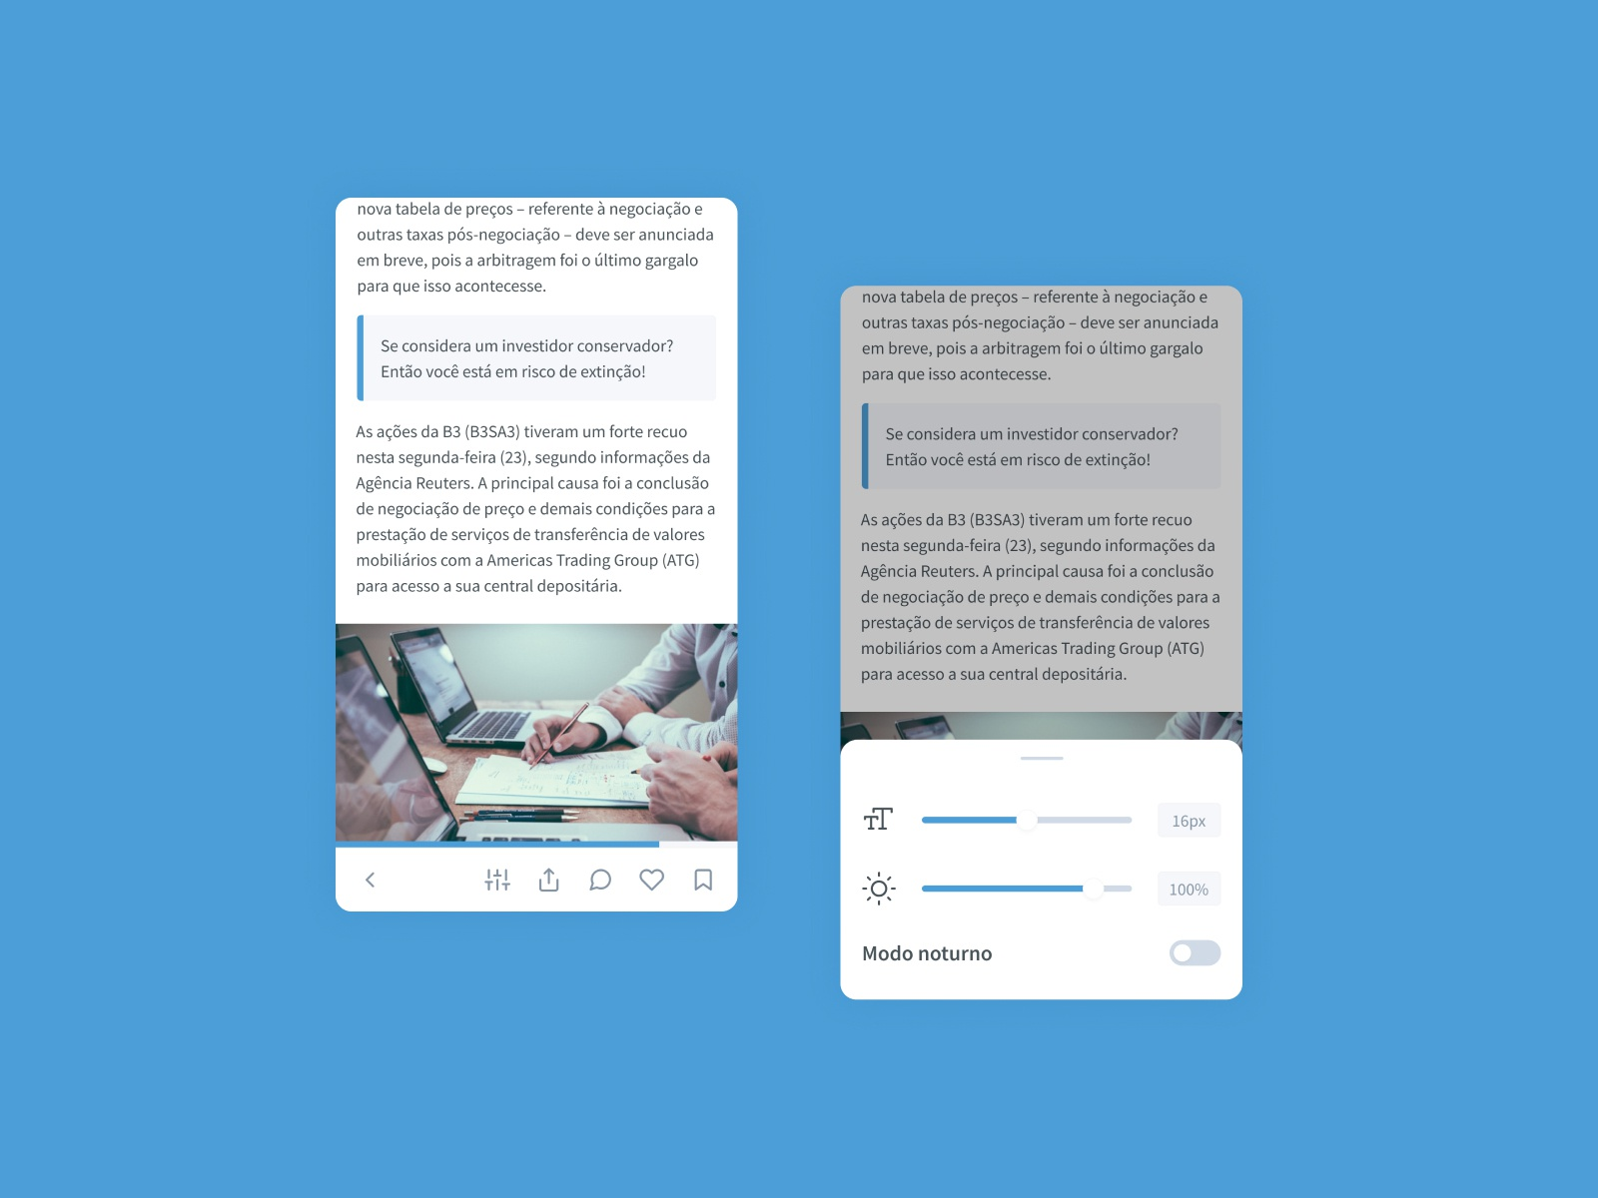
Adaptive font size?

Slide 6
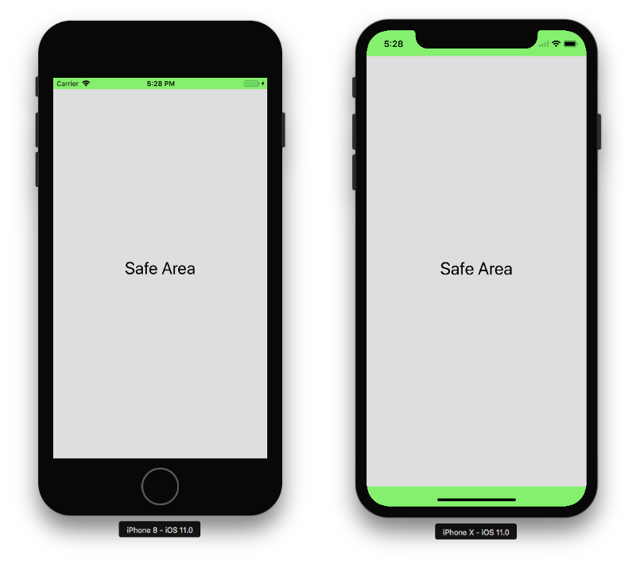
System environment variables?

Slide 7

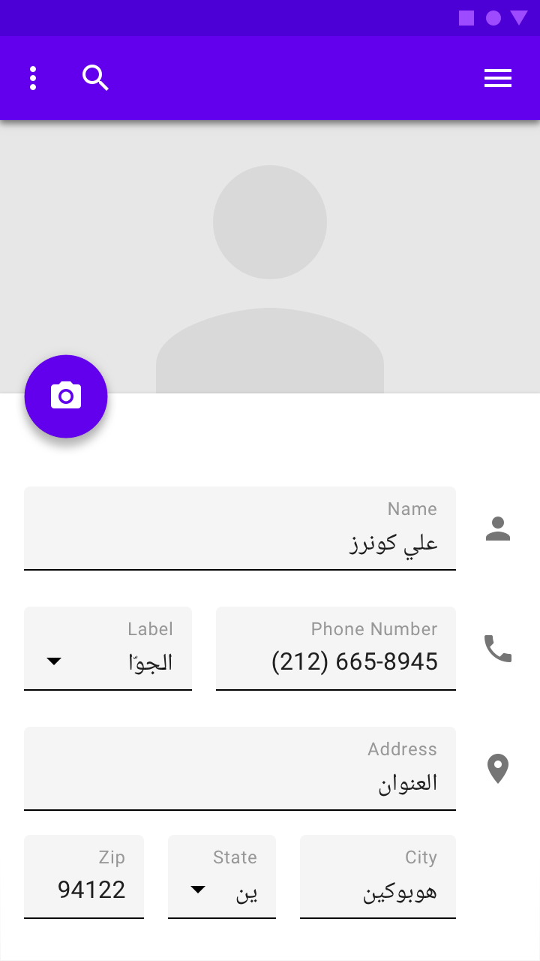
RTL Layouts?

Slide 8
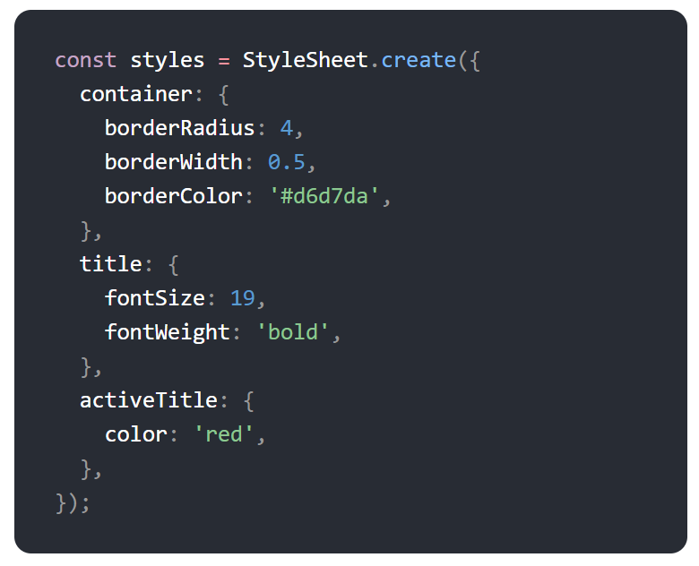
Can StyleSheet helps?

Slide 9

You architecture should be flexible and ready to implement any features

Slide 10


Slide 11
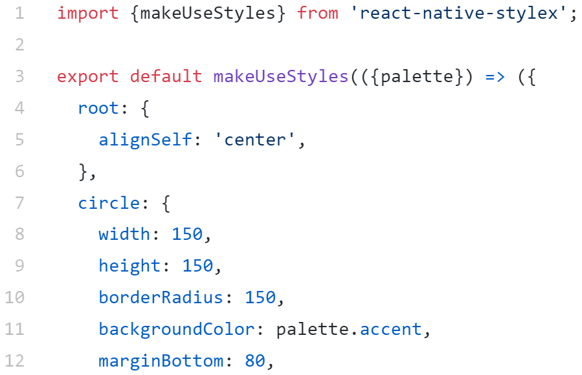
Simple example with theme injection

Slide 12
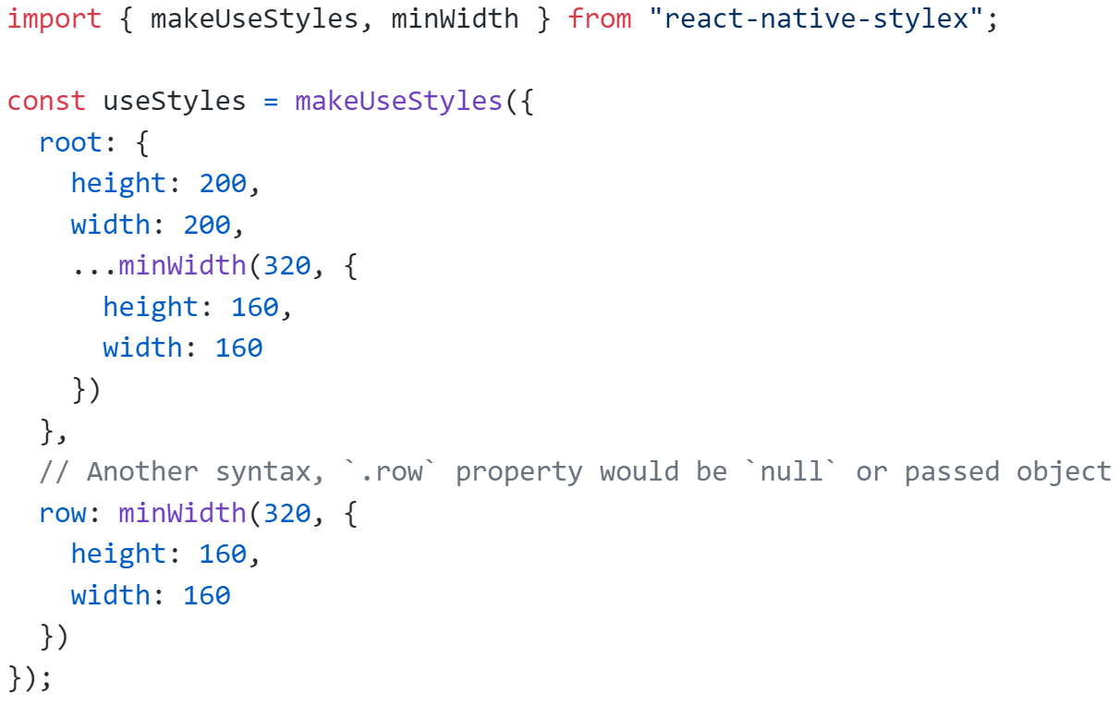
Media Query “syntax”

Slide 13
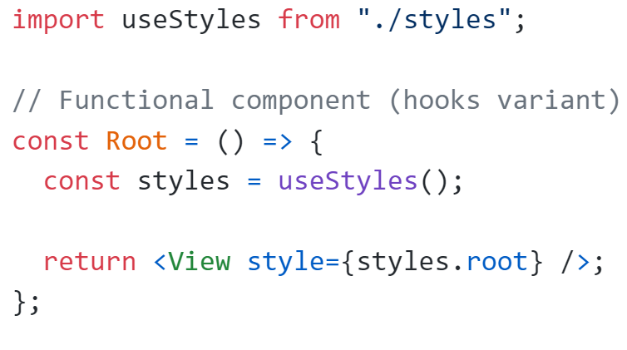
Using styles

