Slide 1


BANKING DATABASE
MANAGEMENT SYSTEM
Designed and Implemented using MySQL
GROUP 1

Slide 2
Introduction
What is a DBMS? A computerized system that manages, stores, and retrieves data efficiently in a structured format, acting as a bridge between a central database and applications or users.
Without a DBMS:
Data redundancy
Slow retrieval
Inconsistent records
Poor security
Difficult reporting
Why banks need it Legacy file systems suffered redundancy, inconsistency, poor security, and weak backup/recovery. Modern DBMS solves this — supporting transaction processing, customer relationship management, and fraud detection.
Our Objective:
Design a relational database that stores banking information accurately while maintaining data integrity.

Slide 3
Project Scope
The Banking System
The system manages:
Customers
Accounts
Branches
Employees
Transactions
Loans
Cards
Features
Customer registration
Account management
Transaction history
Loan management
Card management
Branch & employee records

Slide 4
Methodology
Relational Database Design Methodology
1
2
3
4
5
6
Requirement
Analysis
→
Entity
Identification
→
Attribute
Definition
→
Relationship
Design
→
Normalization
→
Implementation
& Testing
This process reduces redundancy, minimizes errors, and maintains data integrity across all banking records.
Entities Recognised
Customer
Branch
Account
Transaction
Employee
Loan
Card

Slide 5

Conceptual Design — ER Diagram
Crow's Foot Notation

Slide 6
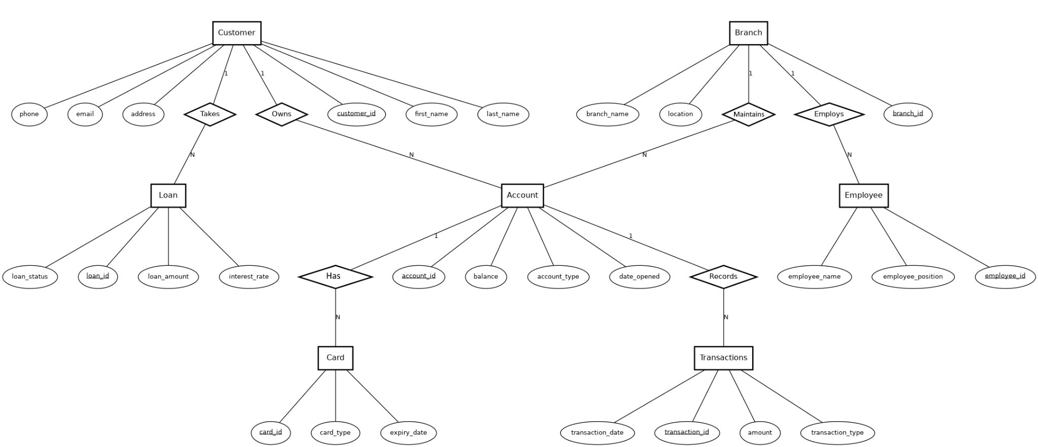
Conceptual Design — ER Diagram
Chen's Notation

Slide 7
Database Tables — 7 Entities
1
2
3
4
Customer
Branch
Account
Transaction
Individuals who interact with the bank
Different branches/offices of the bank
Accounts held by customers
Deposits & withdrawals on an account
5
6
7
Employee
Loan
Card
Staff working at a branch
Loans granted to customers
Debit/credit cards issued per account

Slide 8
Relationships Among Tables
Parent Table
Child Table
Foreign Key
Cardinality
Customer
Account
customer_id
1 : N
Branch
Account
branch_id
1 : N
Account
Card
account_id
1 : N
Account
Transactions
account_id
1 : N
Customer
Loan
customer_id
1 : N
Branch
Employee
branch_id
1 : N

Slide 9
Implementation
Built with SQL & MySQL Workbench 8.0 CE
Creating the database schema
Defining foreign key constraints
1
4
Creating all seven tables
Populating tables with sample data
2
5
Defining primary keys
Executing SQL queries on the database
3
6

Slide 10
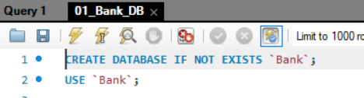
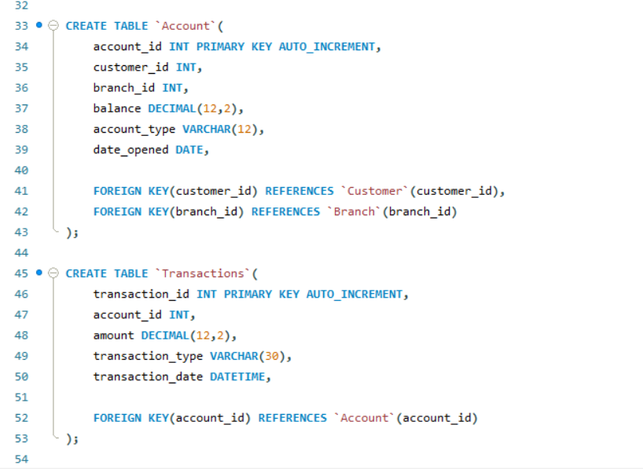
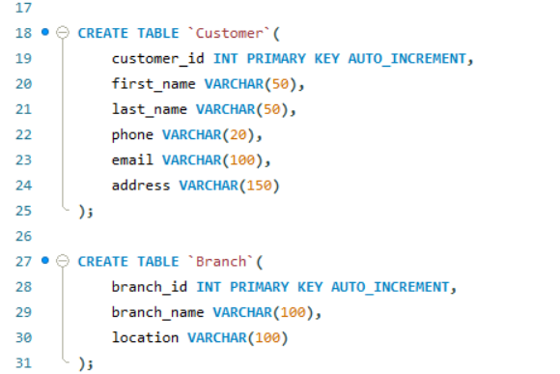

Slide 11
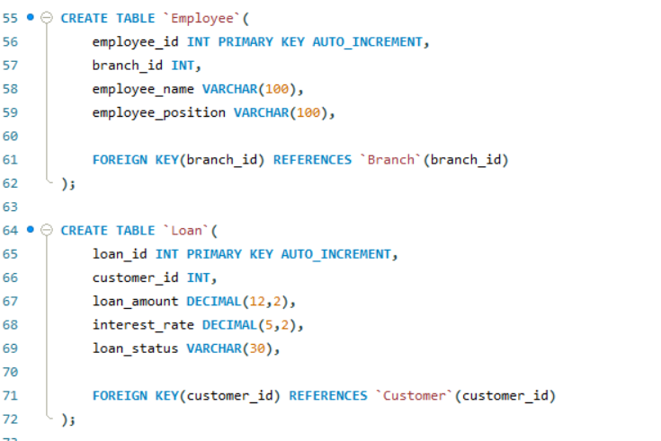
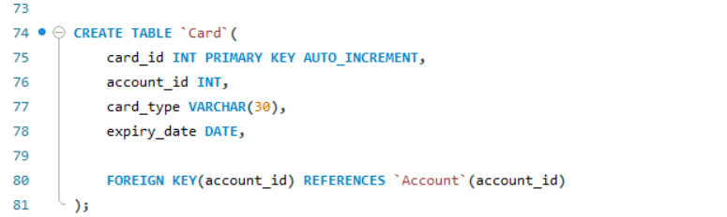

Slide 12
Validating Solution
Using mock data and test queries

Slide 13
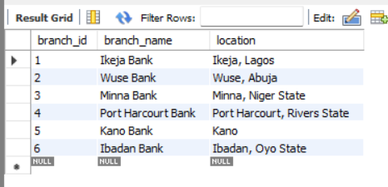

Example of sample data populated into the Database

Slide 14
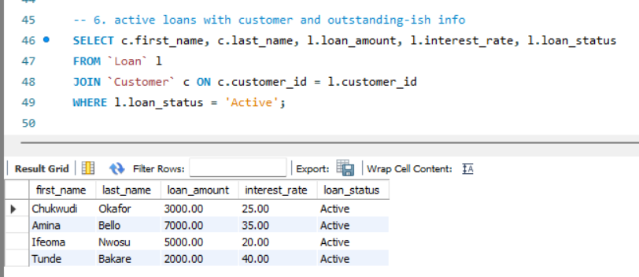
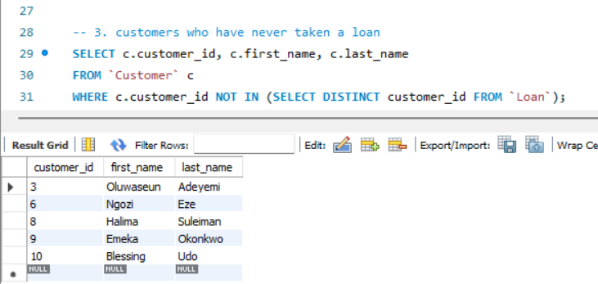
Example of query used to validate the Database solution

Slide 15
Result Discussion
The banking database successfully stores customer information, accounts, loans, transactions, employees, and cards while enforcing relationships through foreign keys.
1
2
3
4
5
Reduced redundancy
Fast data retrieval
Improved data integrity
Easy reporting
Secure storage of banking information

Slide 16
Conclusion
The Banking Database Management System effectively demonstrates the application of relational database concepts in solving real-world banking problems.
MySQL provides a reliable platform for storing and managing banking data while ensuring consistency and integrity.
Source Code
github.com/retzonel/bank-database-sql

