Slide 1

ADUKWU REUBEN

Slide 2


Data Science Project on Students Analysis Performance

Slide 3
What is the best way to teach students?
Determining the best way to teach students is a complex and multifaceted question that depends on various factors, including individual student needs, subject matter, teaching goals, and educational context. Different teaching methods and approaches may be effective for different students and situations. However, there are some general principles and strategies that can contribute to effective teaching:
1. Differentiated Instruction: Recognize and accommodate the diverse learning needs and styles of students by providing personalized and tailored instruction. Adapt teaching methods, materials, and assessments to meet the individual needs of students.
2. Active Learning: Promote active engagement and participation of students in the learning process. Encourage hands-on activities, discussions, problem-solving, and critical thinking to foster deeper understanding and retention of knowledge.
3. Clear Learning Objectives: Clearly communicate learning objectives to students, helping them understand what is expected and what they will achieve. This clarity provides focus and direction for both teachers and students.
4. Varied Instructional Methods: Utilize a variety of instructional methods, such as lectures, group work, demonstrations, multimedia, and technology. This helps cater to different learning preferences and enhances student engagement.
5. Formative Assessment: Use ongoing and frequent formative assessments to monitor student progress and understanding. Provide timely feedback and adjust instruction accordingly to support student learning.
6. Collaboration and Communication: Encourage collaboration and communication among students, fostering a supportive and inclusive learning environment. Promote teamwork, group projects, and peer-to-peer interactions to enhance social and cognitive development.
7. Effective Classroom Management: Establish clear expectations, routines, and behavior management strategies to create a positive and respectful classroom environment that supports learning.
8. Culturally Responsive Teaching: Recognize and embrace the diverse cultural backgrounds and experiences of students. Incorporate culturally relevant materials, examples, and perspectives into teaching to make learning meaningful and inclusive.
9. Continuous Professional Development: Engage in ongoing professional development and stay updated with the latest research and best practices in teaching. Reflect on teaching practices, seek feedback, and continuously improve instructional strategies.
It's important to note that the best way to teach students can vary depending on the specific context, subject matter, and individual needs. Effective teaching often involves a combination of various approaches and strategies tailored to the unique characteristics and requirements of the students being taught.

Slide 4
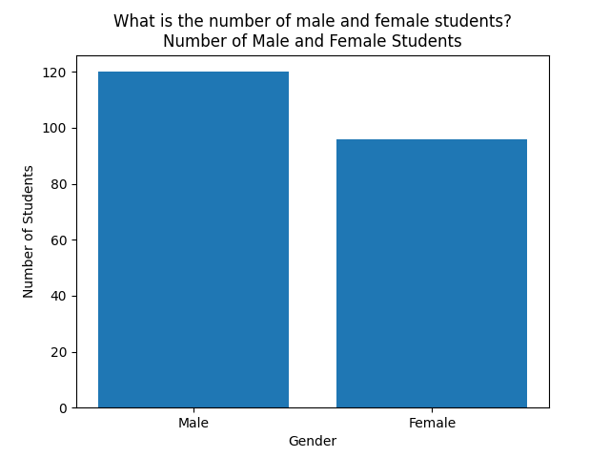
What is the number of male and female students in the dataset?
From the analysis There are 120 male and 96 female students which makes it a total of 216 students available in the dataset.
gender_count = df['Gender']
.value_counts().
#I used the "value_counts()" function to count the occurence of each unique value in the 'Gender' column. The resulting series 'gender_count', provides the count of student in each gender category. by printing 'gender_count' I can view the number of student in each gender.
print(gender_count)

Slide 5
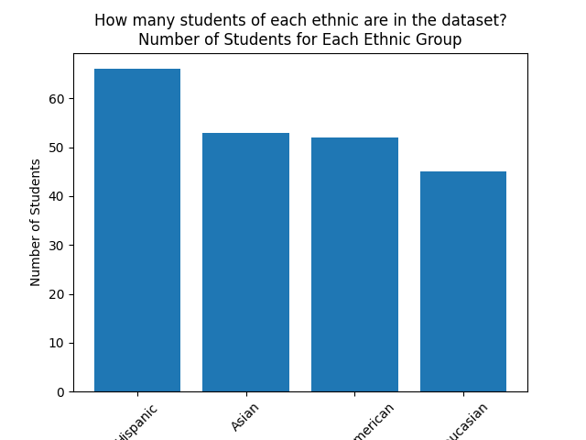
How many students of each ethnic group are in the dataset?
From the analysis there are four ethnic groups present in the dataset, namely: Hispanic, Asian, African-American and Caucasian. There are 66 students from the Hispanic ethnic group, 53 students from the Asian ethnic group, 52 students from the African-American ethnic group and 45 students from the Caucasian ethnic group.
Ethnicity = df['Ethnic'].value_counts()
#I used the "value_counts()" function to count the occurence of each unique value in the 'Ethnic' column. The resulting series 'Ethnicity', provides the count of student in each ethnic category. by printing 'Ethnicity' I can view the number of student in each ethnic group.
print(Ethnicity)
Notes:
From the above analysis there are four ethnic groups present in the dataset, namely: Hispanic, Asian, African-American and Caucasian. There are 66 students from the Hispanic ethnic group, 53 students from the Asian ethnic group, 52 students from the African-American ethnic group and 45 students from the Caucasian ethnic group.

Slide 6
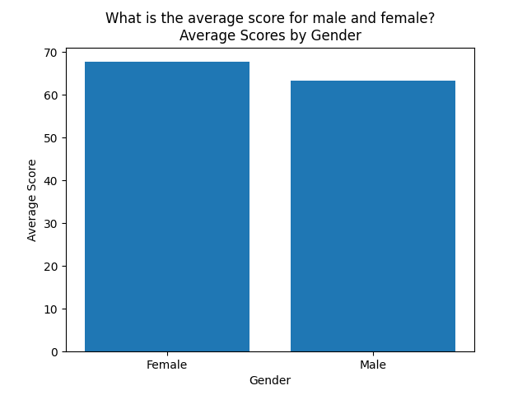
What is the average scores for male and female?
From the analysis the average score for the female and male Gender are 67.66 and 63.37 respectively.
average_score_by_gender = df.groupby('Gender')['Score'].mean().round(2).
print(average_score_by_gender)
In this code, the DataFrame is grouped by the 'Gender' column using groupby(). Then, the mean() function is applied to the 'Score' column within each gender group to calculate the average score for male and female students.
The resulting grouped data, average_scores_by_gender, is a Series object with the gender labels as the index and the average scores as the values.
By accessing the specific values using the gender labels (average_scores_by_gender['Male'] and average_scores_by_gender['Female']), you can print the average score for male and female students, respectively
Notes:
From the above analysis the average score for the female and male Gender are 67.66 and 63.37 respectively.

Slide 7
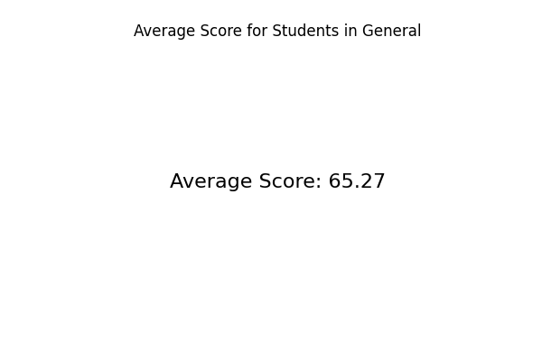
What is the average score for students in general?
The average score for students in general is 65.27.
average_score = df['Score'].mean().round(2) print(f'Average score for students in general:{average_score}').
This code calculates the mean of the 'Score' column in the DataFrame 'df' using the mean() function.
The resulting value, stored in the variable average_score, represents the average score for all students in the dataset.
By printing average_score, you can see the average score for all students in general.
Notes:
The average score for students in general is 65.27.

Slide 8
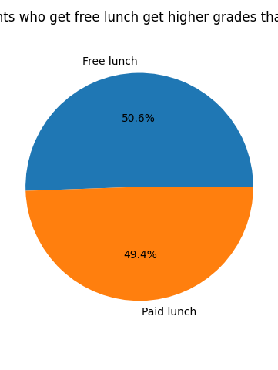
Do students who get free lunch get higher grades than others?
Yes. Because from the analysis students with free lunch program gets higher grades than others with paid lunch program.
average_score_by_lunch = df.groupby('Freeredu')['Score'].mean().round(2) print(average_score_by_lunch).
In this code, the DataFrame is grouped by the ' Freeredu ' column using groupby(). Then, the mean() function is applied to the 'Score' column within each group to calculate the average score for students with free lunch and paid lunch.
The resulting grouped data, average_scores_by_lunch, is a Series object with the lunch types as the index and the average scores as the values.
By accessing the specific values using the lunch types (average_scores_by_lunch['Free Lunch'] and average_scores_by_lunch['Paid Lunch']), you can print the average scores for students with free lunch and paid lunch, respectively.
Notes:
Yes. Because from the above analysis students with free lunch program gets higher grades than others with paid lunch program.

Slide 9
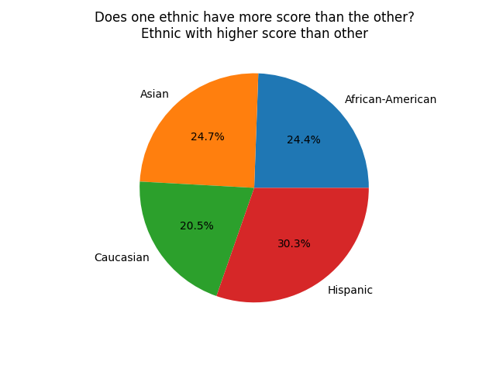
Does one ethnic have more score than the other?
Yes. Because from the above analysis the Hispanic ethnic group have higher score than the other ethnic group.
sumof_score_by_ethnic = df.groupby('Ethnic')['Score'].sum().round(2) print(sumof_score_by_ethnic).
In this code, the DataFrame is grouped by the 'Ethnic' column using groupby(). Then, the sum() function is applied to the 'Score' column within each ethnic group to calculate the tottal score for each group.
The resulting grouped data, sumof_score_by_ethnic, is a Series object with the ethnic groups as the index and the average scores as the values.
By printing sumof_score_by_ethnic, you can see the sum of score for each ethnic group. This will allow you to compare the sum score and determine if one ethnic group tends to have higher scores than the others.
Notes:
Yes. Because from the above analysis the Hispanic ethnic group have higher score than the other ethnic group.

Slide 10
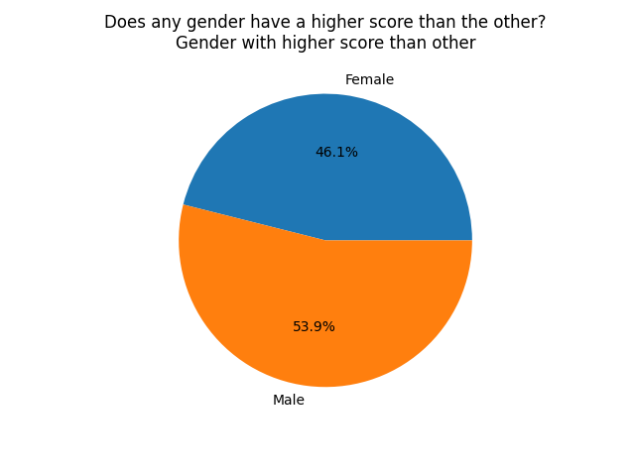
Does any gender have a higher score than the other?
Yes because from the above analysis the male gender have higher score than the female gender.
sumof_score_by_gender = df.groupby('Gender')['Score'].sum().round(2) print(sumof_score_by_gender).
In this code, the DataFrame is grouped by the 'Gender' column using groupby(). Then, the sum() function is applied to the 'Score' column within each gender group to calculate the sum of score for each group.
The resulting grouped data, sumof_score_by_gender, is a Series object with the gender as the index and the sum of score as the values.
By printing sumof_score_by_gender, you can see the sum of score for each gender. This will allow you to compare the average score and determine if one gender tends to have higher score than the other.
Notes:
Yes because from the above analysis the male gender have higher score than the female gender.

Slide 11
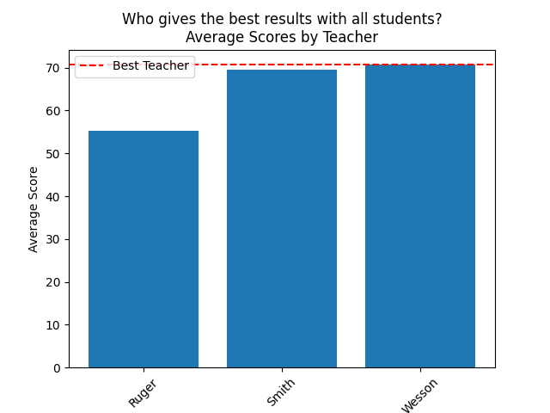
Who gives the best results with all students?
The teacher that gives the best result with all students is Wesson.
average_scores = df.groupby('Teacher')['Score'].mean() # Find the teacher with the highest average score best_teacher = average_scores.idxmax() print("Best Teacher:", best_teacher).
In this code, the DataFrame is grouped by the 'Teacher' column using groupby(). Then, the mean() function is applied to the 'Score' column within each teacher group to calculate the average score for each teacher.
The resulting grouped data, average_scores, is a Series object with the teacher names as the index and the average scores as the values.
By using the idxmax() method on average_scores, you can identify the teacher with the highest average score. The max() method is used to retrieve the highest average score.
The code then prints the best teacher and their corresponding average score.
By analyzing the average scores for each teacher, you can determine who gives the best results with all students in the dataset.
Notes:
The teacher that gives the best result with all students is Wesson.

Slide 12
Thank You

