Slide 1
ADUKWU REUBEN
ANALYZING DRUG REVIEW DATA WITH SENTIMENT
20TH JULY,2022
A PROJECT SUBMITTED TO UPVIEW PHARMACY LIMITED :
To Understand Patient Experiences
For Drug Safety Monitoring
Identifying Efficacy of Drugs
gain insights into market trends
Research and Development

Slide 2
INTRODUCTION
Today, I am thrilled to present to you the outcome of an exciting project focused on analyzing a dataset of drug reviews and sentiment. We embarked on this journey with the goal of extracting valuable insights from a rich collection of reviews, uncovering patterns, and drawing meaningful conclusions. By leveraging advanced data analysis techniques, we sought to gain a deeper understanding of the factors influencing review sentiment and their implications for drug usage and perception.
Throughout the project, we employed various data preprocessing techniques such as Pandas, Numpy, Matplotlib, Scikit-learn and datetime to clean and transform the dataset, ensuring its suitability for in-depth analysis. With these powerful analytical tools, we delved into the dataset to identify the most popular drugs, investigate correlations between different factors, and assess some patterns.
One of our key focuses was to explore the distribution of ratings and analyze how they relate to review sentiments. By examining temporal trends, such as reviews per year and per month, we uncovered interesting patterns and gained insights into the seasonality of drug usage. We also delved into the predictive aspect, attempting to forecast drug ratings based on the textual content of the reviews.
Throughout this presentation, we will share our key findings, highlight the most significant insights, and discuss the codes used to achieve those results. We encourage you to actively engage, ask questions, and contribute to the discussion. Your participation will enrich our understanding and foster a meaningful exchange of ideas.

Slide 3
import numpy as np
import pandas as pd
import seaborn as sns
import matplotlib.pyplot as plt
from sklearn.linear_model import LinearRegression
from sklearn.model_selection import train_test_split
from sklearn.feature_extraction.text import CountVectorizer
file = pd.read_csv(r"C:\Users\pc\PycharmProjects\My_Project\review_dataset_with_sentiment.csv") df = pd.DataFrame(file) df = df.reset_index(drop=True) print(df.columns)
Index(['Unnamed: 0', 'drugName', 'condition', 'review', 'rating', 'date', 'usefulCount', 'drug_class', 'sentiment', 'sentiment_label'], dtype='object')

Slide 4
INTRODUCTION CONT'D
Key areas (df.columns);
Drugs (drug name)
Condition
Review
Rating
Date
Useful Count
Sentiment
Sentiment Label
print(len(df))
Total number of entries in the data: 161,297

Slide 5
What is the most popular drug? (Code)
p_d = []
popular_drug = df['drugName'].value_counts().idxmax()
for i in df['drugName']: if i == popular_drug: p_d.append(i)
print("The most popular drug is {}, with a total usage of {} people.".format(popular_drug, str(len(p_d))))
popular_drugs = df['drugName'].value_counts().head().rename_axis('Drug Name').reset_index(name='Usage Count')
sns.barplot(x='Drug Name', y='Usage Count', hue='Usage Count', data=popular_drugs, palette='magma', hue_order=popular_drugs['Usage Count'])
plt.title('TOP 5 MOST POPULAR DRUGS')
plt.legend(title='Number of Users')
plt.show()

Slide 6
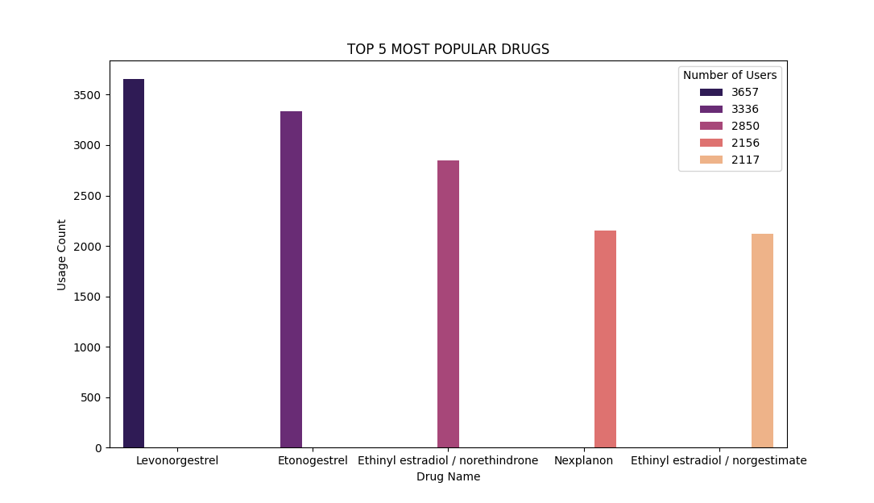
What is the most popular drug? (Result)
The most popular drug is Levonorgestrel with a total usage of 3657 people.

Slide 7
2. What are the groups/classification of drugs used? (Code)
class_file = pd.read_csv(r"C:\Users\pc\PycharmProjects\My_Project\drugs_classification.txt", sep=":")
class_df = pd.DataFrame(class_file)
class_df['Drug Name'] = class_df.iloc[:, 0]
class_df['Drug Classification'] = class_df.iloc[:, 1]
class_df = class_df[['Drug Name', 'Drug Classification']]
class_df.index = range(1, len(class_df) + 1)
print("Groups/Classification of drugs used;")
print(class_df)
classification = class_df['Drug Classification'].value_counts().head().rename_axis('Drug Classification').reset_index(name='Number of Drugs')
sns.barplot(x='Drug Classification', y='Number of Drugs', data=classification, palette='gist_earth')
plt.title('TOP 5 CLASSIFICATION OF DRUGS USED')
plt.show()

Slide 8
2. What are the groups/classification of drugs used (Result)
S/N | Drug Name | Drug Classification
1 | Azole | Antifungal(except metronidazole)
2 | Caine | Anaesthetic
3 | Cillin | Antibiotic(penicillins)
4 | Mycin | Antibiotic
5 | Micin | Antibiotic
6 | Cycline | Antibiotic
7 | Oxacin | Antibiotic
8 | Ceph | Antibiotic(cephalosporins)
9 | Cef | Antibiotic(cephalosporins)
10 | Dine | H2 blockers (anti-ulcers)
11 | Done | Opiod analgesics
12 | Ide | Oral hypoglycemics
13 | Lam | Anti-anxiety
14 | Pam | Anti-anxiety
15 | Mide | Diuretics
16 | Zide | Diuretics
17 | Nium | Neuromuscular blocking agents
S/N | Drug Name | Drug Classification
18 | Olol | Beta blockers
19 | Tidine | H2 antagonist
20 | Tropin | Pituitary hormone
21 | Zosin | Alpha blocker
22 | Ase | Thrombolytics
23 | Plase | Thromboytics
24 | Azepam | Anti-anxiety(benzodiazepine)
25 | Azine | Antipyschotics(phenothiazine)
26 | Barbital | Barbiturate
27 | Dipine | Calcium channel blocker
28 | Lol | Beta blocker
29 | Zolam | Cns depressants
30 | Pril | Ace inhibitor
31 | Artan | Arb blocker
32 | Statins | Lipid-lowering drugs
33 | Parin | Anticoagulants
34 | Sone | Corticosteroid(prednisone)

Slide 9
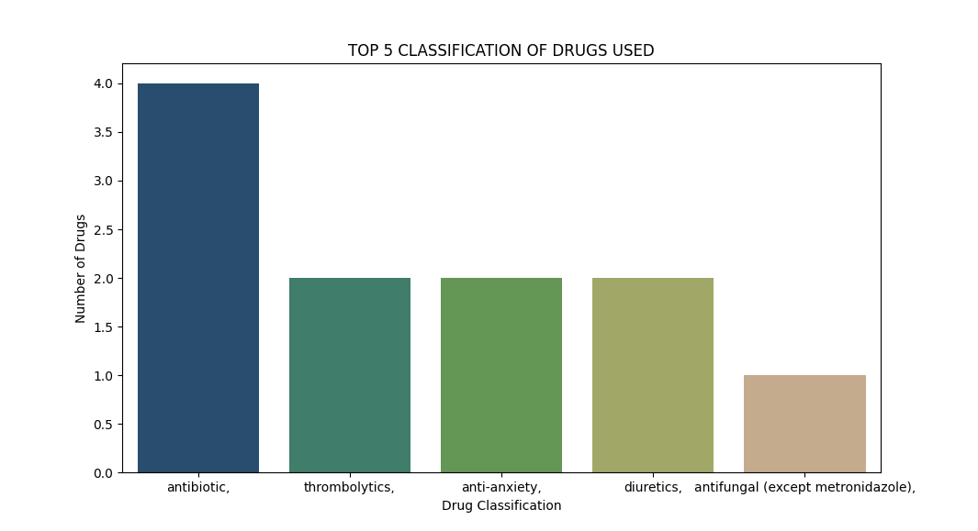
CLASSIFICATION OF DRUGS USED
2.

Slide 10
3. Which drug has the best review? (Code)
max_rating = df[df['rating'] == df['rating'].max()]
max_sentiment = max_rating[max_rating['sentiment'] == max_rating['sentiment'].max()]
best_review_drugName = max_sentiment.loc[max_sentiment['usefulCount'].idxmax(), 'drugName']
best_review = max_sentiment.loc[max_sentiment['usefulCount'].idxmax()]
selected_columns = ['drugName', 'condition', 'review', 'rating', 'usefulCount', 'sentiment', 'sentiment_label']
best_review_info = best_review[selected_columns]
print("Drug with the best review:", best_review_drugName)
print(best_review_info)
top_review_drugs = max_sentiment.nlargest(5, 'usefulCount')[['drugName', 'condition', 'rating', 'sentiment', 'usefulCount']]
top_review_drugs.index = range(1, len(top_review_drugs) + 1)
print(top_review_drugs)
x = top_review_drugs['drugName']
y = top_review_drugs['usefulCount']
plt.barh(x, y, color=['green', 'blue', 'brown', 'magenta', 'grey'])
plt.xlabel('Useful Count of the Review')
plt.ylabel('Drug Name')
plt.title('TOP 5 BEST REVIEW DRUGS')
for i, count in enumerate(top_review_drugs['usefulCount']):
plt.text(count, i, str(count), ha='left', va='center')
plt.show()

Slide 11
3. Which drug has the best review (Result)
S/N | Drug Name | Condition | Rating | Sentiment | Useful Count
1 | Viibryd | Depression | 10.0 | 1.0 | 406
2 | Lorcaserin | Weight Loss | 10.0 | 1.0 | 180
3 | Belviq | Weight Loss | 10.0 | 1.0 | 180
4 | Lorazepam | Anxiety | 10.0 | 1.0 | 163
5 | Ativan | Anxiety | 10.0 | 1.0 | 163
Drug Name | Viibryd
Condition | Depression
Review | "Awesome. Best medicine I&#039;ve ever found f...
Rating | 10.0
Useful Count | 406
Sentiment | 1.0
Sentiment Label | Positive
Drug with the best review: Viibryd

Slide 12
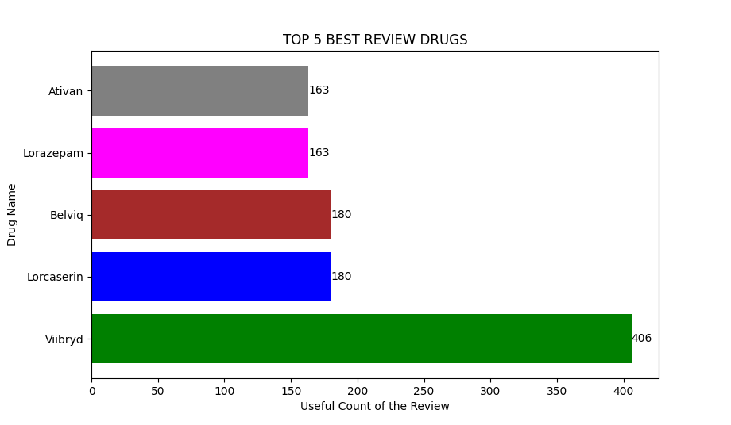
Drugs with top review.
3.

Slide 13

4. How many drugs do we have?
(Code & Result)
Total number of drugs: 3436
This was obtained by storing the unique drugs in a dataframe using value_count algorithm then we got the length of the dataframe
drug_total = df['drugName'].value_counts().rename_axis('List of Drugs').reset_index(name='Number of Usage per Drug')
drug_total.index = range(1, len(drug_total) + 1)
print("Total number of drugs: ", str(len(drug_total)))

Slide 14
5. Number of drugs per condition (Code)
drugs_per_condition = df.groupby('condition')['drugName'].nunique()
drugs_per_condition = drugs_per_condition.iloc[73:]
print("Number of drugs per condition: ")
print(drugs_per_condition))
top_conditions = drugs_per_condition.nlargest(11).reset_index(name='Number of Drugs')
top_conditions = top_conditions[1:]
top_conditions.index = range(1, len(top_conditions) + 1)
print("Top 10 conditions with the highest number of drugs: ")
print(top_conditions[['condition', 'Number of Drugs']])
sns.barplot(x='condition', y='Number of Drugs', hue='Number of Drugs', data=top_conditions, palette='magma', hue_order=top_conditions['Number of Drugs'])
plt.title('TOP 10 CONDITIONS')
plt.xlabel('CONDITION')
plt.legend(title='Number of Drugs')
plt.show()

Slide 15
5. Number of drugs per condition (Result)
S/N | Condition | Number of Drugs
1 | Pain | 200
2 | Birth control | 172
3 | High blood pressure | 140
4 | Ance | 117
5 | Depression | 105
6 | Rheumatoid arthritis | 98
7 | Diabetes, type 2 | 89
8 | Allergic rhinitis | 88
9 | Bipolar disorder | 80
10 | Osteoarthritis | 80
The Condition with the highest number of drugs is Pain with 200 drugs.

Slide 16
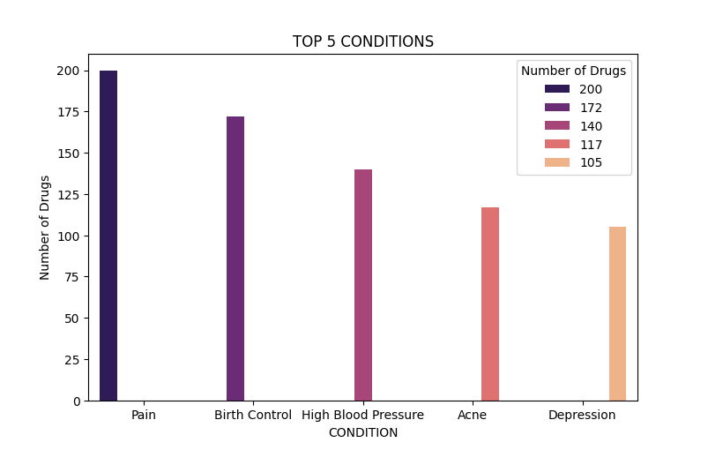
Top conditions with the highest number of drugs
5.

Slide 17
6. Number of patients that searched on a particular drug (Code & Result)
patients_per_drug = df['drugName'].value_counts().rename_axis('List of Drugs').reset_index(name='Number of Patients')
patients_per_drug.index = range(1, len(patients_per_drug) + 1)
print("Patients Per Drug")
print(patients_per_drug)
print(patients_per_drug.head(10))
S/N | List of Drugs | Number of Patients
1 | Levonorgestrel | 3657
2 | Etonogestrel | 3336
3 | Ethinyl estradiol / norethindrone | 2850
4 | Nexplanon | 2156
5 | Ethinyl estradiol / norgestimate | 2117
6 | Ethinyl estradiol / levonorgestrel | 1888
7 | Phentermine | 1543
8 | Sertraline | 1360
9 | Escitalopram | 1292
10 | Mirena | 1242

Slide 18
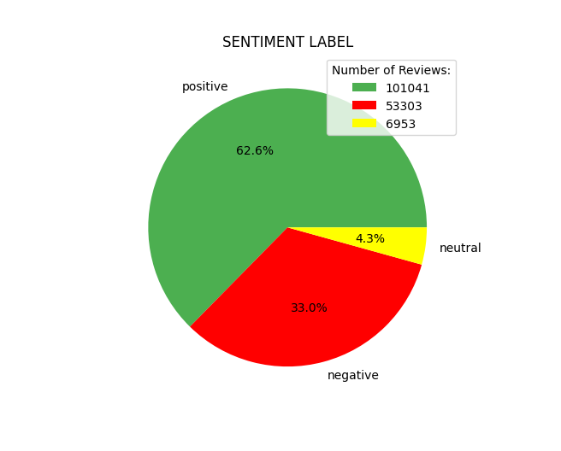
7. How many reviews are positive, negative and neutral (Code & Result)
sentiments = df['sentiment_label'].value_counts().rename_axis('Sentiment Label').reset_index(name='Number of Reviews per Sentiment')
sentiments.index = range(1, len(sentiments) + 1)
x = sentiments['Sentiment Label']
y = sentiments['Number of Reviews per Sentiment']
print(sentiments)
plt.pie(y, labels=x, colors=['green', 'red', 'yellow'], autopct='%1.1f%%')
plt.title('SENTIMENT LABEL')
plt.legend(y, title='Number of Reviews:')
plt.show()
S/N | Sentiment Label | Number of Reviews per Sentiment
1 | Positive | 101041
2 | Negative | 53303
3 | Neutral | 6953

Slide 19
8. Correlation between Rating, Review Text, and Useful Count (Code)
vectorizer = CountVectorizer()
x = vectorizer.fit_transform(df['review'])
review_df = pd.DataFrame.sparse.from_spmatrix(x, columns=vectorizer.get_feature_names())
df['review_text'] = review_df.sum()
a = 'rating'
b = 'review_text'
c = 'usefulCount'
correlation = df[[a, b, c]].corr()
print(correlation)
sns.heatmap(correlation, annot=True, cmap='plasma', square=True)
plt.title('Correlation between Rating, Review Text, and Useful Count')
plt.show()

Slide 20
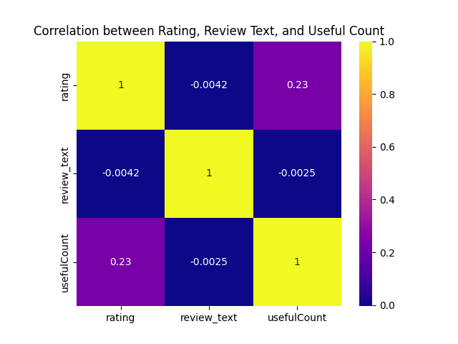
8. Correlation between Rating, Review text, and Useful Count (Result)

Slide 21
9. Predicting the rating using the review (Code)
l = LinearRegression()
x = vectorizer.fit_transform(df['review'])
y = df['rating']
x_train, x_test, y_train, y_test = train_test_split(x, y, test_size=0.2)
l.fit(x_train, y_train)
drug_rating = l.predict(x_test)
rating = np.clip(drug_rating, 0, 10)
rating_df = pd.DataFrame(rating)
rating_df.columns = ["Predicted Values"]
rating_df["Predicted Values"] = rating_df["Predicted Values"].astype(int)
actual_value = pd.DataFrame(y_test)
actual_value.columns = ["Actual Rating"]
comparison_df = pd.concat([rating_df.reset_index(drop=True), actual_value.reset_index(drop=True)], axis=1, sort=False)
print("Comparison of the Predicted Rating and the Actual Rating")
print(comparison_df)
score = l.score(x_test, y_test)
score_percent = int(score * 100)
print('The linear regression model performed well on the test data by a score of: ', str(score_percent)+'%')
sns.kdeplot(data=comparison_df, x="Predicted Values", fill=True, alpha=0.5, label="Predicted Rating")
sns.kdeplot(data=comparison_df, x="Actual Rating", fill=True, alpha=0.5, label="Actual Rating")
plt.xlabel("Rating")
plt.ylabel("Density")
plt.title("Comparison of Predicted Rating and Actual Rating")
plt.legend()
plt.show()

Slide 22
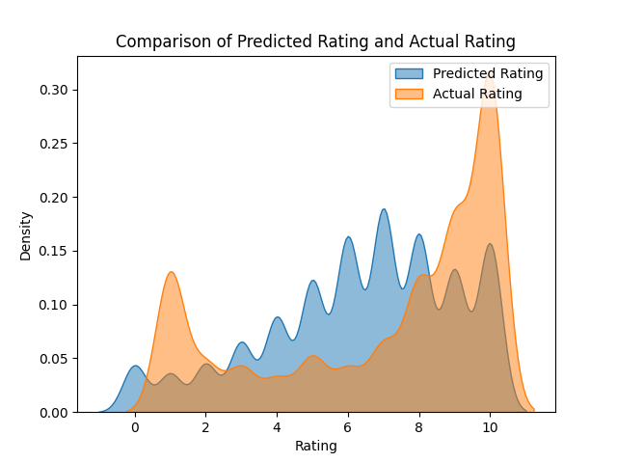
9. Predicting the rating using the review (Result)
comparison_df = pd.concat([rating_df.reset_index(drop=True), actual_value.reset_index(drop=True)], axis=1, sort=False)
The linear regression model performed on the test data by a score of: 22%

Slide 23
10. Distribution of rating (Code)
rating_distribution = df['rating'].value_counts().rename_axis('Ratings').reset_index(name='Distribution')
rating_distribution = rating_distribution.sort_values(by='Ratings', ascending=True).reset_index(drop=True)
rating_distribution.index = range(1, len(rating_distribution) + 1)
print("Rating distribution:")
print(rating_distribution)
plt.hist(df['rating'], bins=len(rating_distribution), edgecolor='black', color='magenta')
plt.xlabel(str('Rating'))
plt.ylabel('Frequency')
plt.title('Rating Distribution')
plt.xticks(rating_distribution['Ratings'])
plt.show()

Slide 24
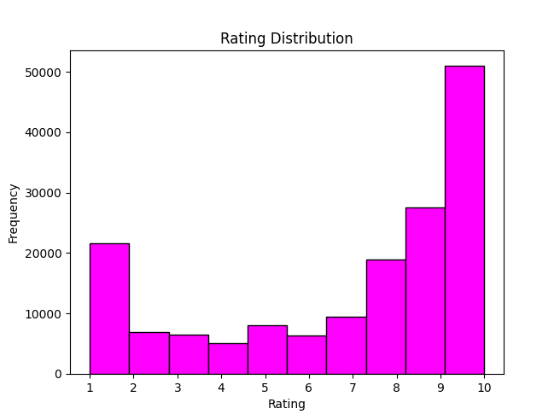
10. Distribution of rating (Result)
Ratings | Distribution
1.0 | 21619
2.0 | 6931
3.0 | 6513
4.0 | 5012
5.0 | 8013
6.0 | 6343
7.0 | 9456
8.0 | 18890
9.0 | 27531
10.0 | 50989

Slide 25
11a. Amount of review per year (Code)
df['date'] = pd.to_datetime(df['date'])
reviews_per_year = df['date'].dt.year.value_counts().sort_index().rename_axis('Year').reset_index(name='Number of Reviews')
reviews_per_year.index = range(1, len(reviews_per_year) + 1)
print(reviews_per_year)
a = reviews_per_year['Year']
b = reviews_per_year['Number of Reviews']
plt.plot(a, b, 'o-m', ms=5)
plt.xlabel('Year')
plt.ylabel('Number of Reviews')
plt.title('Number of Reviews per Year')
plt.show()

Slide 26
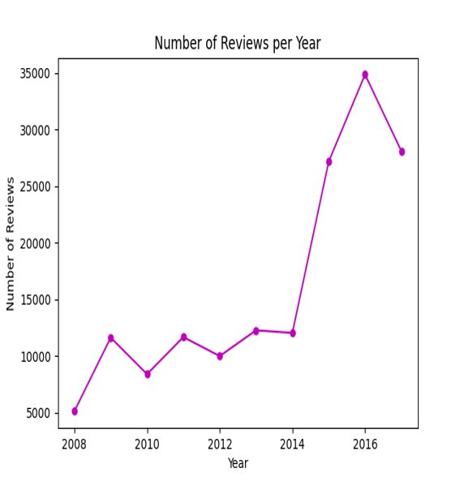
11a. Amount of review per year (Result)
S/N | Year | Number of Reviews
1 | 2008 | 5137
2 | 2009 | 11636
3 | 2010 | 8413
4 | 2011 | 11682
5 | 2012 | 10007
6 | 2013 | 12278
7 | 2014 | 12051
8 | 2015 | 27164
9 | 2016 | 34842
10 | 2017 | 28087

Slide 27
11b. Amount of review per month (Code)
df['date'] = pd.to_datetime(df['date'])
reviews_per_month = df['date'].dt.strftime('%B').value_counts().sort_index().rename_axis('Month').reset_index(name='Number of Reviews')
reviews_per_month['Month'] = pd.Categorical(reviews_per_month['Month'], categories=['January', 'February', 'March', 'April', 'May', 'June', 'July', 'August', 'September', 'October', 'November', 'December'], ordered=True)
reviews_per_month = reviews_per_month.sort_values('Month')
reviews_per_month.index = range(1, len(reviews_per_month) + 1)
print(reviews_per_month)
x = reviews_per_month['Month']
y = reviews_per_month['Number of Reviews']
plt.plot(x, y, '*-k', ms=5)
plt.xlabel('Month')
plt.ylabel('Number of Reviews')
plt.title('Number of Reviews per Month')
plt.show()

Slide 28
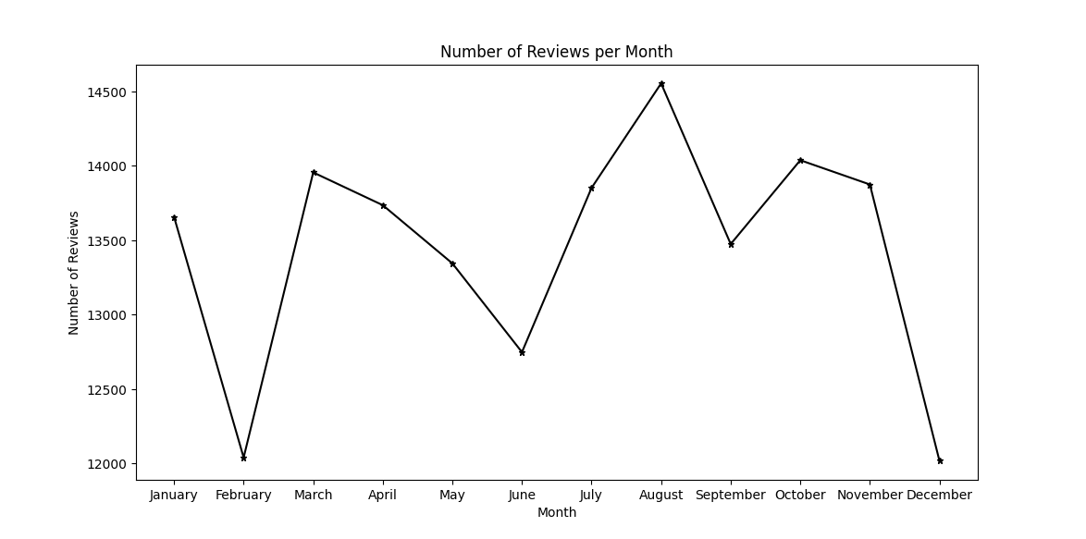
11b. Amount of review per month (Result)
S/N​ | Month​ | Number of Reviews​
1​ | January​ | 13657​
2​ | February​ | 12041​
3​ | March​ | 13956​
4​ | April​ | 13736​
5​ | May​ | 13345​
6​ | June​ | 12749​
7​ | July​ | 13852​
8​ | August​ | 14554​
9​ | September​ | 13475​
10​ | October​ | 14038​
11​ | November​ | 13875​
12​ | December​ | 12019​

Slide 29
12. Which condition has the most review on drugs (Code)
conditions_most_reviews = df['condition'].value_counts().head().rename_axis('Condition').reset_index(name='Number of Reviews')
conditions_most_reviews.index = range(1, len(conditions_most_reviews) + 1)
condition_most_reviews = df['condition'].value_counts().idxmax()
print(conditions_most_reviews)
print("Condition with the most reviews on drugs:", condition_most_reviews)
sns.barplot(x='Number of Reviews', y='Condition', data=conditions_most_reviews, palette='autumn', orient='h')
plt.title('TOP 5 CONDITIONS WITH THE MOST REVIEWS')
plt.show()

Slide 30
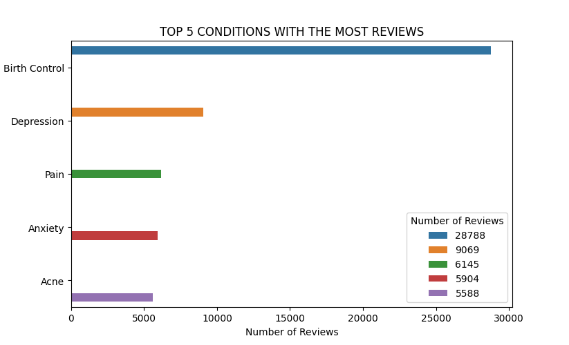
Top 5 Conditions
12. Which condition has the most review on drugs (Result)
Condition with the most reviews on drugs is Birth Control

Slide 31
THANK YOU

