Slide 1
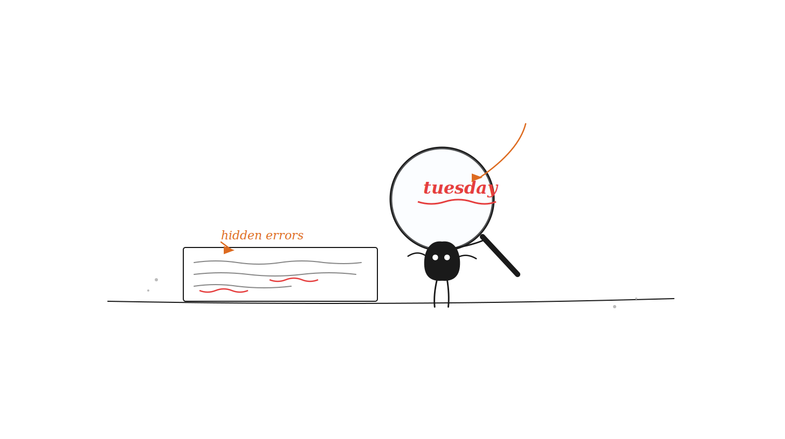
Becoming a
Grammar
Detective
TOEFL Primary Step 2 Writing
Edit a Text Task
Notes:
Open by asking: 'What does a detective do?' Guide them to discover that today they'll be Grammar Detectives — hunting mistakes instead of criminals. Point to Xiaohei on the screen: 'This is our helper. He's holding a magnifying glass. What do you think he's looking at?'

Slide 2
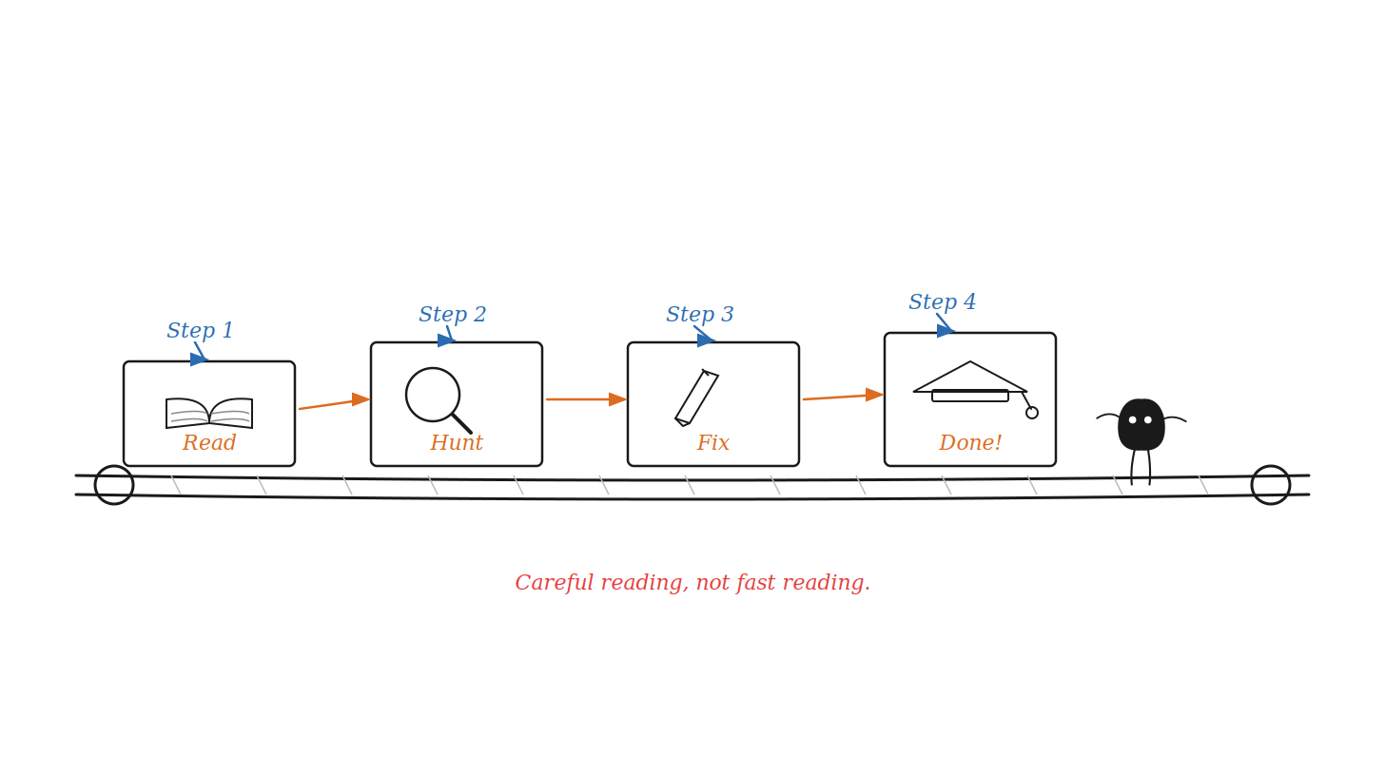
What is the Goal?
Notes:
Walk through each station box on the conveyor belt one at a time. Ask: 'A conveyor belt moves things forward — what does that tell us about this task?' Read the tip at the bottom aloud, then have students repeat it back to you. Xiaohei is standing at the end looking proud — he's waiting for YOU to reach Step 4.

Slide 3
Here are 5 completely different incorrect sentences:
we plays soccer after school
the baby cry because he is hungry
look at that big yellow bus
i saw three birds in the tree
tomorrow we will visits the library
Notes:
Incorrect: we plays soccer after school\🟢 Correction: We play soccer after school.
Errors: Capitalization, verb grammar ("we play"), missing period.
Incorrect: the baby cry because he is hungry\🟢 Correction: The baby cries because he is hungry.
Errors: Capitalization, verb grammar ("baby cries"), missing period.
Incorrect: look at that big yellow bus\🟢 Correction: Look at that big yellow bus. (or !)
Errors: Capitalization, missing punctuation at the end.
Incorrect: i saw three birds in the tree\🟢 Correction: I saw three birds in the tree.
Errors: Capitalization of pronoun "I", missing period.
Incorrect: tomorrow we will visits the library\🟢 Correction: Tomorrow we will visit the library.
Errors: Capitalization, future tense verb grammar ("will visit"), missing period

Slide 4
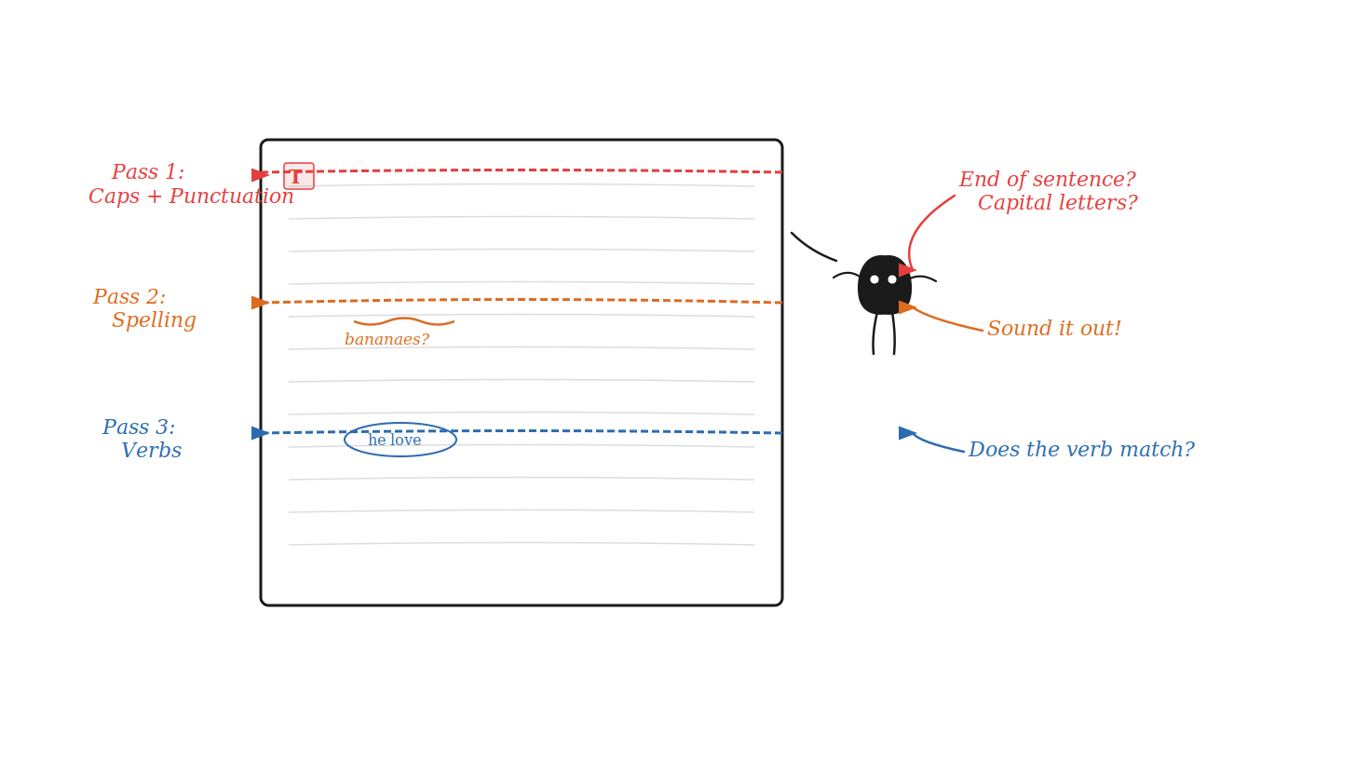
The 3-Step Search Strategy
Notes:
Use your hand to mime three 'sweeps' across the board as you describe each pass. Pass 1 (red): 'Go back and CHECK — did the sentence start with a capital? Does it end with a period?' Pass 2 (orange): 'Sound out each word. Banana-e-s? Is that right?' Pass 3 (blue): 'Point to the verb. Does it match its subject?' Ask Xiaohei fans: 'What is Xiaohei doing here — is he checking once or three times?'

Slide 5
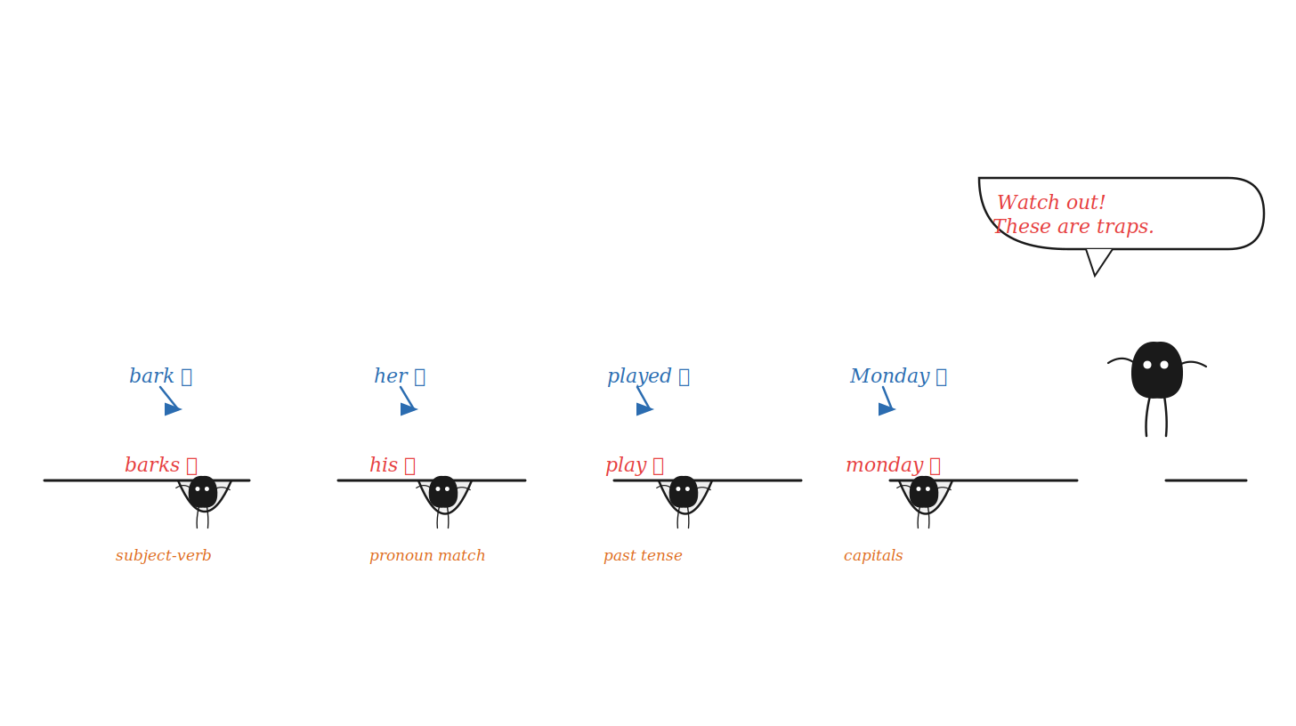
Common TOEFL Traps
Notes:
Point to each trap pit and the little Xiaohei falling in. For each one: read the WRONG form aloud with an exaggerated mistake, then ask 'What's wrong here?' before revealing. Trap 2 (pronoun): 'Sarah is a girl — so should we say HIS bag?' After all four, have students chant: 'Subject-verb! Pronoun! Past tense! Capital!'

Slide 6
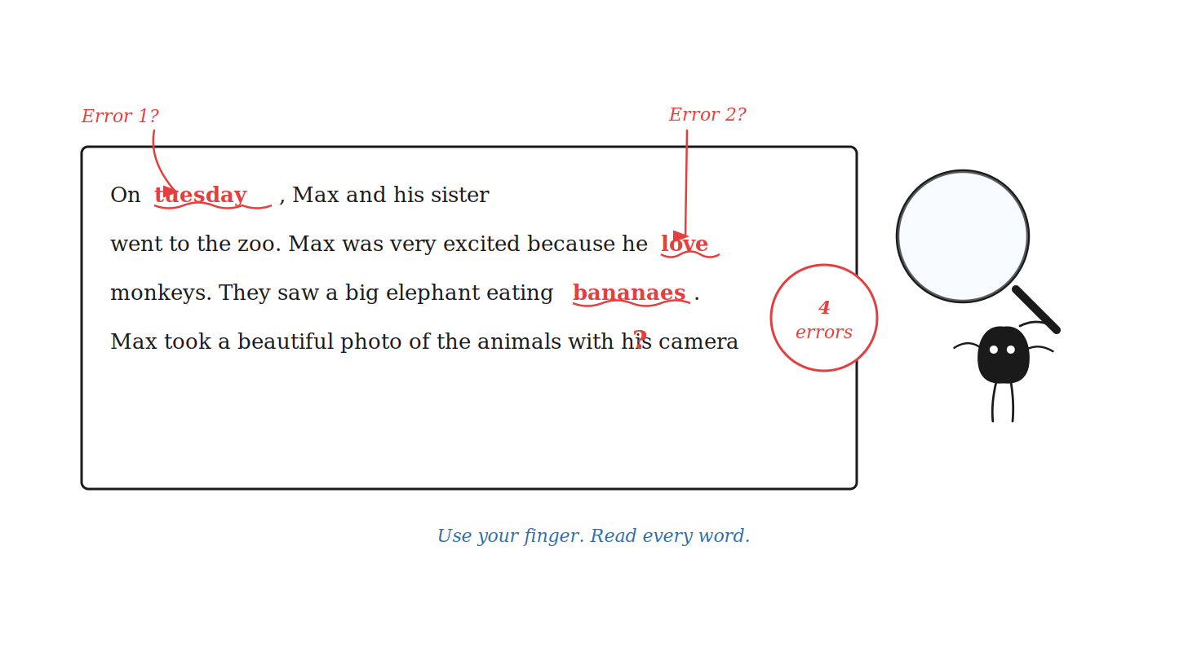
Class Mission: Find the 4 Errors!
Notes:
Tell students: 'Xiaohei already found ONE error — can you find the rest?' Give 90 seconds of silent reading. Then call on students one at a time. After each correct answer: 'Which PASS did you use? Pass 1? 2? 3?' Do NOT show the answer slide yet — build the suspense. Hint if needed: 'Look at the very last word. Something is missing.'

Slide 7
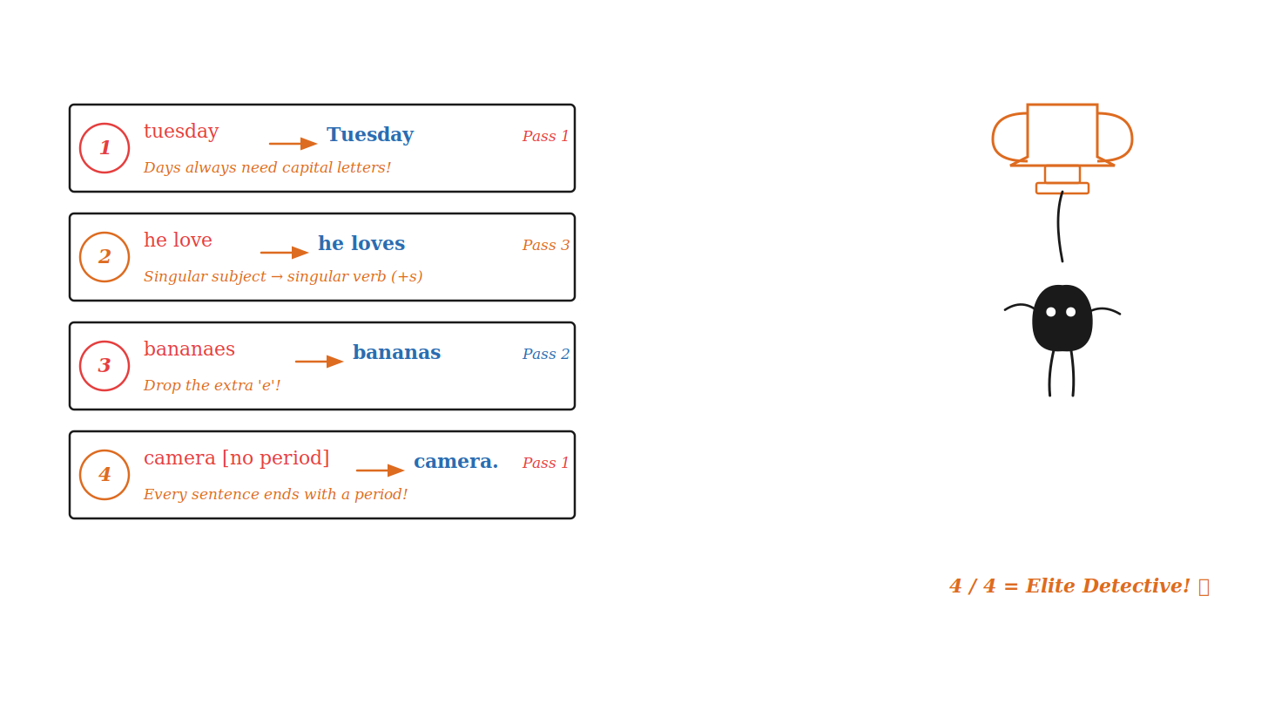
Mission Accomplished!
Notes:
Reveal one correction slip at a time if possible (use animation or cover with a shape). For each: read the rule label aloud and have students repeat it. Point to the Pass tag: 'Which pass catches this one?' At the end: '4 out of 4 = Elite Detective status! How many did you get?' For students who got 2-3: 'Real detectives always get better with practice!'

Slide 8
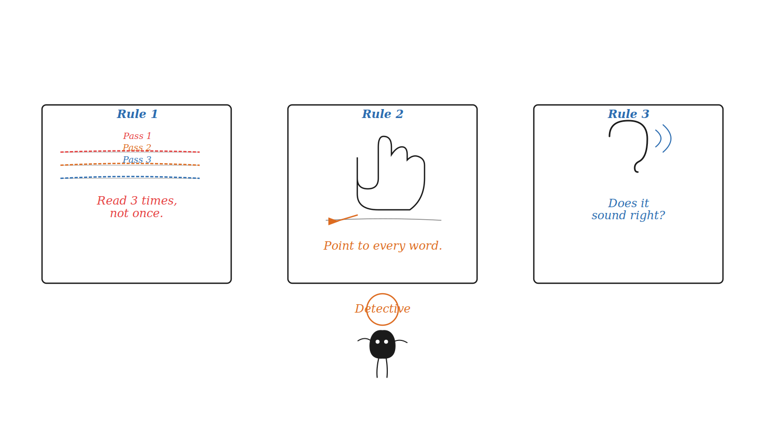
Remember Your Detective Tools!
Notes:
Cover the three cards and ask students to recall each rule from memory. Mime each one: hold up fingers for '3 times', point your finger for Rule 2, cup your ear for Rule 3. Close by asking: 'Name ONE thing you will do differently next time you edit a text.' Xiaohei at the bottom has earned his Detective badge — so have your students.

Slide 9
my friend sam likes to play games. he have a big red ball. We play together at the park
last Saturday, Lily went to the pet shop. She look at the cute kittens. One small kitten was sleeping on a blue blanket
every Sunday, Max goes to the beach with his family. He loves to swim in the blue water. Yesterday, Max build a giant sandcastle near the ocean. His sister helped him decorate it with pretty shells? They had a wonderful day and eat ice cream before going home.

Slide 10
📝 TOEFL Primary Writing Homework: Grammar Detective
Name: _____________________ Date: _____________________
Instructions for Students:
Read the story below carefully.
There are exactly 5 hidden mistakes (Capitalization, Spelling, Punctuation, and Grammar).
Draw a circle around each mistake.
Rewrite the correct words on the lines below the story.
last night, Lily and her brother tom cooked dinner for their parents. They made a delicious pizza with fresh cheese and tomatos. Lily accidentally drop a spoon on the floor, but her brother washed it quickly? Their parents loved the food and said it tasted wonderful

Slide 11
every tuesday afternoon, ben plays soccer with his school friends. He loves to score goals for his team. Last night, ben run across the entire field to catch up to the ball. The goalkeeper tried to block his powerful shot? They won the tough match and drink fresh juic together afterward.
during the summer break, Liam goes camping in the mountains. He love to look up at the bright stars. Last weekend, Liam make a warm campfire to roast sweet marshmallows. A curious animal sneaked into their campsite looking for food? They sat by the fire and sing favorite songs until midnight.
on hot days, Emma visits the city zoo with her class. She loves to watch the tal giraffes. Yesterday, Emma give a crunchy green apple to an old elephant. The monkeys swung wildly from tree to tree above her head? They took a lot of photos and find a cool spot to rest.

Slide 12
The Text Chain:
Alex: hey, did you hear about what happened to Sam at the stadium last night?
Chris: No, what happened?
Alex: well, he lose his front row ticket right before the concert started. He spend an hour looking under all the seats?
Chris: Oh no! Did he ever find it?
Alex: Yeah, a security guard found it and brought it back.
Making a good snack is fun and fast. Yesterday, I wanted to eat an apple with peanut butter. first, I washed the fruit in the sink. I take a small knife and cut the apple. My mom helped me put it on a blue plate? Then I sit down at the table and ate it all up.

