Slide 1

Learning from Data Coursework Presentation
By Reuben Kurian

Slide 2
Research Question
My research question is "Can machine learning models accurately predict stock price movements based on historical market data?“. There are a multitude of reasons as to why anyone should care about my question. These reasons include:
Investment Decision Making
Risk Management
Algorithmic Trading
Market Analysis

Slide 3
Introduction to my Dataset
My dataset consists of historical stock market data from 10 companies The dataset contains information such as:
- company name
- the date
- the trading volume, the opening, closing, high and low prices on this given date.
It is a large dataset, containing 25,161 rows, with data from Apple, Starbucks, Microsoft, Cisco Systems, Qualcomm, Meta, Amazon, Tesla, Advanced Micro Devices, and Netflix, spanning over the course of 10 years.

Slide 4
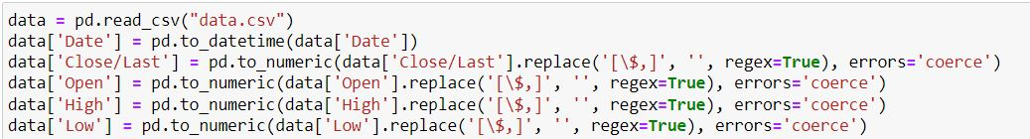
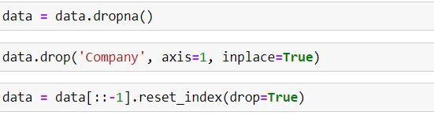
Preprocessing
As shown above, preprocessing was undertaken to ensure that the data was ready to be used by the models.

Slide 5
The type of Machine Learning Technique Used
The machine learning technique I used is regression. I chose regression as my machine learning technique as it makes most sense for the type of data I am working with, and regression would produce the most usable predictions as opposed to classification and clustering, which cannot predict continuous values.

Slide 6
Description of Machine Learning models employed
I have decided to use three machine learning models for my data analysis. One model is a linear regression model, one is a neural network (multi-layer perceptron) regressor model and the other is a random forest regressor model.

Slide 7
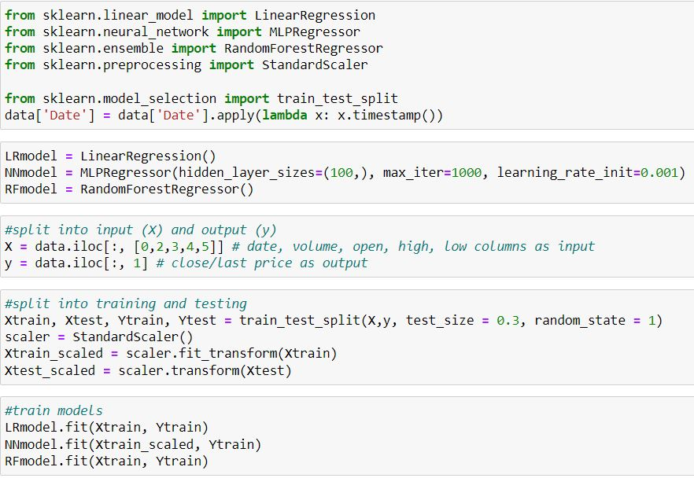
Training the Models
The image on the left shows how I trained the models. I used the sklearn library, which provides me with the various models that I can use.

Slide 8
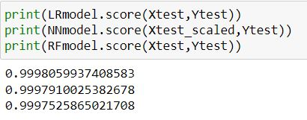
Data Analysis and Results Overview
The image on the left displays the R-squared (R2) scores of the three models. As shown, all of the values are very close together. They are all above 0.999, with the LR model having the highest accuracy at 0.99981 (to 5 decimal places), then the NN model (MLP regressor) having an R2 score of 0.99979, and the RF regressor model having an accuracy of 0.99975. The values being so close to 1 suggests that all of these models are performing extremely well on the dataset.

Slide 9
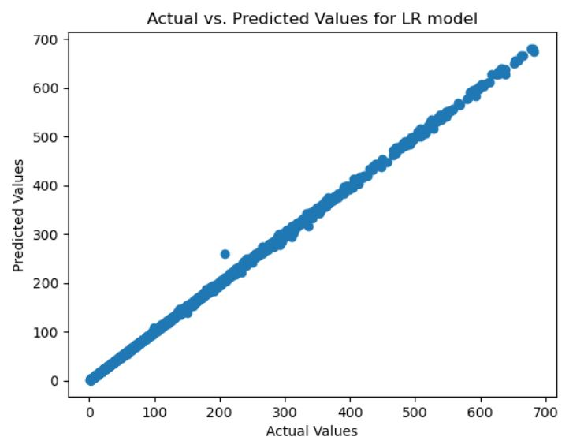
Data Analysis and Results Overview

Slide 10
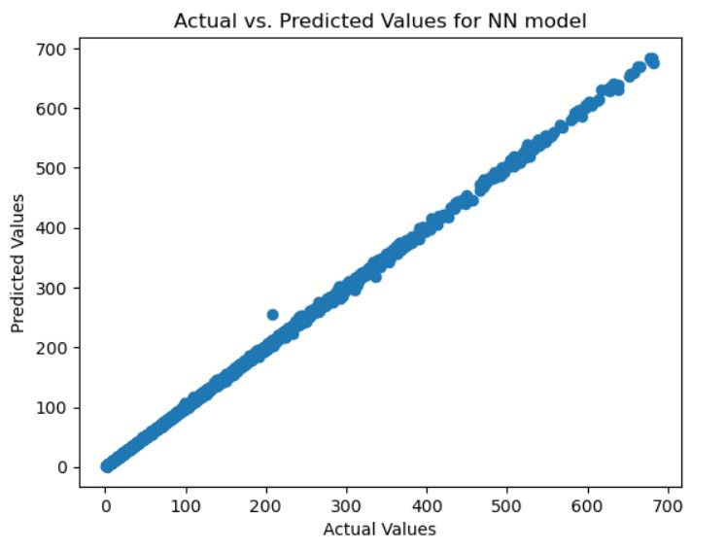
Data Analysis and Results Overview

Slide 11
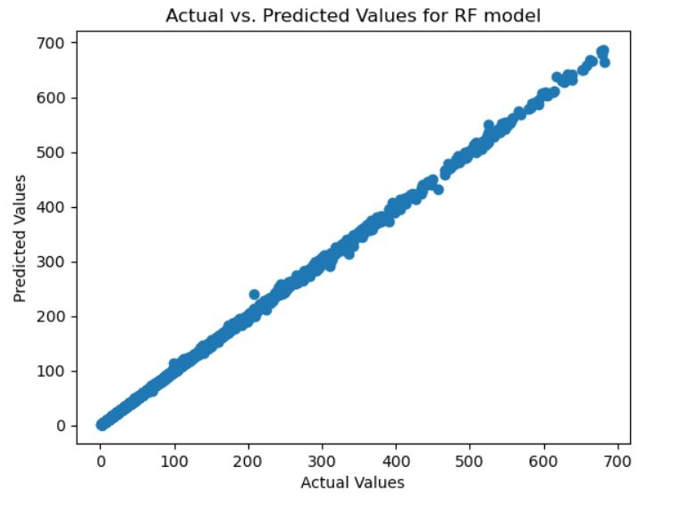
Data Analysis and Results Overview

Slide 12
Limitations of my data and chosen methods
There are a few limitations on my data and the methods I used to obtain my results. The dataset has a few limitations, which include industry bias, the timeframe only being ten years and the dataset only containing stock price data from ten companies.
Limitations on my methods include only using one method of testing the data (only using R2 scores), only using three models, not adjusting hyperparameters for random forests model and not using a different training/testing split to compare results.

Slide 13
Concluding Remarks
Throughout the course of this project, I have learnt how to find datasets, preprocess data, train and test machine learning models and allowed myself to learn more about machine learning techniques, more specifically regression. The key takeaways are that machine learning models that utilise regression can effectively predict stock price movements based on historical data. In the real world, the values may be influenced by many other factors, from financial factors to global events.

