Slide 1


Data Analysis

Slide 2

Today's agenda
Brief Overview of Social Buzz
Problem Statement
Analytics Team Introduction
Data Analysis Process
Findings: Top 5 Content Categories

Slide 3

Social Buzz, founded by two former engineers, aims to emphasize content by keeping users anonymous.
Unique feature: Over 100 ways users can react to content.
Rapid growth with over 500 million active users each month.
Objective: Analyze unstructured data to identify top-performing content categories.
Project Recap

Slide 4

Problem
Problem Statement: Identifying the top-performing content categories based on user reactions.
Importance: Insights into user preferences for content-centric strategy.
Objective: Provide actionable recommendations for enhancing content engagement.

Slide 5




Myself - Data Analyst
Marcus Rompton - Senior Principle
Andrew Fleming - Chief Technical Architect
The Analytics team

Slide 6
Process
1
Data Cleaning: Handled missing values, irrelevant columns, and data types.
Data Merging: Combined Reaction, Content, and ReactionTypes datasets.
Data Aggregation: Calculated total scores for each content category.
Results: Identified the top 5 performing content categories.
2
3
4
5

Slide 7
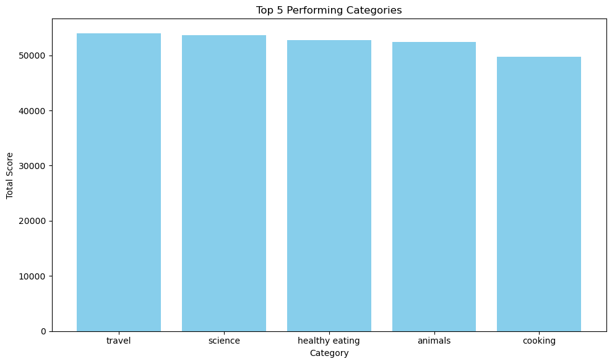

Insights
Total Scores of Top Content Categories
Overview of Content Categories

Slide 8
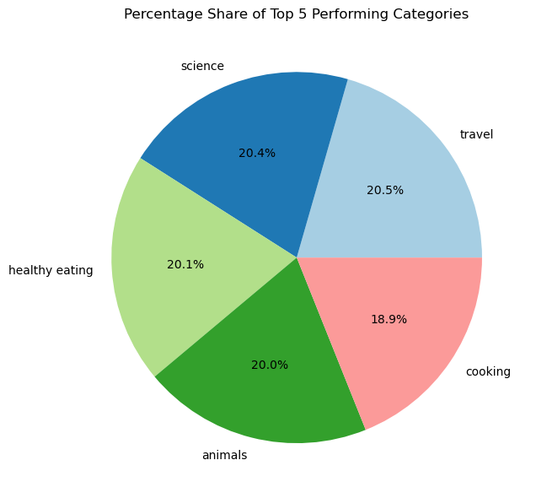

Slide 9
Unique Content Categories
There are a total of 17 unique content categories on Social Buzz.

Slide 10
Engagement with Most Popular Category
The most popular category, 'travel', received a total of 1368 reactions.

Slide 11
Summary
Number of Posts Made Each Month
Monthly Content Trends

Slide 12
Thank you!
ANY QUESTIONS?

