Slide 1
Topic Modelling
Topic 1: Focuses on the in-flight experience including aspects such as cabin, lounge, food, and service quality.
Topic 2: Centers around the pre-flight experience, including aspects like the airport, luggage check-in, and staff interactions.
Topic 3: Primarily discusses different classes and seats available, including premium, economy, and business classes.
Topic 4: A general topic discussing various aspects of the flight experience including seat comfort, food, and staff service.
Topic 5: Focuses on negative experiences such as flight cancellations and poor customer service.

Slide 2
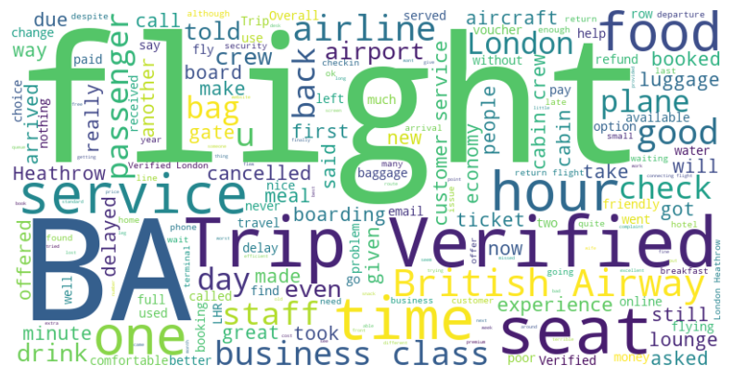
Sentiment Analysis & Word Cloud
Sentiment Distribution:

