Slide 1
Customer Booking Analysis
Data Exploration and Model Evaluation

Slide 2
Data Analysis Summary
Majority of bookings are made via the internet and are round trips.
Most bookings are made with a lead time of less than 100 days.
Majority of the bookings are for flights scheduled around 4-5 AM and 4-5 PM.
New features created: is_weekend, is_morning_flight, and is_long_stay.
Dataset balanced by oversampling the minority class (completed bookings).

Slide 3
Model Evaluation
Model used: RandomForest Classifier
Accuracy: 85.62%
High precision and recall achieved for both classes indicating good performance.

Slide 4
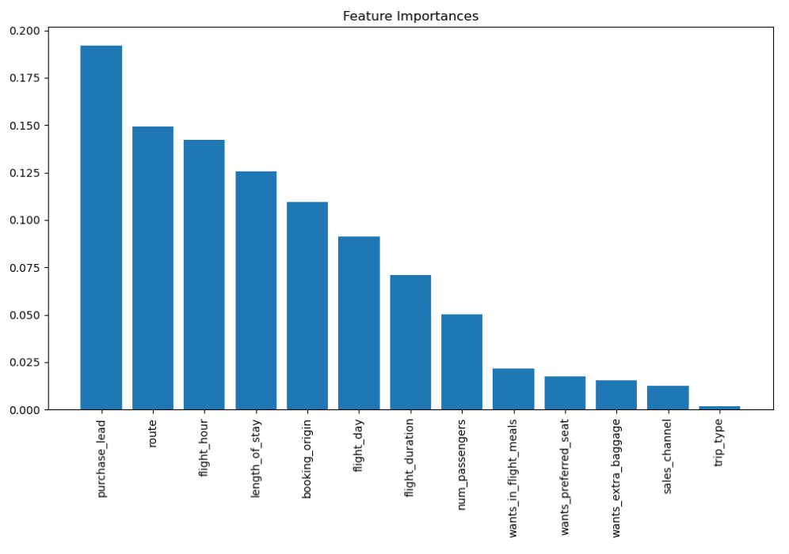
Feature Importance

