Slide 1
Quantium Project Report
Evaluation of Store Trial Performance

Slide 2
Store 77 Analysis
Total Sales, Number of Customers, and Average Transactions per Customer Comparison for Store 77

Slide 3
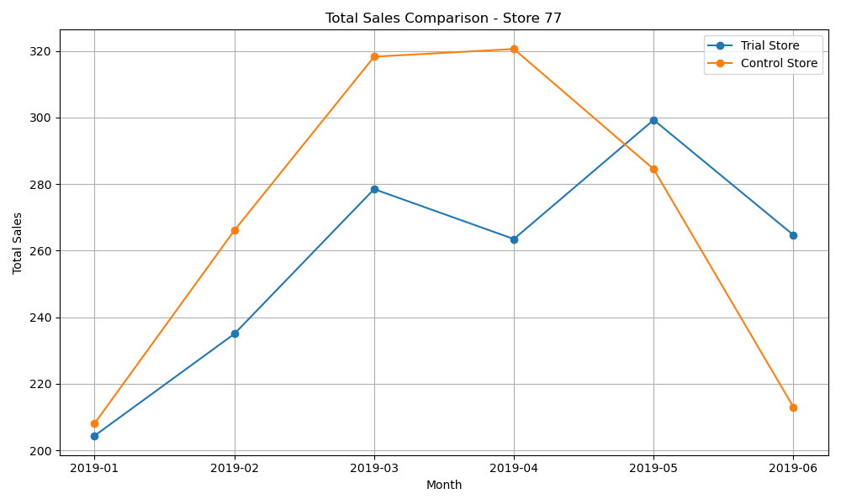
Total Sales comparison – store 77

Slide 4
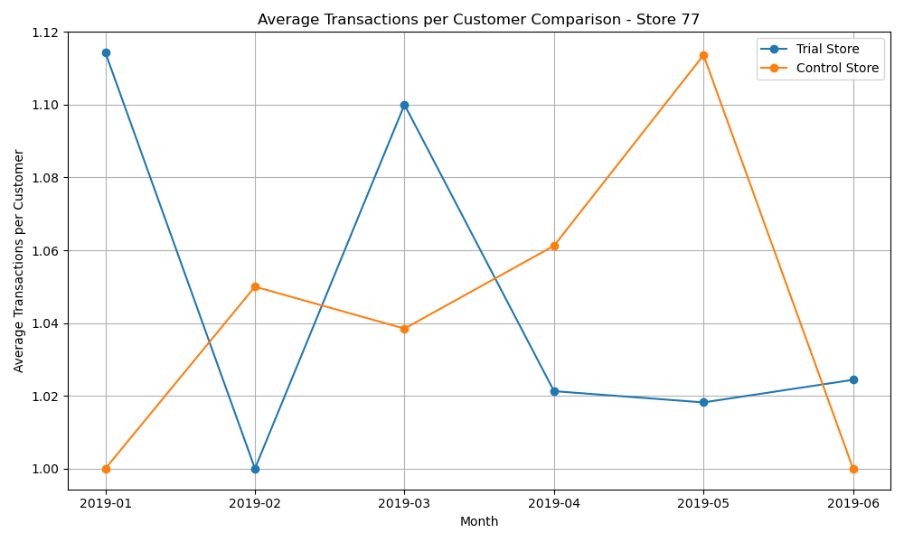
Average transactions per customer comparison – store 77

Slide 5
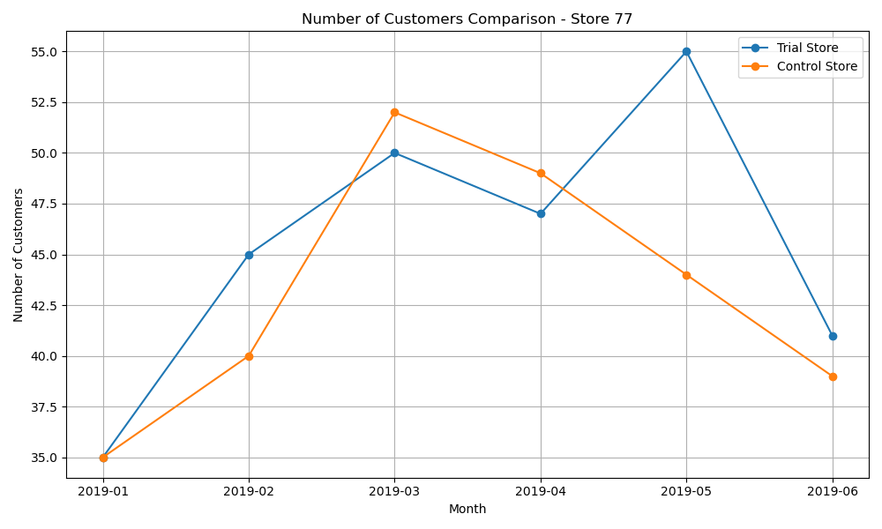
Number of customers comparison – store 77

Slide 6
Store 86 Analysis
Total Sales, Number of Customers, and Average Transactions per Customer Comparison for Store 86

Slide 7
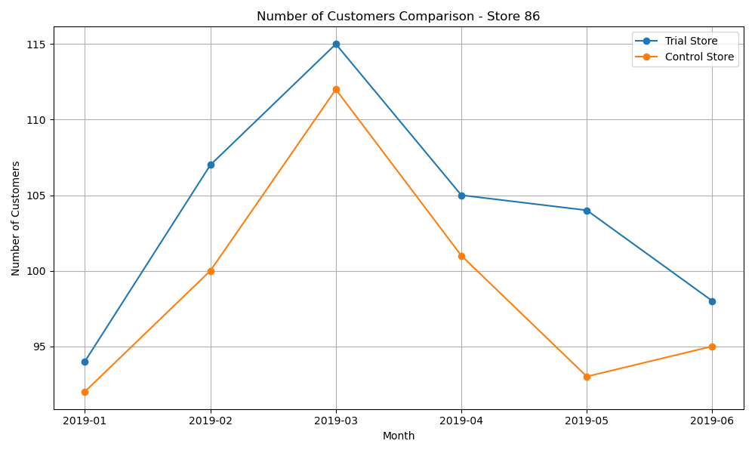
Number of customers comparison – store 86

Slide 8
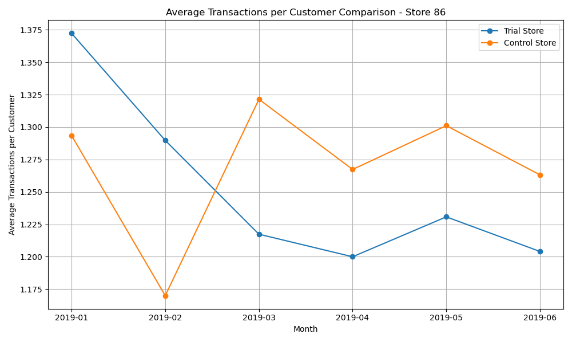
Average transactions per customer – store 86

Slide 9
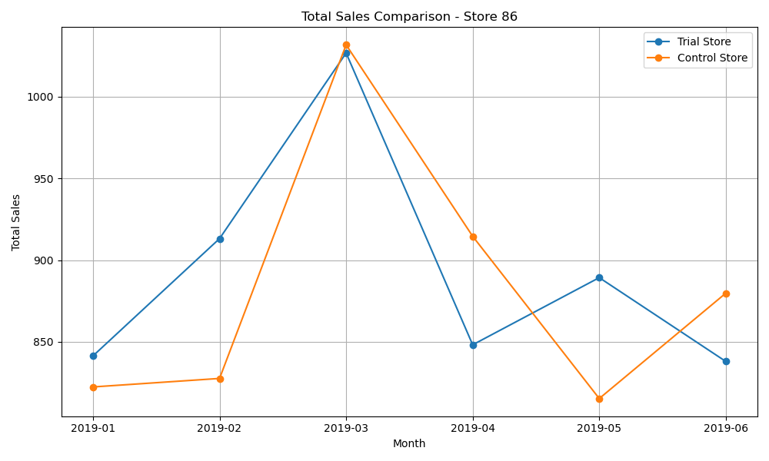
Total sales comparison – store 86

Slide 10
Store 88 Analysis
Total Sales, Number of Customers, and Average Transactions per Customer Comparison for Store 88

Slide 11
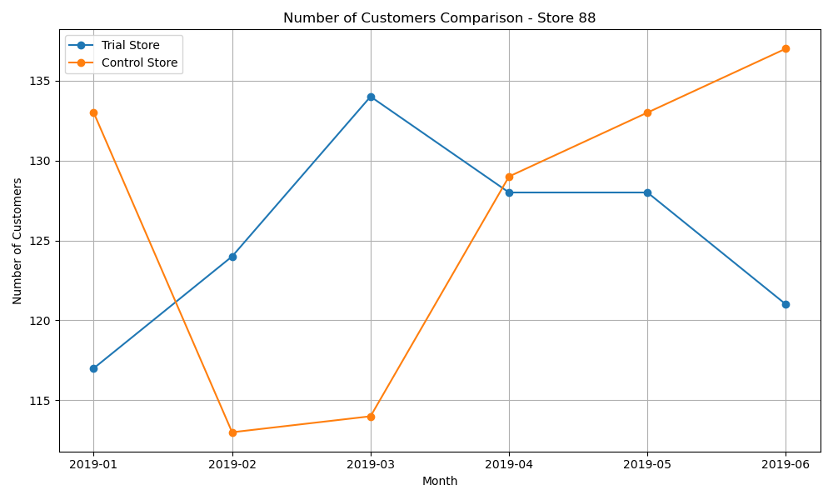
Number of customers comparison- store 88

Slide 12
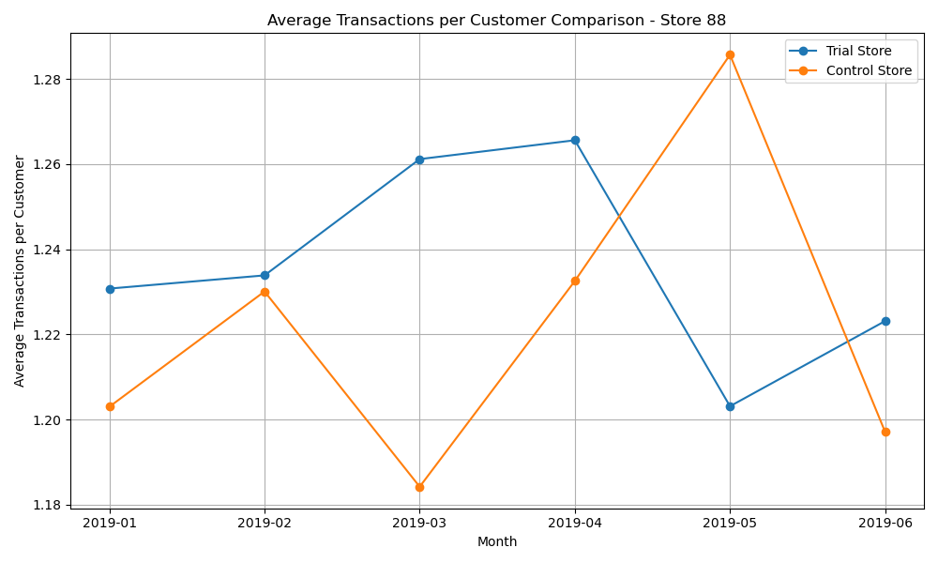
Average transactions per customer comparison – store 88

Slide 13
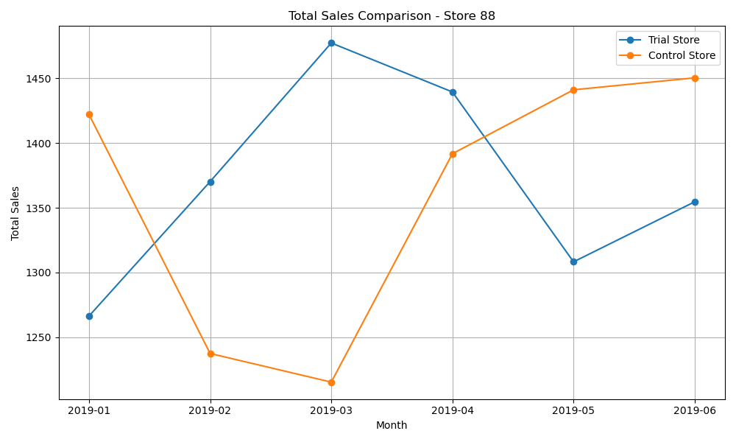
Total sales comparison – store 88

Slide 14
Recommendations
1. Reevaluate Trial Strategy: Consider revising the trial strategy, such as extending the trial period, modifying promotional tactics, or selecting different trial stores to achieve a more noticeable impact.
2. Further Analysis: Conduct a more detailed analysis to identify any potential trends or patterns that might not be captured by the overall sales metrics. This could include customer feedback, product-specific performance, or regional differences.
3. Targeted Promotions: Implement targeted promotions for high-frequency purchasers to increase loyalty and spending.
4. Stock Optimization: Focus on stocking the most popular pack sizes (175g, 150g) to ensure availability and meet customer demand.
5. Brand Partnership Opportunities: Leverage the popularity of top brands to negotiate better deals or co-promotional opportunities.
6. Customer Segmentation: Use the purchase behaviour data to segment customers based on their lifecycle stage and premium status. Tailor marketing campaigns to each segment.
7. Cross-Selling and Upselling: Introduce complementary products in the same category or related categories (e.g., dips, sodas) to increase basket size. Highlight these products during checkout or through personalized recommendations.

