Slide 1

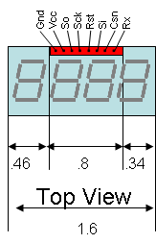
Gnd
Vcc
So
Sck
Rst
Si
Csn
Rx
.75
.46
.8
.34
Top View
1.6

