Slide 1

Woof Wisdom
By
Neta Vega
Reut Hakiki
Tamar Ben-Hillel

Slide 2



Help Us to choose a logo

Slide 3
What is the problem you are trying to solve ?
Currently the market suggests verity of dog’s care solutions like vet forums, doggisiter, medication track, stool analyzer etc.

Slide 4


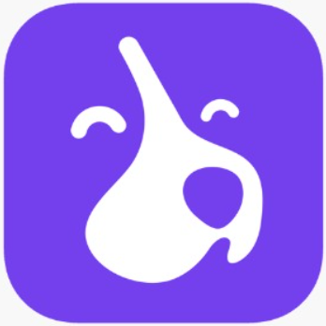
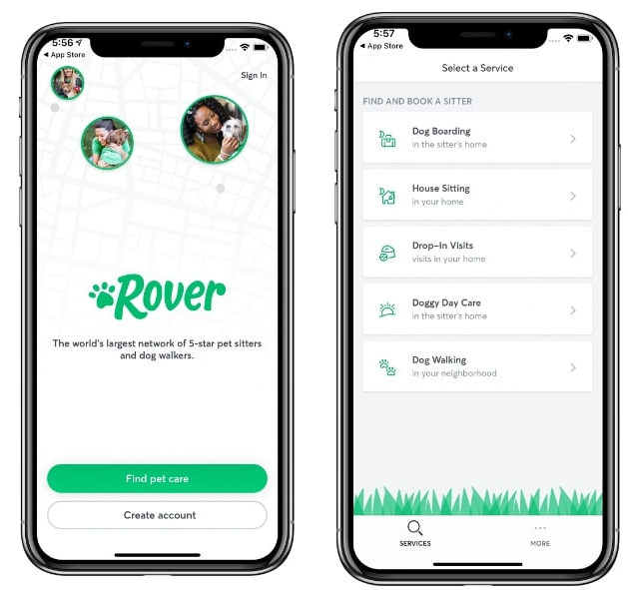
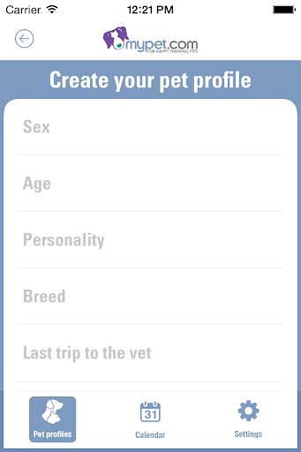
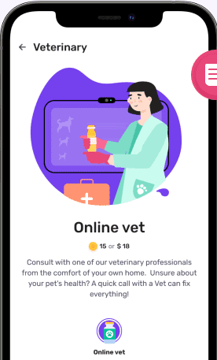
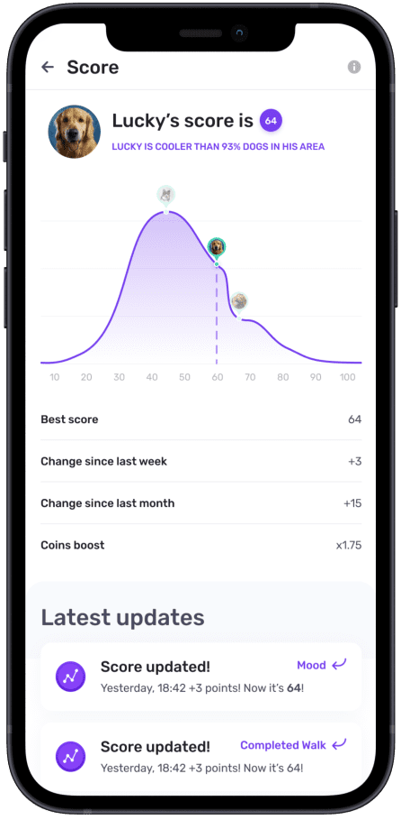
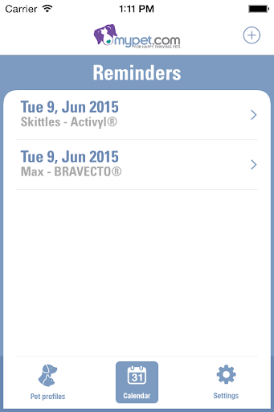
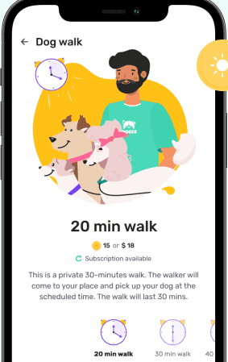
MYPET REMINDERS
Keeping track of your pet's veterinarian appointments and medications
ROVER
Dog sitter, pet boarders, house sitters
Dogiz
Track your dog’s health & fitness and earn Dogiz coins, which you can use as discounts on premium dog food, online vet visits, and professional pet care services!

Slide 5



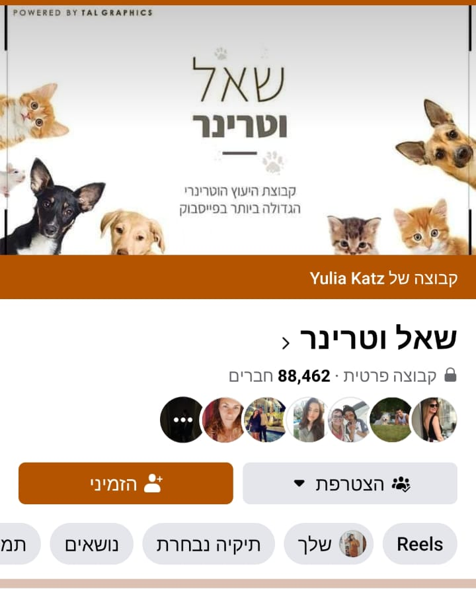
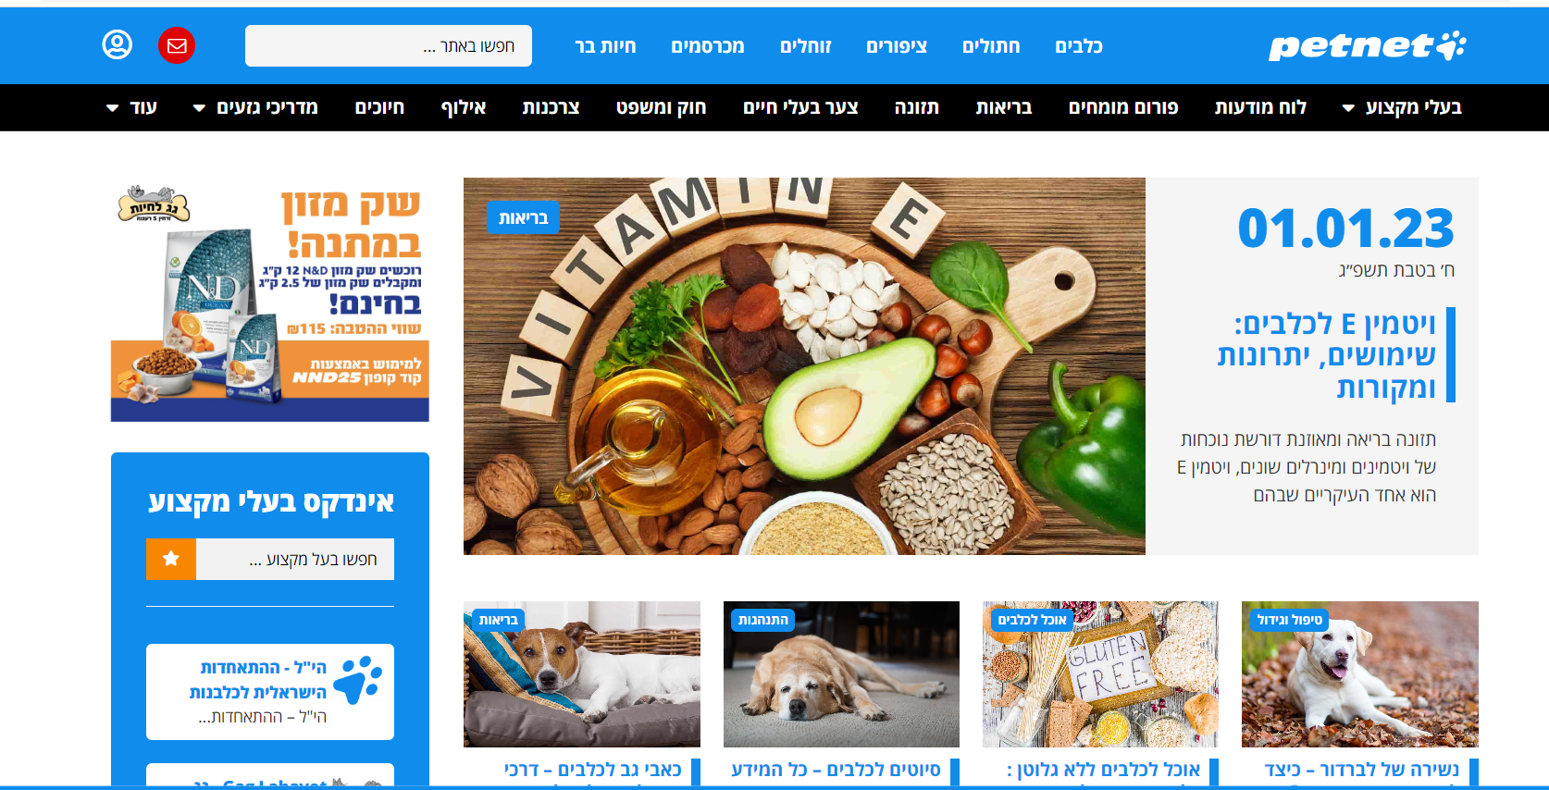
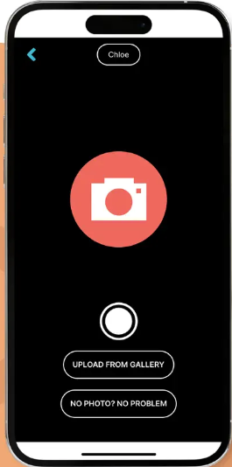
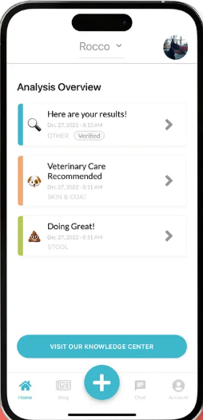
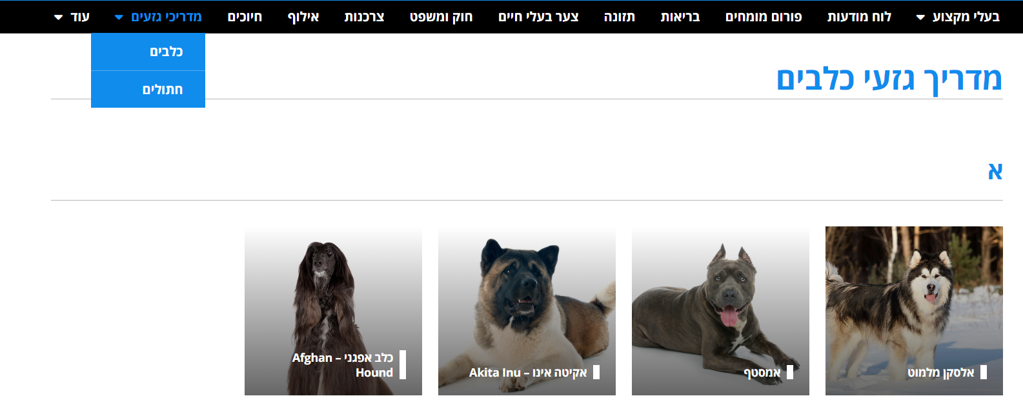
Ask the Vet
A Facebook group that serves as a platform for consultation with veterinarians about all animals free of charge.
PETNET
Dog owner's assistance - get information on your dog breed and consult with experts from the field of dog training
DIG LABS
Weird poop? Funky rash? Give your dog a voice between vet visits and perform a FREE 10-second health check to analyze your dog’s stool or skin, now WITH OR WITHOUT PHOTOS

Slide 6
How do you intend to approach the problem ?
One place, app or web that unites all dog’s owner needs.
The app will contain the following functionality:
Forums with vet, trainers , doggisiter
Breed information (how to treat, unique characteristics etc)
Bot medical consultation
Stool analyzer
Puke analyzer
Eyes and ears analyzer
Treatment of parasites
Vaccinations required and prices
Reminders
Record of immunizations
A veterinarian/veterinary hospital closest to your home
Diagnosing dangerous food

Slide 7
Are there other approaches ?
Notes:
What? Need to ask Hadar

Slide 8

Who are the expected users of the application ?
Notes:
Guess who???

Slide 9
Are there any external dependencies ?
Notes:
Need to ask Hadar

