Slide 1

Woof Wisdom
By
Neta Vega
Reut Hakiki
Tamar Ben-Hillel

Slide 2



Help Us to choose a logo

Slide 3

What is the problem you are trying to solve ?
Currently the market suggests verity of dog’s care solutions like vet forums, doggisiter, medication track, stool analyzer etc.

Slide 4
How do you intend to approach the problem ?
One place, app or web that unites all dog’s owner needs:
Get information, consult with experts, get medical suggestions from bot and learn more about medical care available to you.

Slide 5
Main features:
Forums with vets, trainers , doggisiters
A veterinarian/veterinary hospital closest to your location
Diagnosing dangerous food

Slide 6
Main features:
Bot medical consultation:
Stool analyzer
Puke analyzer
Eyes and ears analyzer
Treatment of parasites

Slide 7
Main features:
Breed information (how to treat, unique characteristics etc)
Vaccinations required and prices:
Reminders
Record of immunizations

Slide 8



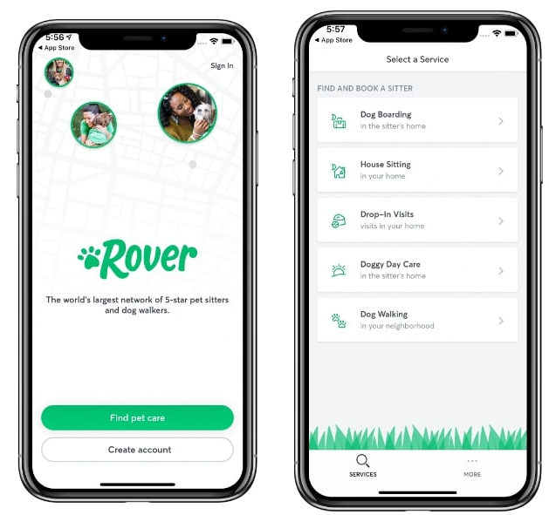
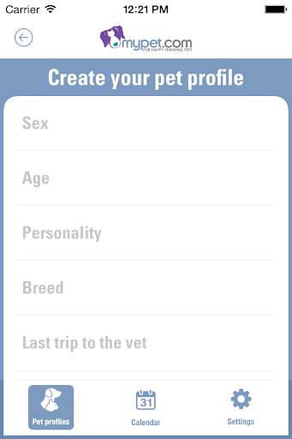
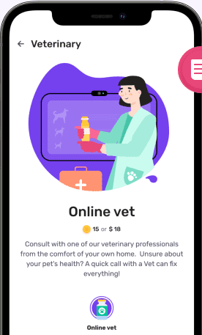
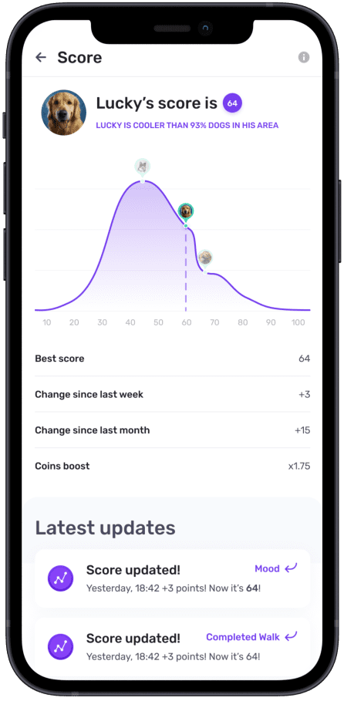
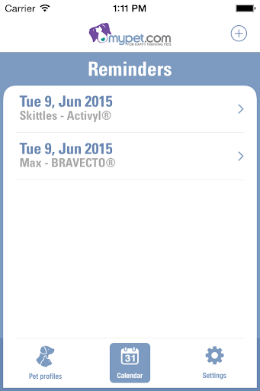
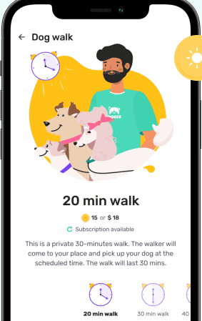
MYPET REMINDERS
Keeping track of your pet's veterinarian appointments and medications
ROVER
Dog sitter, pet boarders, house sitters
Dogiz
Track your dog’s health & fitness and earn Dogiz coins, which you can use as discounts on premium dog food, online vet visits, and professional pet care services!

Slide 9



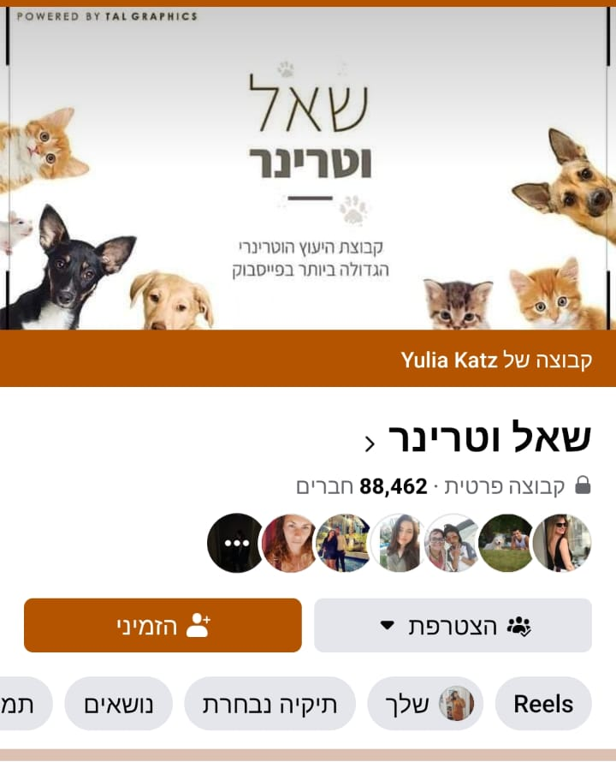
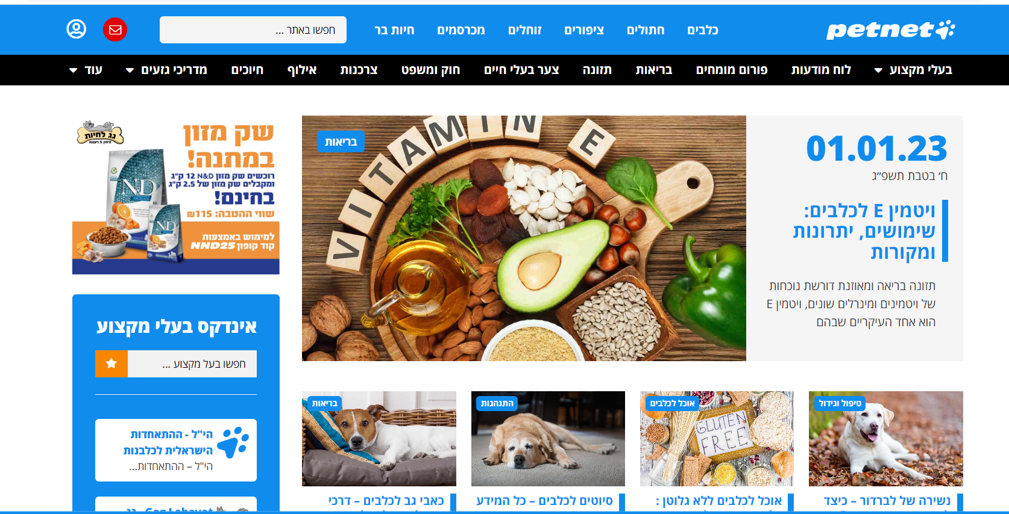
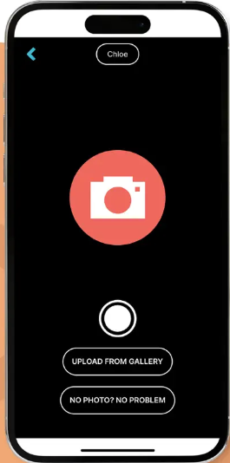
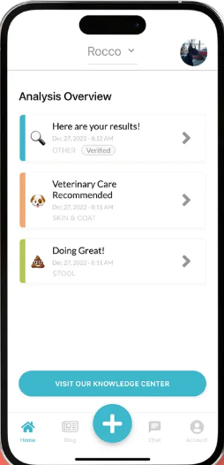
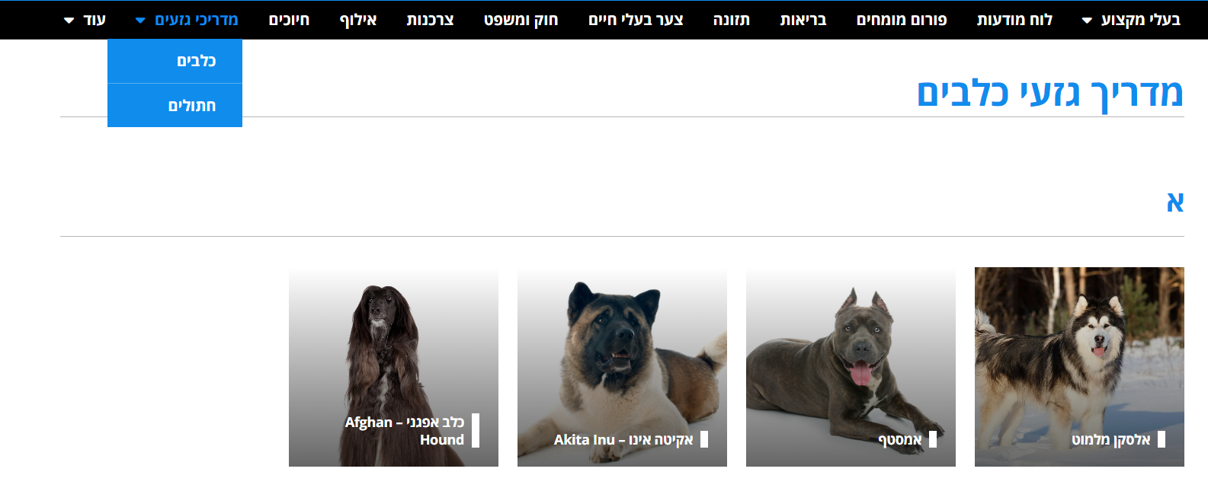
Ask the Vet
A Facebook group that serves as a platform for consultation with veterinarians about all animals free of charge.
PETNET
Dog owner's assistance - get information on your dog breed and consult with experts from the field of dog training
DIG LABS
Weird poop? Funky rash? Give your dog a voice between vet visits and perform a FREE 10-second health check to analyze your dog’s stool or skin, now WITH OR WITHOUT PHOTOS

Slide 10
Are there other approaches ?
Website – less accessible and less convenient to use anywhere
Few applications – each concentrating on different subject – less convenient to the user
Notes:
What? Need to ask Hadar

Slide 11
Who are the expected users of the application ?
Different types of users for dog owners, vets, doggisiters, trainers
Notes:
Guess who???

Slide 12
Are there any external dependencies ?
External databases containing information about dog breeds
Location services
Notes:
Need to ask Hadar

Slide 13

Thank you for listening

