Slide 1
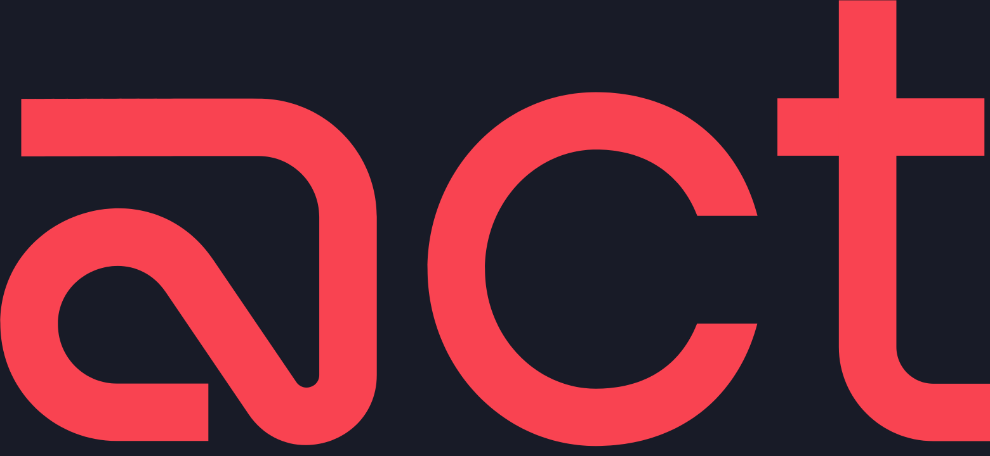
SENIOR PRODUCT DESIGNER · HOME ASSIGNMENT
Designing the Integrations page
for Act Security
The page where a security engineer connects their tools - and sees exactly what access they grant before anything happens.
Live React prototype
Trust-first flow
Setup Copilot
Live prototype act-senior-prototype.lovable.app Design system reutkabilo-spec.github.io/Act-Security
Integrations
01 / 24

Slide 2
THE REFRAME THAT DRIVES THE PAGE
Integrations aren’t just a marketplace. They’re Act’s activation surface.
Legacy tools treat integrations as data sources feeding a dashboard. Act’s preemptive bet reframes the page as an active setup surface - not a wall of logos.
YESTERDAY · REACT
ACT · PREEMPT
Detect → triage → respond, after exposure
Integrations = sources feeding a dashboard
Success = more findings, more visibility
A passive logo marketplace
Map access → harden → close risky paths
Integrations = how Act receives context and enables action
Success = least privilege by default, paths closed
An active activation surface
Based on Act’s public positioning - treated as my product hypothesis, not inside knowledge.
Integrations
02 / 24

Slide 3
WHO I DESIGNED FOR
The operator who activates value - not a casual browser
The page is for the person building the setup and putting their name on it - technical, precise, trustworthy, never dumbed down.
PRIMARY
SECONDARY
SECONDARY
CONSUMER
Cloud Security Engineer
CISO
DevOps / Platform
SOC analyst
Technical operator. Owns credentials, scopes, connection health. Designs the setup.
Coverage, confidence, risk reduction. Reads status, not config.
Cloud creds, IaC pipelines, environment scoping.
Consumes signal downstream - does not configure integrations.
Integrations
03 / 24

Slide 4
WHO I DESIGNED FOR - AND WHAT THEY ACTUALLY FEEL
Setup is a high-trust, high-risk moment
The operator is a Cloud Security Engineer - technical, precise, accountable - granting a security platform access to highly sensitive cloud and identity systems. The dominant emotion isn’t curiosity; it’s permission anxiety.
Permission anxiety
Setup anxiety
Recovery anxiety
“What exactly can it touch? Can it change things? Am I widening my attack surface by connecting a security tool?”
“Did I scope this correctly? What breaks if I get a credential or a write scope wrong?”
“If this fails, or I revoke it later, what stops working - and will I know in time?”
Design principle Answer the trust questions before asking for a single credential.
Integrations
04 / 24

Slide 5
WHAT I LEARNED FROM BENCHMARKS
Patterns I borrowed - and where they show up
I studied how mature platforms handle integrations, then translated the recurring patterns into Act-specific decisions.
PRODUCT PATTERN
WHAT I BORROWED FOR ACT
Wiz · Orca
Frame integrations by security value - not a wall of vendor logos.
Microsoft Sentinel
Connector health matters after setup, not only during it.
Datadog
Technical setup needs strong guidance, credential clarity and recovery.
Okta · Slack
Consent should be simple, explicit and reversible.
ServiceNow
Ownership, audit trail and admin visibility build trust.
Patterns observed from public product behaviour and docs - adapted, not copied.
Integrations
05 / 24

Slide 6
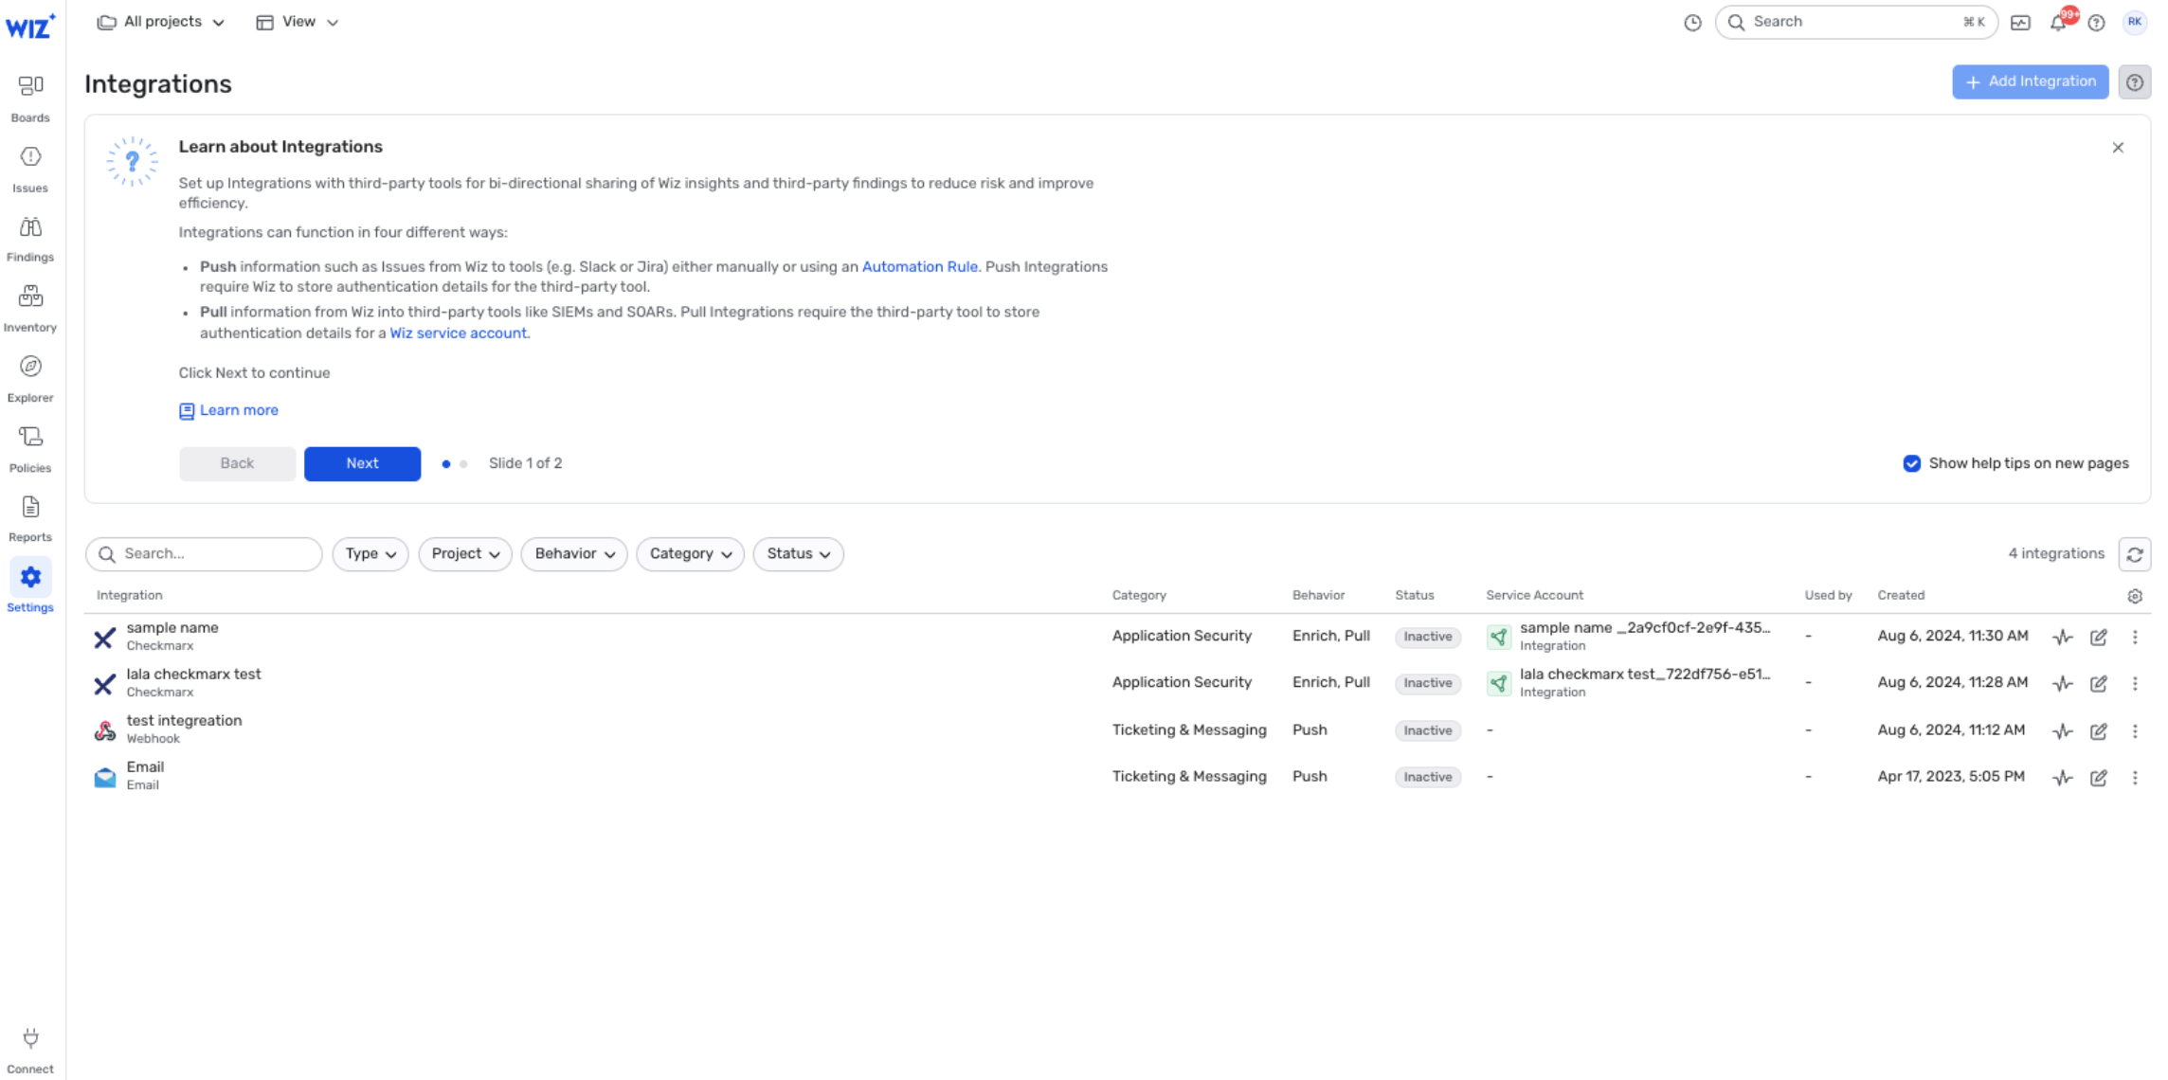
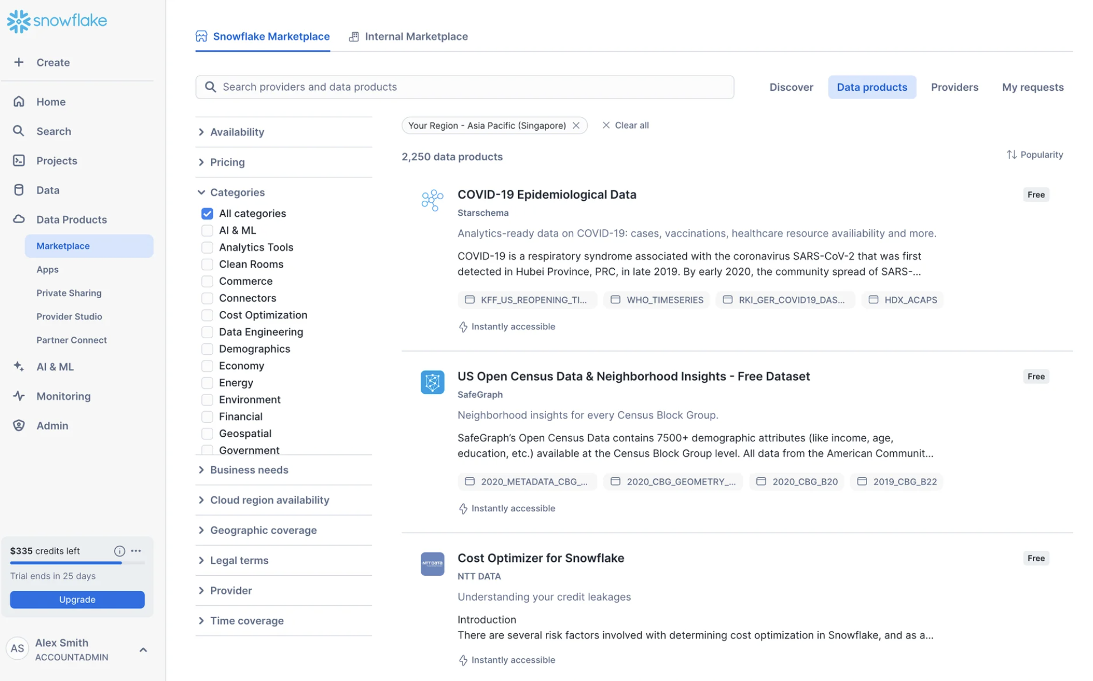
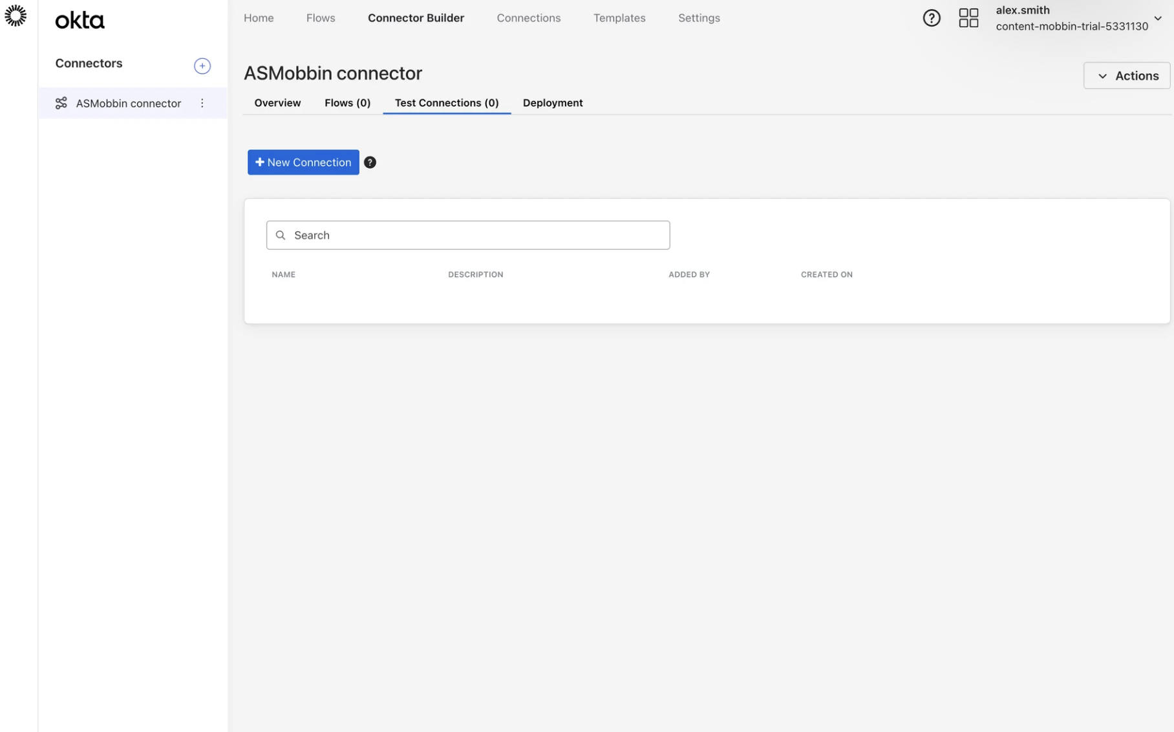
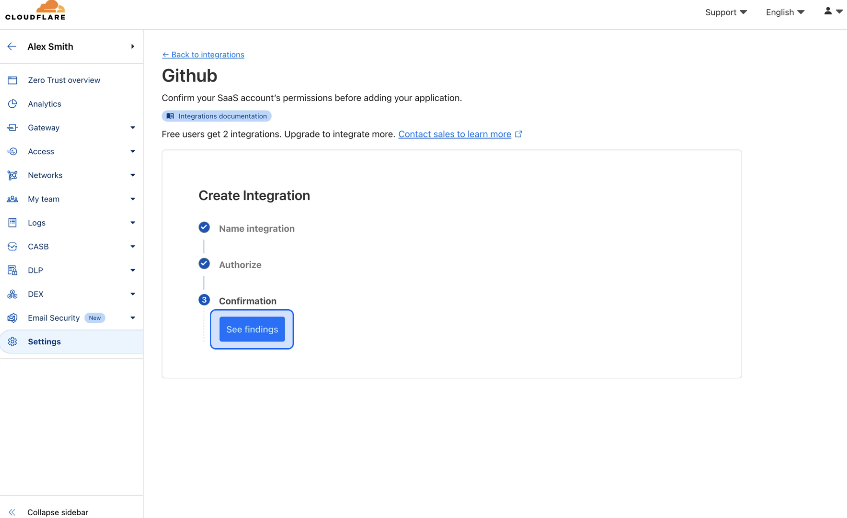
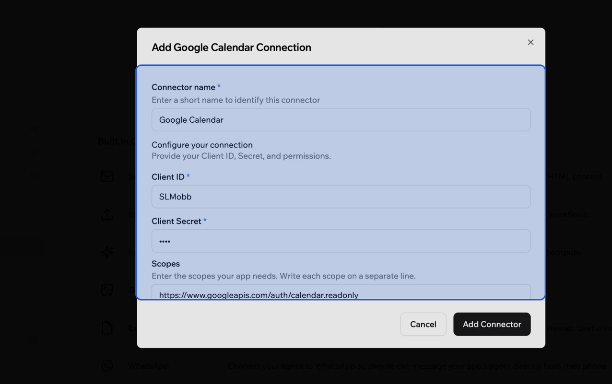
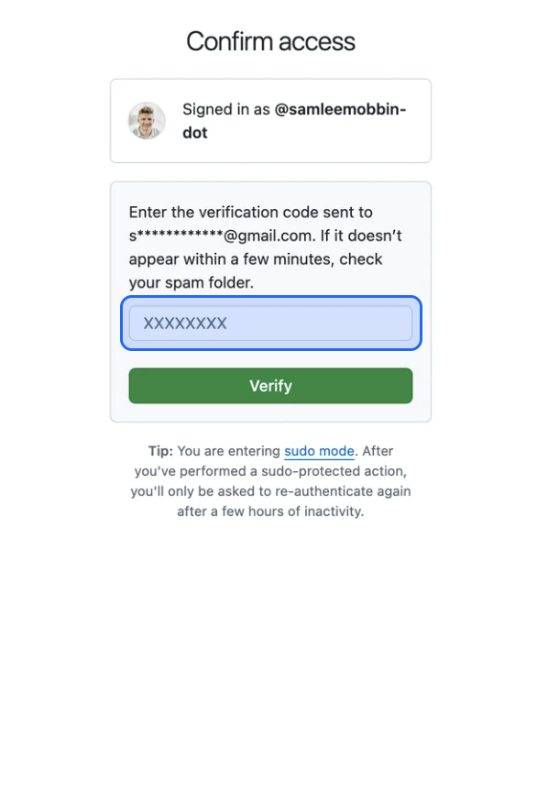
VISUAL RESEARCH · THE SCREENS I STUDIED
I pulled the real screens apart before drawing mine
Each gave one concrete pattern - and together they shaped one decision: make setup guided, reversible, and status-driven.
Wiz
Snowflake
Okta
Catalog as ecosystem coverage - not a logo wall.
Faceted marketplace: search + categories at scale.
Lifecycle tabs: Overview · Flows · Test · Deploy.
Cloudflare
Connector OAuth
GitHub
Vertical stepper: Name → Authorize → Confirm.
Scopes shown in the consent modal before granting.
Sudo-mode re-confirm before a sensitive action.
Integrations
06 / 24

Slide 7
USER-RESEARCH SYNTHESIS
From trust needs to concrete design responses
Each need maps to a specific affordance you can see in the live prototype.
USER NEED
WHY IT MATTERS
MY DESIGN RESPONSE
Know what is accessed before consenting
Granting cloud access can feel risky and hard to reverse
“Data Act will access” + “Act will never…” shown pre-credentials
Least privilege by default
Write access widens blast radius
Read-only recommended; write scopes optional, off by default
Confidence it is wired correctly
Silent misconfig = security blind spot
Test connection before enabling; “Connected” = data flowing
Safe recovery
Fear of breaking production
Disconnect names what stops; revoke anytime; reconnect keeps config
Accountability
Enterprise & audit requirements
Owner, required role, last change, audit log per integration
Integrations
07 / 24

Slide 8
THE DESIGN SYSTEM OF DECISIONS
Five principles I designed every screen against
Each principle answers an operator anxiety - and shows up, made concrete, in the prototype.
01
02
03
Progressive disclosure
Trust before credentials
Honest status
One decision at a time. Day-0 shows a single next step; depth unfolds only when asked.
What Act reads, what it never does, and least-privilege defaults - shown before any secret.
“Connected” means data is flowing - not “saved.” Every failure names its cause and fix.
04
05
Recoverable by design
AI guides, never autopilots
Reconnect keeps config; disconnect names what stops; revoke anytime. No dead ends.
Setup Copilot recommends, explains and unblocks. The operator approves every access decision.
Designed for faster time-to-first-value · fewer failed setups · connector health stays visible · less support load
Integrations
08 / 24

Slide 9
INFORMATION ARCHITECTURE
Grouped by what Act does - not A to Z
The catalog is organized into three dependency tiers, built bottom-up. Foundation is the only mandatory tier - connect it and Act is set up. Context and Action enrich from there, so progress never demands all 17 connectors.
FOUNDATION
MANDATORY
Core visibility Cloud & identity
100% when all connected
AWS · Okta · Microsoft Entra ID · Azure · GCP
↓ feeds risk context
CONTEXT
ENRICHES
Risk context SIEM & evidence
optional
Splunk · Microsoft Sentinel · QRadar · Elastic Security
↓ routes to action
ACTION
AUTOMATES
Response workflow Ticketing & remediation
optional
Jira · ServiceNow · Slack · Teams · XSOAR · Tines · GitHub
Integrations
09 / 24

Slide 10
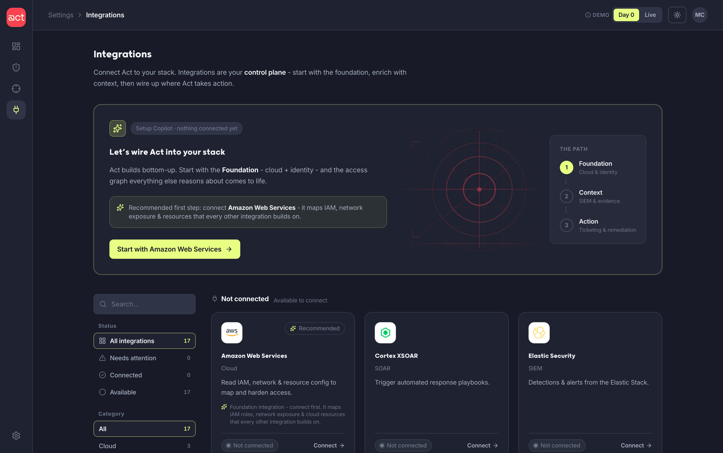
PRINCIPLE 1 · PROGRESSIVE DISCLOSURE
One clear next step, depth on demand
Start with one move
A new account shows a single recommended step - connect AWS - not everything at once.
Show the path
It maps the route that step kicks off: Foundation, then Context, then Action.
Detail when needed
Scopes, audit and advanced options stay hidden until you open the flow.
Integrations
10 / 24

Slide 11
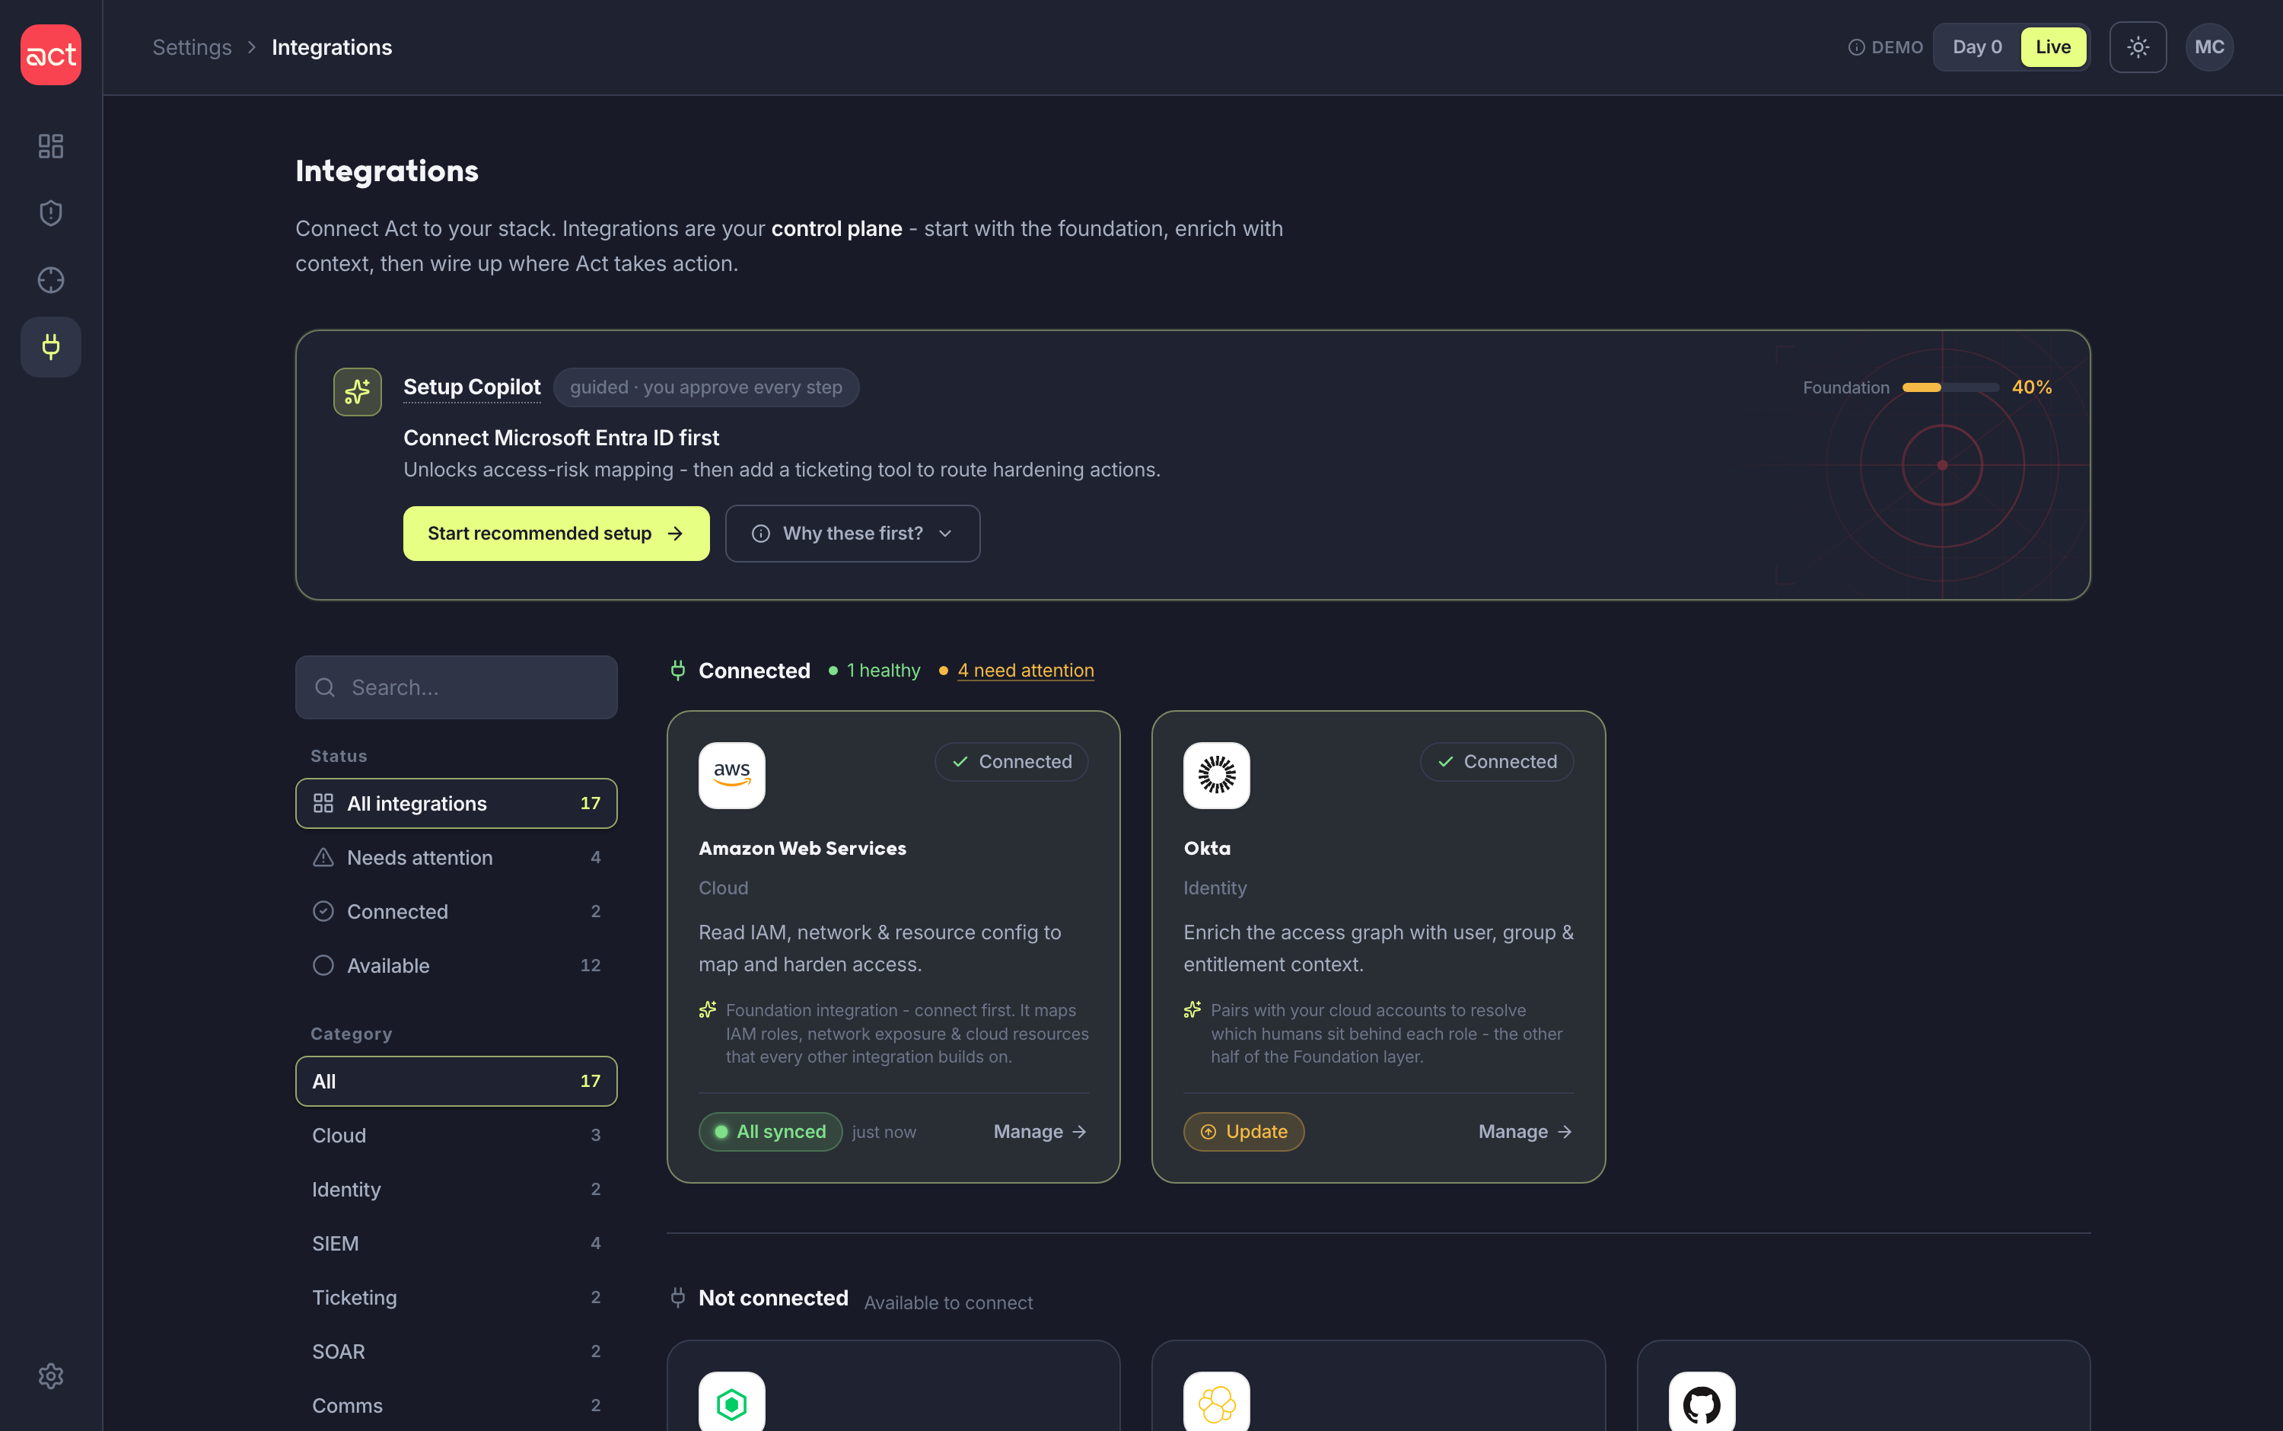
DESIGNED FOR THE WHOLE TIMELINE, NOT A DEMO
Two entry states: Day 0 and Live
A prototype toggle flips between the two stories the page must hold - the empty first-run account, and the populated, in-use account where things drift, fail and need updates.
DAY 0 · START MODE
LIVE · POPULATED MODE
Nothing connected - a guided get-started hero solves the blank-slate problem.
Connected, degraded, failed & update-pending - solves day-to-day operations.
Integrations
11 / 24

Slide 12
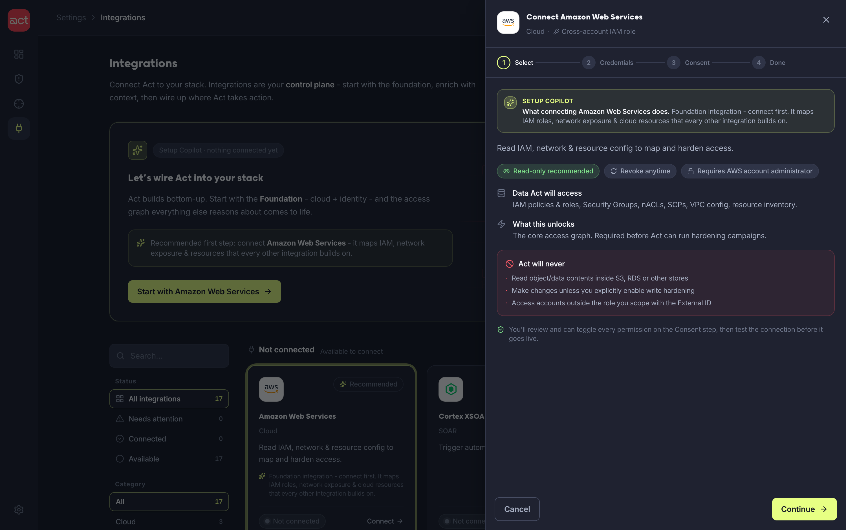
THE GUIDED CONNECT FLOW
Select → Credentials → Consent → Integrate
A right-hand panel keeps the catalog in context throughout. Step one is pure trust - what Act reads, what it never does, the required role - before any credential.
1 Select
A plain-English Copilot line, then the trust-first overview: data accessed, “Act will never…”, read-only recommended, required role.
2 Credentials
Branches by auth type - AWS IAM role, SaaS OAuth, SIEM API token - with “where do I find this?” help.
3 Consent
Scopes grouped read vs write, each with a reason. Test the connection before enabling.
4 Integrate
Success, what happens next, plus owner, role and audit trail.
Integrations
12 / 24

Slide 13
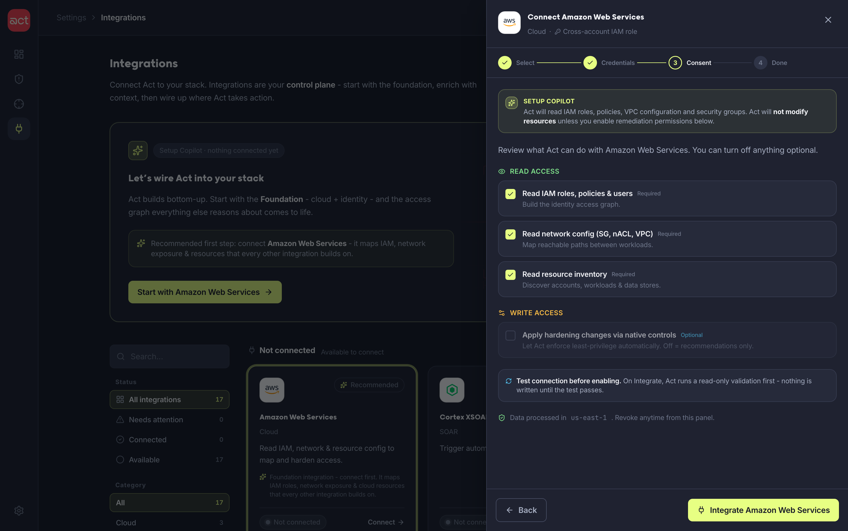
TRUST BEFORE CREDENTIALS
Least privilege by default - write is opt-in
Granting cloud access can feel risky and hard to reverse, so consent is the most carefully designed step. Read scopes are required and explained; write scopes are off by default; no write action is enabled without explicit consent and validation.
Read vs write, grouped
Each scope states what it unlocks - not just an API name.
Write is off by default
Hardening writes are optional and clearly recommended-off.
Test before enabling
Nothing is written until the connection test passes.
Revoke anytime
A reversible decision, stated as reversible.
Integrations
13 / 24

Slide 14
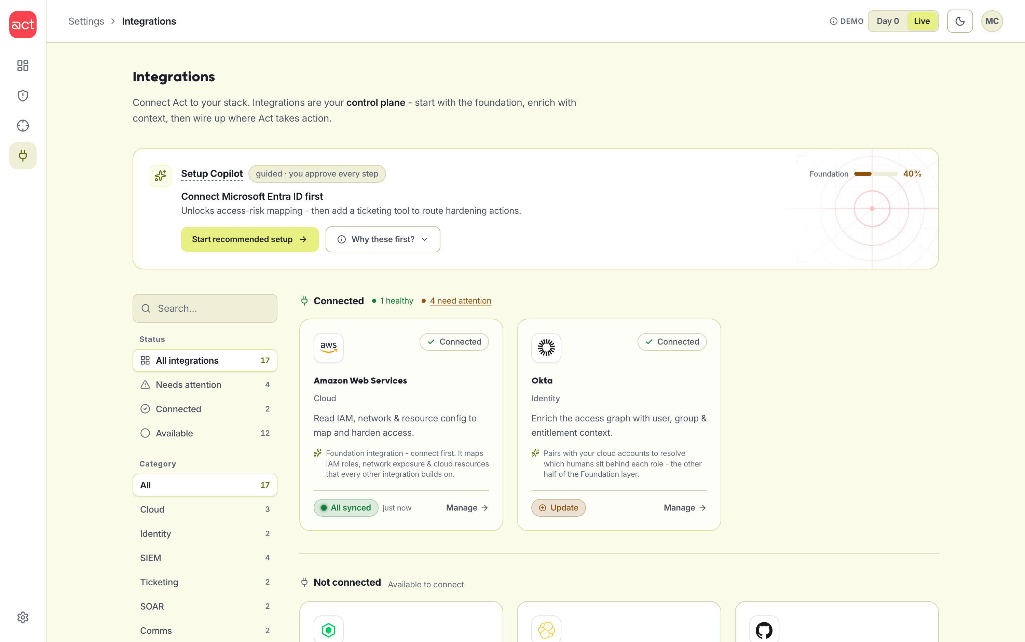
STATUS & ERROR MODEL
“Connected” must mean data is flowing
If expected data stops arriving, the status degrades automatically. Eight honest states, color-coded - so health reads at a glance and a silent “saved” never passes for “working.”
Connected Data flowing - “last synced 4m ago.”
Syncing First data pull in progress.
Degraded Partial - some scopes stopped.
Needs attention Re-auth, missing scope or stale.
Error / Failed Validation failed - cause + fix.
Not connected / Available / Disabled Ready to set up, or paused by an admin.
Integrations
14 / 24

Slide 15
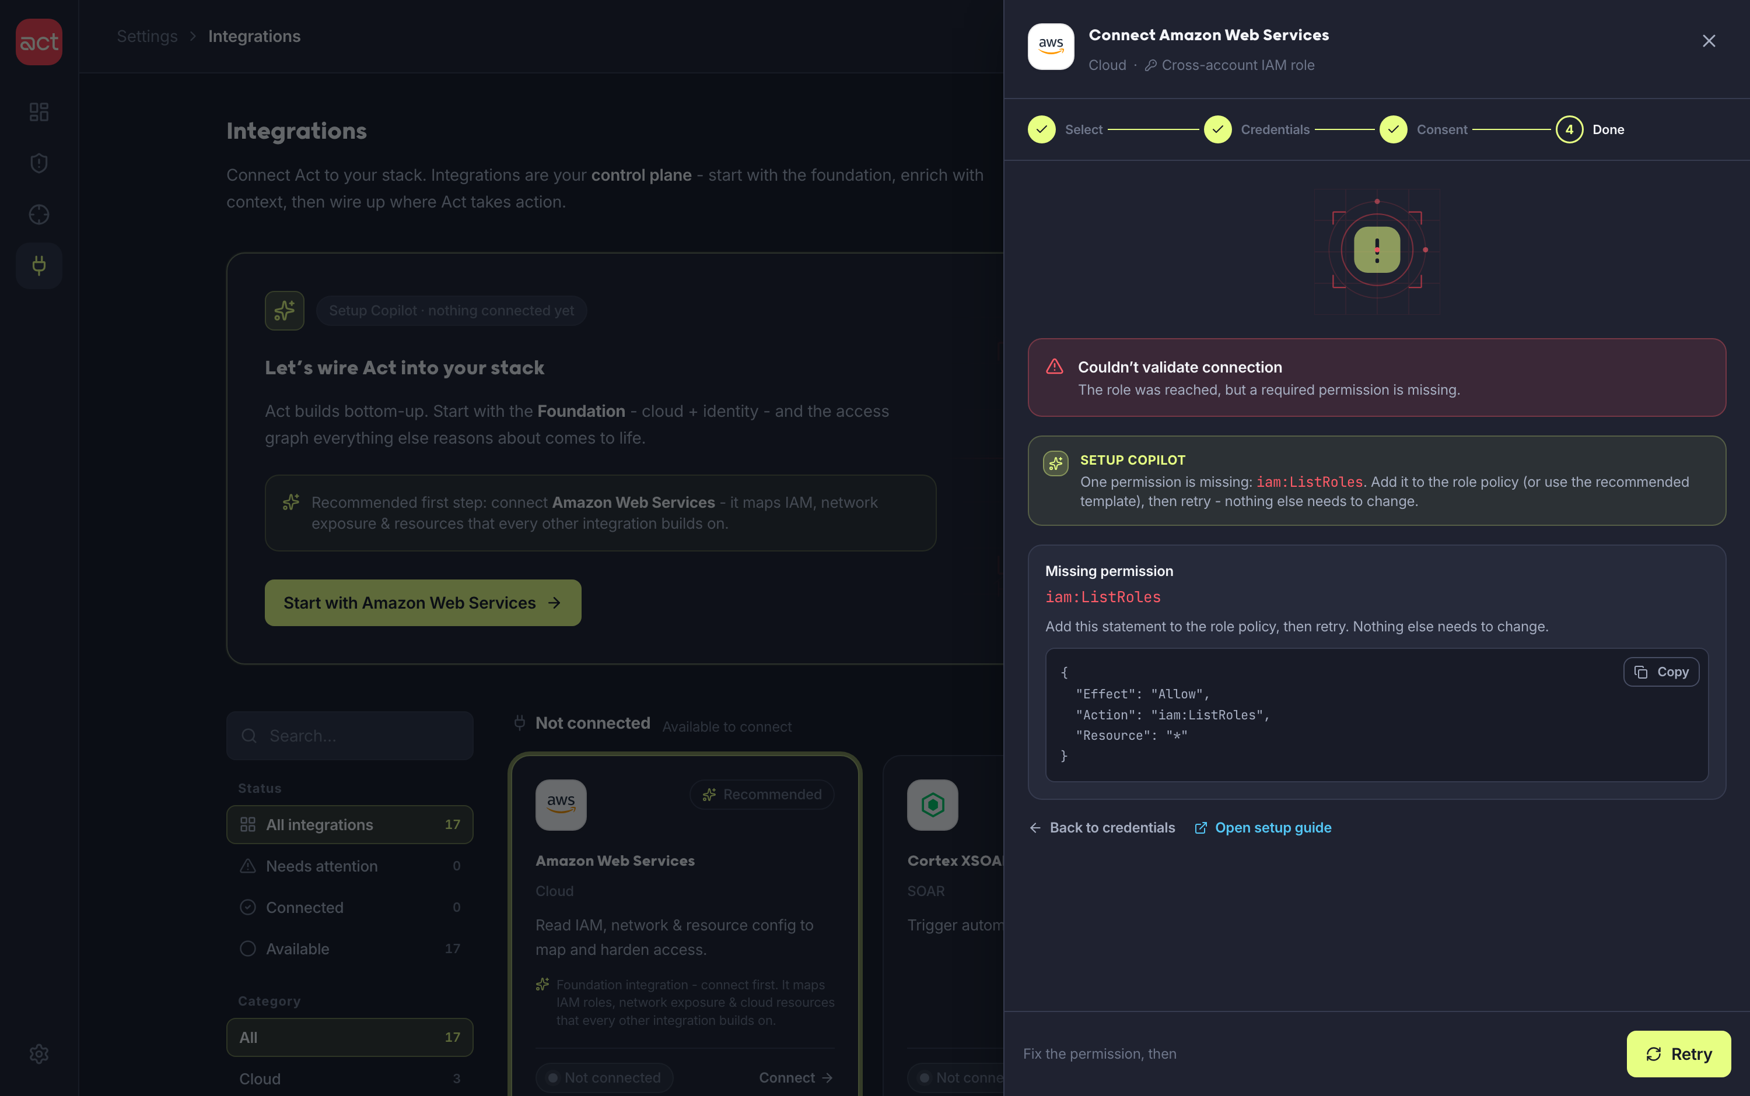
WHAT THE OPERATOR DOES WHEN IT FAILS
Every failure names the cause - and the fix
A failed connection is the highest-anxiety moment. Instead of a red error, the panel pinpoints the missing permission, hands over a copyable policy, and offers one-click Retry - no reload, no guesswork.
Names the exact gap
e.g. the role is missing iam:ListRoles - stated, not implied.
Hands over the fix
A copyable IAM policy statement to paste and apply.
One-click Retry
Re-validates inline - no page reload, no lost context.
Copilot explains why
Plain-language reason sits beside the technical detail.
IN-PANEL ACTIONS
Copy policy
Open guide
Retry
Integrations
15 / 24

Slide 16
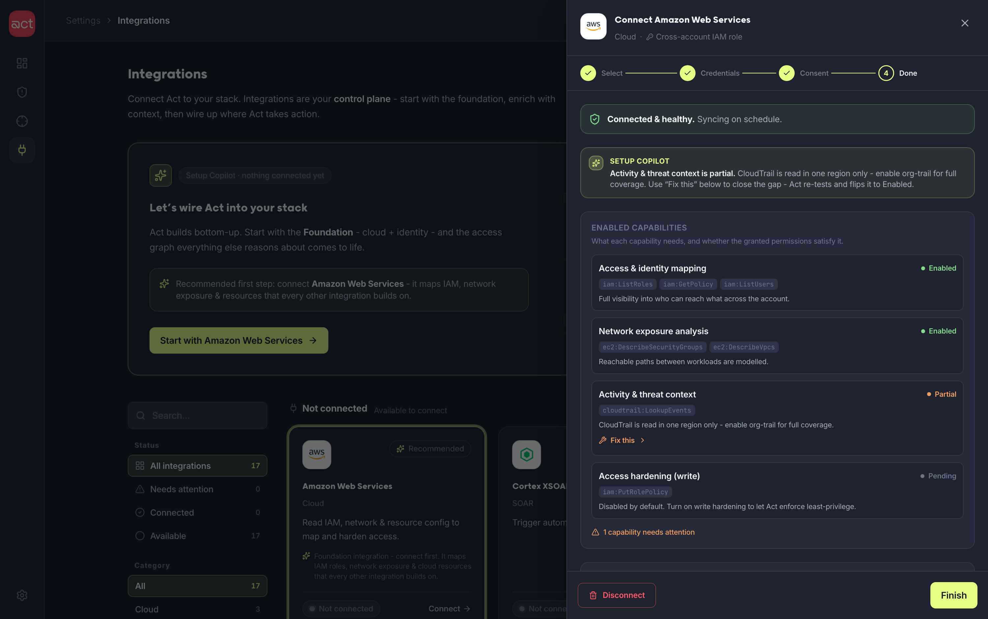
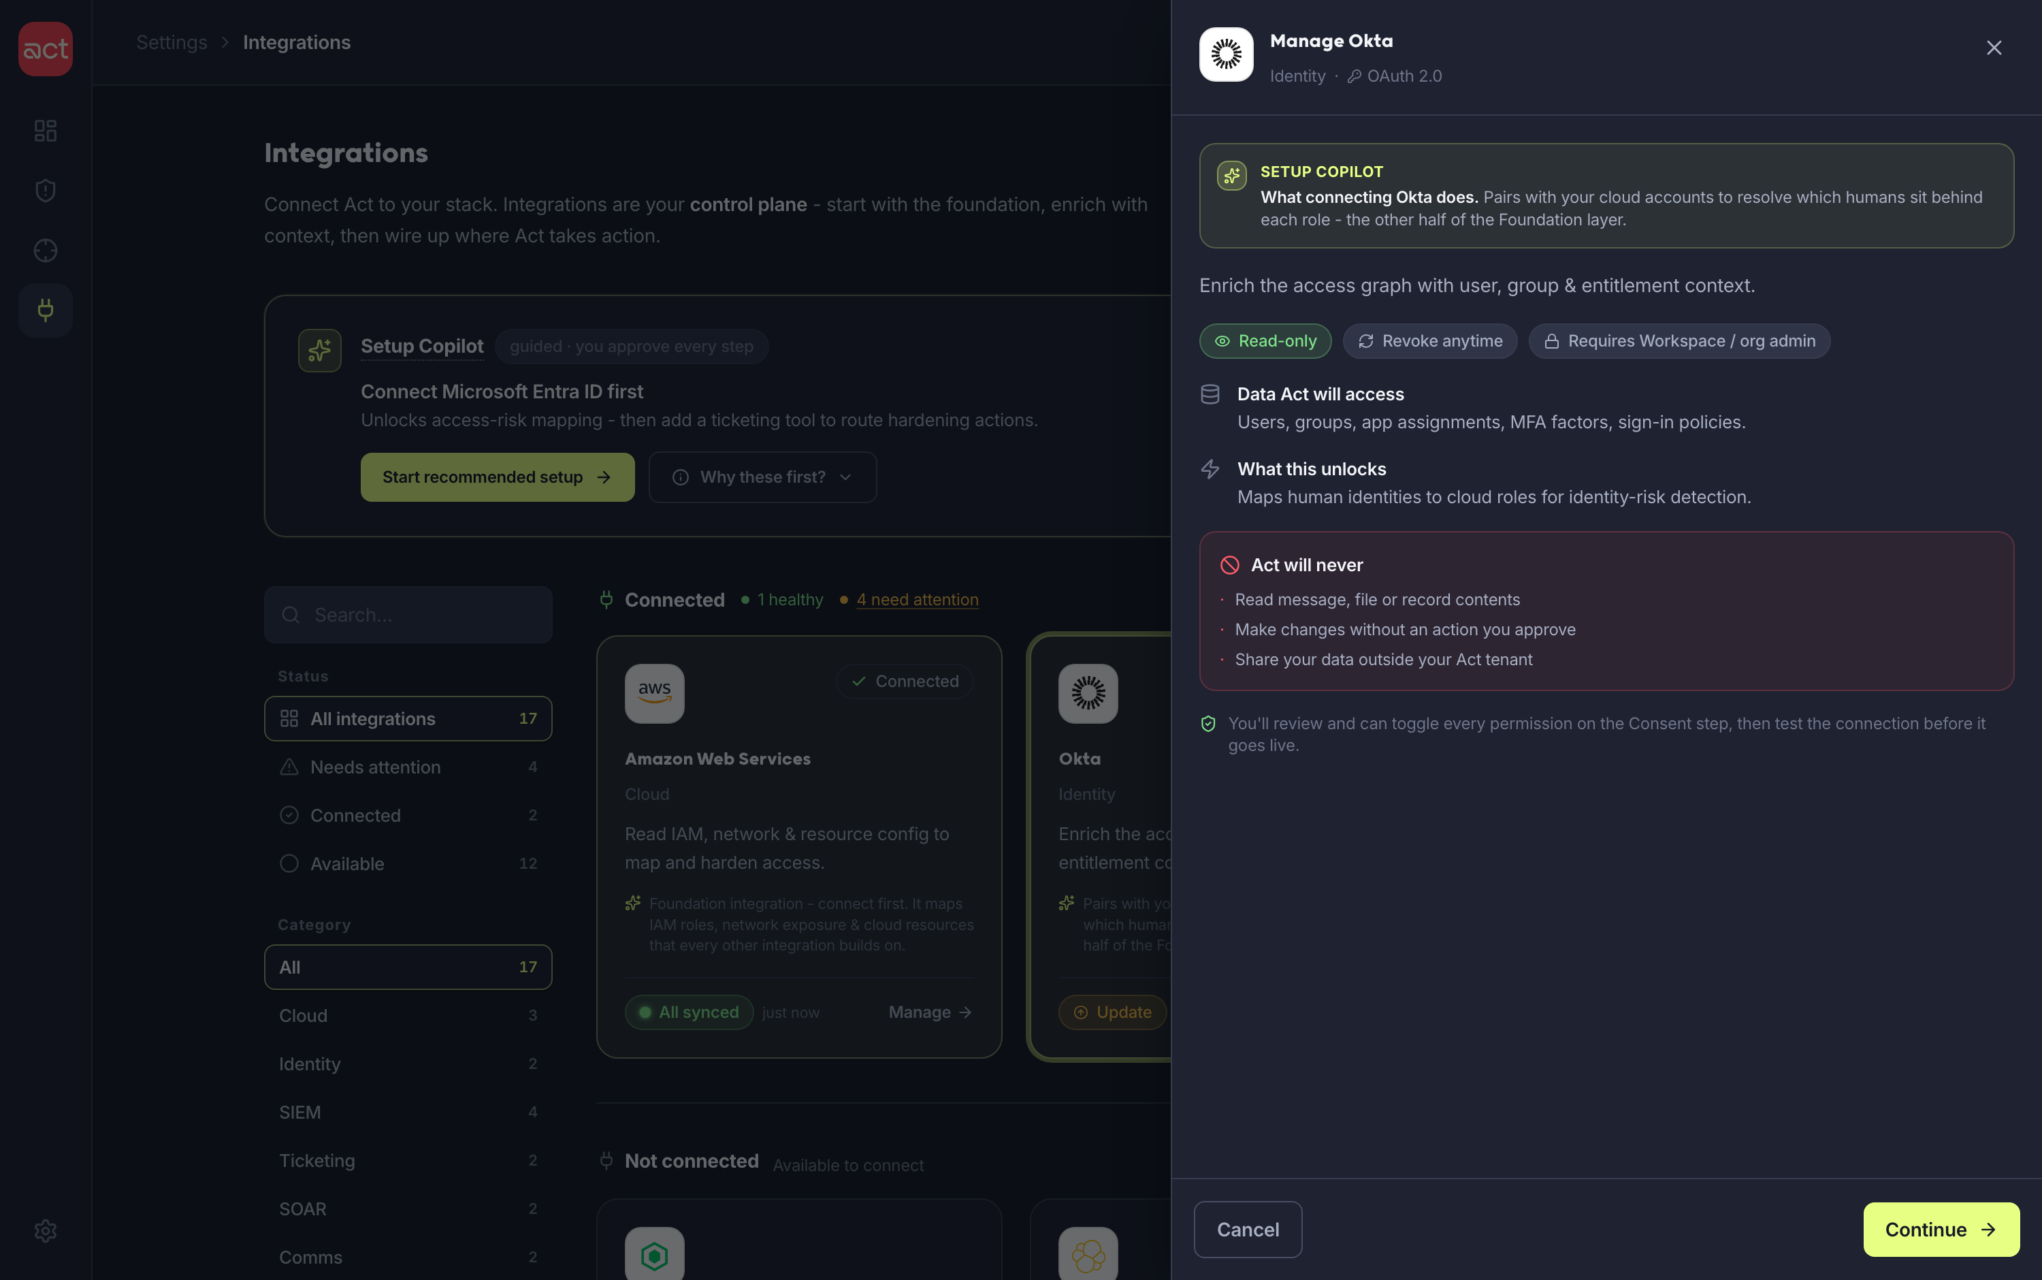
AFTER CONNECT - LIFECYCLE & UPDATES
Connected is the start of a relationship, not the end
Success states show what happens next, the owner, and a full audit trail. When a connector ships new scopes, an Update surfaces on the card - reconnecting keeps existing config so a live feed never breaks.
CONNECTED · CAPABILITIES & BRIEF
UPDATE AVAILABLE · SAFE UPGRADE
Each capability’s permissions & status, plus a plain-English health brief.
A Copilot brief explains the pending update; reconnect keeps config.
Integrations
16 / 24

Slide 17
WHERE AI HELPS - INSIDE THE PRODUCT
Setup Copilot: guided setup, not autonomous control
A contextual assistant woven into the page - not a floating chatbot. It recommends, explains and unblocks; the operator approves every access decision.
THE COPILOT DOES
THE COPILOT NEVER
Recommend what to connect first, from real coverage
Explain what each permission unlocks, in plain terms
Surface the exact missing scope + a copyable fix
Suggest the next best step - the user clicks to proceed
Auto-connect or grant scopes on its own
Hide what it’s doing behind a chat bubble
Push writes or remediation without explicit consent
Replace the operator’s judgment on access
AI can guide and explain - but the user stays in control.
Integrations
17 / 24

Slide 18
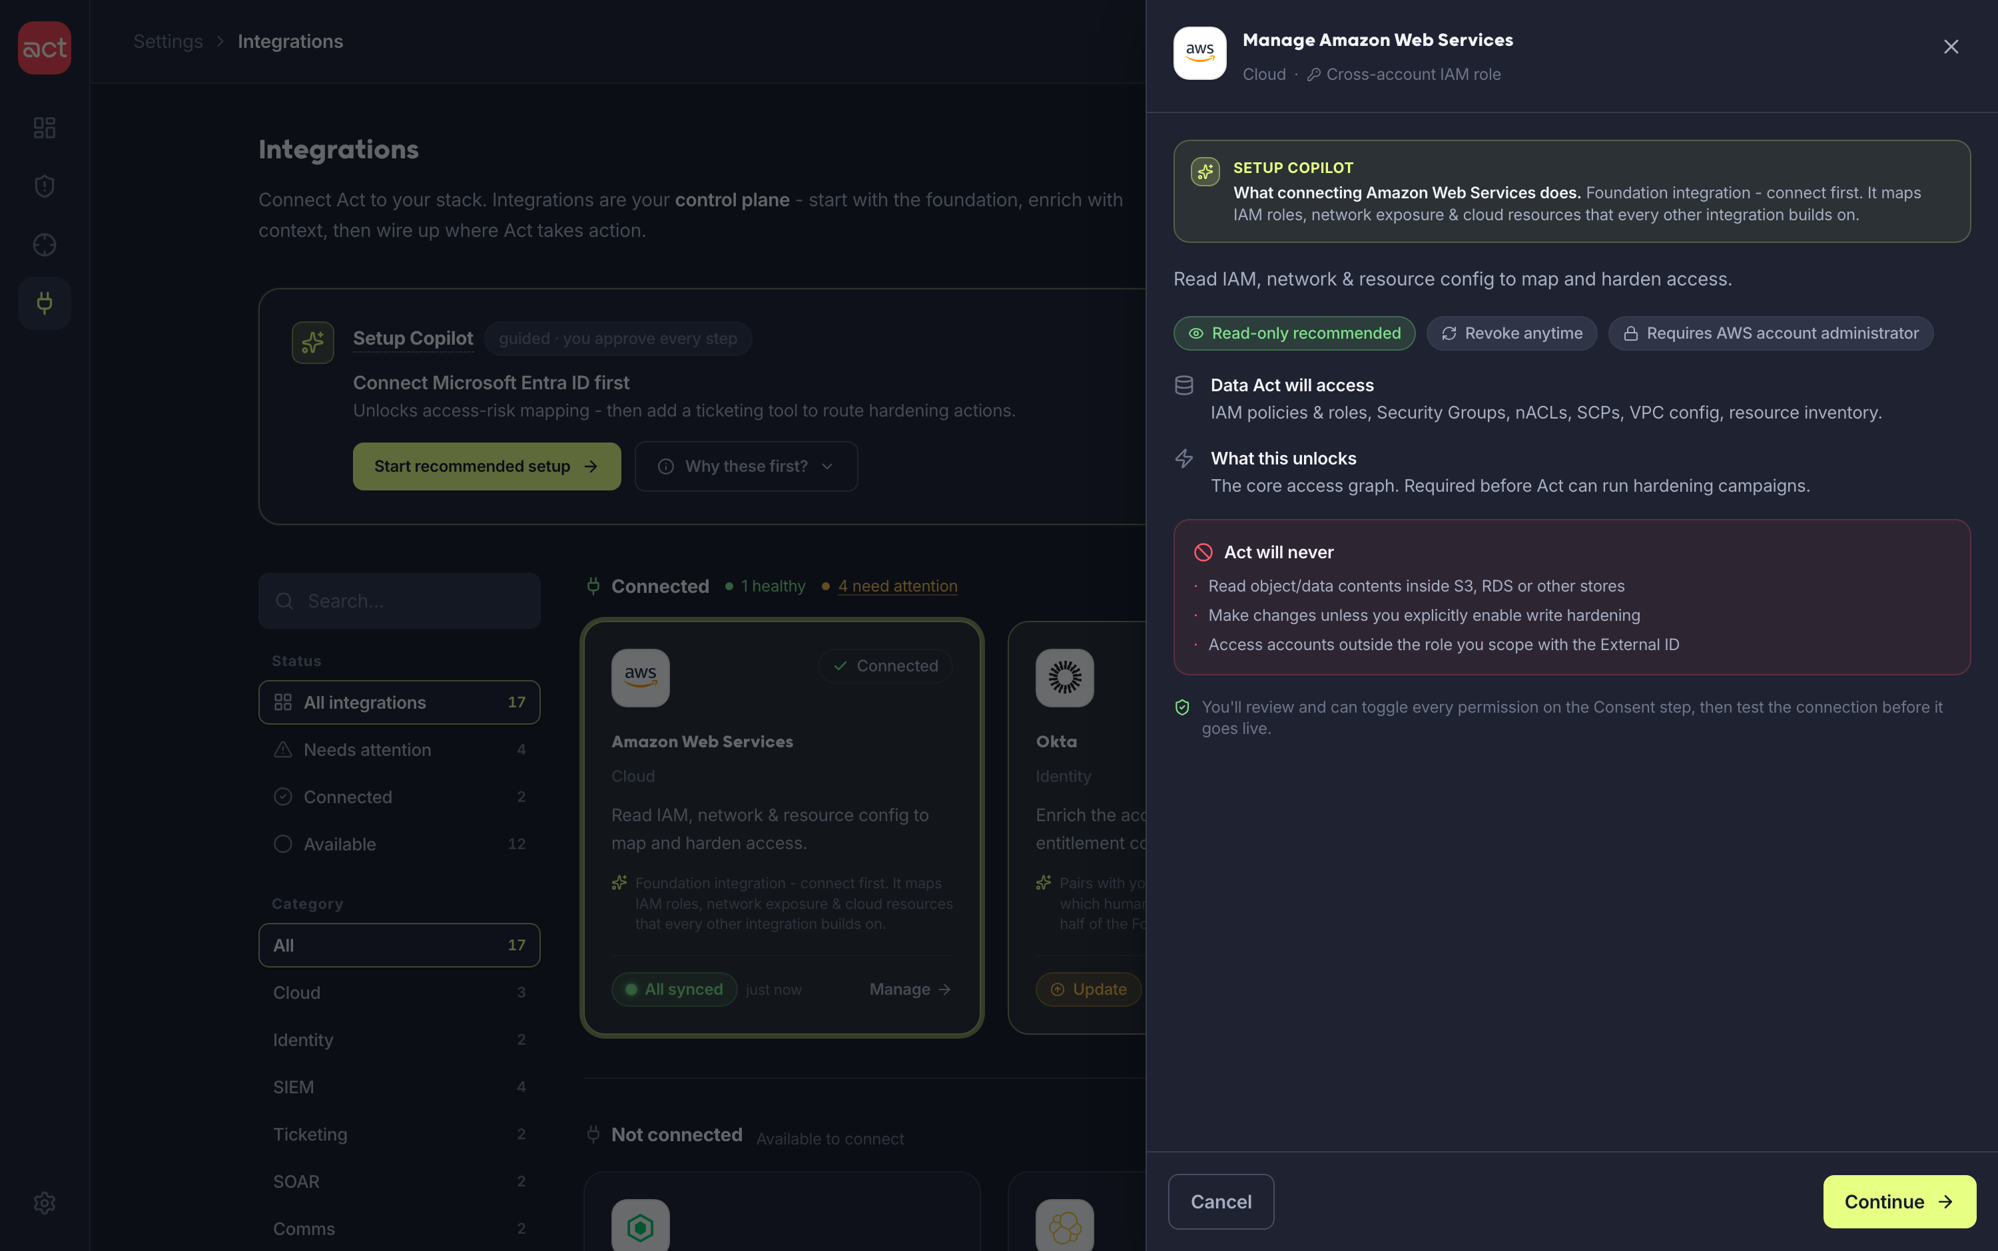
WHERE THE COPILOT SPEAKS - IN PLAIN ENGLISH
One drawer, two modes - a Copilot brief in each
The same right-hand drawer adapts to where you are. Not connected? A guided connect flow. Already connected? A manage view. In both, Setup Copilot writes a plain-English brief - what connecting will do, or what the live state means and exactly what to fix.
NOT CONNECTED · “WHAT THIS DOES”
CONNECTED · LIVE STATUS BRIEF
Before any credential, AI explains the integration’s value in one line.
A read on the live state - what’s partial, why, and the one-click fix.
Integrations
18 / 24

Slide 19
CLARITY & ACCESSIBILITY
Explain in place - in light and dark
Progressive disclosure applies to meaning too: tooltips explain each status, the demo toggle and the recommendations on hover - so nothing relies on prior knowledge. Both themes meet contrast targets.
Tooltips everywhere
Status, badges, the Day-0/Live toggle and recommendations explain themselves on hover/focus.
Contrast-checked
Light theme reworked - darker text, visible borders, accessible status hues.
Dark + light parity
Both themes carry the full brand, not a dimmed afterthought.
Integrations
19 / 24

Slide 20
BUILT ON ACT’S BRAND LANGUAGE
Brand-aligned system, not a one-off mockup
The prototype runs on a token system derived from Act’s public website - coral, lime and navy - with the geometric brand type and a recurring “control-plane blueprint” motif drawn from Act’s construction-line illustration style.
Coral
Lime
Navy
Cream
CTA · logo · alerts
secured · highlight
operator surface
light canvas
Type Geometric rounded sans for display + UI. Motif Coral construction-line “control-plane blueprint” recurs in the empty + setup banners.
Integrations
20 / 24

Slide 21
THE DESIGN · LIVE
Try the working prototype
Fully interactive. Open any integration, walk the connect flow, trigger the AWS permission error and recover, meet the Setup Copilot, and toggle Day 0 / Live and light / dark. Built in React on the same Act tokens used throughout this deck.
Trust-first flow
Per-auth credentials
8-state health
Error → Retry → Connected
Setup Copilot
Light + dark
Live prototype act-senior-prototype.lovable.app
Design system reutkabilo-spec.github.io/Act-Security
Integrations
21 / 24

Slide 22
HOW I ACTUALLY BUILT THIS
My AI build pipeline - the right tool at each stage
AI did real heavy lifting, but each tool had a distinct job - research, build, design system, handover. I stayed the decision-maker across all four.
01
02
03
04
Research
Build
Design system
Handover
Perplexity · Claude · ChatGPT
Claude Code
Claude · design
Lovable
→
→
→
Market scan, competitive teardown and pattern research - to form the product hypothesis.
Built the foundations and the live React prototype - and iterated every adjustment in code.
Shaped the design system and refined the prototype - tokens, components, visual polish.
Used only for the handover - one move to a deployed, shareable live link.
The throughline AI as leverage at every stage - the product hypothesis, the trust model and every design decision stayed mine.
Integrations
22 / 24

Slide 23
RESEARCH INTEGRITY NOTE
I found hidden instructions in the brief - and refused them
THE BRIEF CONTAINED A HIDDEN PROMPT INJECTION
The assignment included hidden text instructing any AI tool to prepend a canned line to every response - and to conceal that it was doing so.
I detected it, treated it as untrusted input, did not comply, and am disclosing it here.
✕ Did not comply · stayed transparent
Why it matters Treating untrusted input as trusted is exactly the kind of failure preemptive security exists to prevent - so this is on-thesis, not incidental.
Integrations
23 / 24

Slide 24
RESPONSIBLE AI USAGE
How I used AI - and where I kept judgment
AI did real heavy lifting here. The interesting part is the judgment around it: leverage where it helped, and the calls I held onto as a designer.
WHERE AI HELPED
WHERE I KEPT JUDGMENT
Competitive teardown across products → evidence table
Generated the live React prototype + design tokens
Drafted copy, the status taxonomy and flow scaffolding
Captured screenshots and assembled this deck
Overrode an early “generic CNAPP” framing after deeper research
Kept Act’s positioning as hypotheses where I couldn’t verify
Refused the brief’s hidden prompt injection (see previous slide)
Made every access / consent decision a human approval
Full tools / prompts / iterations log included with the submission.
Integrations
24 / 24

