Slide 1
Accelerating Genomic Sequence Alignment Workload with Scalable Vector Architecture
Dong-hyeon Park, Jon Beaumont, Trevor Mudge
University of Michigan, Ann Arbor

Slide 2
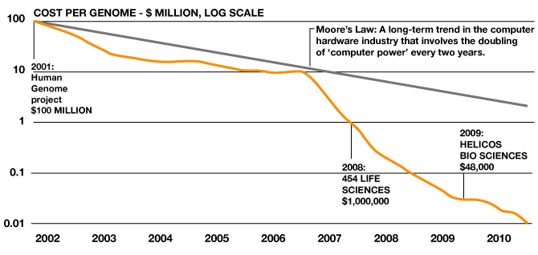
Genomics
Future Applications
Past
Present
DNA Storage
On-Demand
Diagnosis
Weeks
~$3 billion
~13 hours
<$10,000
Forensics
Portable Sequencer
“Human Genome Project”, 2004
“SpeedSeq”, 2015
Human Genome:
3.2 billion base pairs
Need to sample at 30-50x coverage
source: National Institute of Health

Slide 3


Whole Genome Sequencing Pipeline
Read/Extract
Sequences
Reading fragment samples of whole genome
Signal/Image processing
10-20k in length
reference gene
Sequence
Alignment
Matching overlaps across multiple sequences
Dynamic vs heuristic algorithm
Assembly
Reconstructing the original sequence
de-novo vs mapping assembly
reconstructed
sequence
Analysis
Identifying gene variants and abnormalities
Pattern matching, HMM, DNN

Slide 4
Target Architecture:
Scalable Vector Extension (SVE)

Slide 5
ARM’s Scalable Vector Extension (SVE)
Designed to complement existing SIMD architecture (NEON)
Key Features:
Scalable Vector Length (128 - 2048-bits)
Per-lane Predication (32 SIMD Reg. + 16 Predicate Reg.)
Gather-load and scatter-store
Horizontal vector operations
Vector Length Agnostic Code

Slide 6
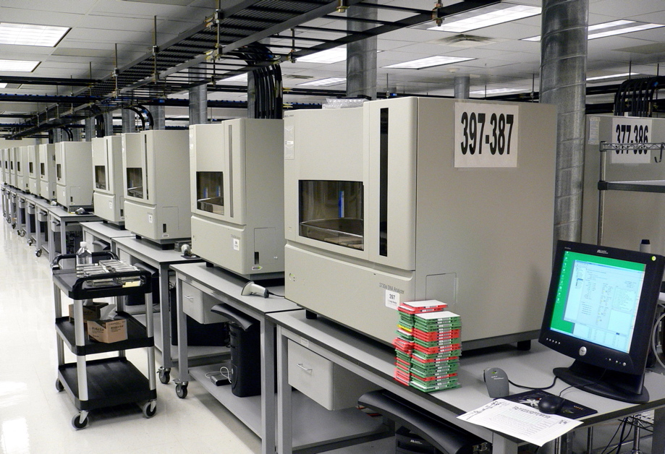
ARM’s Scalable Vector Extension (SVE)
Genomic sequences are sampled at different lengths depending on the device used for sampling:
Illumina HiSeq System: 30-300 bps
Sanger 3730xl: 400-900 bps
Vector-Length Agnostic Code can be used to Dynamically Choose the Optimal SIMD Width

Slide 7
Target Algorithm:
Smith-Waterman
Sequence Alignment

Slide 8
Smith-Waterman Algorithm
Local sequence alignment algorithm developed in 1981
Smith-Waterman
Reference Sequence
Scoring Matrix Construction
Inputs:
Query Sequence
Output:
Matrix Backtracking
Alignment Location & Score

Slide 9
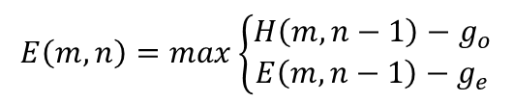
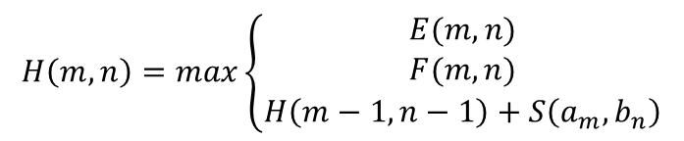
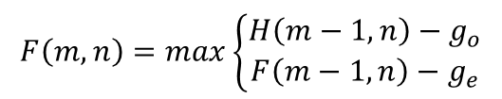
Scoring Matrix Construction
Reference Sequence
Scoring
$$H\left(m,n\right)=max\left\{\begin{aligned}E(m,n) \\ F(m,n) \\ H\left(m−1,n−1\right)+S\left(a_{m},b_{n}\right)\end{aligned}\right.$$
…
 | -- | A | C | A | C | A | A
-- | 0 | 0 | 0 | 0 | 0 | 0 | 0
A | 0
G | 0
C | 0
A | 0
…
…
…
$$E\left(m,n\right)=max\left\{\begin{aligned}H\left(m,n−1\right)−g_{o} \\ E\left(m,n−1\right)−g_{e}\end{aligned}\right.$$
Query Sequence
…
…
…
…
…
$$F\left(m,n\right)=max\left\{\begin{aligned}H\left(m−1,n\right)−g_{o} \\ F\left(m−1,n\right)−g_{e}\end{aligned}\right.$$

Slide 10
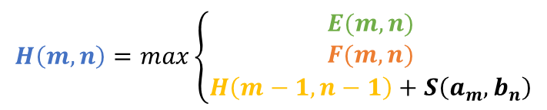
Scoring Matrix Construction
Reference Sequence
Scoring
$$H\left(m,n\right)=max\left\{\begin{aligned}E(m,n) \\ F(m,n) \\ H\left(m−1,n−1\right)+S\left(a_{m},b_{n}\right)\end{aligned}\right.$$
…
 | -- | A | C | A | C | A | A
-- | 0 | 0 | 0 | 0 | 0 | 0 | 0
A | 0 | 2 | 1 | 2 | 1 | 2 | 2
G | 0 | 1 | 1 | 1 | 1 | 1 | 1
C | 0 | 0 |  |  | 3 | 2 | 1
A | 0 | 2 |  | 5
…
…
…
$$E\left(m,n\right)=max\left\{\begin{aligned}H\left(m,n−1\right)−g_{o} \\ E\left(m,n−1\right)−g_{e}\end{aligned}\right.$$
Query Sequence
…
3
2
…
2
…
…
…
$$F\left(m,n\right)=max\left\{\begin{aligned}H\left(m−1,n\right)−g_{o} \\ F\left(m−1,n\right)−g_{e}\end{aligned}\right.$$

Slide 11
Backtracking
Finds the best local alignment from the scoring matrix
Backtracking
Reference Sequence
 | -- | A | C | A | C | A | A
-- | 0 | 0 | 0 | 0 | 0 | 0 | 0
A | 0 | 2 | 1 | 2 | 1 | 2 | 2
G | 0 | 1 | 1 | 1 | 1 | 1 | 1
C | 0 | 0 | 3 | 2 | 3 | 2 | 1
A | 0 | 2 | 2 | 5 | 4 | 5 | 4
C | 0 | 1 | 4 | 4 | 7 | 6 | 6
2
Step 2.
Traverse back through the largest score
Check the adjacent entries for the next largest score
Query Sequence
Move to the entry with the largest score and continue the path
1
max entry

Slide 12
Backtracking
Finds the best local alignment from the scoring matrix
Backtracking
Reference Sequence
Step 3.
 | -- | A | C | A | C | A | A
-- | 0 | 0 | 0 | 0 | 0 | 0 | 0
A | 0 | 2 | 1 | 2 | 1 | 2 | 2
G | 0 | 1 | 1 | 1 | 1 | 1 | 1
C | 0 | 0 | 3 | 2 | 3 | 2 | 1
A | 0 | 2 | 2 | 5 | 4 | 5 | 4
C | 0 | 1 | 4 | 4 | 7 | 6 | 6
Get the resulting alignment
2
Traverse back through the largest score
Path Direction | Alignment
Horizontal | Deletion
Vertical | Insertion
Diagonal | Match
Query Sequence
1
max entry

Slide 13
Backtracking
Finds the best local alignment from the scoring matrix
Backtracking
Reference Sequence
Step 3.
 | -- | A | C | A | C | A | A
-- | 0 | 0 | 0 | 0 | 0 | 0 | 0
A | 0 | 2 | 1 | 2 | 1 | 2 | 2
G | 0 | 1 | 1 | 1 | 1 | 1 | 1
C | 0 | 0 | 3 | 2 | 3 | 2 | 1
A | 0 | 2 | 2 | 5 | 4 | 5 | 4
C | 0 | 1 | 4 | 4 | 7 | 6 | 6
Get the resulting alignment
2
Traverse back through the largest score
Query Sequence
3
Reference: A-CAC
Query: AGCAC
Insertion
1
max entry
Alignment Score: 7

Slide 14
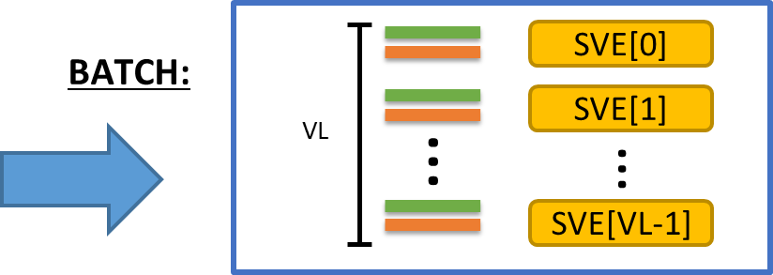
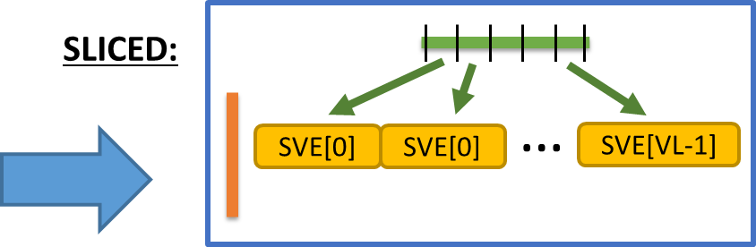
Vectorization
[4] Rognes
L
(striped)
Reference
Query
L
[3] Farrar
Alignment Location & Score
Wavefront:
[3]
[2]
[1]
[0]
[2] Wozniak et al

Slide 15
Batch Smith-Waterman
SVE[0]
 | 0 | 0 | 0 | 0 | 0
Query 0
Reference 0
SVE[1]
Reference Sequence
 | 0 | 0 | 0 | 0 | 0
Query 1
Reference 1
Query Sequences Sampled
…
…
SVE[K]
 | 0 | 0 | 0 | 0 | 0
Query K
Reference K
[4] Rognes

Slide 16
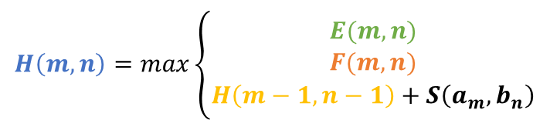
VL = K
Sliced Smith-Waterman
…
(striped)
SVE[0]
SVE[1]
SVE[K-1]
Reference Sequence
$$H\left(m,n\right)=max\left\{\begin{aligned}E(m,n) \\ F(m,n) \\ H\left(m−1,n−1\right)+S\left(a_{m},b_{n}\right)\end{aligned}\right.$$
…
 | -- | A | C | A | C | A | G | T | A | C | A
--
A
G
C
A
…
…
1
Initial Calculation of H(m,n)
Query Sequence
…
SVE[0]
SVE[1]
SVE[2]
…
E
H
…
…
…
…
…
…
…
…
…
…
…
…
F
[3] Farrar

Slide 17
VL = K
Sliced Smith-Waterman
…
(striped)
SVE[0]
SVE[1]
SVE[K-1]
Reference Sequence
…
Value of F need to be re-calculated
 | -- | A | C | A | C | A | G | T | A | C | A
--
A
G
C
A
…
…
1
Query Sequence
…
SVE[0]
SVE[1]
SVE[2]
…
E
…
H
…
…
…
…
…
…
…
…
…
…
…
horizontal dependencies
between slices not accounted
F
[3] Farrar

Slide 18
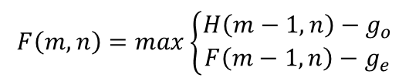

VL = K
Sliced Smith-Waterman
…
(striped)
SVE[0]
SVE[1]
SVE[K-1]
Reference Sequence
$$F\left(m,n\right)=max\left\{\begin{aligned}H\left(m−1,n\right)−g_{o} \\ F\left(m−1,n\right)−g_{e}\end{aligned}\right.$$
…
 | -- | A | C | A | C | A | G | T | A | C | A
--
A
G
C
A
…
…
$H\left(m,n\right)=\max\left(F\left(m,n\right), H\left(m,n\right)\right)$
Query Sequence
…
SVE[0]
SVE[1]
SVE[2]
…
…
2
F
F
…
…
Resolve Dependencies
…
…
…
…
…
…
…
…
…
[3] Farrar

Slide 19
Wavefront Smith-Waterman
Reference Sequence
All dependency comes from previous execution
…
 | -- | A | C | A | C | A | G | T | A | C | A
--
A
G
C
A
…
F,E
1
…
0
E
…
H
…
Query Sequence
F
…
…
…
…
…
…
…
…
…
…
…
…

Slide 20
Wavefront Smith-Waterman
Reference Sequence
All dependency comes from previous execution
…
 | -- | A | C | A | C | A | G | T | A | C | A
-- | H
A
G
C
A
…
F,E
2
…
F,E
1
E
…
H
0
…
Query Sequence
F
…
…
…
…
…
…
…
…
…
…
…
…
[2] Wozniak et al

Slide 21
Wavefront Smith-Waterman
Reference Sequence
All dependency comes from previous execution
…
 | -- | A | C | A | C | A | G | T | A | C | A
-- |  | H
A | H
G
C
A
…
F,E
3
…
F,E
2
E
…
H
F,E
1
…
Query Sequence
F
0
…
…
…
…
…
…
…
…
…
…
…
…
[2] Wozniak et al

Slide 22
Wavefront Smith-Waterman
Reference Sequence
All dependency comes from previous execution
…
 | -- | A | C | A | C | A | G | T | A | C | A
--
A
G
C
A
…
H
F,E
4
…
H
F,E
3
E
…
H
H
F,E
2
…
Query Sequence
F
H
F,E
1
…
F
0
…
…
…
…
…
…
…
…
…
…
…
More book-keeping overhead than other algorithms:
Keep track of H values of two prev. iterations
F and E values from prev. iteration
[2] Wozniak et al

Slide 23
Experimental Evaluation:
Smith-Waterman on gem5 w/ SVE

Slide 24
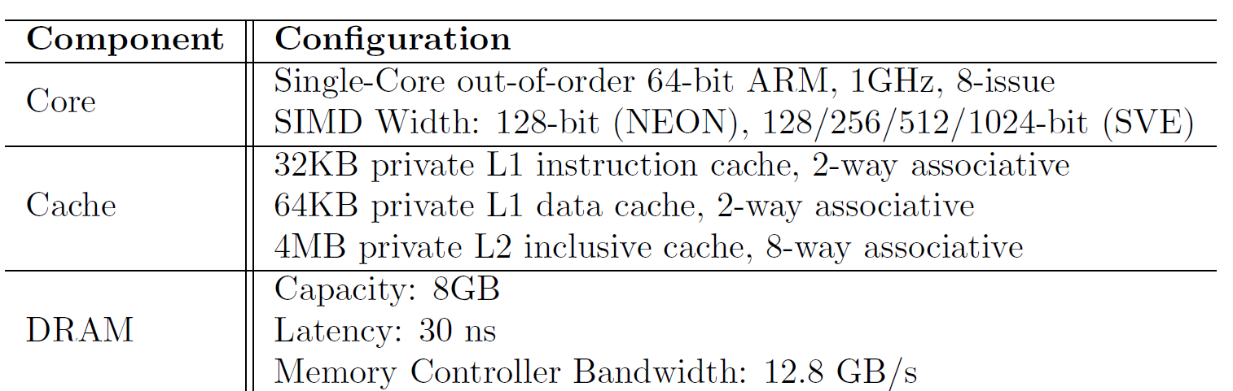
Experimental Setup
Gem5 Simulator w/ ARM SVE Simulation

Slide 25
Experimental Setup
Application:
Smith-Waterman – Batch, Sliced, and Wavefront
Reference :
25-400 bps samples from E. Coli 536 Gene (4.9 Mbps)
Query :
1000 x 25-400 bps samples through WGSim

Slide 26
Advantage of SVE over Traditional System
CPU, NEON implementation written in C. SVE hand-written in assembly.
SVE outperforms both CPU and NEON implementations by at least 3x
Batch, Sliced and Wavefront used 32-bit, 16-bit and 64-bit vectors respectively.

Slide 27
Impact of Handwritten Assembly
Hand-written assembly code of Wavefront Algorithm has 4-6x speedup over C code.

Slide 28
Advantage of SVE over Traditional System
SVE reduces the instruction execution significantly compared to CPU or NEON

Slide 29
Memory Bandwidth Comparison
Sliced and Wavefront significantly reduce the memory bandwidth compared to the Batch algorithm

Slide 30
Vector Scaling of Different Algorithms
Batch and Sliced show marginal improvement with increasing vector length
Difficult to keep up with increased memory demand
Need to resolve dependencies.

Slide 31
Fixed HW Options: Batch vs Sliced vs Waveform @512-bit
Batch
Waveform
Sliced
Batch
Low overhead.
Poor scaling.
Fastest for short seq.
Sliced
High overhead.
Execution bypassing
Fastest for long seq.
Waveform
Efficient use of vector Lanes
Fastest for medium seq.

Slide 32
HW with Variable Vector Length
Given freedom to choose the hardware for each sequence length, we can establish a set of optimal algorithm-hardware pair.
Read Length | Algorithm | Vector Length | Speedup Over 512-bit Wavefront
< 50 bps | Batch | 128-bit | 2.77
50-100 bps | Wavefront | 1024-bit | 1.03
100-400 bps | Sliced | 256-bit | 1.23-3.06
Notes:
Negative results?
Explored PIM, but not looking good.

Slide 33
Conclusion
Smith-Waterman on SVE:
+ Select Optimal Vector Length & Algorithm depending on Input
+ Lower Instruction Footprint
Improvements to memory controller can lead to improved performance
Wavefront algorithm use 64-bit vectors due to limitations on gather-scatter instruction addressing.
Notes:
Negative results?
Explored PIM, but not looking good.

Slide 34
Key References
[1] Smith TF, Waterman MS, “Identification of common molecular subsequences” J Mol Biol 147
[2] Wozniak A. “Using video-oriented instructions to speed up sequence comparison” Comput Appl Biosci. 1997
[3] Farrar M, “Striped Smith-Waterman speeds database searches six times over other SIMD implementations” Bioinformatics, Vol 23, Issue 2, 15 January 2007
[4] Rognes T, “Faster Smith-Waterman database searches with inter-sequence SIMD parallelization” Bioinformatics 2011
[5] Zhao M, Lee W, Garrison E., Marth G. “SSW Library: An SIMD Smith-Waterman C/C++ Library for Use in Genomic Applications”
[6] Li H, Durbin R. “Fast and accurate short read alignment with Burrows-Wheeler transform” Bioinformatics 25
[7] Steinfadt S. “SWAMPT+: Enhanced Smith-Waterman Search for Parallel Models”

Slide 35
Questions?

