Slide 1
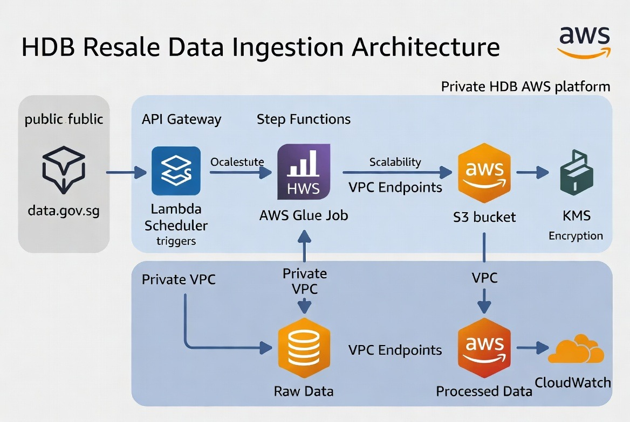
Data Ingestion Architecture

Slide 2
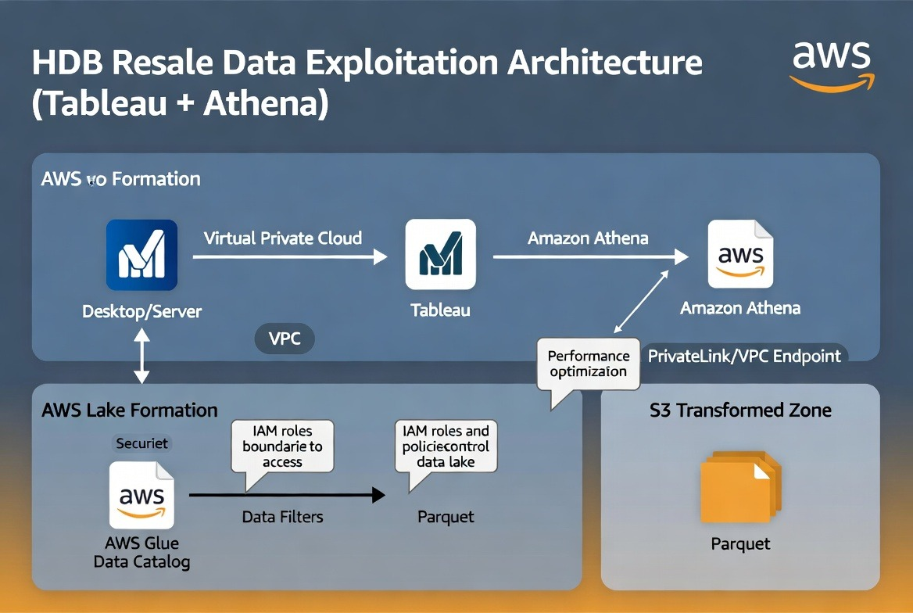
Data Exploitation Architecture

Slide 3
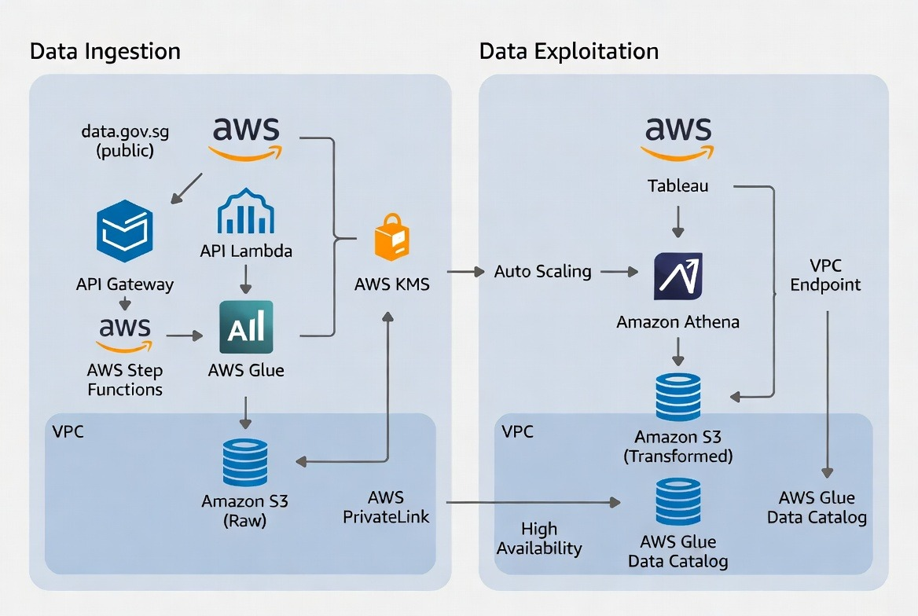
End-to-End Architecture Diagram (Ingestion + Exploitation)

Slide 4
Assumptions & Design Rationale
Key Assumptions
HDB’s data platform is hosted in a private AWS VPC with no direct public internet access
Source data from data.gov.sg is available via public HTTPS API or downloadable files (CSV/Parquet, >100MB)
Target storage is Amazon S3 with a medallion architecture (Raw → Cleaned → Transformed)
Data team uses Tableau connected via Athena JDBC/ODBC driver
Data is treated as sensitive → encryption and strict access control required
Batch ingestion on a daily/scheduled basis
Design Rationale
Security: All traffic between public internet and internal platform uses secure private endpoints (VPC Endpoints / PrivateLink)
No public exposure of S3 or Athena
Scalability: Serverless services (Glue, Step Functions, Athena, S3) automatically scale with data volume
Performance: Partitioned Parquet format + columnar storage for fast Athena queries. Private connectivity reduces latency
Maintainability: Orchestration via AWS Glue / Step Functions with monitoring via CloudWatch + SNS alerts
Compliance: KMS encryption at rest, TLS in transit, IAM least privilege, and audit logging via CloudTrail

Slide 5
Benefits
Fully managed AWS services → low operational overhead
Private network flow for both ingestion and exploitation
Ready for future real-time streaming

