Slide 1

Internship
Presentation
SEE Assessment | Internship I, II & III
Name: Revanasidda
USN: 22BBTCS244
Department: Computer Science & Engineering
SoET, CMRU

Slide 2
Company Overview
Platform Name CODEC TECHNOLOGIES
Internship Type:
Hybrid Domain: WEB DEVELPEMENT
Mode of Internship: Online (Self-Paced)
Duration: 2 Months
Description
CODEC Technologies provides internship opportunities which is designed to help students gain practical knowledge and industry exposure while strengthening the connection between academic concepts and real-world applications.
SoET, CMRU

Slide 3
Introduction
Internship Theme
Learning practical software development practices used in the industry
Exposure to modern web development tools, technologies, and workflows
Improving understanding of frontend and backend integration in web applications
Internship Objectives
Understanding the different phases involved in the software development process
Learning the fundamentals of client-side and server-side web development
Gaining basic knowledge of database management and application architecture
Enhancing analytical thinking and debugging abilities while solving development issues
SoET, CMRU

Slide 4
Core Concepts Learnt
Web Technologies Applied:
HTML5: Provides the basic structure and layout for web applications.
CSS3: Used for designing visual styles, layouts, and adding animations.
JavaScript: Enables dynamic behavior and interactive features in applications.
Bootstrap: Helps create responsive layouts using a mobile-first framework.
jQuery: Makes DOM manipulation and event handling easier and more efficient.
Development Concepts
Ensured web applications function properly across desktop, tablet, and mobile platforms.
Implemented techniques to update webpage content dynamically without refreshing the page.
Handled application logic implementation in projects such as calculator-based applications.
Created user-friendly and visually appealing interface designs.
Performed cross-browser testing to identify and fix issues in browsers like Chrome, Safari, and Firefox.
SoET, CMRU

Slide 5
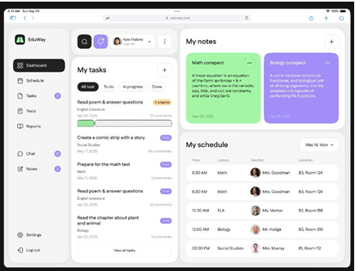
Task 1: Frontend Website Development
Tasks Performed
Created web pages using HTML for structure and content
Styled and arranged webpage layouts using CSS
Implemented interactive features using JavaScript
Developed navigation menus, forms, and integrated images into
webpages
Technologies Used
HTML
CSS
JavaScript
Outcome
Gained practical experience in building dynamic and interactive web pages
SoET, CMRU

Slide 6

Task 2: Responsive Web Design
Implemented responsive layout techniques
Used CSS media queries
Designed pages that adapt to different devices
Tested website on:
Desktop
Tablet
Mobile devices
Outcome
Improved website usability across multiple screen sizes.
SoET, CMRU

Slide 7
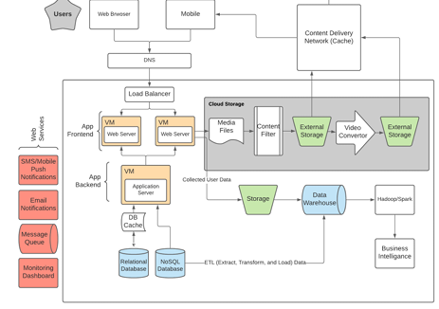
Task 3: Backend Development
Studied backend architecture of web applications
Understood client–server communication
Learned how servers process HTTP requests
Learned how data is handled in web applications
Outcome
Gained understanding of server-side logic and
workflow.
SoET, CMRU

Slide 8
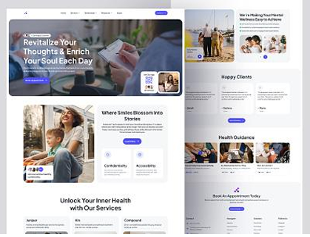
Task 4: Development of Complete Web Application
Integrated frontend and backend concepts
Designed user interface and website structure
Implemented forms, navigation menus and dynamic content
Tested and debugged the application
Outcome
Learned complete web application development workflow.
SoET, CMRU

Slide 9
Skills Learned
Technical Skills
HTML, CSS, JavaScript
Responsive web design
Web application workflow
Debugging techniques
Professional Skills
Problem solving
Time management
Independent learning
SoET, CMRU

Slide 10
Outcome Details
Key Outcomes
Project-Based Learning
Built a strong understanding of front-end web development fundamentals
Enhanced programming proficiency and troubleshooting abilities
Acquired practical experience by developing real-time applications
Gained deeper insight into creating user-friendly and effective interface designs
Developed readiness for more complex academic and professional projects
Followed a task-oriented approach during the development process
Gained insight into practical project requirements used in real-world applications
Applied a systematic method for implementation and testing
Developed features step-by-step through incremental development
SoET, CMRU

Slide 11
Company Overview
Platform Name Cognifyz
Internship Type:
Remote Domain: Front-End DEVELPEMENT
Mode of Internship: Online
Duration: 1 Months
Description
Cognifyz is a company that focuses on delivering innovative digital solutions for businesses. It helps organizations enhance user experience by building responsive and interactive web applications. During my internship, I worked on real-time frontend features, which helped me understand how modern web applications operate in real-world scenarios. The company emphasizes performance, scalability, and user-centric design in the development process..
SoET, CMRU

Slide 12
Introduction
Full stack web development involves building complete web applications that include both frontend and backend components. The frontend focuses on user interface and interaction, while the backend handles application logic, data processing, and server-side operations. Databases are used to efficiently store and manage data.
During my internship, I worked on all these components, which helped me understand how a complete web application is developed.
Objectives
To gain hands-on experience in real-world projects
To develop frontend and backend development skills
To learn RESTful APIs and database management
To improve problem-solving and debugging skills
To gain exposure to industry-level development workflows
To understand full stack web development concepts
SoET, CMRU

Slide 13

Technologies Used
Technologies Used
Frontend Technologies
HTML
CSS
JavaScript
React.js
Backend Technologies
Node.js
Express.js
Database
MongoDB
Tools & Platforms
Git
Visual Studio Code
SoET, CMRU

Slide 14
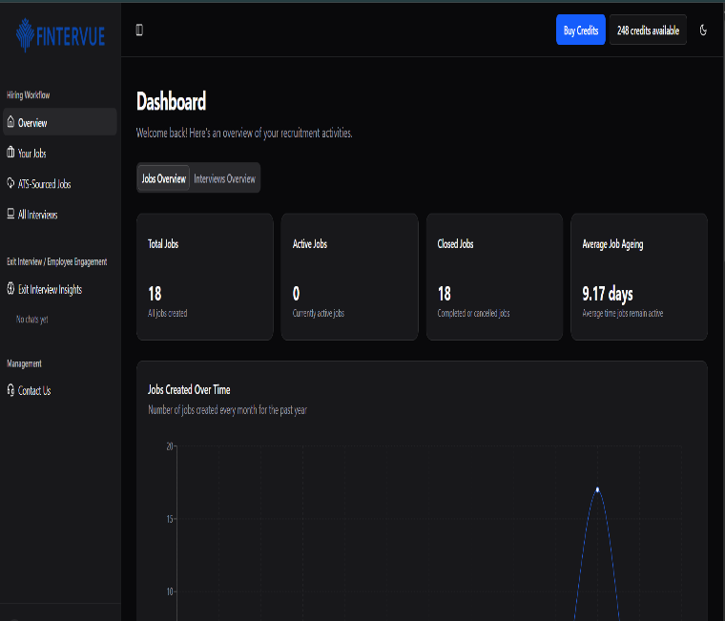
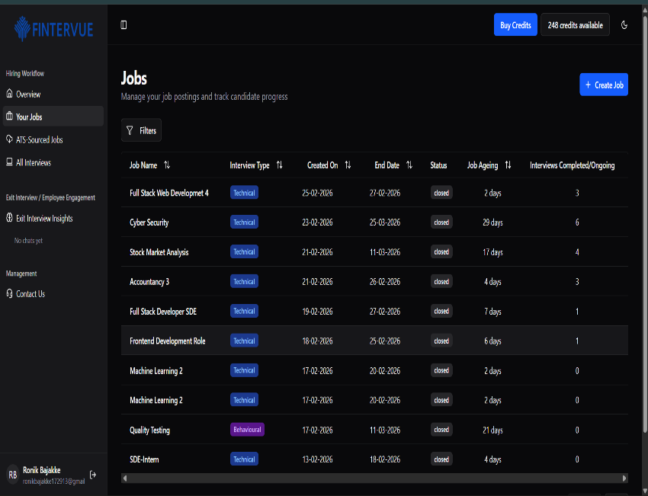
Task 1 – LMS Portal (Admin Panel)
Project: LMS Portal (Admin Panel)
Implemented CRUD operations using RESTful APIs
Developed a system to manage users, courses, and application data
Designed a responsive and user-friendly interface
Managed data flow between frontend, backend, and database
Technologies Used
Frontend: React.js, HTML, CSS, JavaScript
Backend: Node.js, Express.js
Database: MongoDB
SoET, CMRU

Slide 15
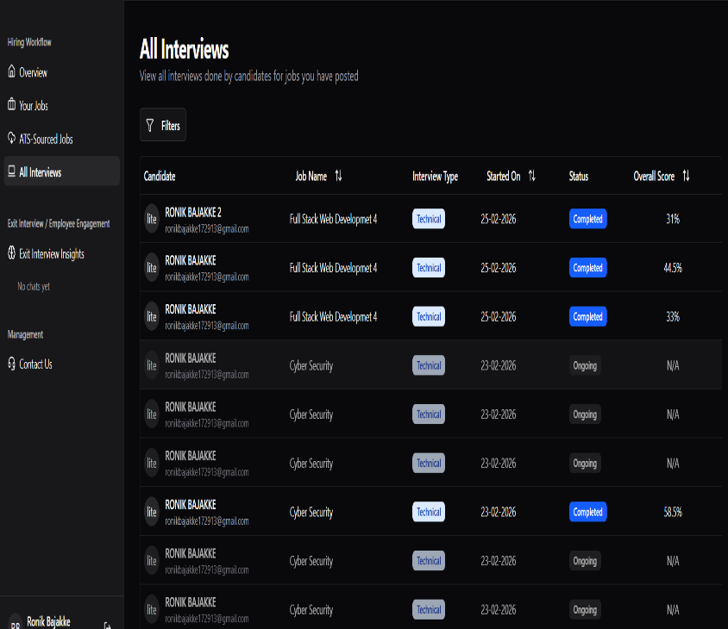
Task 2 – Frontend Development (Hondike Foundation)
Project: Fintervue.io Website
Redesigned the frontend to improve UI/UX experience
Enhanced navigation and overall layout structure
Implemented responsive design for multiple devices
Added interactive elements and dynamic content
Technologies Used
HTML, CSS (Flexbox, Grid, Media Queries)
JavaScript
React.js
SoET, CMRU

Slide 16
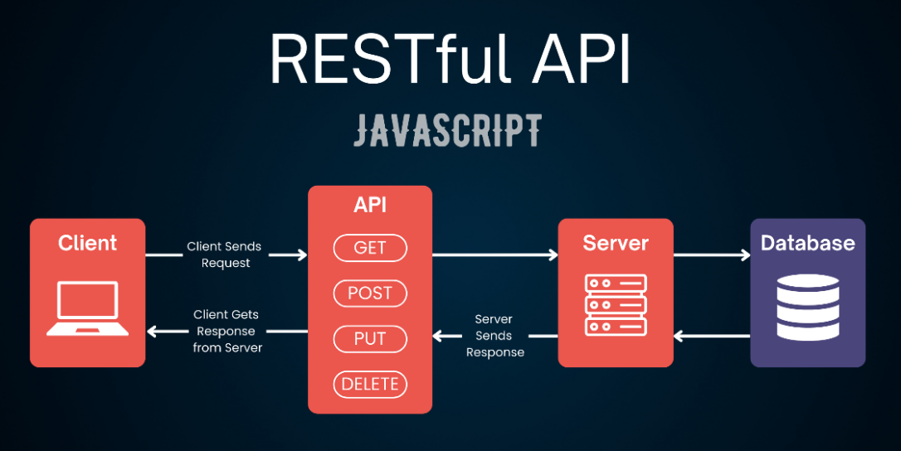
Backend & API Development
Backend Development
Developed RESTful APIs using Node.js and Express.js
Implemented CRUD operations for efficient data handling
Designed structured routes, controllers, and middleware
Performed data validation and handled errors effectively
Ensured smooth communication between frontend and backend
Technologies Used
Node.js
Express.js
REST APIs
SoET, CMRU

Slide 17
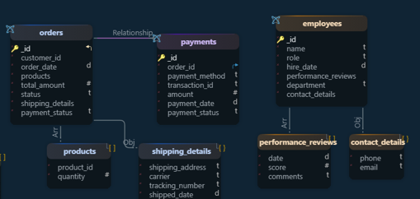
Database Management (MongoDB)
Database Implementation
Used MongoDB for storing and managing application data
Designed efficient schemas and data models
Performed CRUD operations (Create, Read, Update, Delete)
Implemented data validation and optimized database queries
Ensured smooth integration with backend APIs
Technologies Used
MongoDB (NoSQL Database)
Mongoose (Schema Modeling Tool)
SoET, CMRU

Slide 18
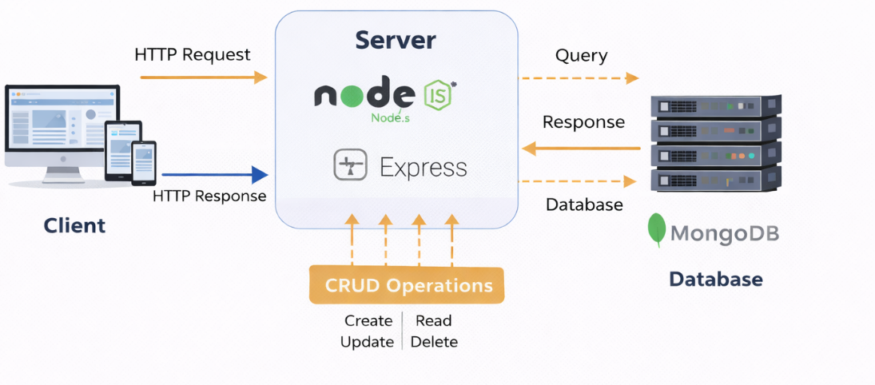
System Workflow & Challenges
System Workflow:
User interacts with the Frontend (React.js UI)
Request is sent to Backend (Node.js & Express API)
Backend communicates with MongoDB Database
Backend processes data and integrates Speech-to-Text
Processed response is sent back to the frontend and
displayed to the user
Challenges Faced:
Integrating AI features (Speech-to-Text & Avatar) with MERN stack
Managing smooth communication between frontend, backend, and database
Handling API errors and debugging backend issues
Ensuring responsive and user-friendly UI across devices
Optimizing performance for real-time interview interactions
Managing time and handling multiple development tasks
SoET, CMRU

Slide 19
Skills Learnt & Outcomes
Skills Learned:
Full Stack Development using MERN Stack (MongoDB, Express.js, React.js, Node.js)
Speech-to-Text Integration & AI-based Features
RESTful API Development & Integration
Frontend UI/UX Design & Optimization
Debugging, Testing & Performance Improvement
Working with AI Avatar Integration (Beyond Presence)
Outcomes Achieved:
Successfully implemented AI-based interview features (speech-to-text & avatar integration)
Automated candidate interview report generation
Improved dashboard UI and fixed critical frontend issues
Enhanced user experience by optimizing page flow and animations
Gained hands-on experience in real-world full-stack development
SoET, CMRU

Slide 20
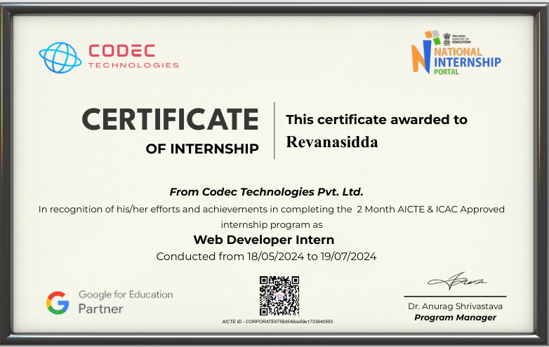
Certificate
SoET, CMRU

Slide 21
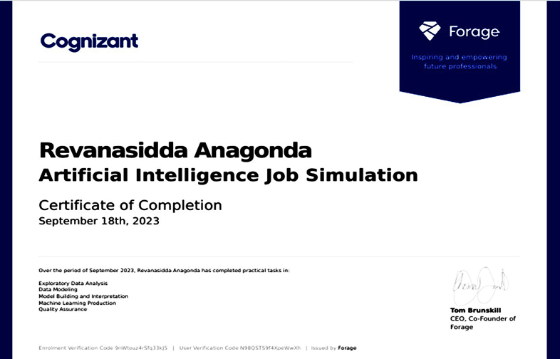
Certificate
SoET, CMRU

Slide 22
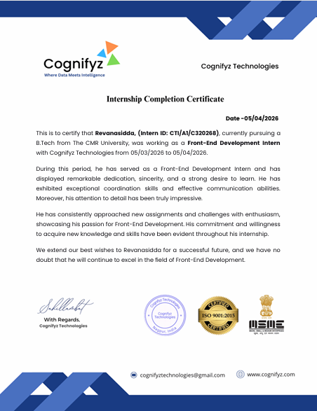
Skills Learnt & Outcomes
SoET, CMRU

Slide 23
THANK YOU
SoET, CMRU

