Slide 1

WATER QUALITY ANALYSIS
Presented by,
AJAI U
PRATHAB M
SALMAN A

Slide 2
MODULES
1)SPLITTING THE TRAINING AND TESTING DATA
2) APPLYING REGULARIZATION
3)CREATING DASHBOARD USING IBM COGNOS
4)CREATING REPORT USING IBM COGNOS
5)STATISTICAL TESTS USING TREEMAP

Slide 3
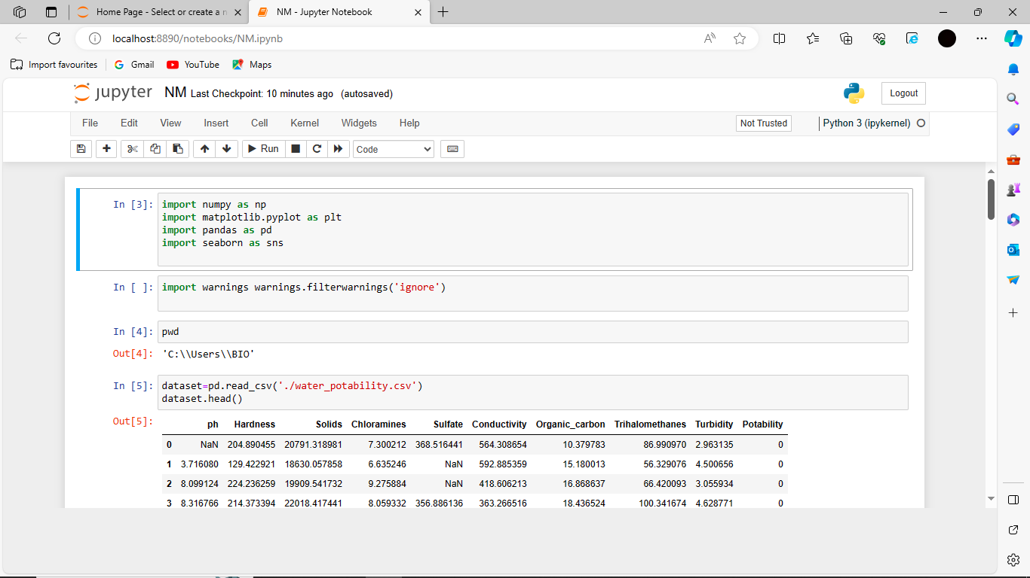
Step 1:SPLITTING THE TESTING AND TRAINING DATA

Slide 4
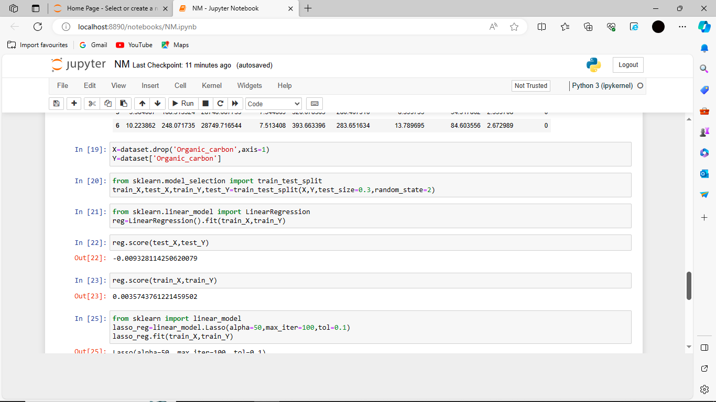

Slide 5
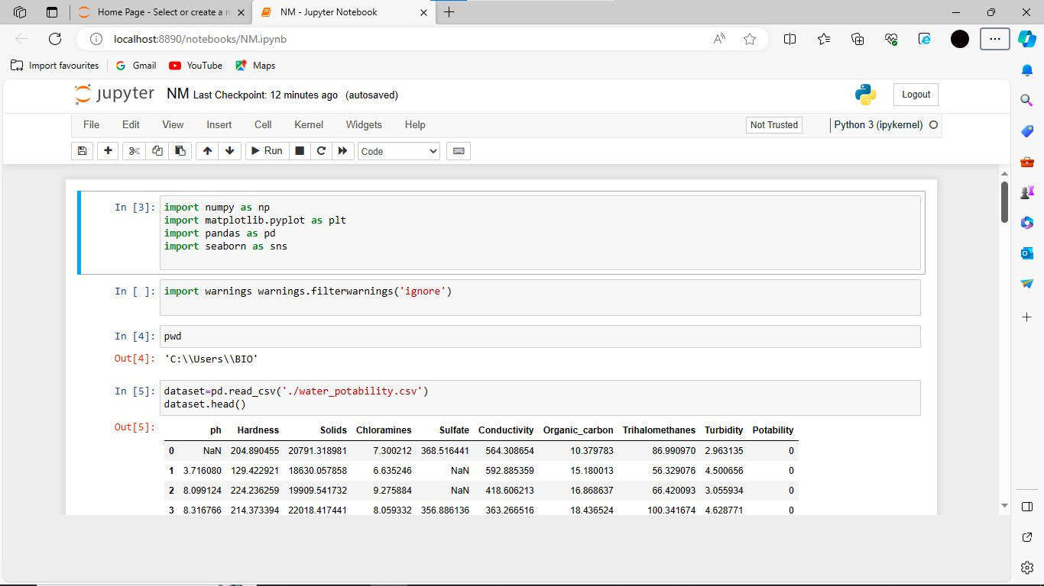
Step 2:Applying Regularization and loss calculation

Slide 6
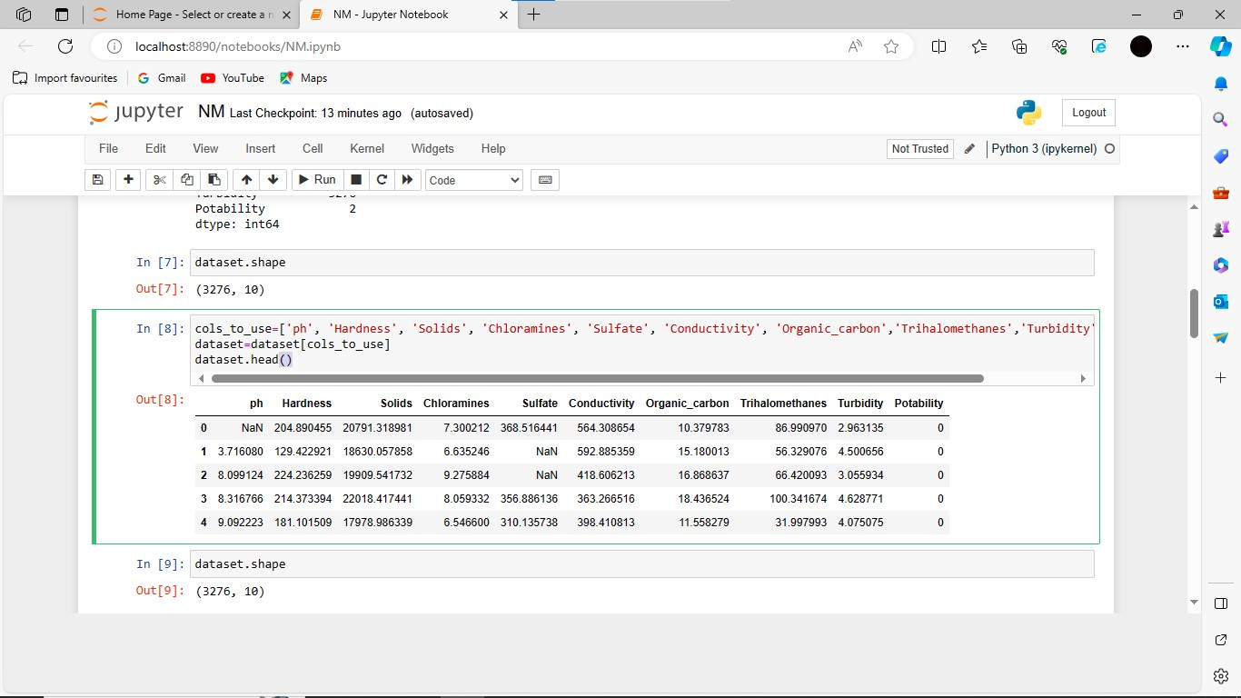

Slide 7
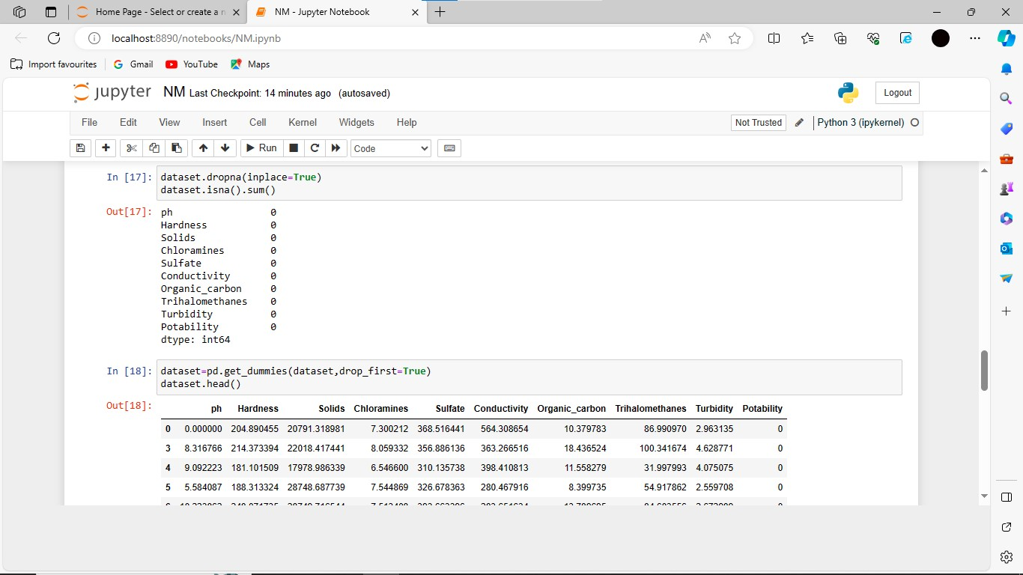

Slide 10
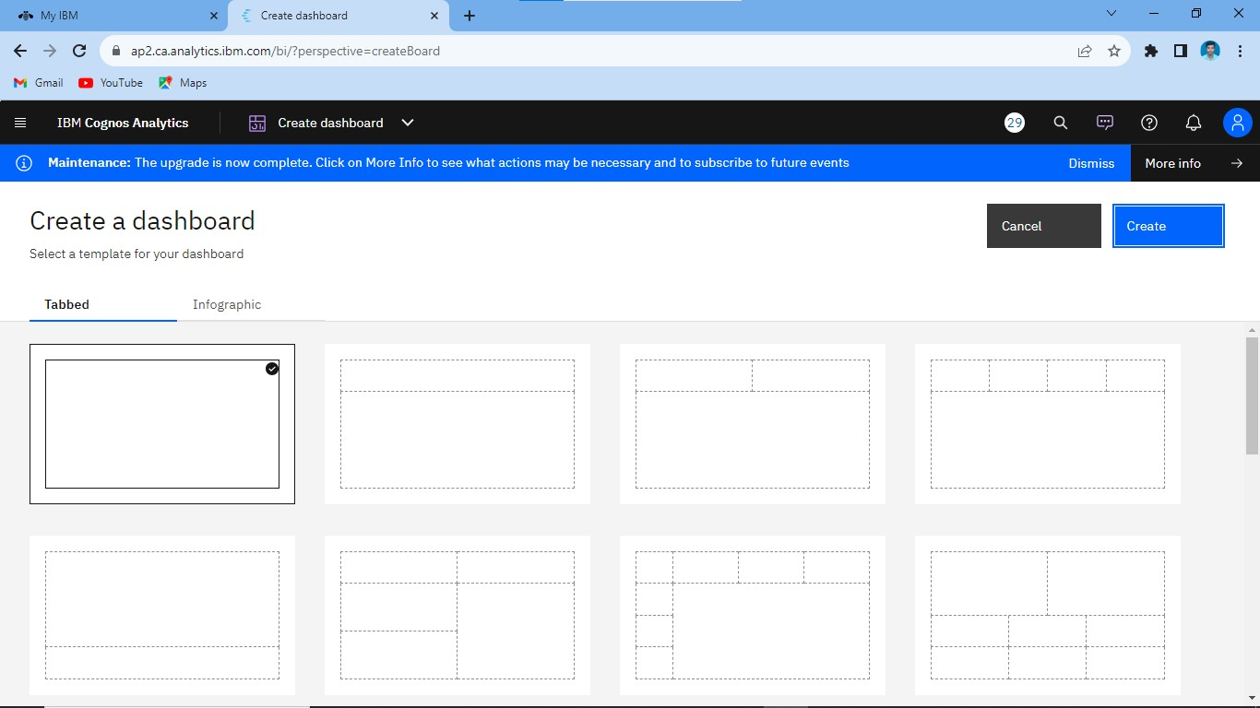
Step 3: CREATING DASHBOARD USING IBM COGNOS

Slide 11
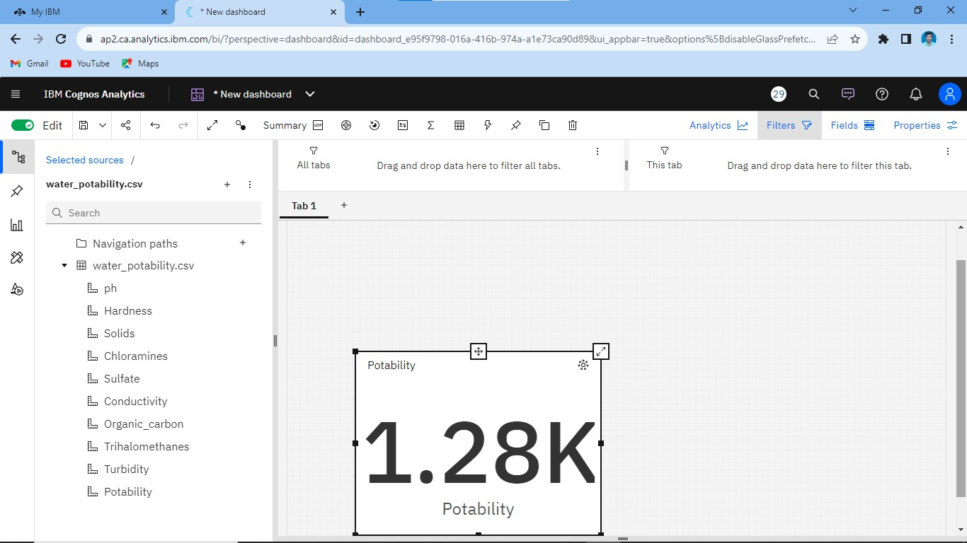

Slide 12
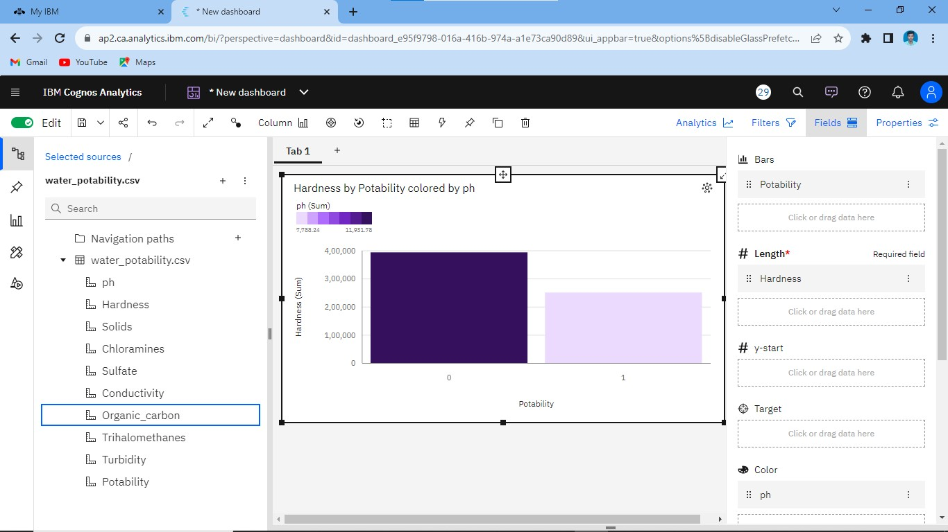
Creating bar graph using dashboard

Slide 13
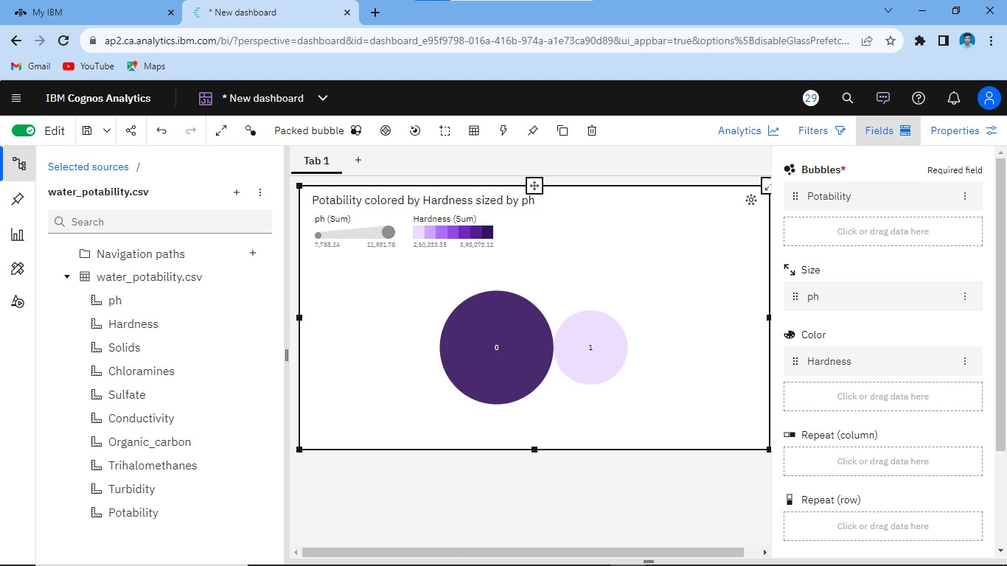
Creating packed ball structure using dashboard

Slide 14
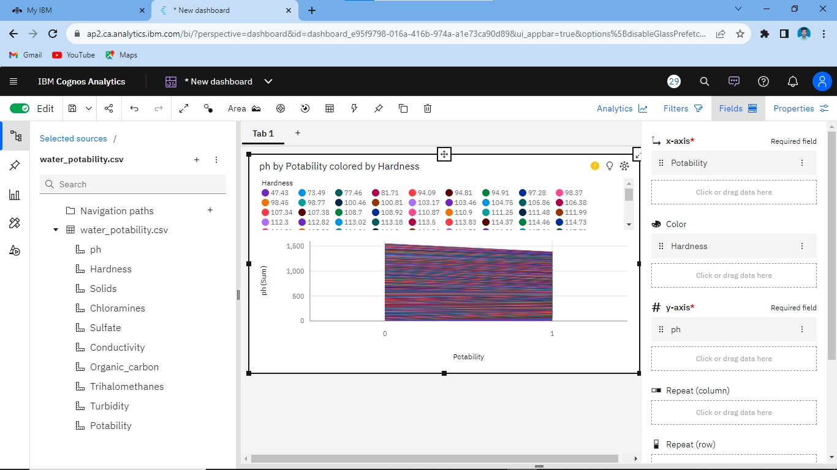
Creating area using dashboard

Slide 15
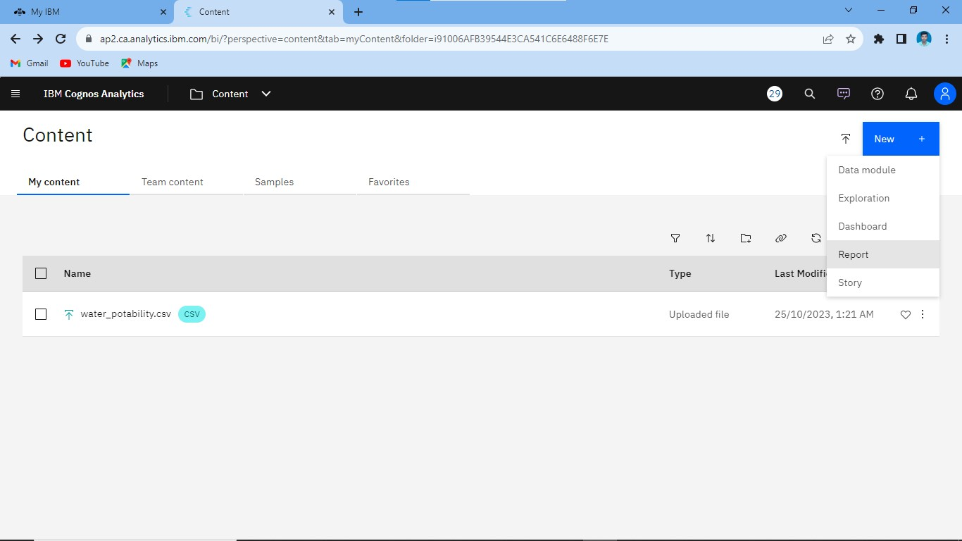
Step 4: CREATING REPORT USING IBM COGNOS

Slide 16
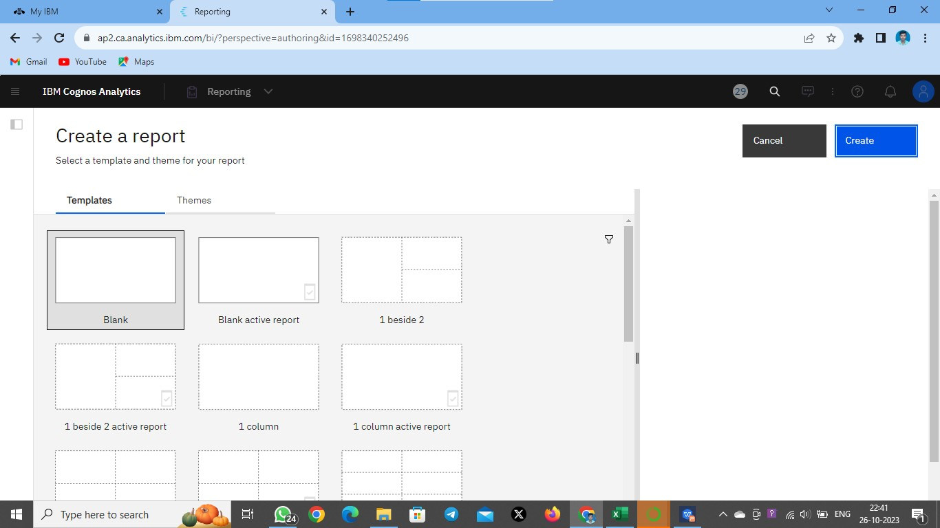

Slide 17
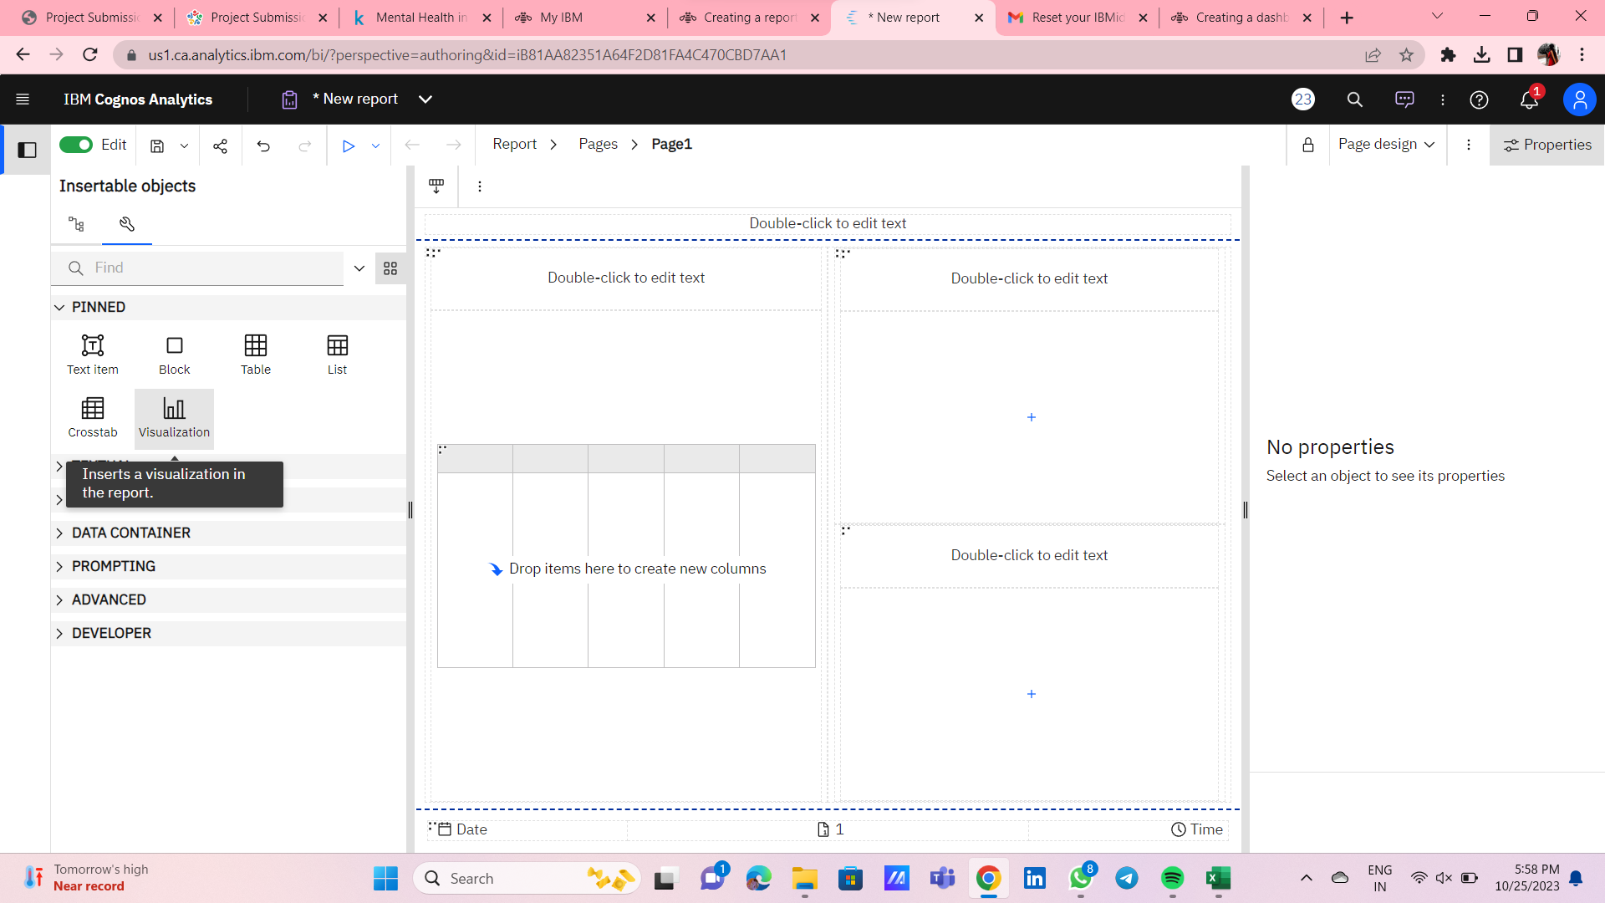

Slide 18
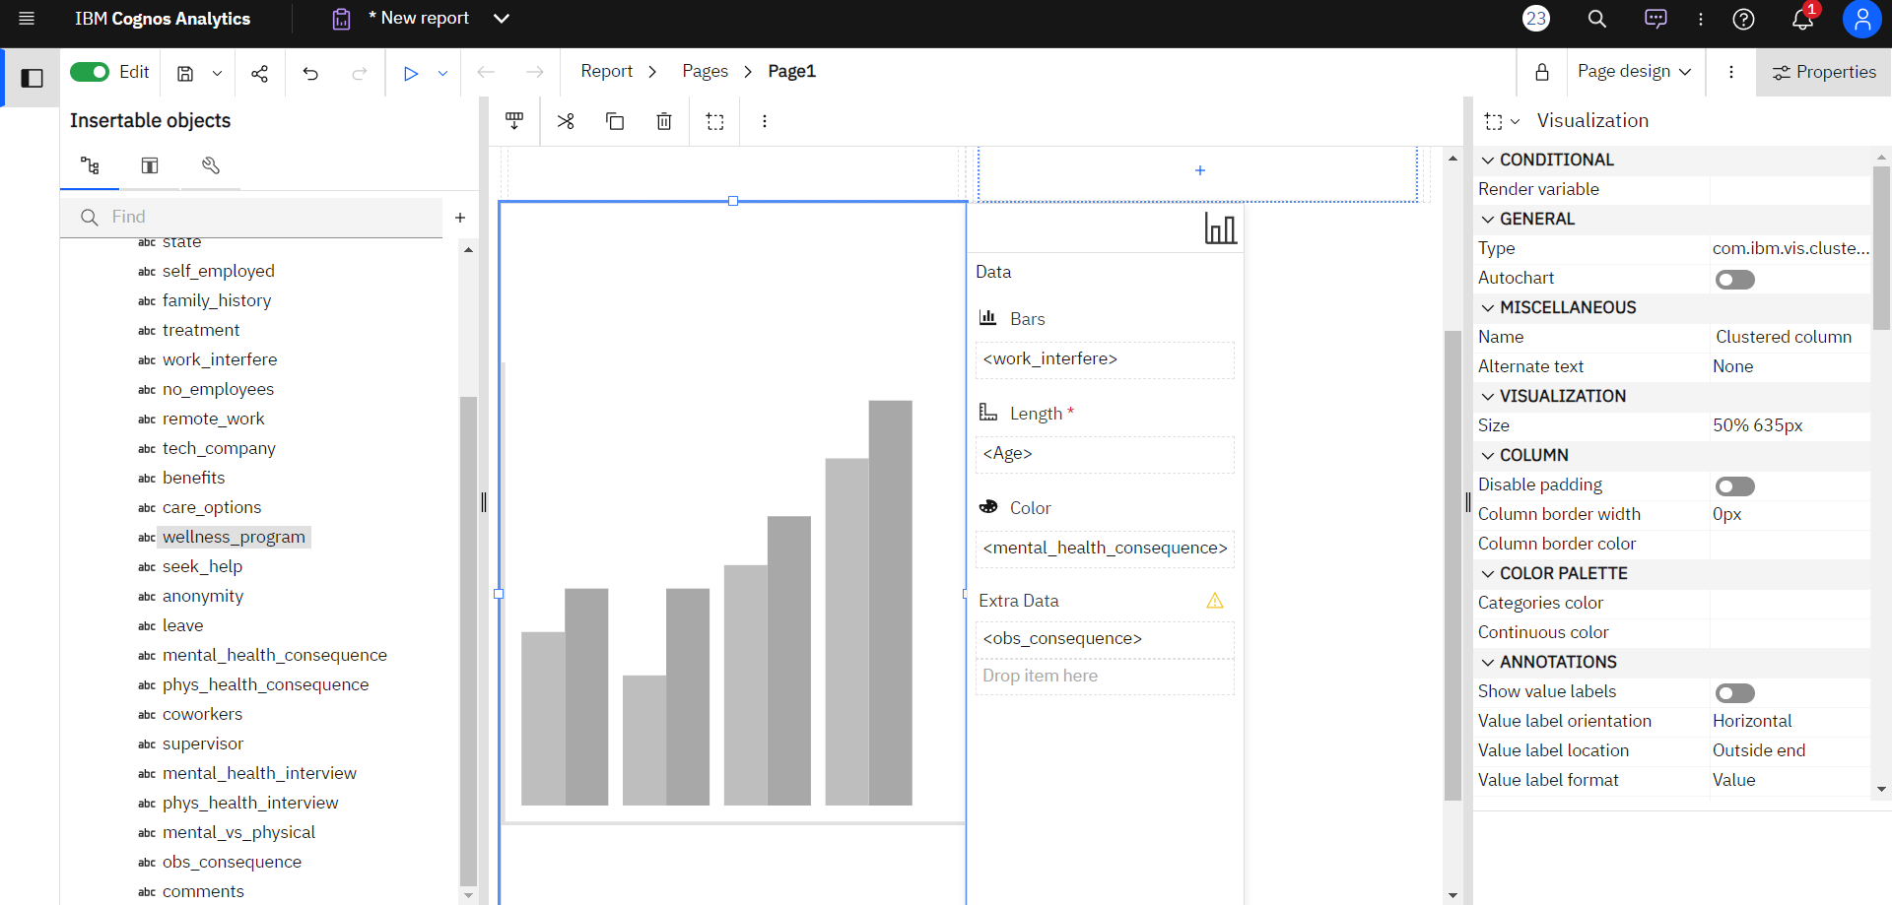
Creating bar graph using report

Slide 19
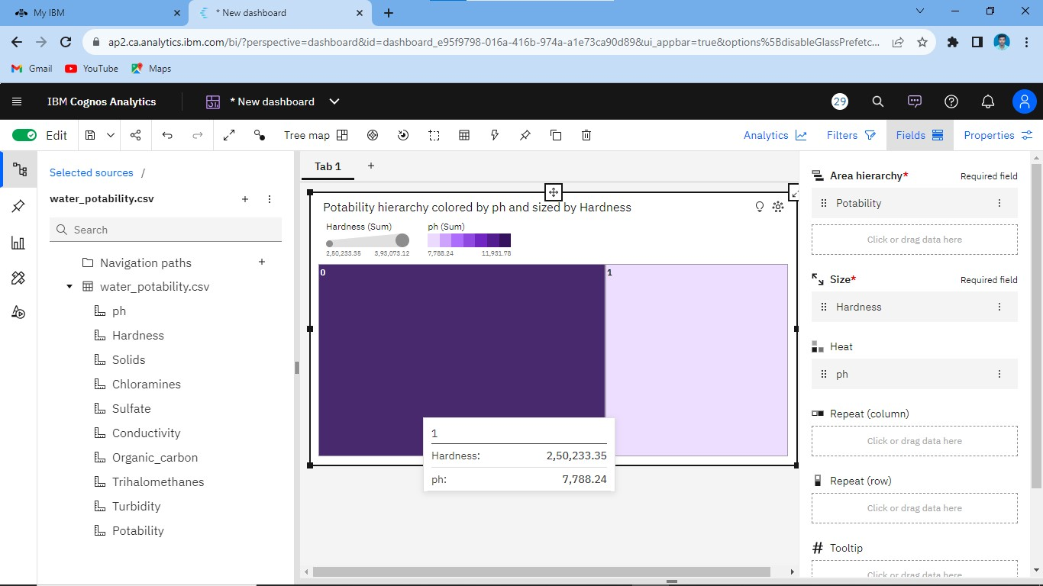
Step 5: STATISTICAL TESTS USING TREEMAP

