Slide 1
Tasks Results
Task 1: Text classification using BERT and comparison with simple LSTM model performance
Task 2: Text based clustering (NLP) : Perform unsupervised topic modelling of unlabeled text
Task 3: Write a function that takes text array as input and returns the data with corrected spellings.
Sachinkumar Revankar
sachinkumarme093@gmail.com
Mob:9008570443

Slide 2
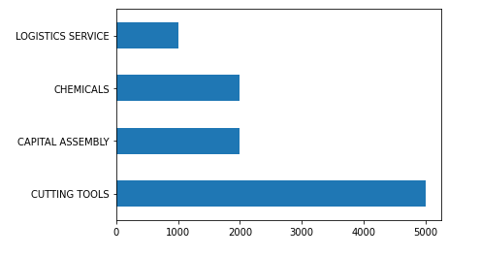
Task 1: Text classification using BERT and comparison with simple LSTM model performance
Data detail:
The given Bert_Sample.csv file has 10000 text data points with 4 classes to classify
Below is the data points each classes having
Transformer based pre trained BERT language mode is fine tuned to classify the 4 different classed and the results as follows
Cleaning and Preprocessing data
Data embedding and Bert model building
Training the model
Model performance evaluation of Test data

Slide 3
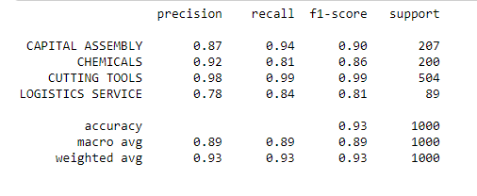
Task 1: Text classification using BERT and comparison with simple LSTM model performance
BERT model results on test data

Slide 4

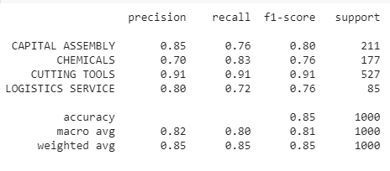
Task 1: Text classification using BERT and comparison with simple LSTM model performance
LSTM model Results
Steps followed in LSTM model to classify
Cleaning and Preprocessing data
Data embedding and LSTM model building
Training the model
Model performance evaluation of test data
Conclusion:
For given text data, BERT model accuracy is more than LSTM model

Slide 5
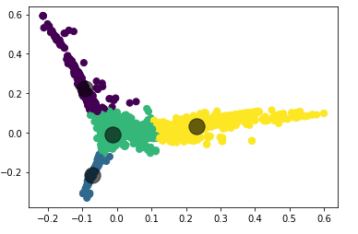
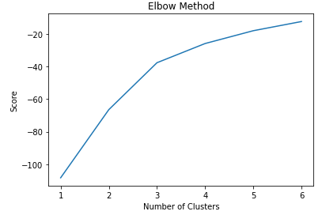
Task 2: Text based clustering (NLP) : Perform unsupervised topic modelling of unlabeled text
In present work, text based clustering is made with 2 approaches
TF-IDF and K-Means Clustering
Latent Drichilet Allocation
K-Means Clustering Results:
Cleaning and Preprocessing data
TF-IDF vectorization
1. K-Means Clustering, 2. LDA
Model performance evaluation

Slide 6
Task 3: Write a function that takes text array as input and returns the data with corrected spellings.
Spelling correction task is performed by with use of 2 library:
TextBlob
Gingerit
Thank You

