Slide 1



Paddy Disease Classification
Using Transfer Learning
Mentor :- Dr. Durgesh Singh
Team :- T Revan Kumar
Arshad
N Pranay Reddy
Siva Ganesh
Rishika

Slide 2



Problem Statement
10 Disease Classes
Agricultural Impact
Real World Impact
~10,000 images from Kaggle
paddy disease dataset
Build accurate classifier for
real-world crop disease detection
Early disease detection can save up to 40% crop loss in paddy farming
Challenge: Predict disease correctly

Slide 3

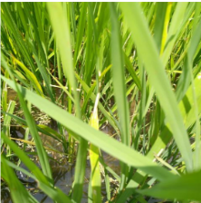
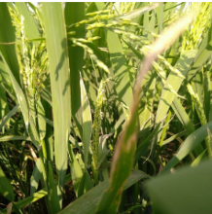
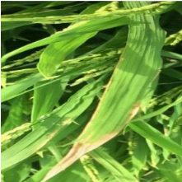
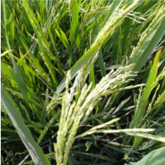

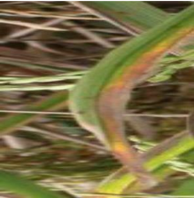
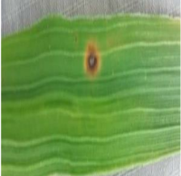
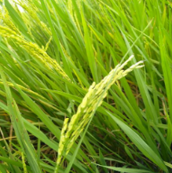
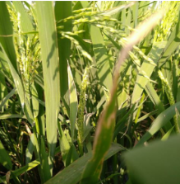
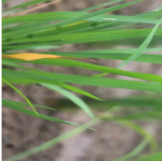
Dataset Overview
Bacterial Leaf Blight
Brown Spot
Blast
Dead Heart
Hispa
Leaf Scald
Narrow Brown Spot
Normal
Sheath Blight
Tungro
~10,000 Images
10 Classes
80/20 Split
5.2x Imbalance
146 removed Deduped

Slide 4




Transfer Learning Approach
ImageNet
Pretrained
Backbone
Paddy
Diseases
14M images
1000 classes
Edges, textures
shapes, patterns
Retrain top layers
for 10 classes
Analogy: Teaching an expert photographer to identify crop diseases — they already understand images, just need domain knowledge
Works with small datasets
Faster convergence
Better generalization

Slide 5



Architecture: EfficientNetB3
Input
300×300×3
>
Stem
7 layers
>
Block 1-2
66 layers
>
Block 3-4
118 layers
>
Block 5-7
190 layers
>
Top
3 layers
>
GAP
Dropout
>
Dense(10)
Softmax
384
10.78M
7
26
Total Layers
Parameters
MBConv Blocks
Sub-blocks
Why EfficientNetB3 over ResNet50?
Compound scaling balances depth, width, resolution
Better accuracy-to-compute ratio for fine-grained tasks
Fits in 4GB VRAM

Slide 6

Architecture Evolution
ResNet50
EfficientNetB0
EfficientNetB3
224×224
224×224
300×300
~84%
~91%
~98%
Over-regularized
Memory safe
Final choice
L2 + BN + Dropout×3
Only conv5_x unfrozen
LR too conservative
Lighter model
Good baseline
Limited capacity
Compound scaling
Native 300px
Minimal head: GAP→D(0.3)→Dense(10)
Key insight: Minimal head (GAP → Dropout → Dense) outperforms over-engineered classifier stacks

Slide 7
3-Phase Progressive Unfreezing
Phase 1
Phase 2
Phase 3
Head Only
Blocks 5-7
Blocks 3-7
~88%
~96%
~98%
Layers
2
Layers
195
Layers
311
Params
15K
Params
9.98M
Params
10.73M
% Model
0.14%
% Model
92.5%
% Model
99.5%
LR
1e-3
LR
1e-4
LR
2e-5
Epochs
15
Epochs
20
Epochs
25
EarlyStopping
ReduceLROnPlateau
Warmup (2 ep)
Cosine Decay
Warmup (2 ep)
Cosine Decay
All frozen
Blocks 5-7 unfrozen
Blocks 3-7 unfrozen

Slide 8





Key Techniques That Pushed Accuracy
Label Smoothing (0.1)
Warmup + Cosine LR
Test-Time Augmentation
Prevents overconfident predictions
+1-2% generalization boost
Protects newly unfrozen layers
from gradient shock
5 passes averaged at inference
Free +1-2% accuracy
Block-Based Freezing
Mixed Precision (FP16)
Phase Checkpoints
Freeze at block boundaries
not arbitrary layer counts
Halves VRAM usage
Fits B3@300 in 4GB
Every phase saves independently
Never lose training progress

Slide 9

Results
Model
EfficientNetB3
Input Size
300×300
98%
Training Phases
3 (progressive)
GPU
RTX 3050 (4GB)
Phase 1 Accuracy
~88%
Validation Accuracy (with TTA)
Phase 2 Accuracy
~96%
Phase 3 Accuracy
~98%
TTA Boost
+1-2%
Accuracy Journey
Phase 1 → 88%
Phase 2 → 96%
Phase 3 → 98%

Slide 10
Lessons Learned
Preprocessing pipeline order is critical for transfer learning
Minimal classifier heads outperform over-regularized ones
Progressive unfreezing beats unfreeze-all-at-once
Always save checkpoints after each training phase
Hardware constraints force better engineering decisions

Slide 11

Future Scope
Model Ensemble
EfficientNetV2-S
Average predictions from EfficientNetB3 + ResNet50 for robust classification
Improved architecture with faster training and better accuracy ceiling
Higher Resolution
Mobile Deployment
Increase to 380×380 pixels for finer disease texture detection
Convert to TFLite and deploy as mobile app for real-world farmer use

Slide 12

TESTING
Kaggle Paddy Disease Classification — 3,469 Unlabeled Test Images
3,469
EfficientNetB3
5
99.4% agree
Test Images
Model
TTA Passes
Normal vs TTA

Slide 13
Prediction Distribution
Normal Inference vs Test-Time Augmentation on 3,469 images
Normal vs TTA agreement: 3,448 / 3,469 images (99.4%)

Slide 14
Sample Predictions
Top 10 test images with confidence scores
Image | Predicted Class | Confidence
200001.jpg | hispa | 94.5%
200002.jpg | normal | 92.3%
200003.jpg | blast | 88.4%
200004.jpg | blast | 94.2%
200005.jpg | blast | 90.6%
200006.jpg | brown_spot | 85.3%
200007.jpg | dead_heart | 90.9%
200008.jpg | brown_spot | 86.6%
200009.jpg | hispa | 87.8%
200010.jpg | normal | 93.3%
Average confidence: 90.4% — model is confident and consistent across disease classes

Slide 15



Test-Time Augmentation Strategy
5-pass inference with multi-strategy augmentation for robust predictions
Clean Passes
Strong Augmentation
Multiscale Crop
2 passes
2 passes
1 pass
No augmentation
Stable baseline predictions
Direct model output
Random flip + brightness
Contrast + saturation shift
Hue variation (0.05)
Resize to 340x340 first
Random crop to 300x300
Tests scale invariance
99.4%
21 / 3,469
Average all 5 passes
Agreement Rate
Changed Predictions
Strategy

Slide 16
Validation vs Test
Model performance across evaluation stages
Validation Set (2,067 images)
Test (3,469 images)
Standard Accuracy
97.44%
Total Predictions
3,469
TTA Accuracy
97.97%
TTA Agreement
99.4%
TTA Boost
+0.53%
Avg Confidence
~90.4%
Misclassified
42 / 2,067
Most Predicted
blast (593)
Best Class
dead_heart (100%)
Least Predicted
bact. panicle (112)
Weakest Class
downy_mildew (91.9%)
Model generalizes well: high confidence and consistent predictions across unseen data

Slide 17
Thank You

