Slide 1
GENERATION OF REALISTIC IMAGES (Photo stack)
Presented by:- Revanth Nagaraj Mallol
1002244969

Slide 2
Background
The crucial job of a Data Scientist is to collect /create data as much as possible so that we can train the model and get better accuracy.
Used to solve real world problems, pre-collected data is not useful.
Insufficient data may lead to low accuracy or inefficient use of the model.
Notes:
ML-based Uber and Google’s self-driving cars are trained with the use of synthetic data. In the medical and healthcare sector, synthetic data is used for testing certain conditions and cases for which real data does not exist. In the research department, synthetic data helps you develop and deliver innovative products for which necessary data might not be available. Synthetic Data - is data that is artificially created rather than being generated by actual events.

Slide 3

Research objectives
To Generate a Photo Realistic Images using GAN(Generative Adversarial Networks).
To learn word embeddings for the vocabulary
Generating image

Slide 4
Research Motivation
Automatic synthesis of realistic images is extremely difficult task and even the state-of-the-art AI/ML algorithm suffer to fulfil this expectation.
Main reasons
Privacy
Training
Testing
Using the Generated images for sales in stores.
Notes:
Privacy - Real data contains sensitive and private user information that cannot be freely shared and is legally constrained.
Training – if there not enough data to train a model we only generate realistic images.
Testing – To test if the generated images are real or not.
Generate fake images of a product to help the stores to use it in there website. Avoids copyrights since it’s a fake image.

Slide 5

Problem statement
“To build a well-performing generator, which makes use of machine learning algorithms to produce the required outputs. ”

Slide 6
LITERATURE SURVEY

Slide 7
Literature Survey
Index | Title | Year | Observations
1 | Generative Adversarial Nets. Goodfellow Ian; Pouget-Abadie Jean; Mirza Mehdi; Xu Bing; Warde-Farley David; Ozair Sherjil; Courville Aaron; Bengio Yoshua (2014). | 2014 | Output generated by this model is better than the previous models.
2 | NIPS 2016: Generative Adversarial Networks Ian Goodfellow | 2017 | Highlights the Advantages of GAN’s over other networks
3 | Conditional Generative Adversarial Nets. Simon Osindero ; Mehdi Mirza; | 2014 | Outputs generated by this model can controlled via text or any other inputs.
4 | StackGAN: Text to Photo-realistic Image Synthesis with Stacked Generative Adversarial Networks Han Zhang , Tao Xu , Hongsheng Li , Shaoting Zhang , Xiaogang Wang , Xiaolei Huang , Dimitris Metaxas | 2017 | It hierarchically extracts information from the data through encoders, generate representation level by level, then learns these representation in a top-down way.
Notes:
1 index paper says – gan’s were designed in such a way to avoid Markov chain approximations(which is computational expensive).
its better than the Boltzmann machines which were popular in 2006 because Boltzmann uses Markov chain approx.
• They can generate samples in parallel, instead of using runtime proportional to the dimensionality of x. This is an advantage relative to DBNs.
• The design of the generator function has very few restrictions. This is an advantage relative to Boltzmann machines, for which few probability distributions admit tractable Markov chain sampling, and relative to nonlinear ICA, for which the generator must be invertible and the latent code z must have the same dimension as the samples x.
• No Markov chains are needed. This is an advantage relative to Boltzmann machines.
• No variational bound is needed, and specific model families usable within the GAN framework are already known to be universal approximators, so GANs are already known to be asymptotically consistent. Some VAEs(Variations Encoders) are conjectured to be asymptotically consistent, but this is not yet proven.
• GANs are subjectively regarded as producing better samples than other methods

Slide 8
Literature Survey
Index | Title | Year | Observations
5 | Synthetic to Real World Image Translation Using Generative Adversarial Networks (CGAN). Sreedhar Radhakrishnan C-C Jay Kuo | 2018 | framework is strongly based on Unpaired Image-to-Image Translation using (Cycle GAN)
6 | Recent Progress on Generative Adversarial Networks (GANs): A Survey Zhaoqing Pan; Weijie Yu; Xiaokai Yi; Asifullah Khan; Feng Yuan; Yuhui Zheng | 2019 | Gan can be used to various applications like computer vision, natural language processing, etc.
7 | An Intelligent Method for Predicting the Pressure Coefficient Curve of Airfoil-Based Conditional Generative Adversarial Networks | 2021 | Convergence will be faster. Even the random distribution that the fake images follow will have some pattern. You can control the output of the generator at test time by giving the label for the image you want to generate

Slide 9
Design and Implementation

Slide 10
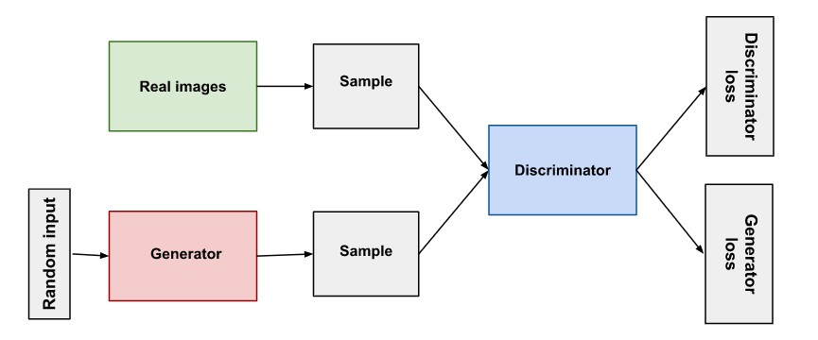
Generative Adversarial networks
The generator produces the synthesized or fake images by taking noise as an input which are close to real training data set.
The discriminator gets the real and synthesized image as an input and determines whether its fake or a real image.

Slide 11

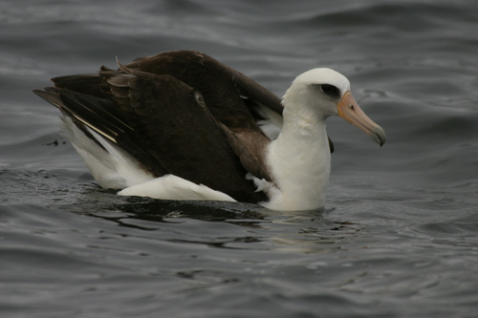
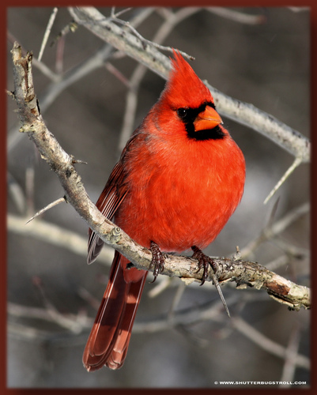
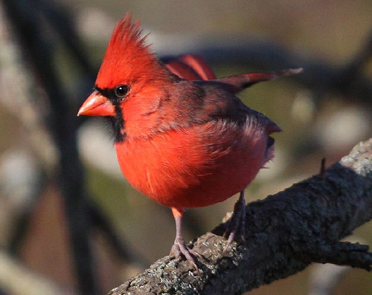
Embedding Vector
Conditioning augmentation
Stage-1
ARCHITECTURE
Input Text
Embedding vector
Generator
Generates low resolution image RGB image.
64*64
Discriminator
Gives output
0 (in case of fake)
1 (in case of real image)
+
This Car is of red Colour
Word2vec embedding
Random noise
=
D – dimensional array
Real image
Stage-2
Generator
Generates the high resolution images
RGB image
256*256
Discriminator
Takes generated images by stage-2 generator and real images from dataset and discriminates them
Real image

Slide 12
KING
ELEPHANT
Feature1 = 1
Feature2 = 0
Feature3 = 1
Feature4 = -1
Feature1 = 0
Feature2 = 1
Feature3 = 0
Feature4 = -1
[1,0,1,-1]
[0,1,0,-1]

Slide 13
 | A | B | C | D | … | Z
Feature 1 | 0 | 1 | 0.2 | 1 | … | 0.2
Feature 2 | 1 | 0 | 0 | 0.5 | … | 0
Feature 3 | 0 | 1 | 0.3 | 1 | … | 0.2
Feature 4 | -1 | -1 | -1 | 1 | .. | 1
A
B
C
G
1
0
1
-1
0.2
0
0.3
-1
0.2
0
0.2
1
1
0
0.9
1
1
0
1
1
-
+
=
~

Slide 14
To Learn This automatically
We specify a fake problem.
Solve this using neural network
You get the word embeddings as a side effect.

Slide 15
There lived a king called Ashoka in India. After Kalinga battle, he converted to Buddhism. This mighty king ordered his ministers to put together a peaceful treaty with their neighbouring kingdoms. The emperor ordered his ministers to also build stupa, a monument with Buddha’s teachings.
Fake problem
Side effect
Ordered his ministers
Ordered his ministers
King
Emperor
King
0.7
0.4
1.2
3.8
0.7
0.5
1.2
3.8
~
emperor

Slide 16
There lived a king called Ashoka in India. After Kalinga battle, he converted to Buddhism. This mighty king ordered his ministers to put together a peaceful treaty with their neighbouring kingdoms.
The emperor ordered his ministers to also build stupa, a monument with Buddha’s teachings.
Samples
Lived , a -> There
a , King -> Lived
his , ministers-> ordered
ordered , his -> emperor

Slide 17

ordered , his -> emperor
Ashoka
0
0
0
0
1
…
0
Back Propagation
emperor
ordered
his
king
$$\hat{y}$$
y
ordered
w1
0.1
0.4
0.02
0.08
0.01
…
0.02
Ashoka
0
1
0
0
0
…
0
Loss
…
w2
emperor
teaching
w3
w5
his
w4
w6
king
w7
Ashoka
0
0
1
0
0
…
0
w8
ordered
emperor
…
his
his
teaching
king
emperor
king
ordered
w1
w2
w3
w4
w5
w6
w7
w8
…
teaching

Slide 18
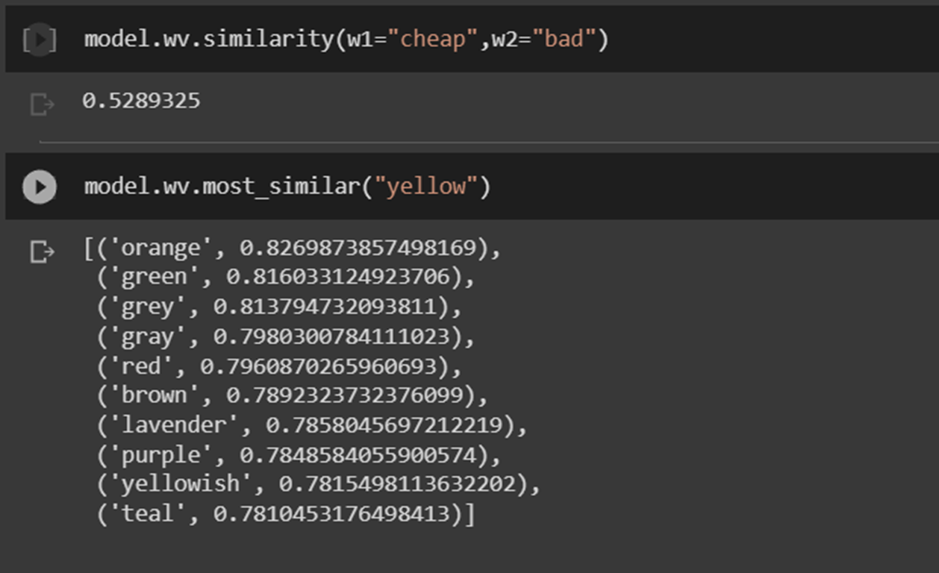
REsults

Slide 19
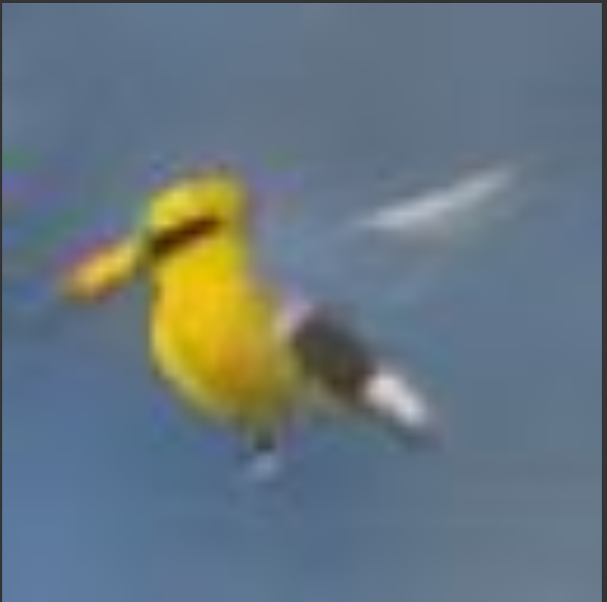

output
Generated image

Slide 20

output
Generated image

Slide 21
Software used
Google Colab
Regular Expression
Pandas
Gensim

Slide 22
Conclusion
Generative Adversarial Networks are a recent development and have shown huge promises already.
It is an active area of research and new variants of GANs are coming up frequently.
In complex domains or domains with a limited amount of data, generative modeling provides a path towards more training for modeling.
GANs have seen much success in this use case in domains such as deep reinforcement learning.
Notes:
Data Augmentation – it’s a way of significantly increasing the dataset available to model, without collecting new data.

Slide 23
References
Goodfellow, Ian; Pouget-Abadie, Jean; Mirza, Mehdi; Xu, Bing; Warde-Farley, David; Ozair, Sherjil; Courville, Aaron; Bengio, Yoshua (2014). Generative Adversarial Nets (PDF). Proceedings of the International Conference on Neural Information Processing Systems (NIPS 2014). pp. 2672–2680.
Isola, Phillip; Zhu, Jun-Yan; Zhou, Tinghui; Efros, Alexei (2017). "Image-to-Image Translation with Conditional Adversarial Nets". Computer Vision and Pattern Recognition.
A Gentle Introduction to Generative Adversarial Networks (GANs) Machine Learning Mastery by Jason Browniee.
Synthetic Data: Applications in Data Privacy and Machine Learning Towards Data Science by Lula Tan
Mustafa, Mustafa; Bard, Deborah; Bhimji, Wahid; Lukić, Zarija; Al-Rfou, Rami; Kratochvil, Jan M. (May 6, 2019). "CosmoGAN: creating high-fidelity weak lensing convergence maps using Generative Adversarial Networks". Computational Astrophysics and Cosmology1. arXiv:1706.02390.
Tang, Xiaoou; Qiao, Yu; Loy, Chen Change; Dong, Chao; Liu, Yihao; Gu, Jinjin; Wu, Shixiang; Yu, Ke; Wang, Xintao (September 1, 2018). "ESRGAN: Enhanced Super-Resolution Generative Adversarial Networks". arXiv:1809.00219
Xi Chen; Yan Duan; Rein Houthooft; John Schulman; Ilya Sutskever; Pieter Abeel (2016). "InfoGAN: Interpretable Representation Learning by Information Maximizing Generative Adversarial Nets". arXiv:1606.03657

