Slide 1
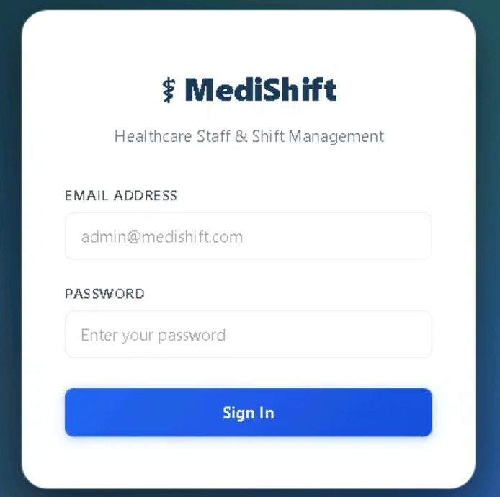
MediShift Infrastructure Deployment
Automated, Non-Containerized Production-Grade Architecture on Microsoft Azure
AZURE CLOUD ARCHITECTURE
HEALTHCARE IT

Slide 2
Project Overview
MediShift is a mission-critical healthcare platform managing staff rosters, shift rotations, and leave administration. Because medical environments operate around the clock, the hosting architecture must guarantee uninterrupted availability, strict network security, and operational resilience.
Healthcare Operational Context
Cloud Availability Requirements
24/7 staff scheduling and shift management
Real-time leave request processing
Multi-role access for clinical and admin staff
Audit-ready compliance logging
Zero planned downtime during deployments
Strict VNet isolation for all backend services
Automated health probing and self-healing
Secure secrets management with no plaintext exposure

Slide 3
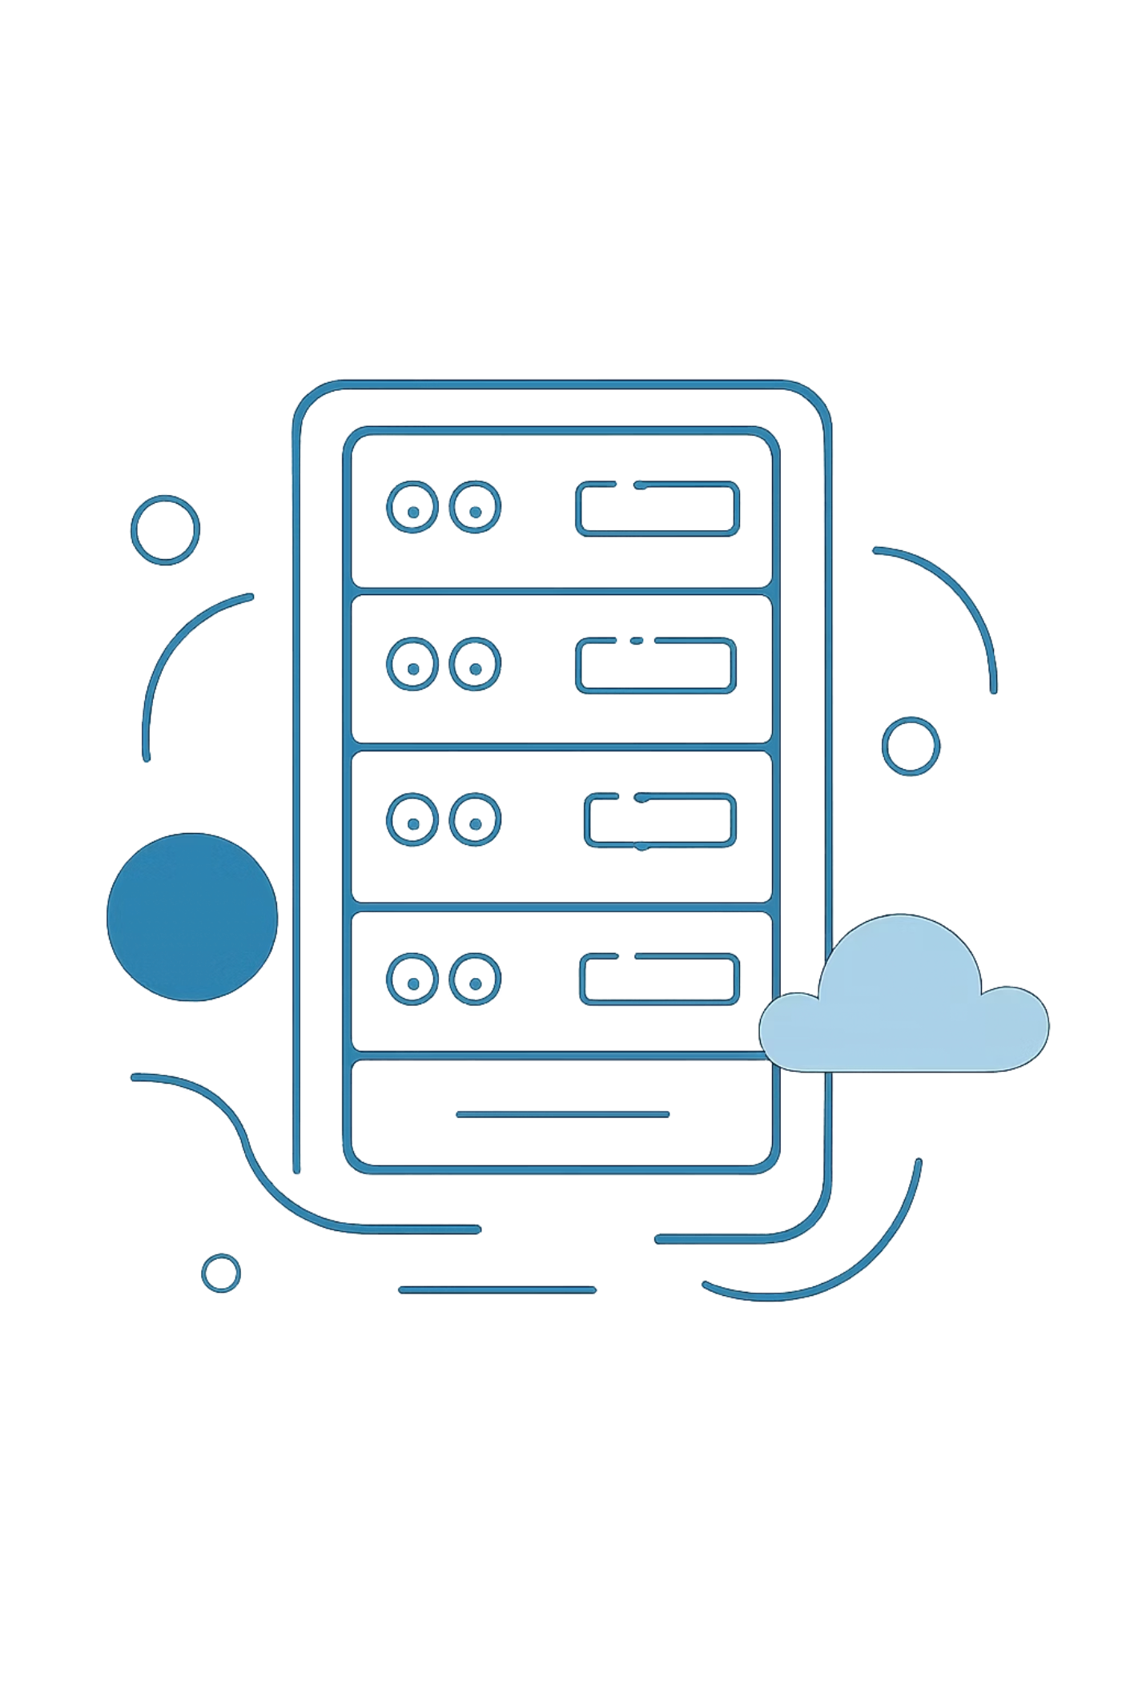
Solution Architecture Strategy
Three structural tiers address every identified problem without container orchestration — using native Linux runtimes, managed Azure services, and infrastructure-as-code.
🌐 Web Tier
VM Scale Sets serving React 18 SPA statically via Nginx. Auto-scaling ready, zero Node.js runtime on frontend.
⚙ Application Tier
Standalone VM hosting 4 Node.js Express microservices daemonized under PM2 with isolated port bindings (3001–3004).
🗄 Database Tier
Fully managed Azure Database for PostgreSQL Flexible Server inside a private delegated subnet — no public endpoint.

Slide 4
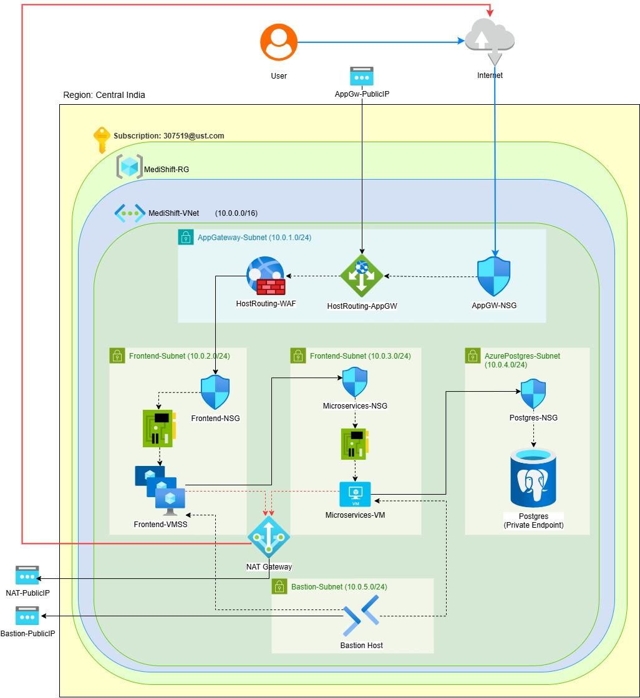

Architecture
& Network Topology
Traffic flows through a strictly controlled ingress point, is routed by path to the appropriate tier, and never exposes the database to the public internet. All inter-tier communication occurs over private VNet addresses within the 10.0.0.0/16 address space.
All backend communication between the Application Gateway, VMSS, Microservices VM, and PostgreSQL occurs exclusively over private VNet addresses. No tier is directly accessible from the public internet except the Application Gateway's frontend IP.

Slide 5
High-Availability Architectural Features
Production readiness is engineered into every layer — from VM SKU selection to Nginx warm-up tricks that eliminate cold-start failures.
100% Non-Containerized
Zero-Downtime Probing
Operates purely on native Linux runtimes, systemd, and PM2. No Docker, no Kubernetes — reducing attack surface and operational complexity.
Instant Nginx loading screen during backend warm-up prevents 502 Bad Gateway failures, ensuring users never see raw errors.
Core Quota Compliant
Secure Source Fetching
Uses Standard_B2as_v2 and Standard_B1ms VM sizes to fit within strict 4-core subscription limits without sacrificing performance.
Code is fetched directly from verified source repositories during cloud-init execution — no manual artifact uploads, no exposed credentials.

Slide 6





Core Technology Stack
Each technology is mapped to its operational layer, forming a clean dependency chain from infrastructure provisioning down to data persistence.
Infrastructure as Code
Cloud Platform
Reverse Proxy
Terraform ≥ 1.3.0 with azurerm provider — repeatable, version-controlled environment provisioning.
Microsoft Azure — VNet, VMSS, Application Gateway, PostgreSQL Flexible Server, Bastion.
Nginx — static file serving, reverse proxy, and health-check warm-up layer.
Runtime & Services
Data Layer
Node.js 20.x, Express, PM2 — microservices process management and API routing.
Managed PostgreSQL v15 with Sequelize ORM — fully isolated, automated backups, private-link only.

Slide 7
Internal Microservices Port Matrix
Local Reverse Proxy Configuration
Path Mapping
Service Engine
Localhost Port
/api/auth/*
Auth Service Engine
3001
/api/departments/* & /api/staff/*
Staff Service Engine
3002
/api/shifts/*
Shift Service Engine
3003
/api/leaves/*
Leave Service Engine
3004

Slide 8

Subnet & Network Allocation Table
The VNet landscape (10.0.0.0/16) is segmented into five purpose-built subnets, each with a clearly defined role and strict access controls.
Subnet Name
CIDR Block
Purpose
Key Ports
AppGateway-Subnet
10.0.1.0/24
Public ingress, SSL termination, WAF policy enforcement
80, 443
Frontend-Subnet
10.0.2.0/24
Hosts Frontend VMSS (React SPA via Nginx)
80
Microservices-Subnet
10.0.3.0/24
Standalone Backend VM running Node.js/PM2
3001–3004
AzurePostgres-Subnet
10.0.4.0/24
Delegated subnet for isolated PostgreSQL Flexible Server
5432
AzureBastionSubnet
10.0.5.0/24
Secure SSH management hub — no public IPs on VMs
22 (via Bastion)
The AzurePostgres-Subnet uses Microsoft.Network/virtualNetworks/subnets delegation to restrict access to the PostgreSQL Flexible Server only. Azure Bastion eliminates the need for SSH public endpoints on any VM.

Slide 9
Compute Sizing & VMSS Upgrade Modes
Compute Layer Optimization
VMSS Scalability
Hardware Resource Layout
Uses a Manual Upgrade Mode to allow cloud-init bootstrap scripts sufficient time to run full builds without triggering deployment timeouts
Burstable Sizes (Standard_B2as_v2 / AMD): Delivers 4 GiB of RAM memory
Provides a safe buffer to run React asset compilation and multiple Node.js runtimes without out-of-memory errors

Slide 10
Modular Project Directory Layout
Terraform Folder Hierarchy
tf_medishift/
├── main.tf # Global orchestrator that connects all modules
├── providers.tf # Configures Azure and hashicorp standard providers
├── variables.tf # Declares all global input variables
├── outputs.tf # Returns public IPs, endpoints, and next steps
├── locals.tf # Defines project tags and default JWT tokens
├── terraform.tfvars # User-customized parameters (region, sizes, quotas)
├── modules/
│ ├── resource_group/ # Standardized Resource Group resource
│ ├── networking/ # VNet, Subnets, NAT Gateway, Bastion, NSGs, Private DNS
│ ├── security/ # User-Assigned Managed Identity configuration
│ ├── storage/ # Backup Blob Storage account & container resources
│ ├── database/ # PostgreSQL Flexible Server & database resource
│ ├── compute/ # Stands up standalone backend VM & Frontend VMSS
│ └── application_gateway/ # Configures WAF_v2 and path-based routing rules
└── scripts/
├── frontend-bootstrap.sh.tpl # Installs Nginx/Node.js, clones Git, compiles React
└── microservices-bootstrap.sh.tpl # Installs PM2/Node/Nginx, clones Git, injects PM2 env variables

Slide 11
The Cloud-Init Provisioning Pipeline
Automated Bootstrapping Sequence
Base Infrastructure Established
Base infrastructure resources are established across Azure
Cloud-Init Initialization
Virtual machines initialize and run cloud-init template files
Configuration & Code Fetch
Environment variables and system configurations are applied securely
Code repositories are fetched natively to construct live services
Service Launch
Services are launched and ready for traffic

Slide 12
Cloud Infrastructure Debugging Guide
Troubleshooting & Operations Runbook
Symptom
Root Cause
Resolution
Immediate 502 Bad Gateway errors post-deployment
System background code optimization is still processing
Wait 3 minutes for Nginx compilation to finish
Core limit quota errors during deployment
Local subscription cap limits exceeded
Set variables to use Standard_B2as_v2 sizes with instance counts at 1
connect ECONNREFUSED database faults
Node processes reverting to local loops instead of Azure endpoints
Validate variables inside pm2 launch arguments

Slide 13
Summary & Next Steps
MediShift's Azure architecture demonstrates that production-grade, highly available healthcare infrastructure can be achieved without containers — through disciplined network design, managed services, and infrastructure-as-code.
Architecture Highlights
Recommended Next Steps
Three-tier, non-containerized design on native Linux
WAF_v2 Application Gateway with path-based routing
Private-link PostgreSQL with delegated subnet isolation
PM2 daemonized microservices with zero cold-start failures
Full Terraform IaC for repeatable deployments
Enable Azure Monitor and Application Insights for observability
Configure automated backup retention policies for PostgreSQL
Implement Azure Policy for compliance guardrails
Conduct penetration testing against the WAF_v2 configuration

Slide 14
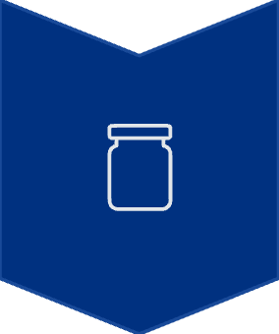



Future Infrastructure Enhancements
Future Architectural Roadmap
Phase 1 - Container Migration
Transition runtime code to Docker containers via Azure Container Apps or Azure Kubernetes Service (AKS)
Phase 2 - Automated Delivery Pipelines
Establish automated GitHub Actions pipelines to deploy updates directly via version control hooks
Phase 3 - Custom Security Extensions
Implement custom domains and integrate automated TLS/HTTPS certificate bindings
Phase 4 - Telemetry Systems
Deploy Azure Monitor, Log Analytics, and Application Insights to capture log files natively

