Slide 1
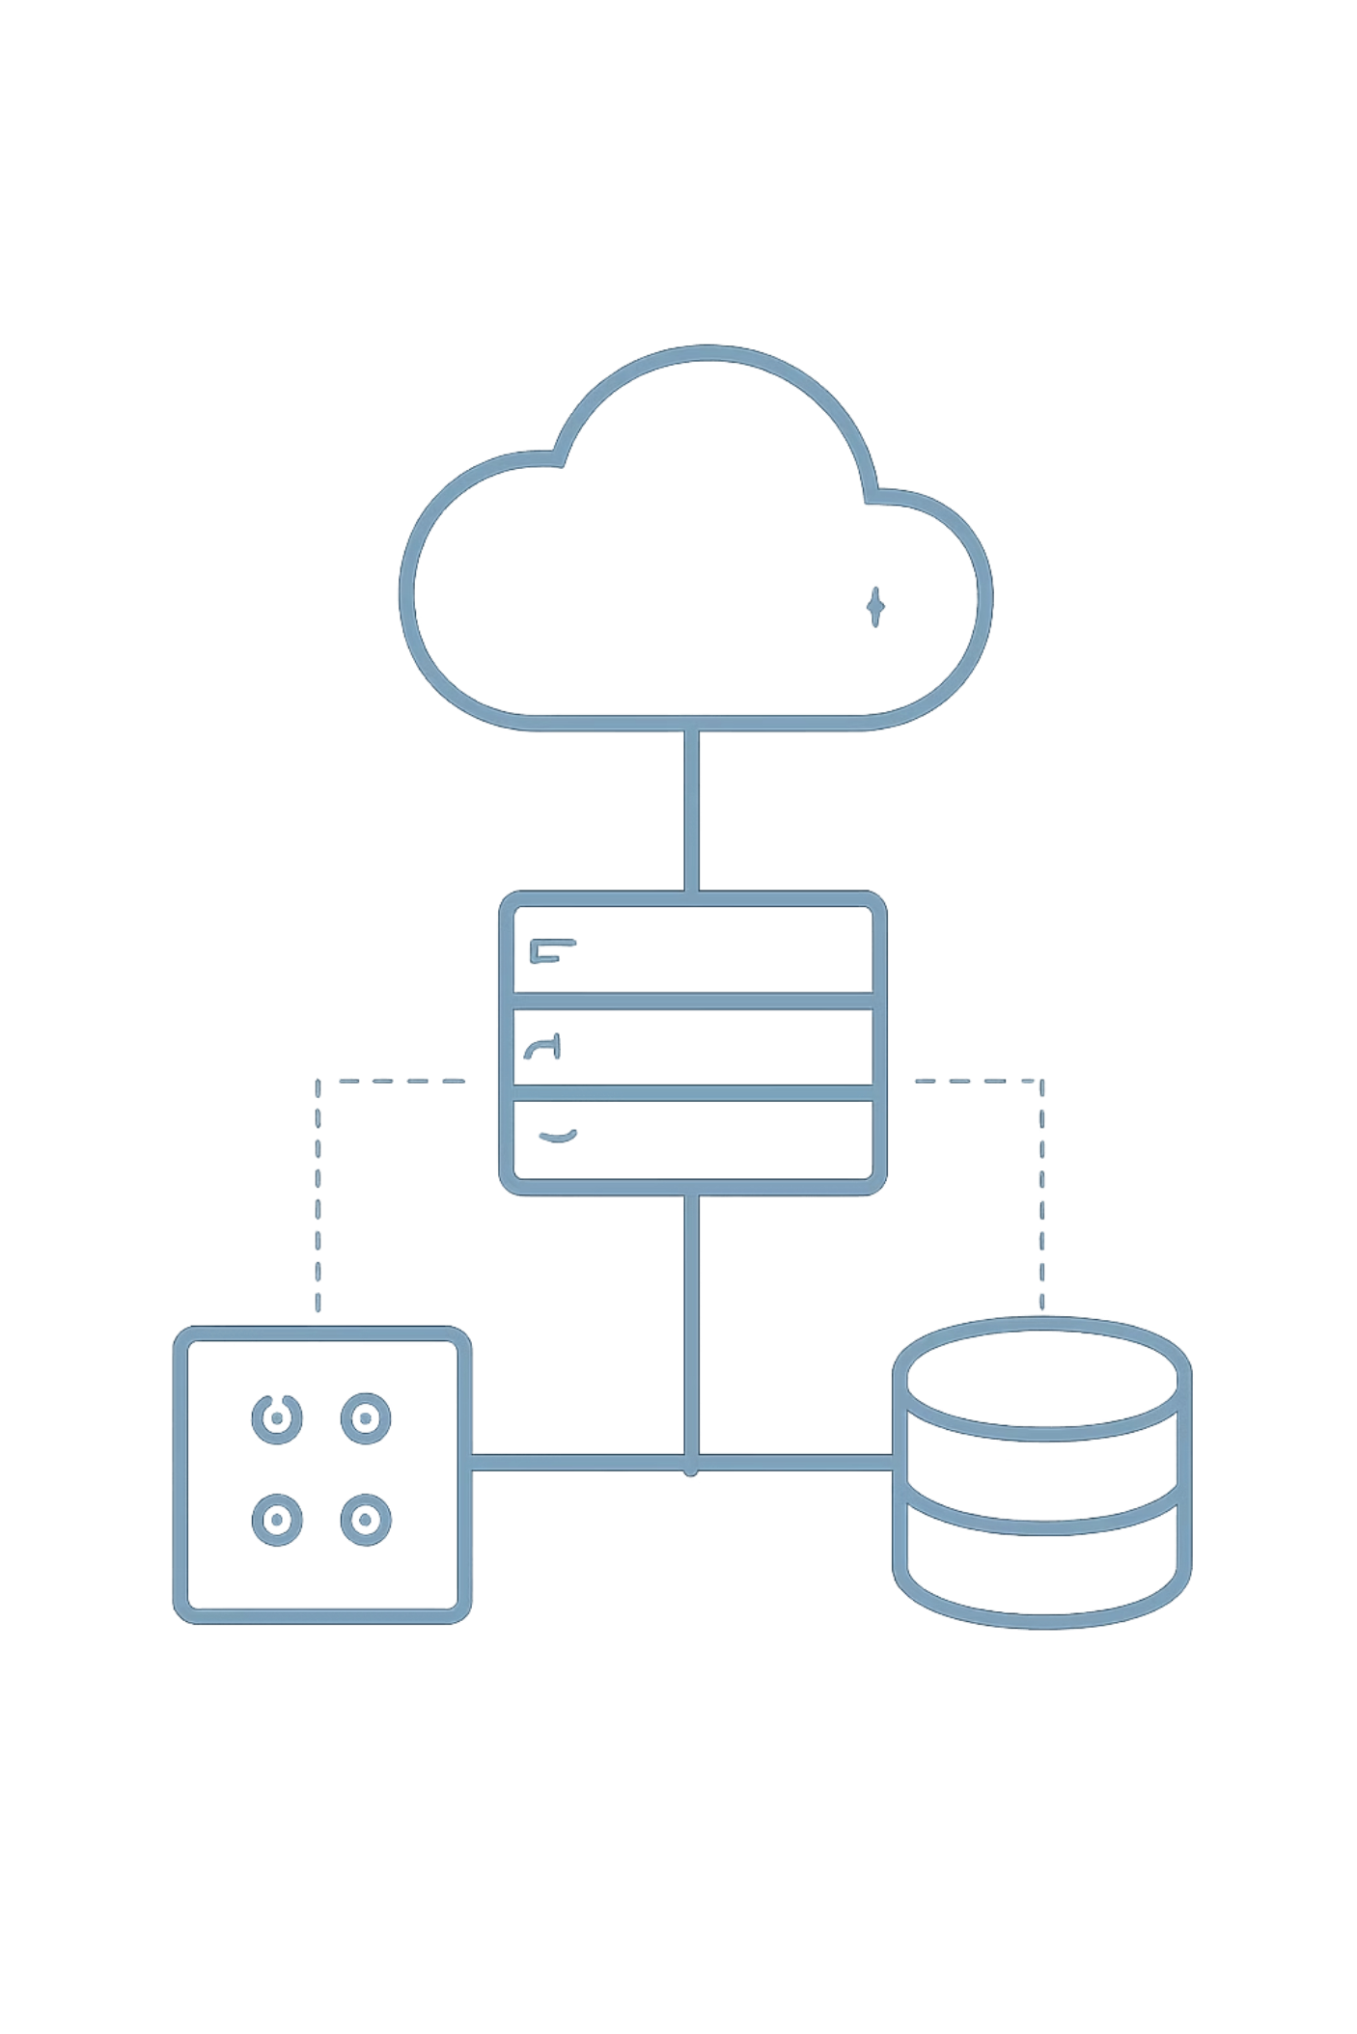
MediShift: Automated Cloud Infrastructure with Terraform
INFRASTRUCTURE AS CODE
AZURE · AKS · TERRAFORM

Slide 2
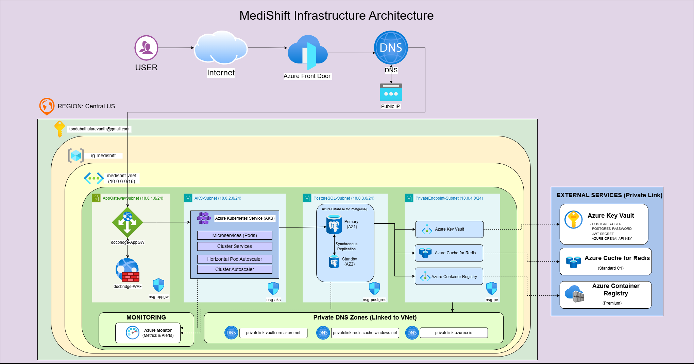
Azure Cloud Infrastructure
The entire MediShift platform resides within a single Azure VNet (10.0.0.0/16), with strict subnet isolation enforcing security boundaries between compute, data, and management layers. Private Endpoints eliminate public internet exposure for all sensitive Azure PaaS services.

Slide 3
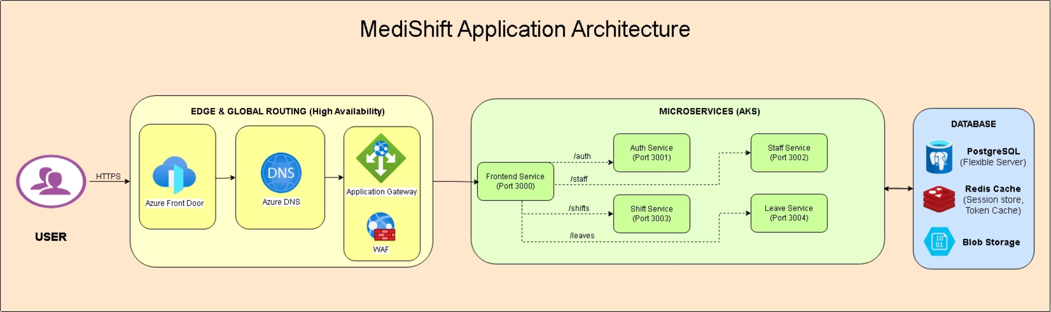
End-to-End Traffic Flow

Slide 4
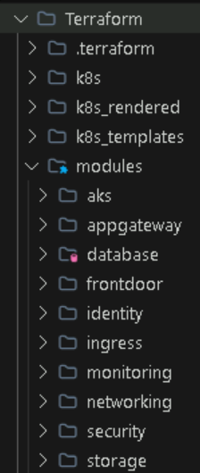
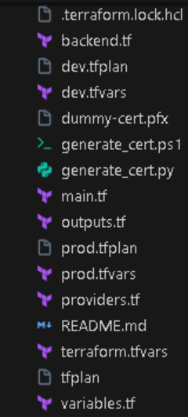
Infrastructure as Code with Terraform
Terraform serves as the single source of truth for all MediShift Azure resources.
The declarative lifecycle ensures reproducible, auditable infrastructure across every environment — from initial provisioning through to controlled teardown.

Slide 5

Environment Configurations
DEV.TFVARS
PROD.TFVARS
Environment-specific .tfvars files encode the cost-to-reliability trade-off between development and production. The same Terraform configuration is applied to both environments — only the variable values differ, ensuring consistency while allowing targeted optimisation.
dev.tfvars — Cost-Optimised / Burstable
prod.tfvars — High Availability / Production
VM SKU: B_Standard_B2s (burstable, low-cost)
PostgreSQL: Burstable SKU, single-zone
Storage: Locally Redundant Storage (LRS)
ACR: Single-region, Basic tier
AKS: Minimal node pool (1 node)
VM SKU: Memory-Optimised (e.g., D4s_v3)
PostgreSQL: GP SKU, Zone-Redundant
Storage: Zone Redundant Storage (ZRS)
ACR: Geo-replicated, Premium tier
AKS: Multi-node pool with autoscaling
Switching environments requires only a flag change: terraform apply -var-file=prod.tfvars. No code modifications are necessary.

Slide 6
Isolated Environments via Terraform Workspaces
State Isolation
Workspace-Aware Naming
Terraform Workspaces maintain completely separate state files per environment. dev and prod operate in total isolation within a single subscription, preventing accidental cross-environment contamination.
resource "azurerm_kubernetes_cluster" "aks" {
name = "aks-medishift-${terraform.workspace}"
location = var.location
kubernetes_version = var.k8s_version
default_node_pool {
name = "default"
node_count = var.node_count
vm_size = var.vm_size
}
}
1
Separate State Files
Each workspace writes to its own .tfstate, eliminating risk of shared-state conflicts.
2
Dynamic Naming
Resource names incorporate ${terraform.workspace}, preventing naming collisions across environments.
Switching workspace with terraform workspace select dev automatically applies the correct naming convention and variable set.
3
Single Subscription
Both environments share one Azure subscription, reducing management overhead while maintaining strict logical separation.

Slide 7
Implicit and Explicit Resource Dependencies
Terraform's dependency graph ensures resources are created in the correct order. MediShift leverages both implicit dependencies (derived from attribute references) and explicit dependencies (declared via depends_on) to guarantee safe, deterministic provisioning.
Implicit Dependencies — Data Flow
Explicit Dependencies — depends_on
When a resource references an attribute from another, Terraform automatically infers the dependency and orders creation accordingly.
Some ordering requirements cannot be inferred from attribute references alone. The Application Gateway must wait for the NGINX Ingress Controller to allocate its internal load balancer IP before it can be configured.
resource "azurerm_kubernetes_cluster" "aks" {
# Implicitly depends on subnet creation
default_node_pool {
vnet_subnet_id = azurerm_subnet.aks_subnet.id
}
}
resource "azurerm_application_gateway" "gateway" {
name = "appgw-medishift"
location = azurerm_resource_group.rg.location
depends_on = [
helm_release.nginx_ingress
]
}
The AKS node pool cannot be created until the subnet exists — Terraform resolves this automatically.
Without this explicit declaration, Terraform may attempt parallel creation, causing intermittent provisioning failures.

Slide 8
Solving PgBouncer & SKU Limitations
Azure's burstable PostgreSQL SKUs (B-series) do not support PgBouncer. Terraform conditional logic dynamically excludes PgBouncer from the deployment when a burstable SKU is detected, preventing apply-time failures.
Conditional Deployment Logic
Dynamic Port Mapping
resource "kubernetes_deployment" "pgbouncer" {
count = startswith(var.postgres_sku_name, "B_") ? 0 : 1
metadata {
name = "pgbouncer"
namespace = "database"
}
# ... deployment spec
}
Port 5432
Port 6432
Direct PostgreSQL connection — always available, used by burstable SKUs without PgBouncer.
PgBouncer proxy port — active only on production SKUs, enabling connection pooling for high-throughput workloads.
Application connection strings are parameterised to reference the correct port based on the active SKU, ensuring seamless connectivity across all environments.
When count = 0, the resource is silently skipped. Production SKUs receive PgBouncer; dev burstable SKUs do not.

Slide 9
Resolving Node CPU Capacity Constraints
During initial deployment, the single-node AKS pool in the dev environment was rapidly exhausted by system overhead — logging agents, metrics server, CSI drivers, workload identity components, and the ingress controller collectively consumed available CPU, leaving workload pods unschedulable.
Before — Single Node Exhaustion
Terraform Fix — Applied Changes
System Overhead (~85% CPU)
Remaining Capacity (~15%)
default_node_pool {
name = "default"
node_count = var.node_count # Changed: 1 → 2
vm_size = var.vm_size
# Removed: lifecycle { ignore_changes = [node_count] }
# Terraform now enforces scaling policy
}
Logging agents · Metrics Server · CSI Drivers · Workload Identity · Ingress Controller
Insufficient for application pods — ingress controller pods entered Pending state indefinitely.
Increasing node_count to 2 in dev.tfvars restored scheduling headroom. Removing lifecycle.ignore_changes ensures Terraform actively manages node count going forward.

Slide 10
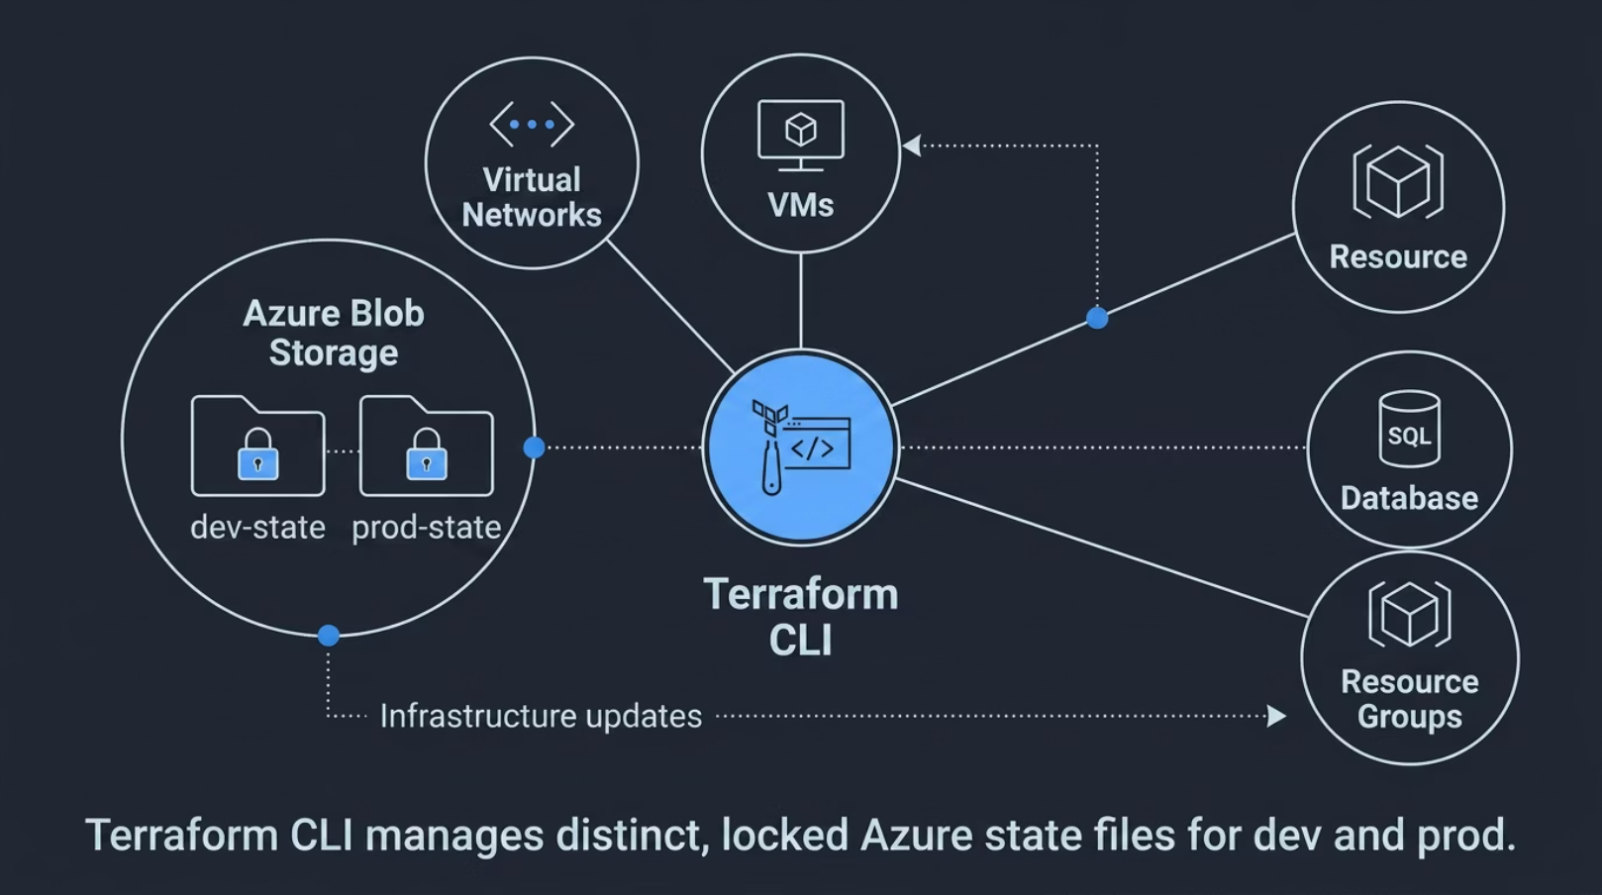
Azure Blob Remote State Backend
Secure Storage
Terraform state stored in encrypted Azure Blob container
Storage account: stmedishifttfstate
Centralized, remote, access-controlled backend
Workspace Path Structure
State path format: env:/<workspace_name>/medishift.terraform.tfstate
Separate state isolation for: dev, prod

Slide 11
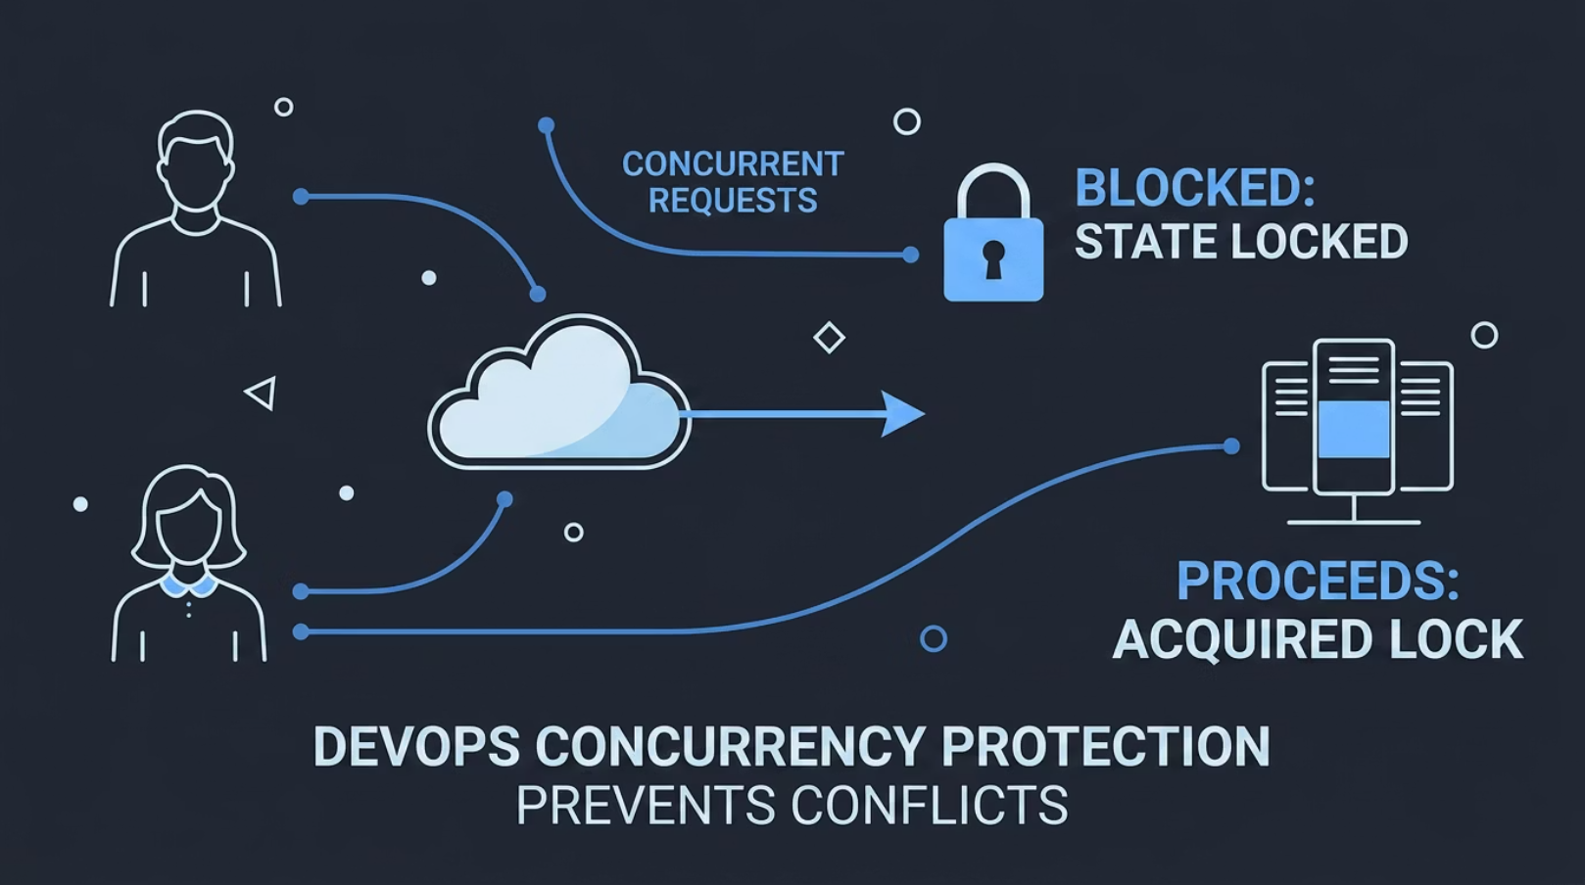
Preventing State Corruption
Blob Lease Locking
Concurrency Protection
Azure Blob automatically applies a lease lock
Prevents parallel operations
Lock active during:
terraform plan
terraform apply
terraform destroy
ResourceConflict: There is already an outstanding lease on this blob.

Slide 12
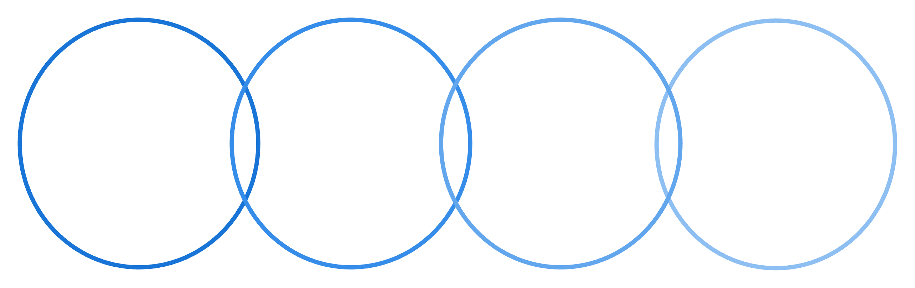
Force-Recreating Specific Resources
Targeted Recreation
Recreate corrupted or misconfigured resources
Avoid full infrastructure teardown
Example resources: Key Vault secret, PostgreSQL server
Modern Replacement Method: terraform taint is deprecated
Resource Flagged
Apply Update
Infra Unchanged
Audit & Verify
Deploy necessary changes to the flagged items.
Confirm infrastructure remains stable post-update.
Conduct a final check to ensure compliance.
Identify and mark resources for review.
Terminal command example in styled code box:
terraform apply -var-file="dev.tfvars" \
-replace="module.database.azurerm_postgresql_flexible_server.postgres"

Slide 13
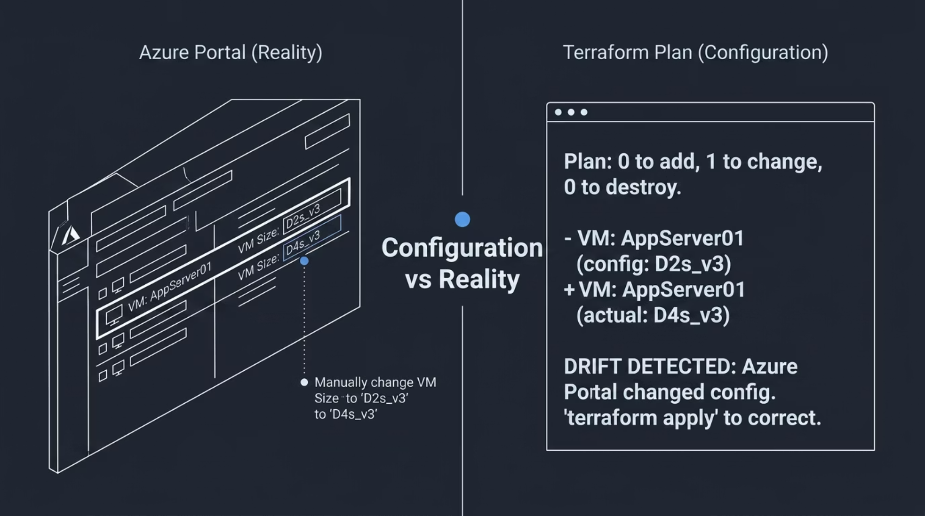
Terraform Drift
Manual Azure Portal changes
Configuration no longer matches: Terraform state and .tf files
Detection Command
terraform plan -var-file="dev.tfvars" -detailed-exitcode
Explanation
Exit code 0 → No changes
Exit code 2 → Drift detected
Enables CI/CD validation

Slide 14
Reconciling Infrastructure Drift
Option 1: Revert Manual Changes
Option 2: Adopt Manual Changes
Command: terraform apply
Update local .tf files
Align configuration with actual resource settings
Overwrites Azure portal changes
Restores declared configuration
Command: terraform apply
Safely updates state file
Decision Point: Handling Drift
Choosing between reverting manual changes or adopting them is a critical decision in maintaining infrastructure integrity. Both paths involve intentional terraform apply operations to bring the environment back into a desired, auditable state, ensuring controlled and consistent change management.

Slide 15
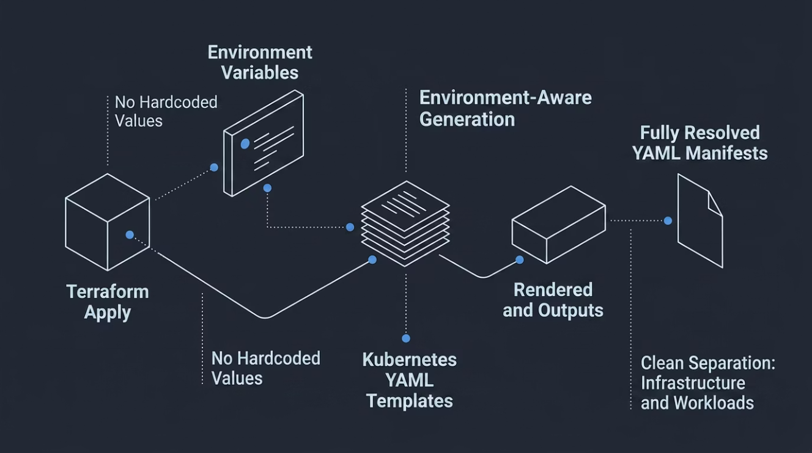
Automated Manifest Generation
Terraform Manifest Rendering Flow
Template Files
resource "kubernetes_manifest" "app_deployment" {
manifest = templatefile("k8s_templates/app_deployment.yaml", {
postgres_host = azurerm_postgresql_flexible_server.postgres.fqdn
postgres_port = azurerm_postgresql_flexible_server.postgres.port
app_image_tag = var.app_image_tag
})
}
Location: k8s_templates/
Example placeholders: host: ${postgres_fqdn}, port: ${postgres_port}
Terraform Rendering Logic
Explain usage of: templatefile()
Rendered output: k8s_rendered/
This process ensures no hardcoded values, facilitates environment-aware manifest generation, and maintains a clean separation of infrastructure and workloads.

Slide 16
Step-by-Step Execution Guide
This guide outlines the standard operational workflow for managing MediShift's infrastructure across environments, ensuring repeatability and automation.
Initialize Backend
1
terraform init -reconfigure
Select Environment
2
terraform workspace select dev
Deploy Infrastructure
3
terraform apply -var-file="dev.tfvars"
(Builds Azure infra + renders Kubernetes manifests)
Deploy Microservices
4
kubectl apply -f k8s_rendered/
Destroy Environment
5
terraform destroy -var-file="dev.tfvars"
This structured approach emphasizes repeatability and automation throughout the infrastructure lifecycle, promoting operational excellence and consistent deployments.

