Slide 1
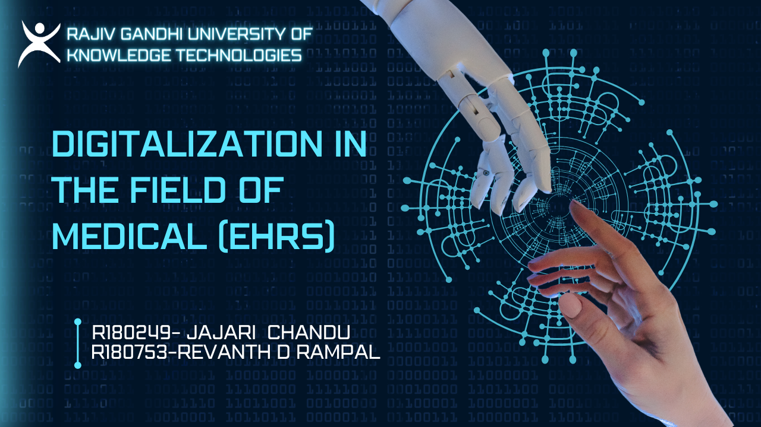

Slide 2
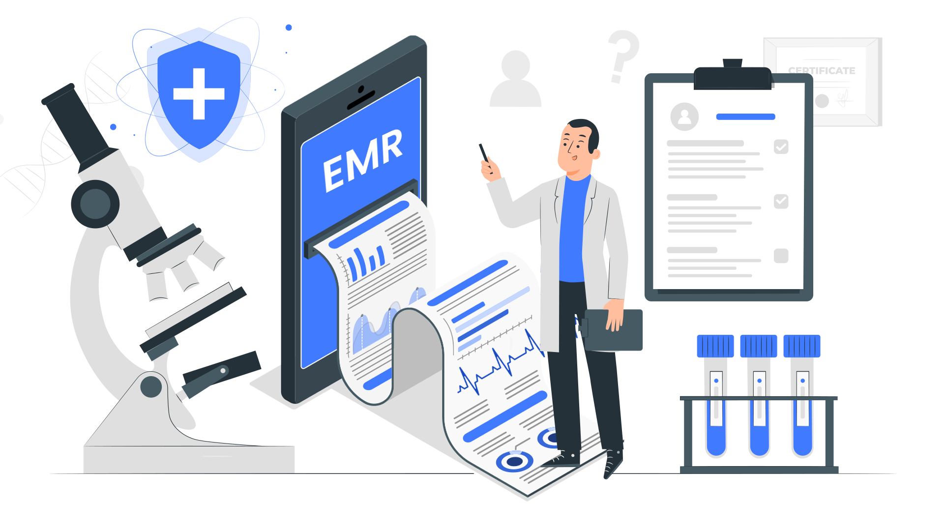
What are Electronic Health Records (EHR)?
EHRs are digital patient records that replace traditional paper charts, providing real-time and secure access to authorized users.
Key Features:
Digital versions of patients' paper charts.
Access to the past medical records
Replaces traditional paper-based medical records.
Real-time updates.

Slide 3
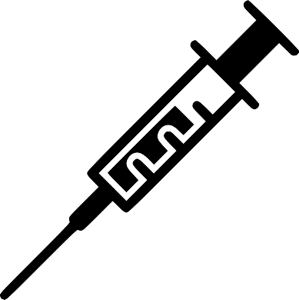


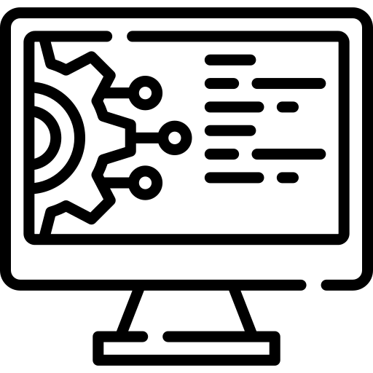
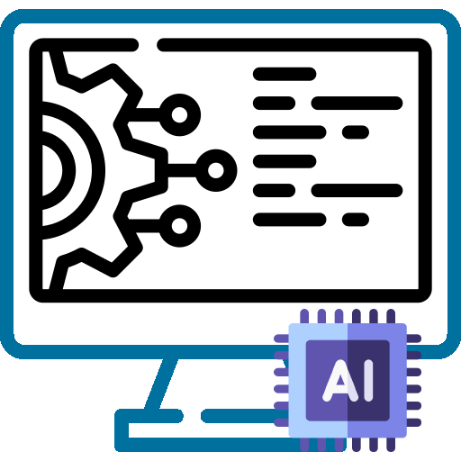
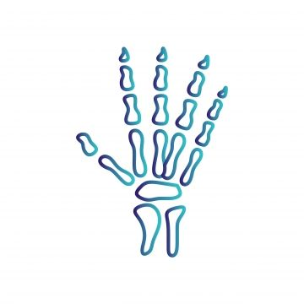

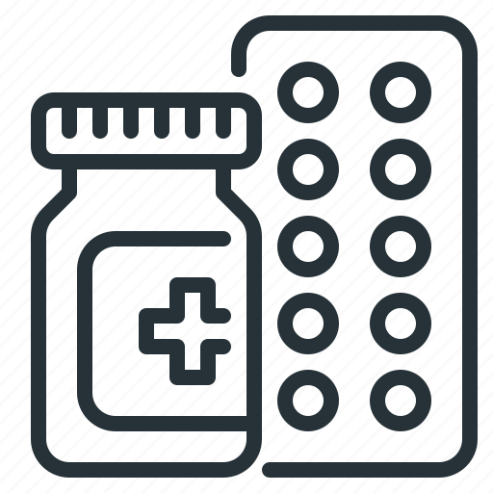
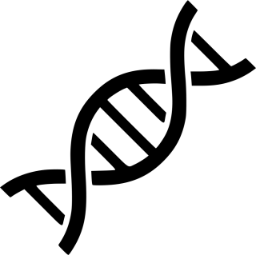

Blood test
Diagnosis
X-ray image
Treatment options
Genetic information
Prognosis
Working of EHR

Slide 4

EHR Features
Medical History
Patient Registration
Record and track a patient's medical history, including past illnesses, surgeries, medications, allergies, and family medical history.
Capture and manage patient demographic information, including name, date of birth, contact details, and insurance information.
Medical History
Patient Registration
Data Security and Compliance
Implement robust data security measures and ensure compliance with healthcare regulations, such as the Health Insurance Portability and Accountability Act (HIPAA).
Laboratory data
Data Security and Compliance
Laboratory data
Test results like blood tests, helping doctors understand and monitor a patient's health.
Insurance Integration
Clinical Notes
Insurance Integration
Clinical Notes
Integrate billing functionalities for healthcare providers to generate invoices and submit claims to insurance companies.
Enable healthcare professionals to create and maintain detailed clinical notes for each patient visit. This includes examination findings, diagnoses, and treatment plans.

Slide 5
Timeline
The 2009 HITECH Act promoted EHR adoption in the U.S. by providing incentives and establishing standards for enhanced patient care and data security.
In 1972, the dawn of Electronic Health Records (EHR) began with early efforts to computerize medical records in healthcare systems.
The dawn of the EHR system
HITECH Act
1962
1972
1996
2009
2030
First Electronic Health Record
HIPPA
Privacy over the Records
A combination of consumer wearable's connect to a patients smartphone to alert for early sign of illness

Slide 6
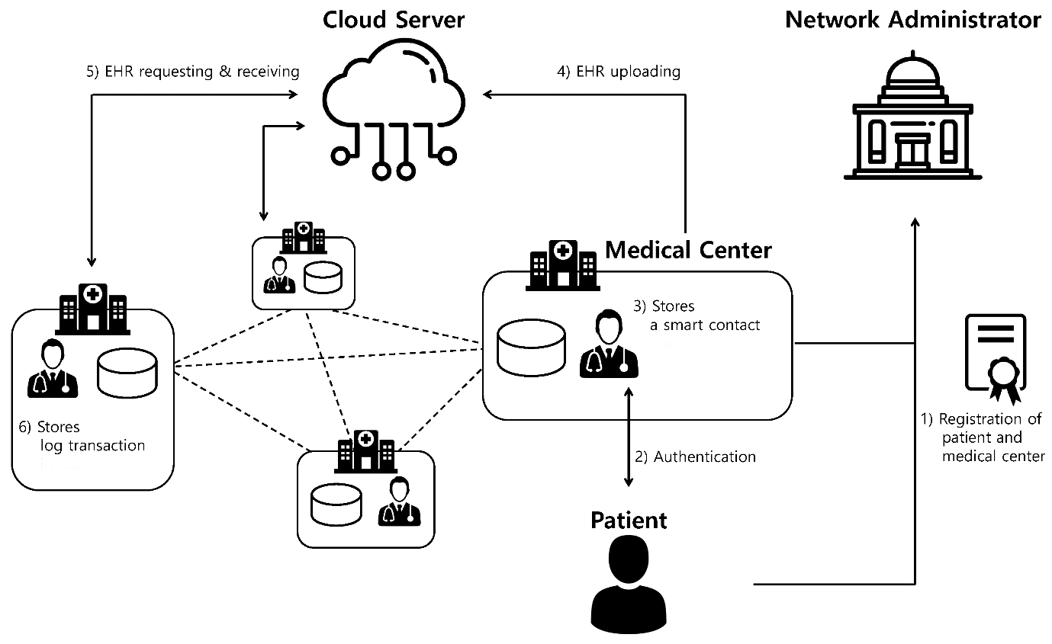
Diagram of The System

Slide 7
Applications of the EHR Project
Access to the past medical records
Electronic Health Records (EHR) provide seamless access to past medical records, ensuring healthcare professionals have instant and comprehensive insights into patients' health histories
Replaces traditional paper-based medical records
Electronic Health Records (EHR) seamlessly replace traditional paper-based medical records, offering a digital solution that enhances accessibility, efficiency, and accuracy in healthcare management.
Real-time updates
Electronic Health Records (EHR) enable real-time updates, ensuring healthcare professionals have immediate access to the latest and most relevant patient information for informed decision-making

Slide 8
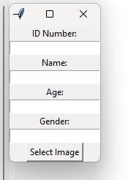
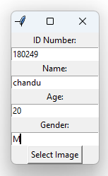
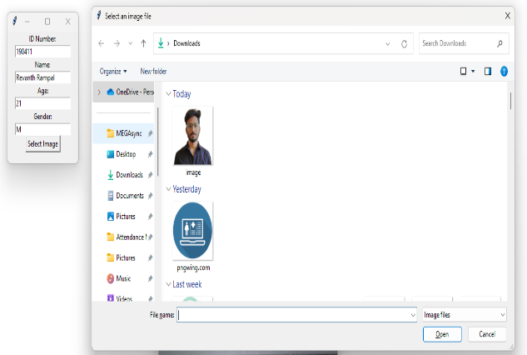
Modules
1
Module -1: Registering Patient Details
The Electronic Health Record system captures vital patient details, including demographic information, storing images for face recognition through OpenCV to facilitate secure and seamless information management in the healthcare journey.

Slide 9
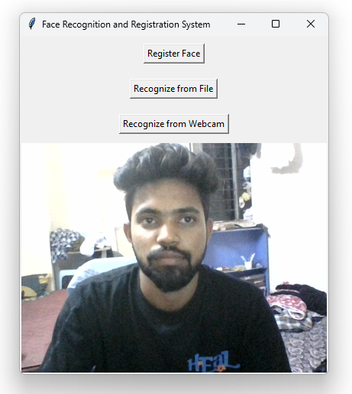
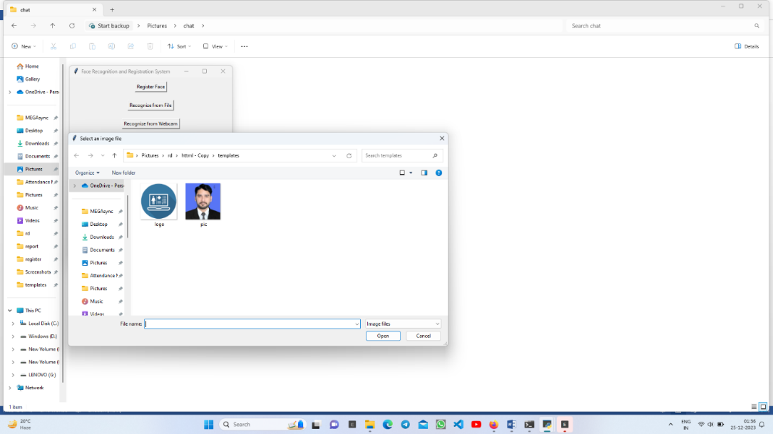
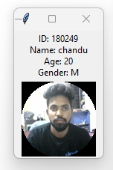
Modules
2
Module -2: recognising patient
Patient details are gathered through OpenCV, allowing verification via uploaded images or a webcam; the "Recognize from webcam" option displays registered patient details or shows an error message if not found.

Slide 10
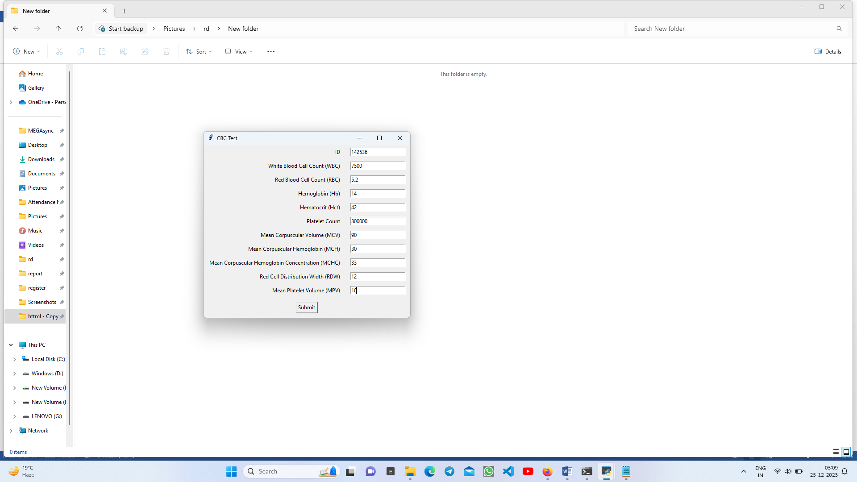
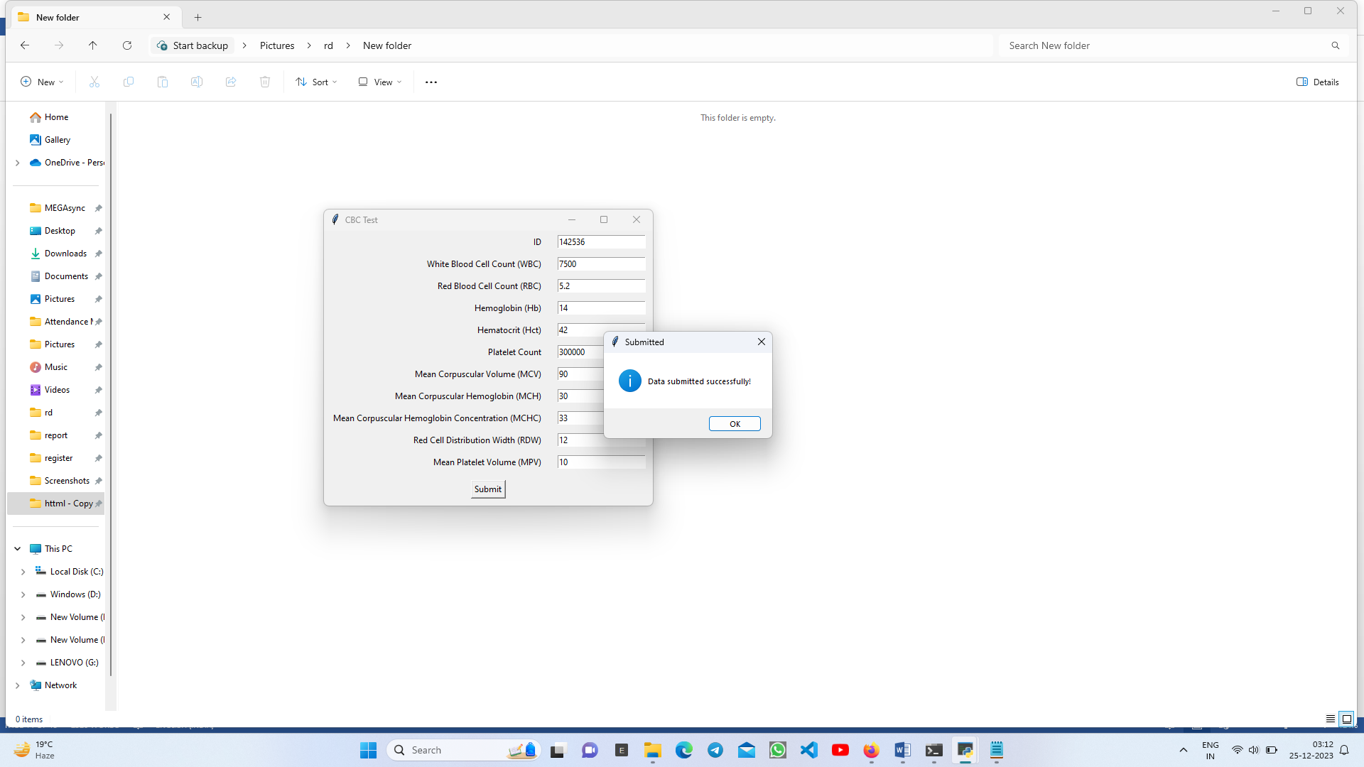
Module -3: Lab Testing
3
Lab testing procedures include secure entry of patient details by technicians, capturing a unique patient ID for data integrity, and precise recording of Complete Blood Count (CBC) details, which are securely uploaded to Google Firebase for streamlined healthcare data management.

Slide 11
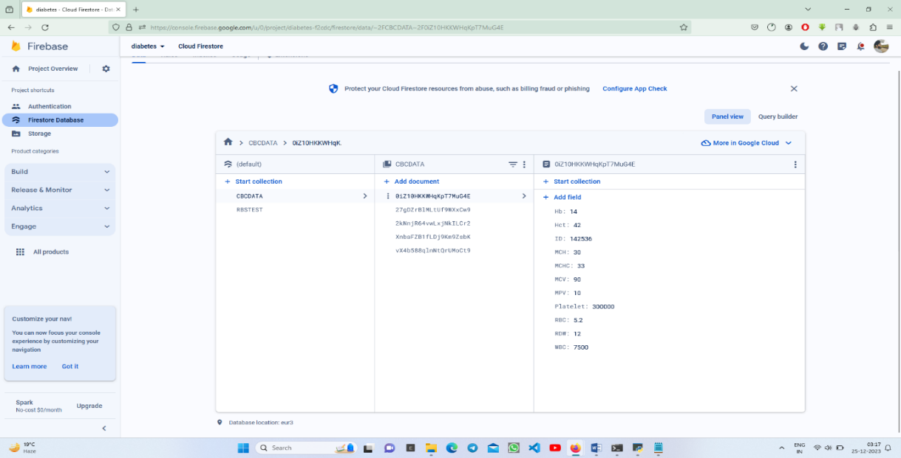
3
Module -3: Lab Testing

Slide 12
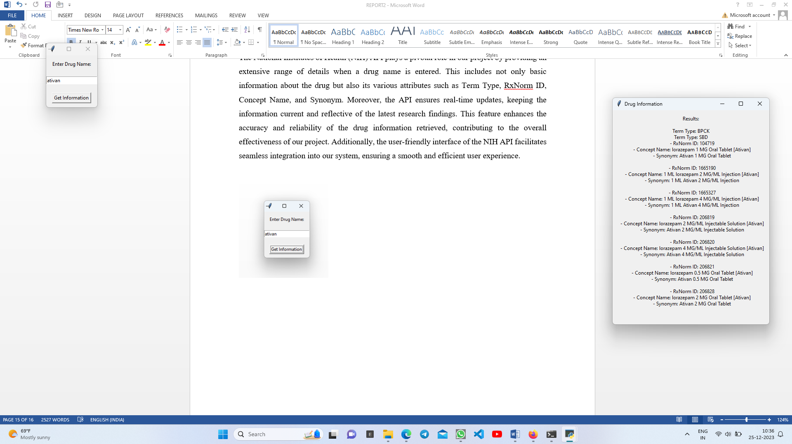
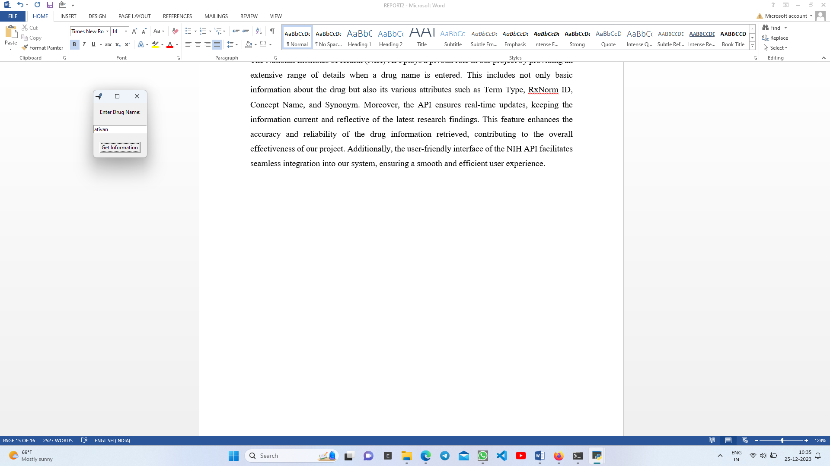
Module -4: Drug Details
4
The NIH API is a crucial component, providing comprehensive and up-to-date drug details, including Term Type, RxNorm ID, Concept Name, and Synonym. Its user-friendly interface seamlessly integrates into our system, enhancing accuracy and user experience with real-time updates.

Slide 13
Future Enhancement
THE INTEGRATION OF WEARABLE DEVICES
The integration of the wearable's and IOT devices can help to access data like steps, heart rate, distance covered, calories count and sleep monitor.
ADDITION OF GRAPH
The addition of graph allows for the easy analysis of the patient data
CREATING AN PORTAL FOR EASY ACCESS OF PATIENT DETAILS
The presence of portal would allow Doctor to access patients details easily

Slide 14
THANK YOU

