Slide 1


Slide 2

What are Electronic Health Records (EHR)?
EHRs are digital patient records that replace traditional paper charts, providing real-time and secure access to authorized users.
Key Features:
Digital versions of patients' paper charts.
Access to the past medical records
Replaces traditional paper-based medical records.
Real-time updates.

Slide 3
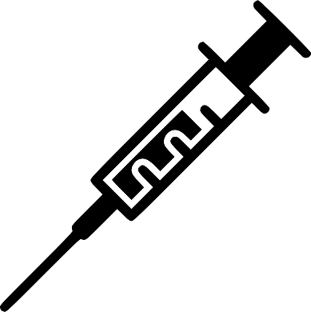



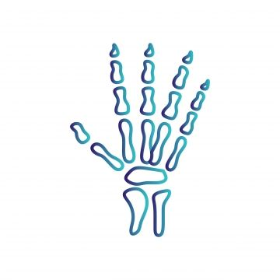


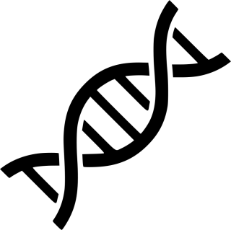

Diagnosis
Blood test
X-ray image
Treatment options
Genetic information
Prognosis
Working of EHR

Slide 4

EHR Features
Medical History
Patient Registration
Record and track a patient's medical history, including past illnesses, surgeries, medications, allergies, and family medical history.
Capture and manage patient demographic information, including name, date of birth, contact details, and insurance information.
Medical History
Patient Registration
Data Security and Compliance
Implement robust data security measures and ensure compliance with healthcare regulations, such as the Health Insurance Portability and Accountability Act (HIPAA).
Laboratory data
Data Security and Compliance
Laboratory data
Test results like blood tests, helping doctors understand and monitor a patient's health.
Insurance Integration
Clinical Notes
Insurance Integration
Clinical Notes
Integrate billing functionalities for healthcare providers to generate invoices and submit claims to insurance companies.
Enable healthcare professionals to create and maintain detailed clinical notes for each patient visit. This includes examination findings, diagnoses, and treatment plans.

Slide 5
Timeline
The 2009 HITECH Act promoted EHR adoption in the U.S. by providing incentives and establishing standards for enhanced patient care and data security.
In 1972, the dawn of Electronic Health Records (EHR) began with early efforts to computerize medical records in healthcare systems.
HITECH Act
The dawn of the HER system
1962
1972
1996
2009
2030
First Electronic Health Record
HIPPA
Privacy over the Records
A combination of consumer wearable's connect to a patients smartphone to alert for early sign of illness

Slide 6
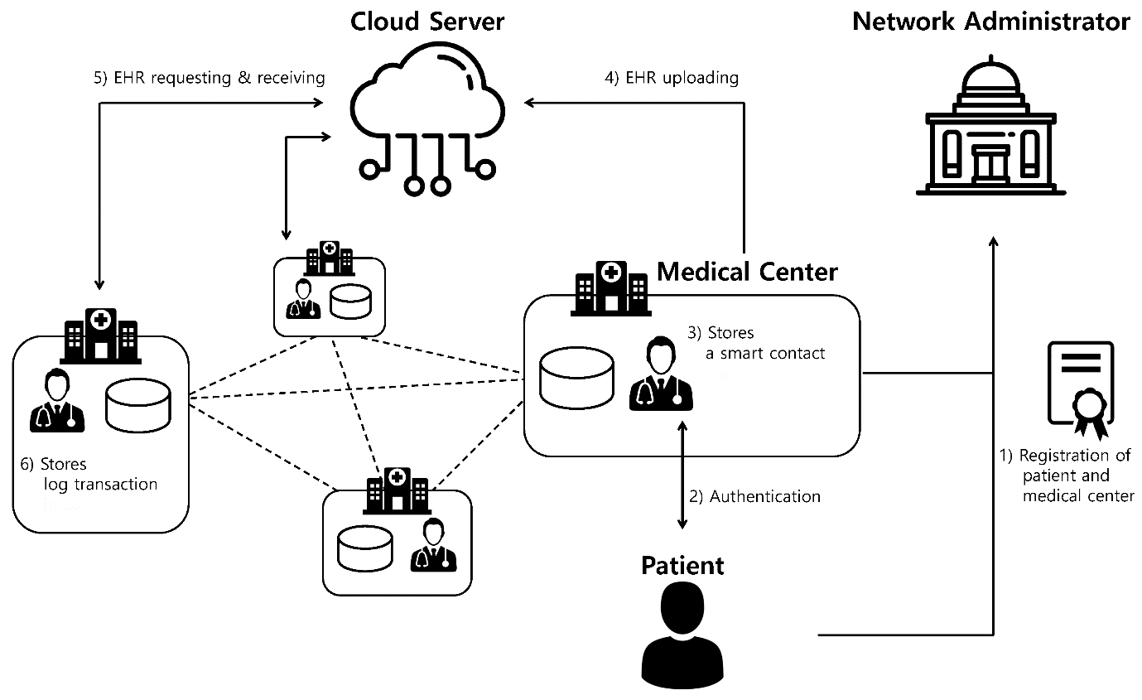
Diagram of The System

Slide 7
Applications of the EHR Project
Access to the past medical records
Electronic Health Records (EHR) provide seamless access to past medical records, ensuring healthcare professionals have instant and comprehensive insights into patients' health histories
Replaces traditional paper-based medical records
Electronic Health Records (EHR) seamlessly replace traditional paper-based medical records, offering a digital solution that enhances accessibility, efficiency, and accuracy in healthcare management.
Real-time updates
Electronic Health Records (EHR) enable real-time updates, ensuring healthcare professionals have immediate access to the latest and most relevant patient information for informed decision-making

Slide 8
Future Enhancement
THE INTEGRATION OF WEARABLE DEVICES
The integration of the wearable's and IOT devices can help to access data like steps, heart rate, distance covered, calories count and sleep monitor.
ADDITION OF GRAPH
The addition of graph allows for the easy analysis of the patient data
CREATING AN PORTAL FOR EASY ACCESS OF PATIENT DETAILS
The presence of portal would allow Doctor to access patients details easily

Slide 9
THANK YOU

