Slide 1


Slide 2

What are Electronic Health Records (EHR)?
EHRs are digital patient records that replace traditional paper charts, providing real-time and secure access to authorized users.
Key Features:
Digital versions of patients' paper charts.
Access to the past medical records
Replaces traditional paper-based medical records.
Real-time updates.

Slide 3

Features
Real-time Tracking
Patient Registration
Track inventory levels in real-time to ensure adequate stock levels and prevent stockouts.
Capture and manage patient demographic information, including name, date of birth and contact details.
Real-time Tracking
Patient Registration
Batch and Expiry Tracking
Monitor batch numbers and expiration dates to prevent the use of expired items.
Patient Billing
Batch and Expiry Tracking
Patient Billing
Test results like blood tests, helping doctors understand and monitor a patient's health.
Automatic Reordering
Transaction History
Automatic Reordering
Transaction History
Set up automatic reordering of supplies when inventory levels fall below a certain threshold.
Maintain a detailed audit trail of inventory movements, billing activities, and user actions for accountability and compliance purposes.

Slide 4
Timeline
The 2009 HITECH Act promoted EHR adoption in the U.S. by providing incentives and establishing standards for enhanced patient care and data security.
In 1972, the dawn of Electronic Health Records (EHR) began with early efforts to computerize medical records in healthcare systems.
The dawn of the EHR system
HITECH Act
1962
1972
1996
2009
2030
First Electronic Health Record
HIPPA
Privacy over the Records
A combination of consumer wearable's connect to a patients smartphone to alert for early sign of illness

Slide 5
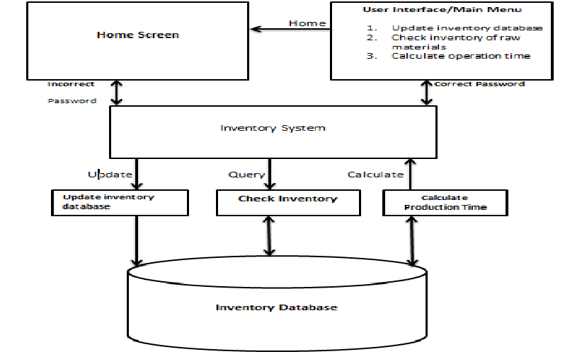
Diagram of The System

Slide 6
Applications of the EHR Project
Hospitals and Medical Centers
Large hospitals and medical centers with multiple departments can use the system to manage their extensive inventory of medical supplies, equipment, and medications.
Replaces traditional paper-based medical records
Electronic Health Records (EHR) seamlessly replace traditional paper-based medical records, offering a digital solution that enhances accessibility, efficiency, and accuracy in healthcare management.
Pharmacies
Pharmacies can utilize the system to manage their inventory of prescription medications, over-the-counter drugs, and medical supplies.

Slide 7
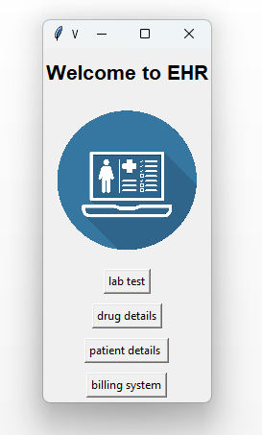
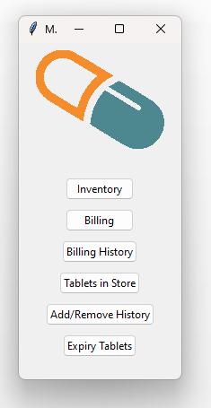
Modules
1
User interference for inventory and billing
The initial stage involves user interface access, integrating Electronic Health Records with inventory and billing for centralized medical data, while the billing interface offers functions like inventory management, tablet expiry checks, and user registration to streamline medicine billing for patients.

Slide 8
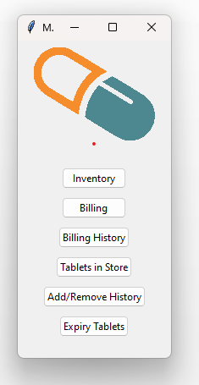
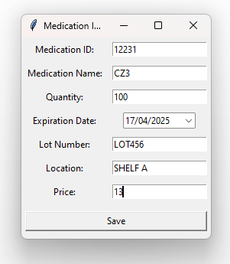
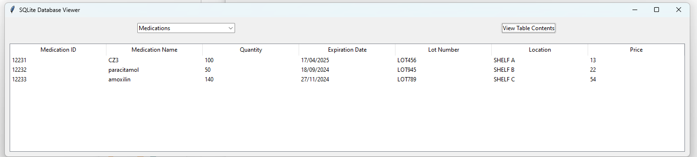
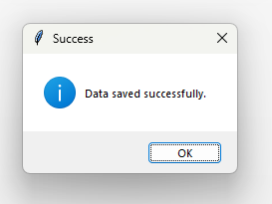
Modules
2
Module -2: Registering Medications for Inventory
Patient details are gathered through OpenCV, allowing verification via uploaded images or a webcam; the "Recognize from webcam" option displays registered patient details or shows an error message if not found.

Slide 9
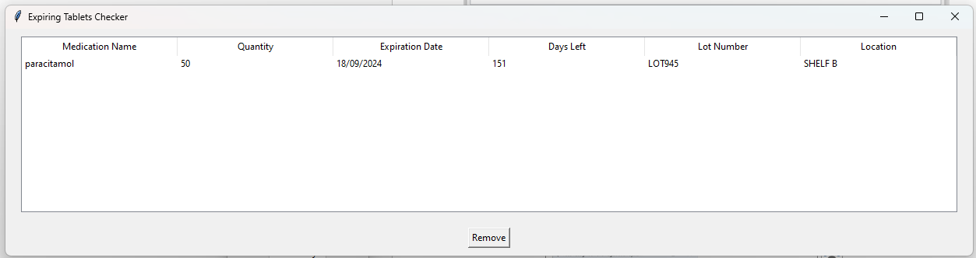
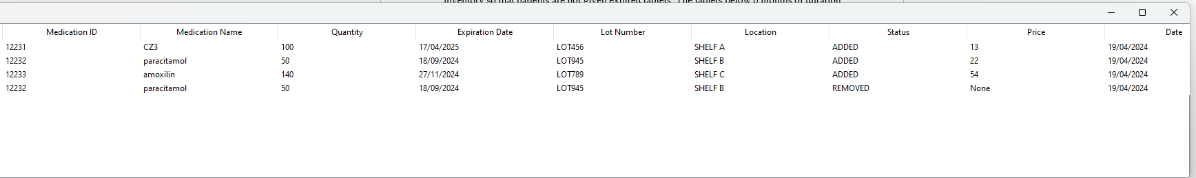
Module -3: Removal of Expired tablets and viewing its history
3
Medical inventory management addresses the crucial task of removing expired tablets to safeguard patient health, with a focus on removing tablets below 6 months' shelf life, allowing easy identification and removal of expired tablets, updating both live inventory and historical records.

Slide 10
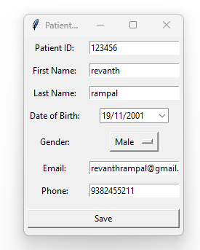
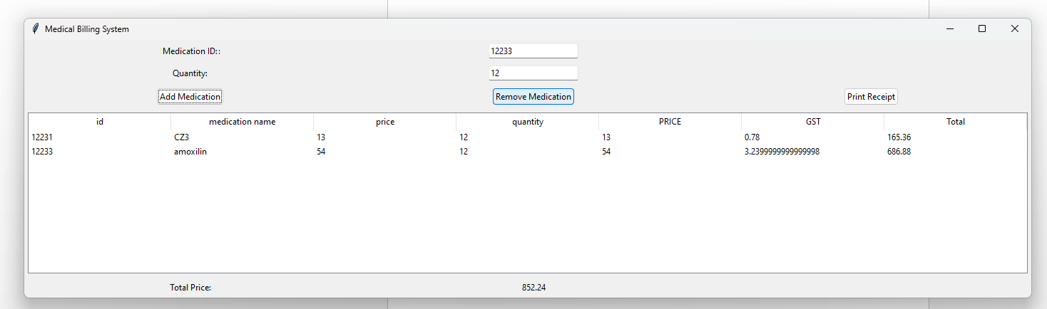
Module -4: Billing and Registering of Patient
4
In this phase, the focus is on registering users for medical billing, capturing basic patient information like ID, name, DOB, gender, email, and phone number, stored in a separate database .New patient details are appended to this database for each registration, enabling billing. The billing interface,utilizes past inventory data to calculate prices based on tablet ID and quantity.

Slide 11
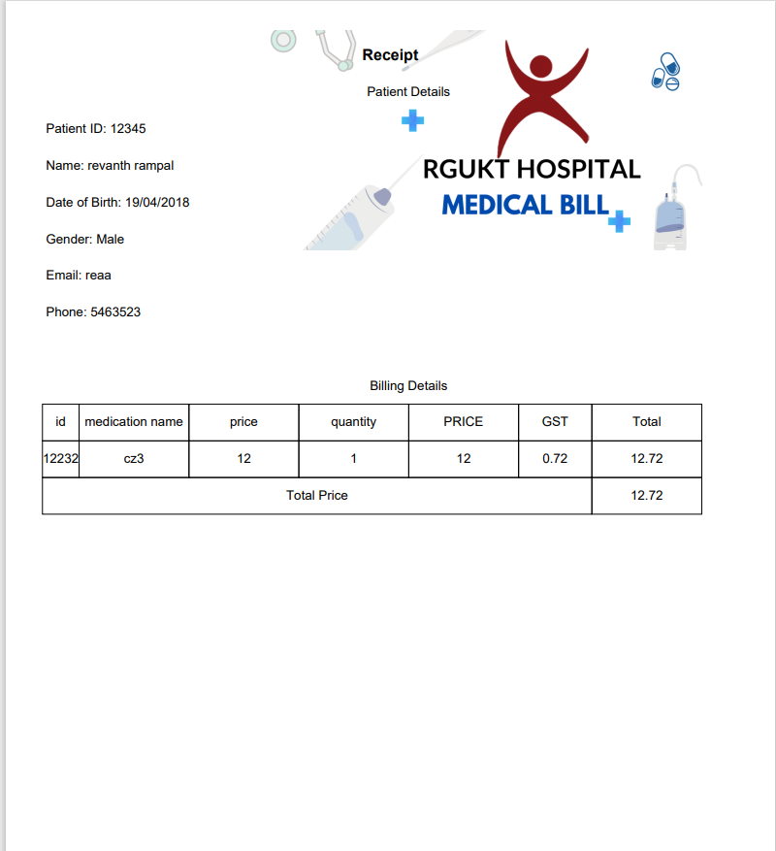
3
Module -4: Billing and Registering of Patient

Slide 12
Future Enhancement
Predictive Analytics
Implement predictive analytics algorithms to forecast demand, anticipate inventory needs, and optimize resource allocation, enhancing efficiency and reducing waste.
ADDITION OF GRAPH
The addition of graph allows for the easy analysis of the medicines sales data
Security Measures
Strengthen security protocols to safeguard patient data and prevent unauthorized access, ensuring compliance with healthcare regulations such as HIPAA.

Slide 13
THANK YOU

