Slide 1


Dinasari
Connecting Rural India's Workforce
Digitizing Agricultural Labor & Machinery INVESTOR PITCH DECK | 2026
Edhigo Pani Technologies Private Limited | funding@dinasari.in | Confidential

Slide 2
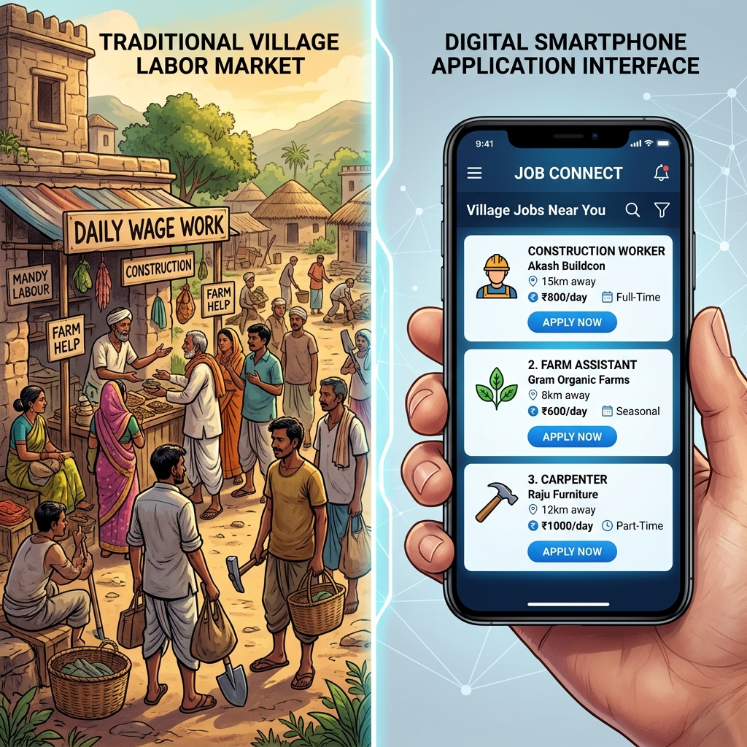
THE VISION
Our Vision: A Unified Digital Ecosystem for Rural India
Edhigo Pani (Find Work)
Dinasari is building a single, trusted platform to connect rural workers, farmers, machinery owners, and local services. We are digitizing the agricultural economy to create jobs, improve livelihoods, and strengthen village economies.
Empower Workers: Find reliable, well-paying work near you instantly.
Support Farmers: Access labor and machinery on demand, eliminating seasonal stress.
Enable Growth: Build a transparent, efficient, and digitized village economy.
Edhigo Pani Technologies Private Limited | funding@dinasari.in | Confidential

Slide 3
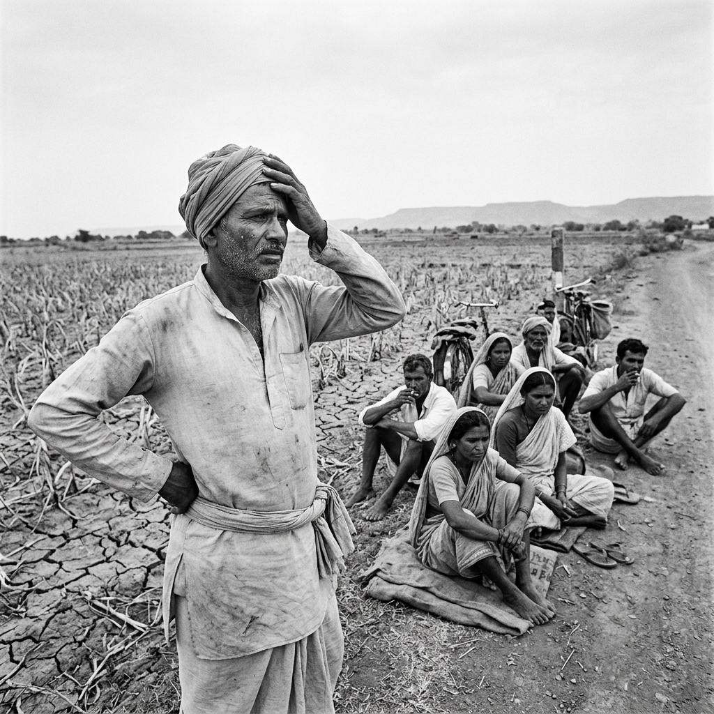
THE PROBLEM
The Agricultural Labor Crisis: A Multi-Faceted Problem
Labor Shortages & Matchmaking
Sowing & harvesting create massive labor demand, but finding workers relies on word-of-mouth or middleman contractors who take high commissions.
Underutilized Machinery & No Trust
Tractor/harvester owners struggle to find bookings, while paper attendance tracking leads to disputes over hours worked and rates.
Payment Insecurity & Literacy Barriers
Gig-workers suffer from delayed/defaulted wages, and digital platforms fail due to complex language and literacy barriers.
KEY STAT: Over 65% of India's population lives in rural areas, where access to organized employment remains limited.
(Data source: World Bank & Census of India 2011)
Edhigo Pani Technologies Private Limited | funding@dinasari.in | Confidential

Slide 4

THE SOLUTION
Introducing Dinasari: The Unified Digital Ecosystem
We are a one-stop solution that digitizes every step of the agricultural employment cycle.
• Smart Matchmaking: Farmers post jobs, and workers/groups discover nearby opportunities.
• QR-Based Attendance: GPS-verified QR check-in/out creates a tamper-proof digital ledger, eliminating disputes.
• Direct Payouts: Payments are calculated automatically and settled via cash or UPI, ensuring transparency.
• Voice & Local Languages: The app guides users in native languages (Telugu, Hindi, English) with simple iconography.
CURRENT STAGE: Product Ready & Pilot Ready
INNOVATION: QR-based attendance, verified worker profiles, digital payments, and AI job matching.
Edhigo Pani Technologies Private Limited | funding@dinasari.in | Confidential

Slide 5
MARKET OPPORTUNITY
A Massive, Untapped Rural Opportunity
TAM (Total Addressable Market): ₹2.5 Lakh Cr+ ($30 Billion+)
Total value of agricultural daily labor payrolls and equipment rentals across India.
WHY NOW?
India's Rural Digital Adoption
• Rapid Rural Digitization: Internet growth in rural markets is now outpacing urban India, driven by widespread digital infrastructure.
• Smartphone Adoption: Increasing availability of low-cost smartphones has put app accessibility directly in the hands of farmers and laborers.
• UPI Settlements: Widespread adoption of the Unified Payments Interface (UPI) makes micro-transactions and wage splits secure and instant.
SAM (Serviceable Addressable Market): ₹25,000 Cr+ ($3 Billion+)
Market in initial target states (AP, Telangana, Karnataka) with strong smartphone penetration and FPO networks.
SOM: ₹250 Cr+ ($30 Million+) in 3-5 Years
Target transactional volume to be captured through focused operations, FPO partnerships, and viral growth.
Edhigo Pani Technologies Private Limited | funding@dinasari.in | Confidential

Slide 6
USER JOURNEY - FARMER
Farmer Journey: Sourcing Labor in Seconds
01
02
03
04
05
Post Job Details
Select crop, work type (Harvesting, Sowing), daily wage, and date.
Match & Select
Browse nearby individual workers or organized groups on our Live Discovery Map.
QR Code Check-In
Worker scans the farmer's QR code upon arrival, verifying location and start time.
Track & Check-Out
Monitor work status. Worker scans the QR code again at the end of the shift.
Dynamic Settlement
Review the automated payment summary, pay via Cash/UPI, and rate the worker.
Edhigo Pani Technologies Private Limited | funding@dinasari.in | Confidential

Slide 7
USER JOURNEY - WORKER & LEADER
Worker & Group Leader Journeys
WORKER JOURNEY: RELIABLE WORK & PAYOUTS
GROUP LEADER JOURNEY: SCALING UP OPERATIONS
• Profile Registration: Register with mobile OTP, age, gender, and skills. Toggle 'Online' to appear in searches.
• Push Notifications: Receive loud, voice-guided job alerts detailing the farm distance, wage, and task.
• GPS Field Navigation: Accept the offer and view precise farm location routes.
• QR Check-In/Out: Scan the farmer's QR code to log attendance.
• Earnings Ledger: Track daily wages and settlement statuses on your personal dashboard.
• Build Digital Groups: Leaders (Mestris) register and bundle village workers into active groups.
• Accept Collective Jobs: Review and accept large-scale group jobs posted by farmers.
• One-Scan Attendance: Farmer scans the Leader's Group QR code, instantly checking in all team members.
• Wage Splitter: Generate structured salary breakdowns per worker based on individual attendance.
Edhigo Pani Technologies Private Limited | funding@dinasari.in | Confidential

Slide 8
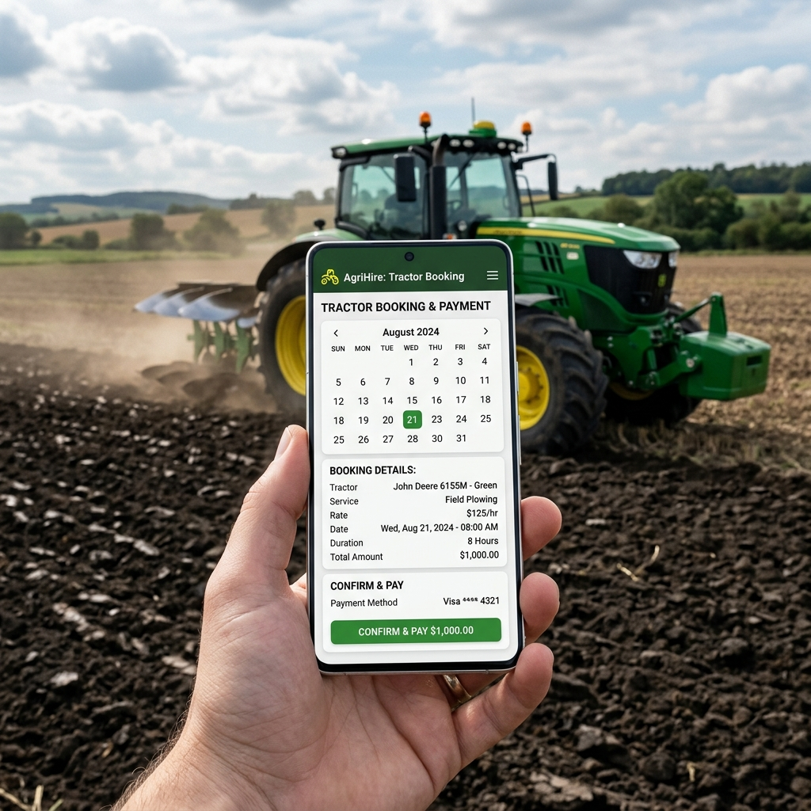
USER JOURNEY - MACHINERY RENTER
Renters: Maximizing Tractor & Equipment Usage
Dinasari is not just for labor; it's a full-fledged agricultural equipment marketplace.
• Equipment Listings: Machinery owners upload details of tractors, harvesters, or power sprayers.
• Set Pricing: Control pricing by the hour or acre.
• Real-Time Bookings: Farmers discover and request machinery directly on the map.
• QR Start/End Work: QR scans verify the start and end of machinery rental operations.
• Booking Calendar: View upcoming bookings, block holiday dates, and manage logistics.
Edhigo Pani Technologies Private Limited | funding@dinasari.in | Confidential

Slide 9
REVENUE STREAMS
Four Direct Revenue Streams
Platform Convenience Fee
3% - 5%
Transaction commission charged on daily worker payouts, calculated automatically on job completion.
Machinery Rental Commission
8% - 10%
Commission on heavy equipment rental bookings (tractors, tillers, harvest tools).
B2B Advertising Banners
Promoted Ads
Banner ads and promoted listings for seed brands, fertilizer suppliers, and tractor agencies.
Financial Service Cross-Selling
Value Addition
Partnership margins for distributing micro-insurance (crop protection, accident) and agricultural credit.
Edhigo Pani Technologies Private Limited | funding@dinasari.in | Confidential

Slide 10
GO-TO-MARKET STRATEGY
Localized GTM & Growth Strategy
FPO Integration
FARMER COOPERATIVES
Partnering with Farmer Producer Organizations to register clusters of farmers efficiently.
Gram Panchayat campaigns
VILLAGE 'CHOUPALS'
Conducting physical village meetings to build trust and address digital barriers.
Leader Referral Loop
MESTRI VIRALITY
Incentivizing gang leaders (Mestris) to onboard their regular worker teams, creating rapid growth.
Retailer Affiliates
AGRI-INPUT STORES
Onboarding local seed & fertilizer retailers as Dinasari registration kiosks.
VIRAL CHANNELS: Localized SMS & Voice Broadcasts explain app benefits in native Telugu and Hindi directly to users.
Edhigo Pani Technologies Private Limited | funding@dinasari.in | Confidential

Slide 11
UNIT ECONOMICS & PROJECTIONS
Strong Unit Economics & Rapid Scaling
CAC (Customer Acquisition Cost)
₹200 ($2.4)
Low CAC achieved via viral worker-to-worker loops and FPO channels.
Metric | Year 1 | Year 2 | Year 3
Active Users | 50,000 | 250,000 | 1,000,000+
Gross Transaction Value (GTV) | ₹50 Cr | ₹300 Cr | ₹1,400 Cr
Platform Revenue | ₹2.5 Cr | ₹15 Cr | ₹70 Cr
LTV (3-Year Lifetime Value)
₹1,800 ($22)
Consistent transactional commissions across multiple crop seasons.
LTV / CAC Ratio
9.0x
High profitability and marketing efficiency.
Edhigo Pani Technologies Private Limited | funding@dinasari.in | Confidential

Slide 12
COMPETITIVE MOAT
Strong Competitive Moat in Rural Tech
Feature / Advantage | Dinasari | Job Portals | Contractors
Rural Agri-Specific Workflows | ✅ Yes | ❌ No (Urban Focus) | ✅ Yes (Inefficient)
Group-Hiring Mechanics | ✅ Yes | ❌ No (1-to-1) | ✅ Yes (Exploitative)
QR-Based Attendance Ledger | ✅ Yes | ❌ No | ❌ No
Machinery Rental Integration | ✅ Yes | ❌ No | ❌ No
Grievance Redressal Desk | ✅ Yes | ❌ No | ❌ No
Low-Literacy Voice & Icon Design | ✅ Yes | ❌ No | ❌ No
Edhigo Pani Technologies Private Limited | funding@dinasari.in | Confidential

Slide 13



THE TEAM
The Team Behind Dinasari
Revanth Lokesh
CEO & CO-FOUNDER
Driving the mission to empower rural India through technology.
Vishnu Sai
CTO & CO-FOUNDER
Responsible for platform technology, product innovation, and digital infrastructure.
Aruna Mani
MENTOR & ADVISOR
Manager at SmartFX (Fintech), providing strategic guidance on business growth, operations, and execution.
Edhigo Pani Technologies Private Limited | funding@dinasari.in | Confidential

Slide 14
RISKS & MITIGATION
Key Risks & Mitigation Strategy
Risk | Mitigation Strategy
Slow Digital Adoption | Drive adoption through village ambassadors, FPOs, and local awareness campaigns (Choupals).
Building Trust | Use verified profiles, QR-based attendance, ratings, and transparent, instant payments.
Scaling Operations | Expand district by district through strategic partnerships and a scalable cloud-based platform.
Maintaining Quality | Implement a dedicated dispute resolution desk and in-field coordinators.
Edhigo Pani Technologies Private Limited | funding@dinasari.in | Confidential

Slide 15
THE ASK
The Ask: Seed Funding
We are seeking ₹8 Crore ($1.0 Million USD) to capitalize on our growth.
3-Year Revenue Snapshot:
• Year 1: ₹2.5 Cr
• Year 2: ₹15 Cr
• Year 3: ₹70 Cr
40% Product & Engineering
Building scalable backend APIs, chatbot voice capabilities, and offline sync.
35% GTM & Customer Acquisition
Marketing roadshows, village panchayat setups, and FPO incentive schemes.
15% Operations & Support
Grievance Desk expansion, on-field coordinators, and helpline operators.
10% General & Administrative
Corporate legal compliance, office space, and reserve contingency.
Edhigo Pani Technologies Private Limited | funding@dinasari.in | Confidential

Slide 16
IMPACT & CLOSING
Our Impact: Aligned with National Priorities
SDG & National Alignment
• Create Jobs: Sustainable employment for millions of rural workers (SDG 1 & 8).
• Boost Agriculture: Improve farmer productivity through faster workforce and machinery access (SDG 2 & 9).
• Promote Financial Inclusion: Enable secure digital payments and credit access (SDG 8 & 10).
• Build Transparency: Increase trust through verified profiles and secure transactions.
Vande Bharatam Alignment: Supports Digital India, financial inclusion, employment generation, and rural development.
Join us in building the future of rural India.
Contact:
funding@dinasari.in
Edhigo Pani Technologies Private Limited
Edhigo Pani Technologies Private Limited | funding@dinasari.in | Confidential

