Slide 1
Dinasari (edhigo_pani) ☞
Digitizing Agricultural Labor & Machinery Renting in India
INVESTOR PITCH DECK | CONFIDENTIAL | 2026

Slide 2
The Agricultural Labor Crisis in India
Labor Shortages during Peak Seasons:
• Sowing and harvesting seasons trigger massive localized demand spikes.
• Finding reliable workers manually is tedious and slow.
Manual Matchmaking Fails:
• Farmers rely on word-of-mouth or local labor contractors (Thekedars).
• Contractors extract high commissions, keeping worker wages low.
Equipment Underutilization:
• Machinery owners (tractors, combine harvesters) suffer from low usage rates.
• Lack of a central marketplace to find bookings.
Lack of Operational Transparency & Trust:
• Attendance is tracked on paper notebooks, leading to constant friction.
• Disputes regarding late arrivals, hours worked, and payout calculations.
No Payment Security:
• Gig-workers are vulnerable to delayed payments or complete wage defaults.
Language & Digital Barriers:
• Standard job portals fail because rural gig-workers cannot read complex English text.
• Need local language voice guidance.

Slide 3
Dinasari: The Unified Digital Ecosystem
Smart Matchmaking Portal:
• Connects Farmers directly with individual Workers, organized labor Groups (via leaders), and Machinery rentals.
• Matches based on task type, proximity, and ratings.
QR-Based Attendance Ledger:
• Locational check-in and check-out verified via secure in-app QR scanning.
• Automatically compiles working hours and removes paper record disputes.
Direct Payout Calculations:
• Calculates exact payments dynamically based on tracked check-in hours.
• Generates payment summaries for cash or direct UPI payouts.
Voice & Local Languages:
• Includes voice guidance and simple, iconography-focused UI templates.
• Available in local languages (English, Telugu, Hindi) for low-literacy users.

Slide 4
A Massive, Untapped Rural Opportunity
TAM (Total Addressable Market):
• ₹22,000 Crore ($2.7 Billion)
• Total value of agricultural daily labor payrolls and equipment rentals across major agricultural states in India.
SAM (Serviceable Addressable Market):
• ₹5,500 Crore ($670 Million)
• Smallholders and gig-workers actively utilizing mobile internet and smartphones in targeted rural zones (AP, Telangana, Karnataka).
SOM (Serviceable Obtainable Market):
• ₹1,100 Crore ($135 Million)
• Our target transactional volume captured within the first 5 years of operation.
• Focus on FPO networks and progressive farming hubs.

Slide 5
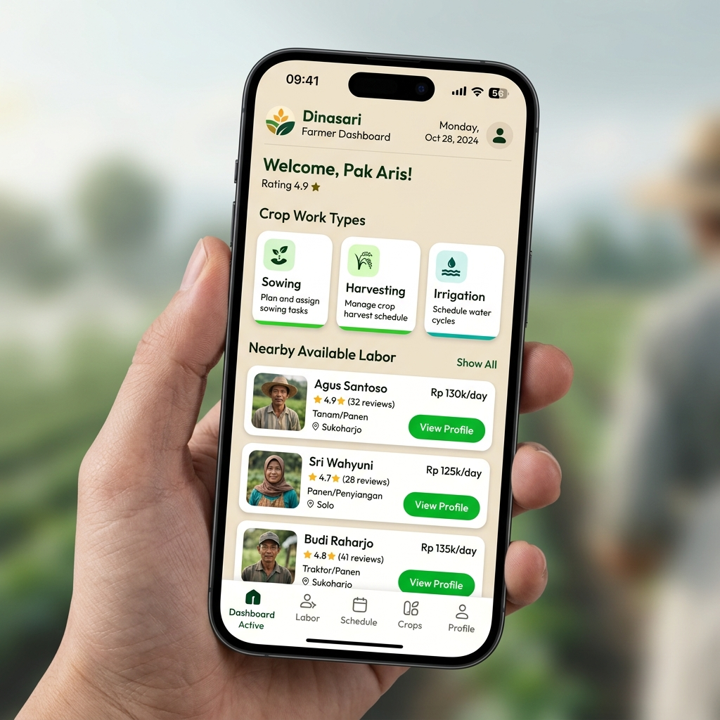
Farmer Journey: Sourcing Labor in Seconds
Step 1: Post Job Details:
• Select crop category and specific work type (Harvesting, Sowing, Spraying).
• Enter daily wage, date, and labor count needed.
Step 2: Match & Select:
• Browse individual workers or organized groups matching proximity on the Live Discovery Map.
Step 3: QR Code Attendance Check-In:
• Display Check-In QR code when workers arrive. Scan verifies worker locations & check-in timestamps.
Step 4: Track Progress & Check-Out:
• Monitor work status and show Check-Out QR code at shift end.
Step 5: Dynamic Settlement:
• Review payment summaries, pay cash/UPI, and rate workers.

Slide 6
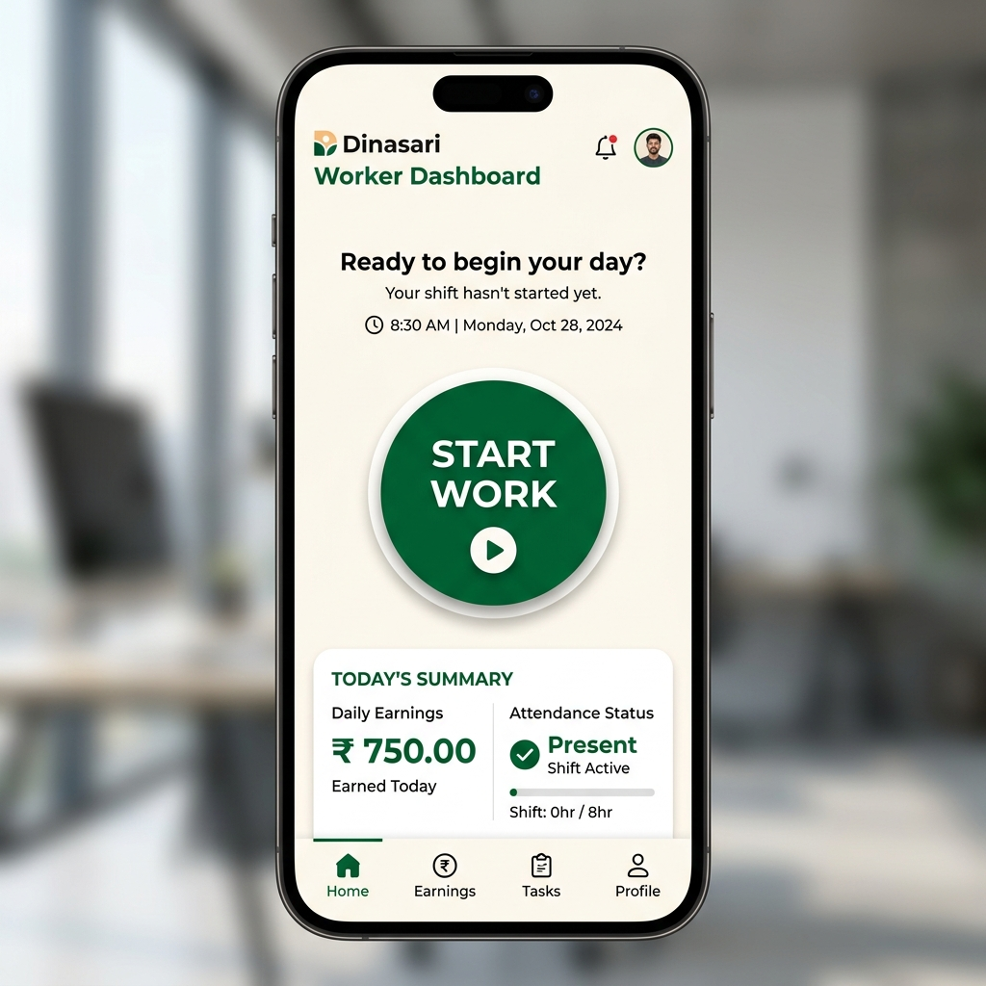
Worker Journey: Reliable Work & Payouts
Step 1: Profile Registration:
• Register with mobile OTP, age, gender, and skills.
• Toggle status to Online to appear in local search lists.
Step 2: Push Notifications:
• Receive loud, voice-guided notifications detailing the farm distance, daily wage, and specific task details.
Step 3: GPS Field Navigation:
• Accept the offer and view precise farm location routes.
Step 4: QR Check-In/Out:
• Scan the Farmer's QR code on arrival and departure.
Step 5: Earnings Ledger:
• Track daily wages and settlement statuses in the personal dashboard.

Slide 7
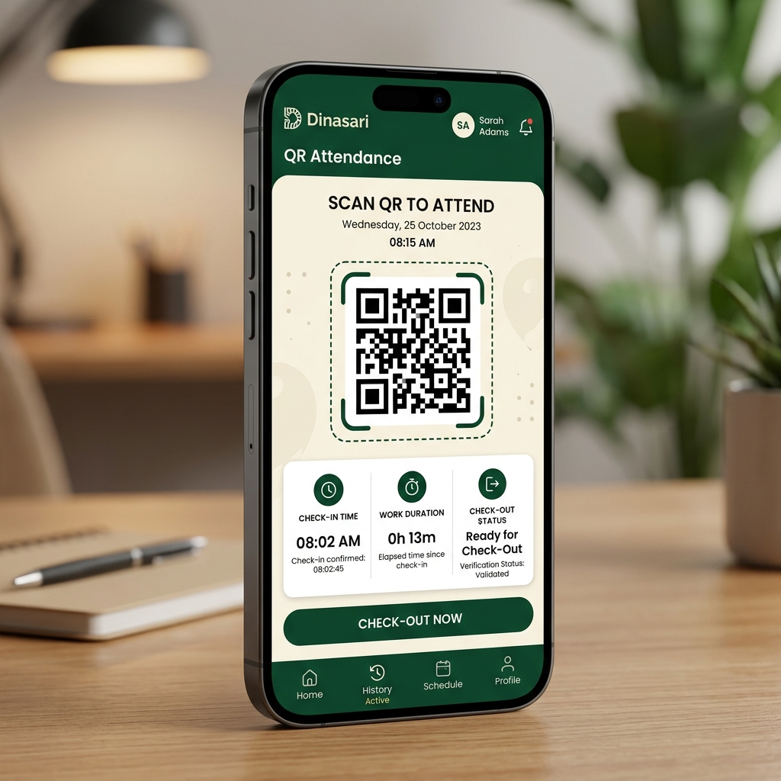
Group Leader Journey: Scaling Up Farm Operations
Empowering Local Gang Leaders (Mestris):
• Build Digital Groups: Leaders register and bundle village workers into active groups.
• Accept Collective Jobs: Leaders review and accept large-scale group jobs posted by farmers.
• One-Scan Attendance: Farmer scans the Leader's Group QR code, checking in all team members instantly.
Operational Controls & Wage Distribution:
• Wage Splitter Calculator: Generates structured salary breakdowns per worker based on individual attendance.
• Group Management Screen: Add or remove group members, assign specific crop skills, and review historical group earnings.

Slide 8
Renters: Maximizing Tractor & Equipment Usage
Equipment Listings & Matching:
• Register Machinery: Owners upload details of tractors, harvesters, or power sprayers.
• Set Hourly / Acre Rates: Control pricing and list available tools directly for matching.
• Real-Time Bookings: Farmers discover and request machinery rental schedules directly on maps.
Tracking & Payouts:
• QR Start Work Verification: QR scans verify the start and end of machinery rental operations.
• Booking Calendar: View upcoming bookings, block holiday dates, and manage logistics.

Slide 9
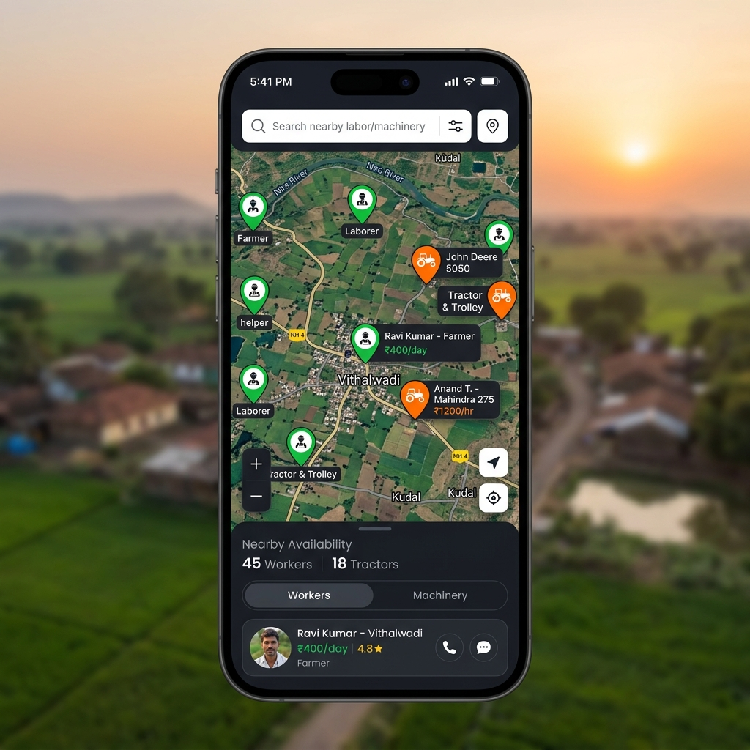
Shared Platform Services & AI Engine
Live Map Discovery:
• GPS-enabled live map shows nearby farmers seeking workers and online workers seeking jobs.
Dinasari AI Chatbot:
• Intelligent chatbot assistant answering queries on weather, mandi rates, and crop-work issues.
• Guides low-literacy users via voice.
Dispute Desk (IT Rules Compliant):
• Formal dispute resolution screen connected to Grievance Redressal Officer Rajendra Prasad.
Notification Center:
• Socket.io real-time alerts for booking acceptances, QR scan completions, and weather warnings.

Slide 10
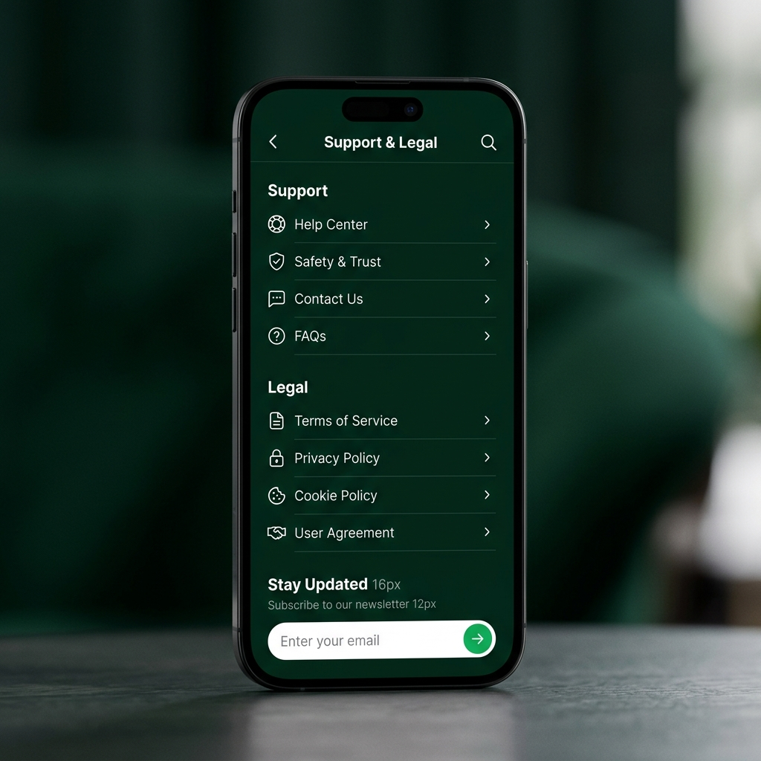
Seamless Navigation Across 61 Screens
Core App Flow Stages:
• Authentication Stack: Splash -> LanguageSelection -> Register (T&C Check) -> OTP Verification -> RoleSelection.
• Farmer Match Flow: FarmerHome -> CropWorkTypes -> FindWorkers/Groups -> RequestSent -> RequestAccepted.
• Attendance Loop: ArrivalAlert -> QRAttendance (Check-In) -> WorkInProgress -> QRAttendanceOUT (Check-Out).
Settlement & Support Flow:
• Payment & Review: Payment (UPI / Cash Summary) -> RateWorker / RateFarmer -> Transaction completed.
• Leader & Machinery Stacks: GroupSetup -> ManageGroup -> GroupQRAttendance | MachineryHome -> MachineryBooking.
• Shared Services Support: Notifications -> Dispute / DisputeHistory -> SupportAndLegal (Terms & Policies).

Slide 11
Four Direct Revenue Streams
Platform Convenience Fee:
• 3% - 5% transaction commission charged on daily worker payouts, calculated automatically on job completion.
Machinery Rental Commission:
• 8% - 10% commission on heavy equipment rental bookings (tractors, tillers, harvest tools).
B2B Advertising Banners:
• Banner ads and promoted listings for seed brands, fertilizer suppliers, and tractor agencies.
Financial Service Cross-Selling:
• Partnership margins for distributing tailored micro-insurance (crop protection, accident) and agricultural credit.

Slide 12
Localized Viral Loops & FPO Partnerships
Leveraging FPOs & Village Leaders:
• FPO Integration: Partnership with Farmer Producer Organizations (FPOs) to register clusters of farmers.
• Gram Panchayat Campaigns: Conducting physical village meetings (Choupals) to address digital trust barriers.
• Mestri / Leader Referral Loop: Incentivizing Gang Leaders to onboard their regular worker teams.
Digital Acquisition & Trust Systems:
• Localized SMS & Voice Broadcasts: Auto-dial calls explaining app benefits in native Telugu and Hindi accents.
• Agri-Input Store Affiliates: Onboarding local seed & fertilizer retailers as Dinasari registration kiosks.

Slide 13
Strong Unit Economics & Rapid Scaling
CAC (Customer Acquisition Cost): ₹200 ($2.4)
• Low CAC achieved via viral worker-to-worker loops and FPO channels.
LTV (3-Year Lifetime Value): ₹1,800 ($22)
• Consistent transactional commissions across crop seasons.
LTV / CAC Ratio: 9.0x
• High profitability and marketing efficiency.
3-Year Projections Roadmap:
• Year 1: 50,000 active users in AP & Telangana. GTV of ₹50 Cr, yielding ₹2.5 Cr platform revenue.
• Year 2: Expansion to Maharashtra & Karnataka. 250,000 active users. GTV of ₹300 Cr, yielding ₹15 Cr platform revenue.
• Year 3: Nationwide scaling. 1,000,000 active users. GTV of ₹1,400 Cr, yielding ₹70 Cr platform revenue.

Slide 14
Strong Competitive Moat in Rural Tech
How Dinasari Beats Competitors:
• Agri-Specific Workflows: Other portals focus on urban white/blue collar jobs. Dinasari matches tasks strictly related to agriculture.
• Group-Hiring Mechanics: Traditional job boards hire 1-to-1. Dinasari supports group recruitment directly, mirroring village labor dynamics.
• QR Attendance Ledger: Verifies actual work duration. No manual diaries, minimizing trust issues.
Defending our Moat:
• Machinery Rental Integration: Solves the labor matching and capital equipment rental challenges in one single application.
• Grievance Desk Integration: Our dedicated dispute resolution desk creates long-term trust.
• Low-Literacy Design: Simple iconography combined with native sound clips keeps users engaged.

Slide 15
The Seed Round: Capitalizing Growth
Seeking ₹8 Crore ($1.0 Million USD) Seed Funding
Funding Allocation Breakdown:
• 40% Product & Engineering: Building scalable backend APIs, chatbot voice capabilities, and offline sync.
• 35% GTM & Customer Acquisition: Marketing roadshows, village panchayat setups, and FPO incentive schemes.
• 15% Operations & Support: Grievance Desk expansion, on-field coordinators, and helpline operators.
• 10% General & Administrative: Corporate legal compliance, office space, and reserve contingency.
Contact: funding@dinasari.in | Edhigo Pani Technologies Private Limited

