Slide 1

Business Intelligence for Samsung’s Electronic Products retailed on Amazon.com
Revanth Reddy Garlapati

Slide 2

Introduction
What is Business Intelligence?
The Pareto principle (the 80–20 rule).
Problem statement: Provide a brief report to the CEO of Samsung that includes only critical information regarding Samsung’s products retailed on Amazon.com.
Notes:
-Business intelligence is about converting data into information that could assist managers make better decisions.
-The importance of carrying out faster and smarter data analysis cannot be underscored enough in this fast paced dynamic world experiencing explosion in volume of relevant data.
- The objective of this work is to develop a tool that could provide useful information to the CEO who would like to know if they is any interesting trend (either positive or negative) in the product’s perception in the market.

Slide 3
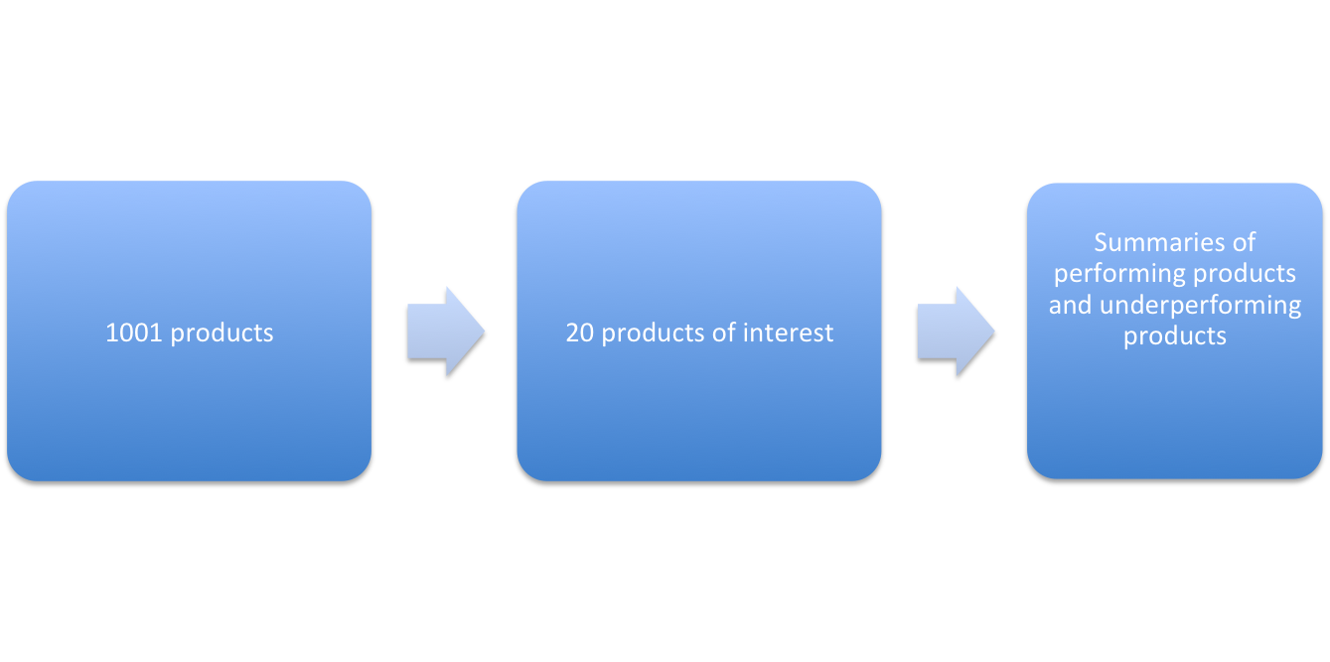



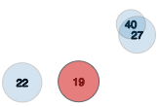


Overview of the project
Topic modeling of reviews,
Visualization of variation in rating and number of reviews
Filtering using sharpness index
(260 K reviews)
(30 K reviews)
(<100 reviews)
PYLDAvis_x0010__x0019_
Notes:
This slide is about overall project plan

Slide 4
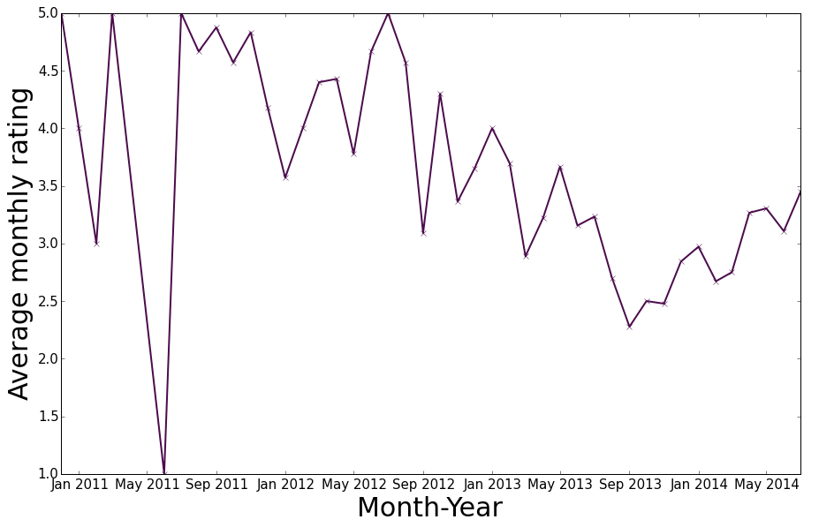
_x0016_Variation in average rating for _x0013_Samsung galaxy detachable multi Travel Charger

Slide 5
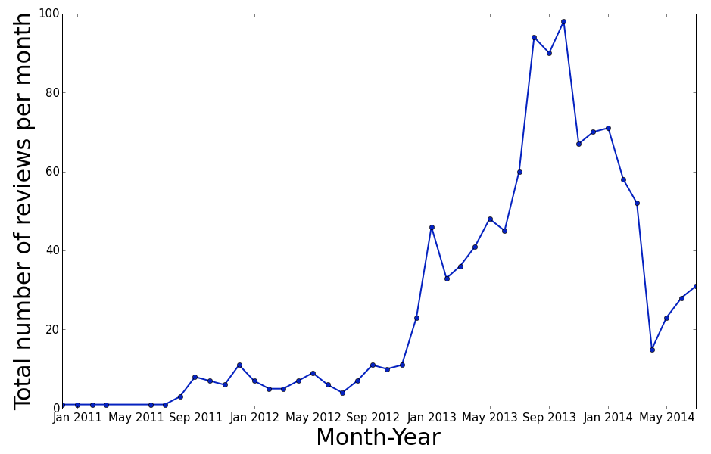
Variation in average rating for Samsung galaxy detachable multi Travel Charger

Slide 6

Topic modeling results

