Slide 1
Identification of target segments for improving the search-to-booking conversion rate
Revanth Reddy Garlapati

Slide 2
Approach
Divide the data in to segments and target the segments with the highest potential for conversion.
Identify the users with large number of searches. The users with large number of searches have high potential for conversion.
The segments with the highest potential for conversion are the ones where the percentage of searches is larger than percentage bookings.
Segment the search data with respect to cookie value/user id, city of search, length of stay, advanced purchase window and calculated the contribution of each segment.
Segment the booking data with respect to city of search, length of stay, advanced purchase window and calculated the contribution of each segment.

Slide 3
Key Assumptions
Each visitor is only relying on Priceline to plan their holiday.
More than 5 searches in 2 weeks are unusually high.
Each visitor logs in before they search for deals on the website or they are an old customer.
Visitors who make a large number of searches could possibly motivated to make a booking by providing the coupon as an incentive.
This approach does not consider the bias in the search data due couples who want to celebrate Valentine's day.

Slide 4
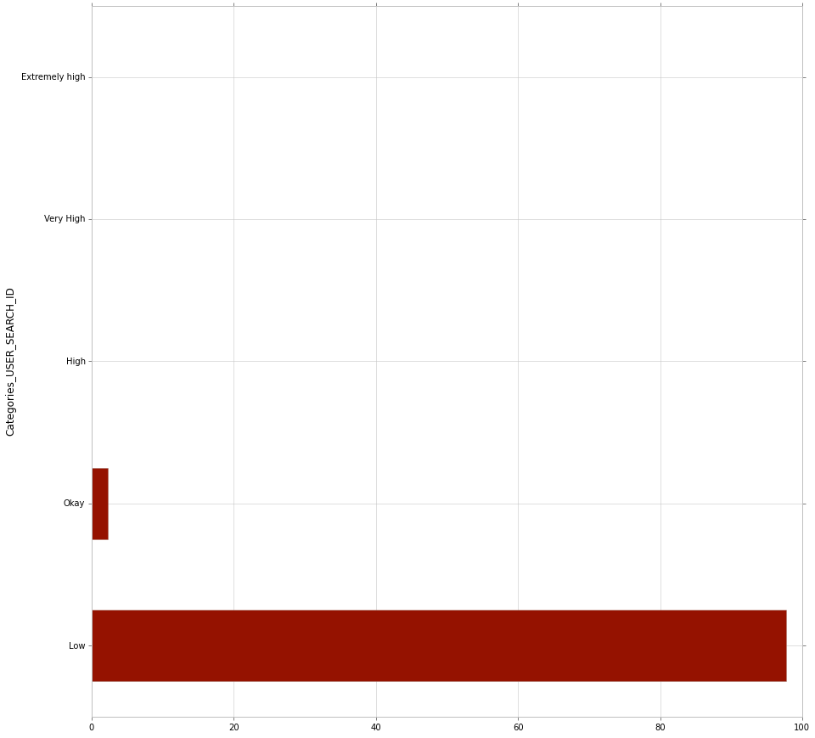
Segmenting search data w.r.t cookie value/user id
40-50
30-40
20-30
5-20
0-5

Slide 5
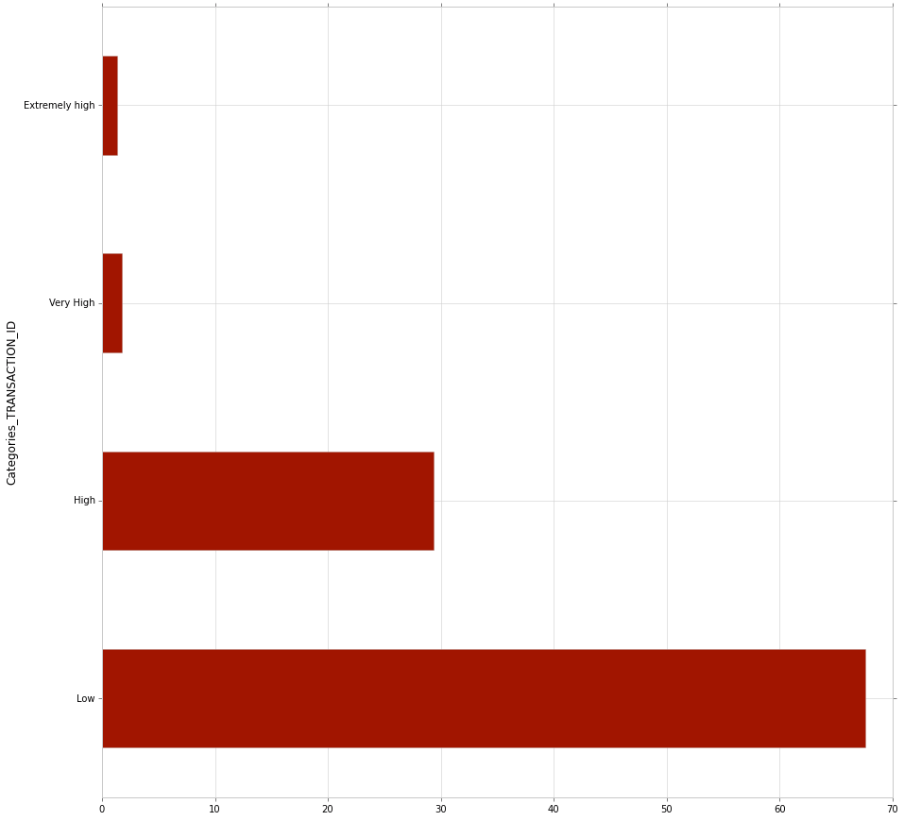
Segmenting bookings w.r.t 'city of search'
1000-7000
500-1000
100-500
0-100

Slide 6
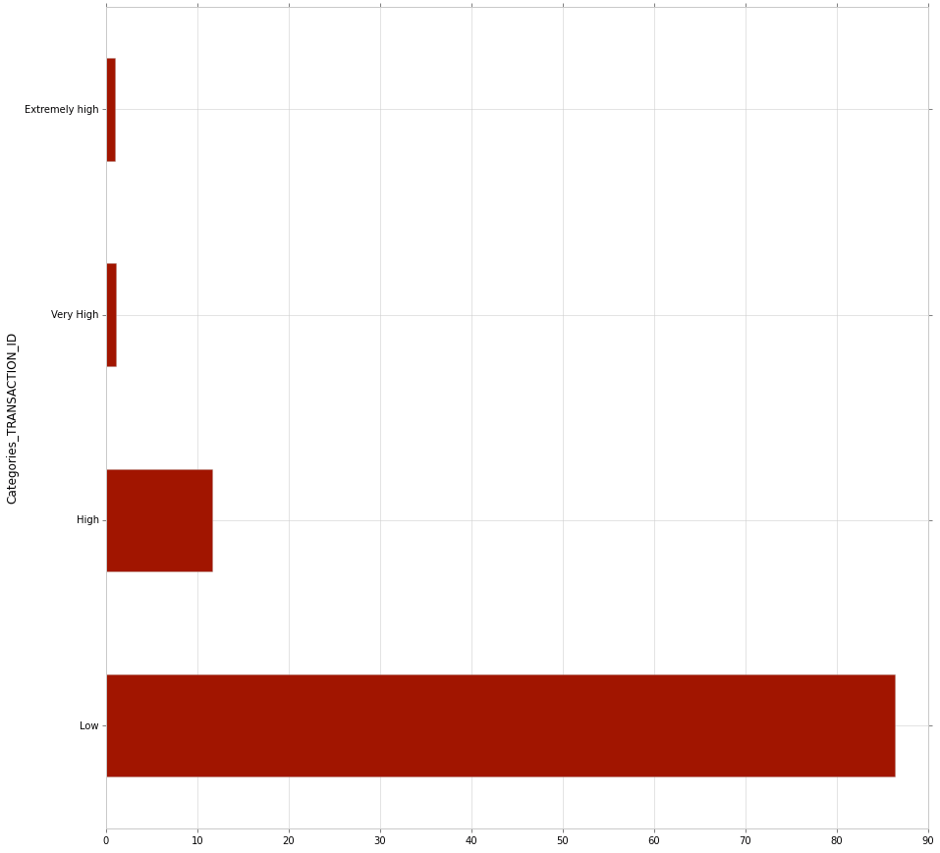
Segmenting search data w.r.t city of search
143-1000
71-143
14-71
0-14

Slide 7
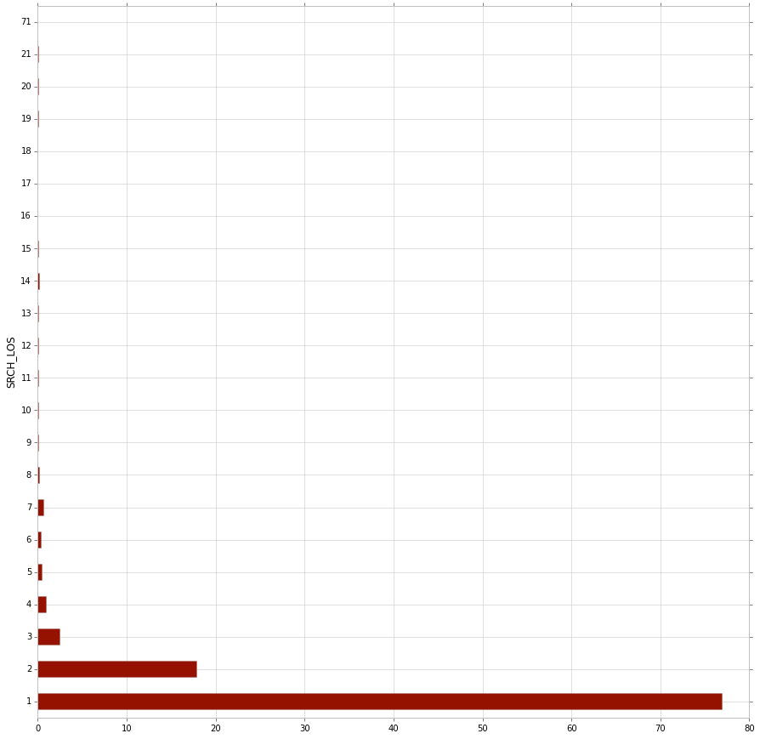
Segmenting search data w.r.t 'SRCH LOS' length of stay

Slide 8
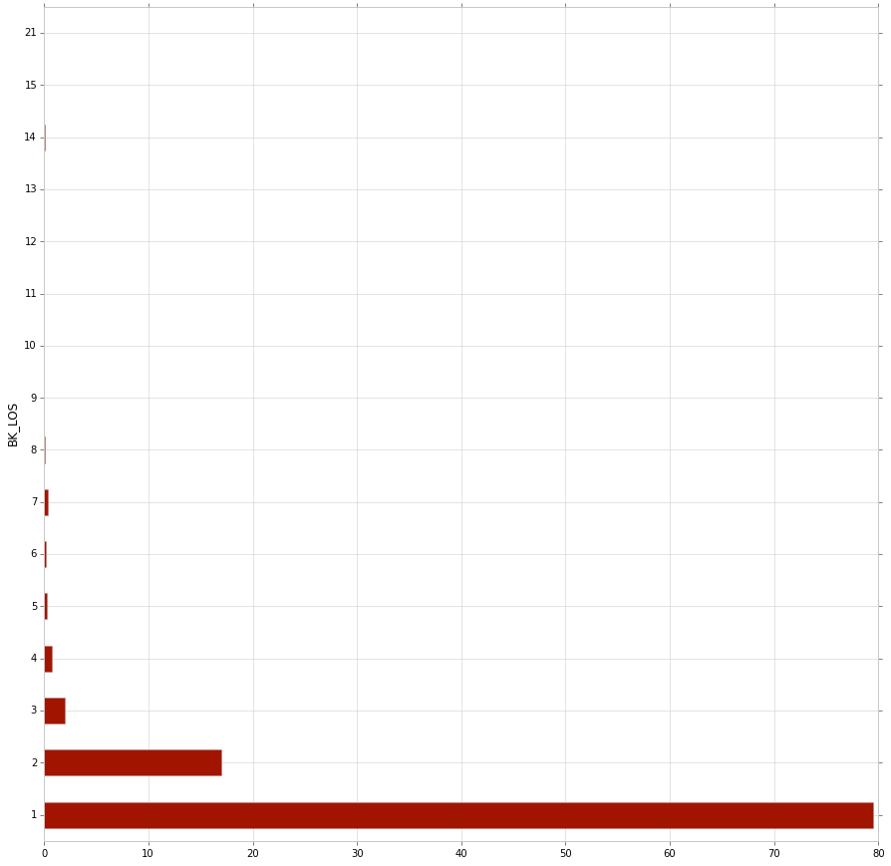
Segmenting bookings w.r.t length of stay

Slide 9
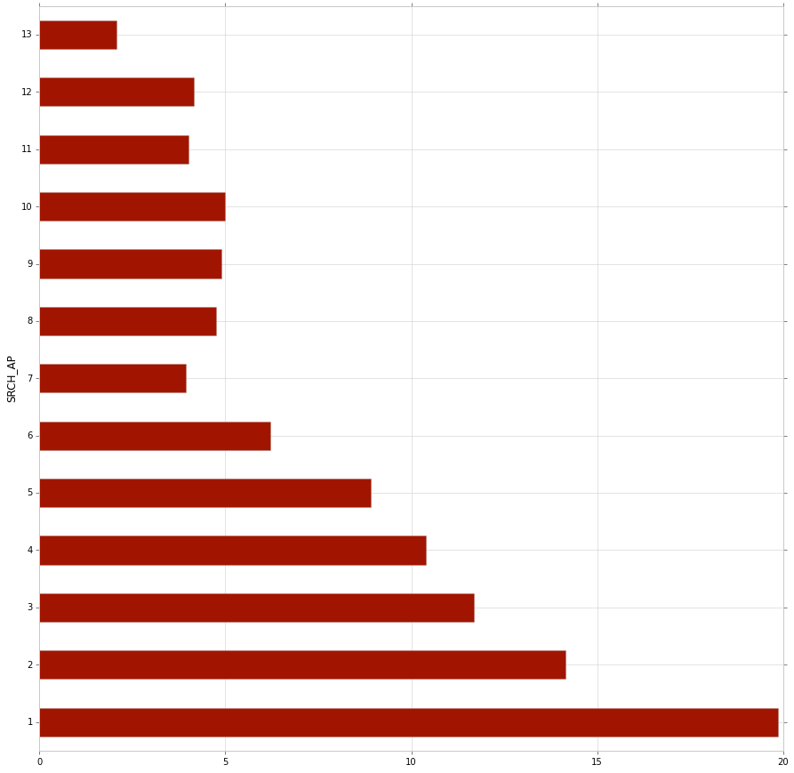
Segmenting search data w.r.t 'SRCH AP' /advanced purchase window

Slide 10
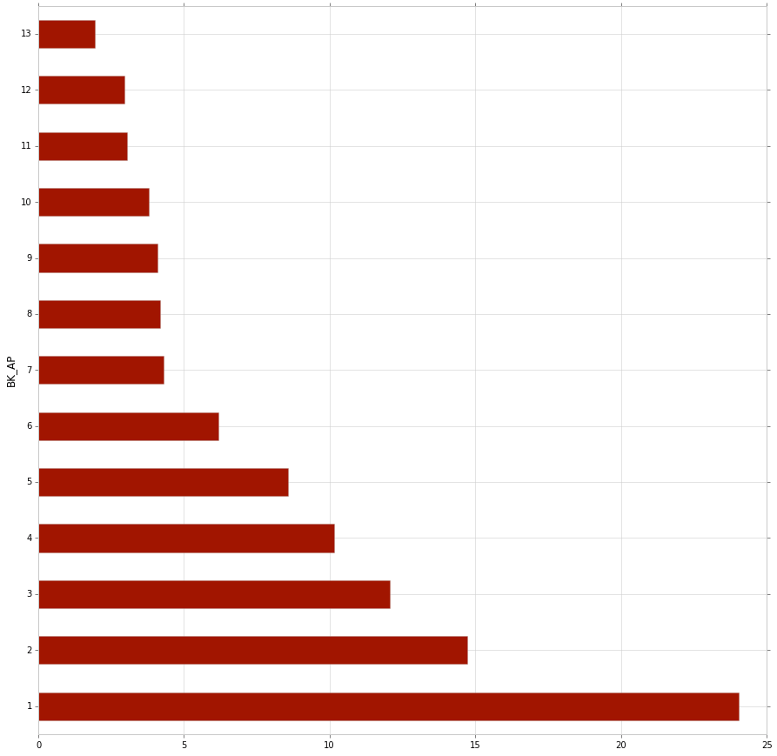
Segmenting bookings w.r.t advanced purchase window

Slide 11
Recommendations
All the users who search more than 5 times in the given time should be offered coupons to increase conversion rate (less than 2.3 % do it).
Target segments of people whose percentage search rate is higher than percentage booking rate.
For example When I segment data with respect to the destination of search, I would suggest offering coupons to those segments that that have greater search percentage than booking percentage.
Similar approach to be followed when we segment data with respect to length of stay and purchase window.

