Slide 1

Question Answering on SQuAD 2.0
Project members
Manasa Rangineni
Revanth Reddy Bandaru
Sowmya Davuluri

Slide 2
Objectives
Building a model which can answer the questions provided with atmost accuracy.
Base line model is based on Bi-Directional Attention Flow ( BiDAF )
Encoding layer uses GloVe word embeddings to represent words.
Value:
This model can stratify users who are looking to answer a specific question in Natural Language

Slide 3
Data
Stanford Question Answering Dataset (SQuAD) is a reading comprehension dataset, consisting of questions posed by crowdworkers on a set of Wikipedia articles, where the answer to every question is a segment of text, or span, from the corresponding reading passage, or the question might be unanswerable.
SQuAD2.0 combines the 100,000 questions in SQuAD1.1 with over 50,000 unanswerable questions written adversarially by crowdworkers to look similar to answerable ones. To do well on SQuAD2.0, systems must not only answer questions when possible, but also determine when no answer is supported by the paragraph and abstain from answering.

Slide 4
Approach
converts the input word indices into word embedding for both the question and the context
Uses a bi-Directional LSTM to cover the temporal dependencies between timesteps of the embedding layers outputs
Modelling:
This uses a LTSM to take in the information between context representations given the background of the questions

Slide 5
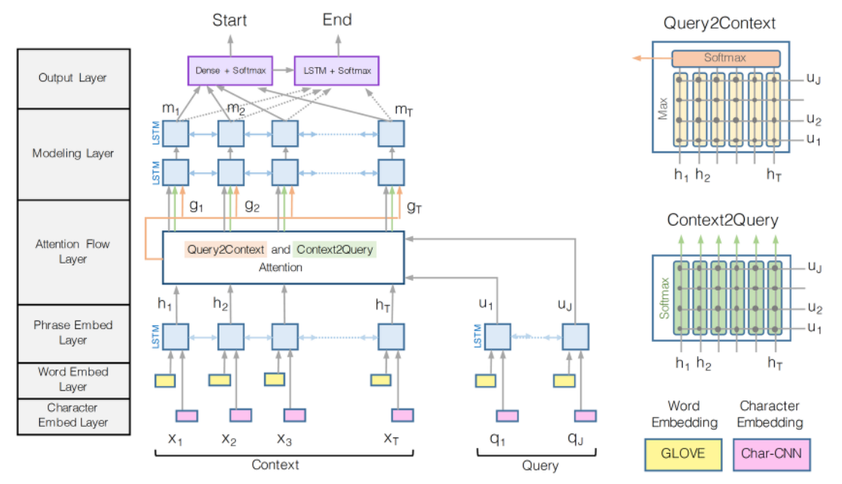
BIDAF Architecture:

Slide 6
BIDAF mechanism:
Embedding Layer : It converts the input word indices into word
embedding for both the question and the context.
Encoder Layer: Uses a bi-Directional LSTM to cover the temporal dependencies between timesteps of the embedding layers outputs.
Attention Layer: The core layer which takes care that the attention flows both ways - from Context-to-Question and Question-to-Context.
Modelling Encoder Layer: This layer uses a 2-Layer LTSM to take in the temporal information between context representations given the background of the questions. This happens as this appears after the attention layer were the cross-conditioning between questions and context has already taken place.
Output Layer: It provides a vector of probabilities for each position in the context. Here we use a softmax function.

Slide 7
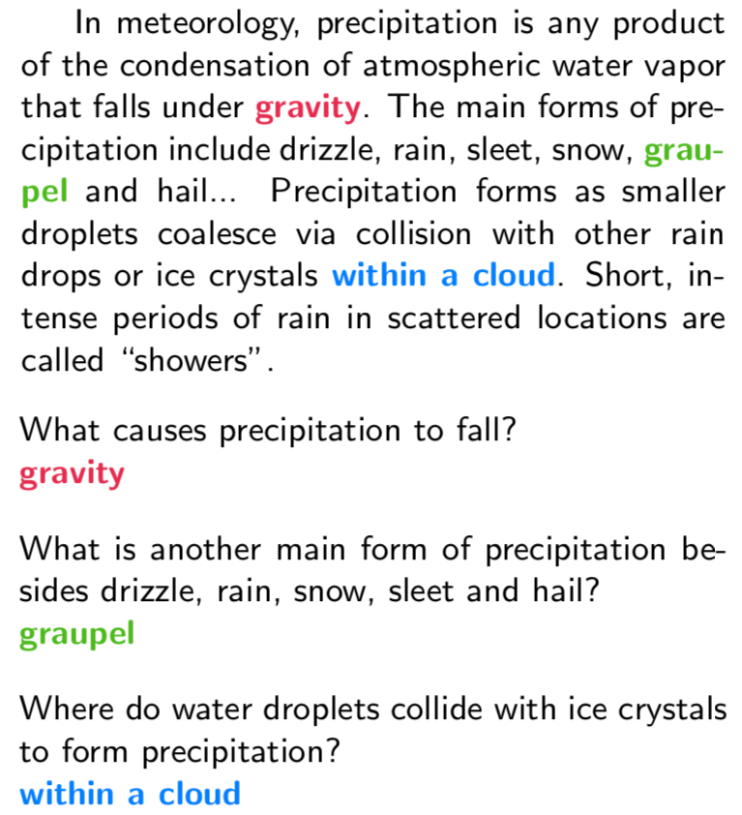
QA model Examples:

Slide 8
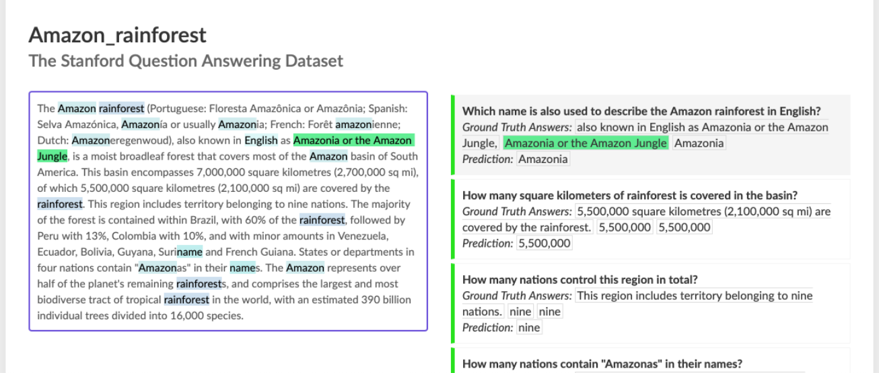

Slide 9
Evaluation methodology
There are three metrics used for evaluating the model accuracy
Exact Match FM : This metric measures the percentage of predictions that exactly match one of the ground truth answers.
F1 score : This metric measures the average overlap between the predicted answer and the ground truth answers.
AvNA : This stands for Answer vs No Answer and it measures the classification accuracy of the model when only considering its answer ( any span predicted ) vs no-answer predictions.

Slide 10
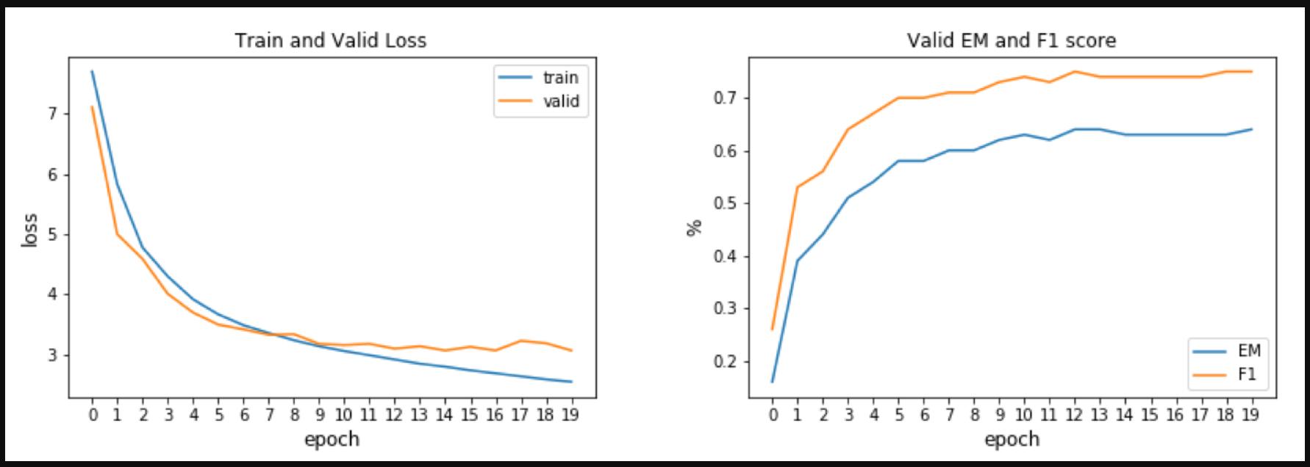
Results:

Slide 11
Citations
https://web.stanford.edu/class/archive/cs/cs224n/cs224n.1194/reports/default/15839661.pdf
Seo, Minjoon, Kembhavi, Aniruddha, Farhadi, Ali and Hajishirzi, Hannanah. (2016) Bidirectional attention flow for machine comprehension. arXiv: 1611.01603, 2016.
Rajpurkar, Pranav, Zhang, Jian, Lopyrev, Konstantin and Liang, Percy. (2016). Squad: 100,000+ quetions for machine comprehension of text. In Proceedings of the Conference of Empirical Methods in Natural Language Processing. CORR, abs/1606.05250, 2016.

