Slide 1

Customer Data Analysis

Slide 2
Project Team ID: PTID-CDA-NOV-25-879
Project code: PRDA-05
Project Name: Customer Data Analysis
Team Members: B.Chandu
P.Rajiv Revanth
Y.Ashok kumar

Slide 3
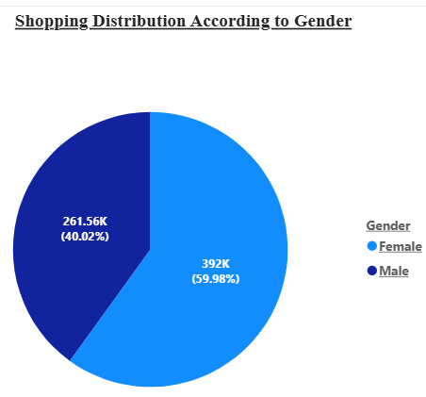
“ The shopping distribution according to gender ”
The shopping distribution shows that female customers contribute 392K, which is significantly higher than the 261.56K contributed by male customers.
This indicates that women are your strongest purchasing group.
Focusing marketing campaigns, product variety, and targeted promotions toward female shoppers could further boost overall sales.

Slide 4
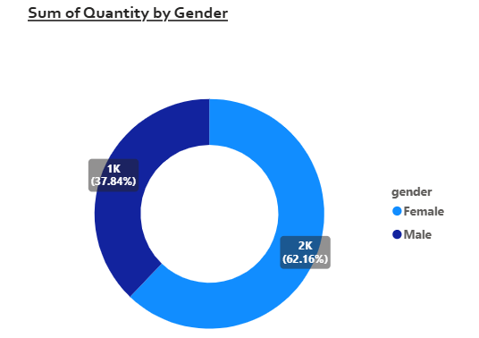
“which gender did we sell more products?”
Overall sales volume and purchase frequency were higher among women compared to men, indicating that female customers were your primary buyers

Slide 5
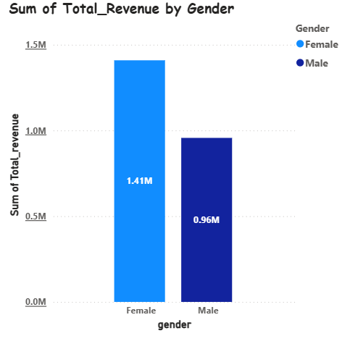
“Which gender generated more revenue?”
Female customers generated the highest revenue, contributing approximately 1.41 million.
This makes women your most valuable customer segment in terms of total sales revenue.

Slide 6
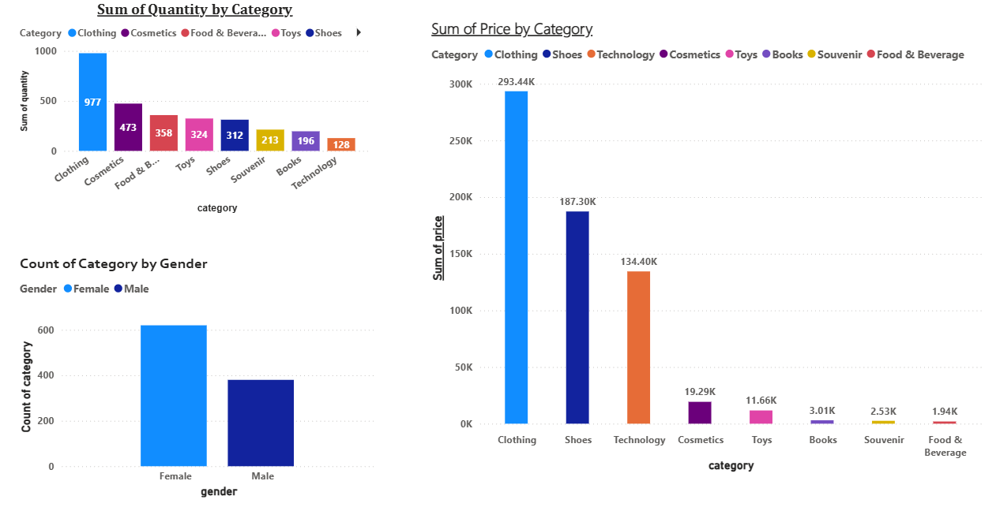
“Distribution of purchase categories relative to other columns?”
The distribution shows that Clothing is the top category when looking at the sum of quantity purchased.
When comparing category by gender, female customers dominate most purchase categories.
Clothing also leads in the sum of price, making it the highest-value category overall.

Slide 7
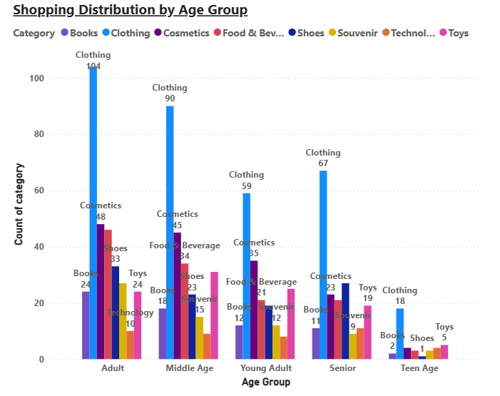
“How is the shopping distribution according to age?”
Across all age groups—including teenagers, young adults, adults, middle-aged customers, and seniors—Clothing consistently shows the highest shopping distribution.
This trend indicates that clothing is the most preferred category regardless of age.
Every age segment contributes significantly to clothing purchases, making it the dominant category overall.
The uniform preference across demographics highlights clothing as a universally popular product line.

Slide 8
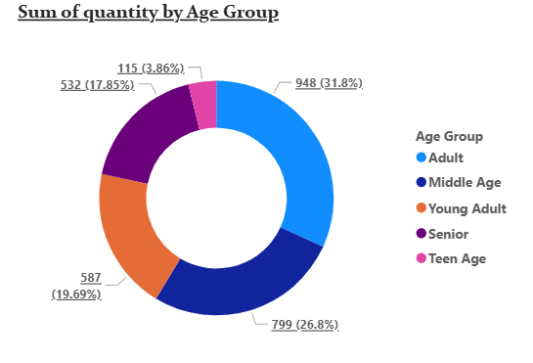
“Which age category did we sell more products to?”
The Adults age category represents the largest portion of your product sales, contributing 31.8%.
This makes adults the most engaged and active buyers among all age segments.
Their strong purchasing share highlights them as a key target group for your sales strategy.

Slide 9
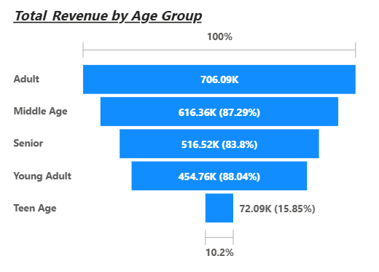
“Which age category generated more revenue?”
The Adults age category generated the highest revenue, totaling 706.09K.
This clearly shows that adults are your most profitable customer segment.
Their strong spending power makes them a key contributor to overall business revenue

Slide 10
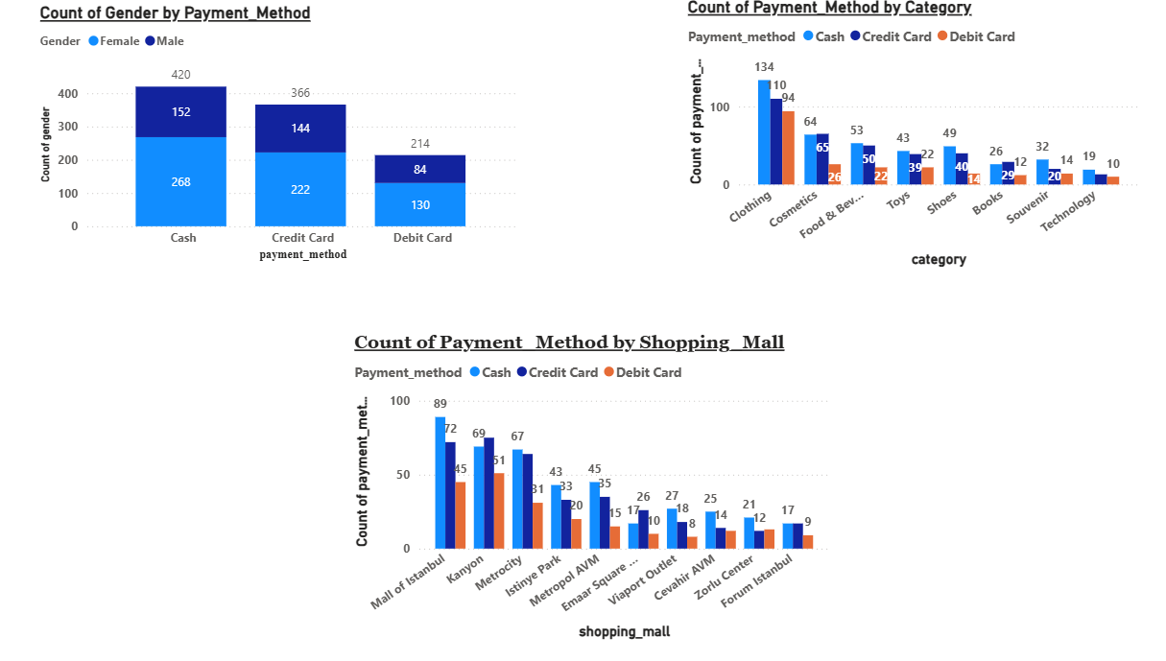
“Does the payment method have a relation with other columns?”
payments, showing a strong preference for cash.
Across all categories, Clothing leads in every payment type—cash, credit card, and debit card—making it the most frequently purchased category.
Among shopping malls, the Mall of Istanbul has the highest number of payments across all three methods, indicating its strong customer traffic and spending.
These patterns show consistent customer behavior across gender, category, and mall location.

Slide 11
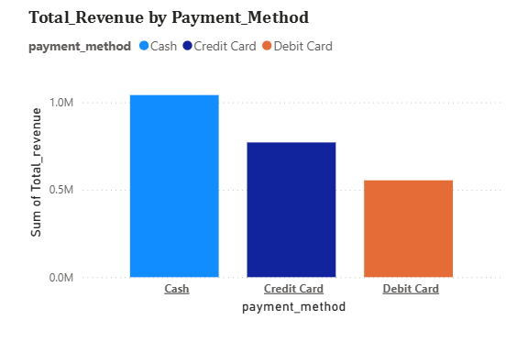
“How is the distribution of the payment method?”
The revenue distribution shows that cash payments outperform both credit card and debit card transactions.
To optimize this trend, you could ensure smooth cash-handling processes and offer targeted promotions for digital payments to balance the mix.
Strengthening digital options may also attract customers who prefer convenient, card-based transactions.

Slide 12
