Slide 1
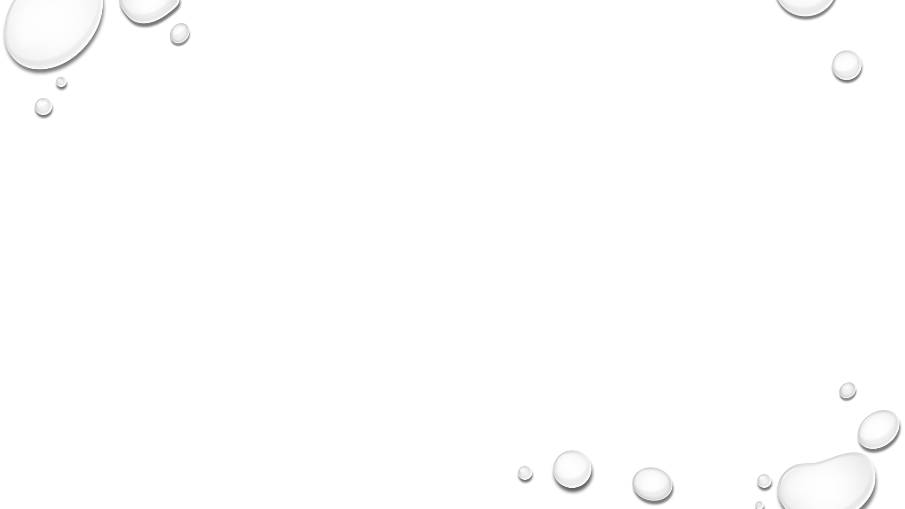

Generative adversarial networks for image Generation
Sai revan Vemuri
Samaja polepally
Revanthreddy malgireddy

Slide 2
Objective
Generative Adversarial Network (GAN) on OpenCV and Keras for generating images, to regulate trainings of generator (G) and discriminator (D) networks. The GAN utilizes deep convolutional neural networks (DCNNs) with Batch Normalization being used only on G and not D to prevent overfitting. FID score is calculated to measured to know the quality of generated image.

Slide 3
Introduction
GANs are deep learning models used for unsupervised learning and synthetic data generation.
Composed of two neural networks, Generator (creates fake data) and discriminator (evaluates authenticity).
Introduced by Ian goodfellow in 2014 as a breakthrough in generative modeling.
It has variants like DCGAN, WGAN, etc to improve training stability and models performance.
Widely used for image generation ,data augmentation ,anomaly detection ,missing data imputation .
Generates realistic synthetic data without requiring additional real-world samples.

Slide 4
Task description
Develop a generative adversarial network (GAN) that :
Creates realistic 64x64 RGB images from random noise.
Learns features effectively from MNIST dataset.
Trains stably with well-balanced generator-discriminator dynamics.

Slide 5
MNIST Dataset
Total number of images: 70000
Total number of training images: 60000
Total number of testing images: 10000
Total number of classes: 10
Class types: handwritten digits 0,1,2,3,4,5,6,7,8,9.
Each image is 28x28 pixels with single channel (grayscale)
Pixel values range from 0 to 255 (black to white)

Slide 6
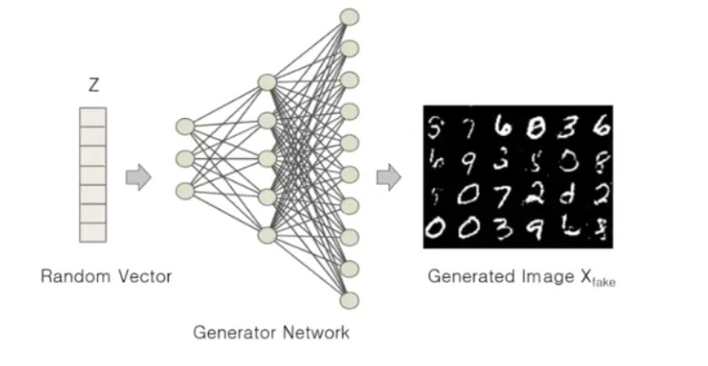
Methods used
Generator
Input: 100-dim random noise.
Output: 28×28 MNIST-like image.
Layers: Dense → Batch Norm → Up Sampling → Conv2D.

Slide 7
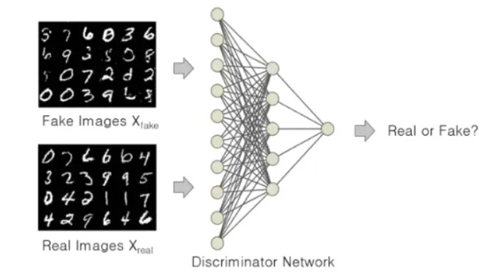
Methods used
Discriminator:
Input: 28×28 image.
Output: binary classification (real/fake).
Layers: conv2d → max pooling → dense.

Slide 8
Methods used
Training process
Optimizer: Stochastic Gradient Descent (SGD) with momentum (0.9) and Nesterov acceleration to guarantee stable convergence.
Loss Function: Binary cross-entropy loss to measure real vs. fake classification performance.
Batch Size: 128 samples per batch to balance memory efficiency and gradient accuracy.
Learning Rate: Fixed value of 0.0005 to avoid overshooting during weight update.
Evaluation Metrics
Frechet Inspection Distance (FID) compares feature distributions.
Low FID means better quality

Slide 9
Visual inspection
Manually checking the results for realism and diversity.

Slide 10
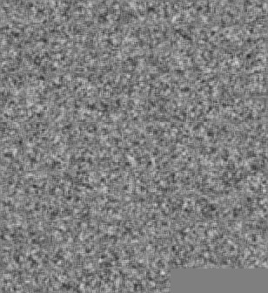
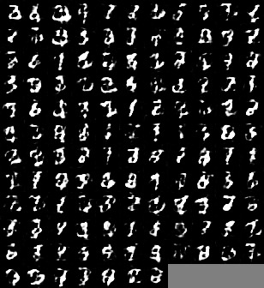
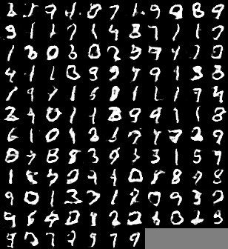
Results
Initial Noise
After Epoch 5
After Epoch 15

Slide 11
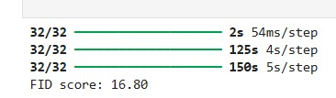
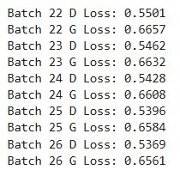
Results
FID score is 16.80
Balance between generator loss and discriminator loss shows stable training.

Slide 12
Challenges
Training instability
Generator and discriminator struggle to stabilize, resulting in unstable learning.
Mode collapse
Generator produces limited digit types
Hyperparameter sensitivity
Performance relies on precise tuning of learning rate or the batch size.
Vanishing gradients
Dominant discriminator brings generator output to a halt.
Evaluation difficulty
No numerical measure; need to look at images by manually.

Slide 13
Performance improvement strategies
Replace regular CNN with DCGAN or RENSET blocks for sharper image generation.
Learning rate scheduling.
Add dynamic LR adaptation to converge more.
Data augmentation.
Apply rotations/scaling on MNIST to increase diversity and reduce overfitting.
Generalize to labeled generation (eg. Generate certain digits on demand).

Slide 14
Conclusion
This GAN implementation is able to generate MNIST digits but also struggles with issues such as training instability and blurry images. The code offers a functional starting point, but needs to be optimized for performance. Some of the major improvements would be newer architectures and more advanced loss functions. Learning these tradeoffs is useful for mastering generative models. The project illustrates both the promise and challenges of using GANS in practice.

